Slide 1
KESEIMBANGAN FASE UAP-CAIR

Slide 2
Vapor-Liquid Equilibrium for Multi-component Systems

Slide 3
Data keseimbangan uap-cair : di mana diperoleh?
1. Tabel data

Slide 4
2. Diagram x-y

Slide 5
3. Diagram T-komposisi(x-y)

Slide 9
SIMPLE MODELS FOR VLE
Simple Models
For VLE :
Find T, P, composition
Raoult’s Law
Henry’s Law

Slide 10
Henry’s Law
Assumptions :
For pressure low
  It is so low that it can be assume as ideal gas
For species present as a very dilute solution in liquid phase

Slide 11
Henry’s Law
Where;

Slide 12
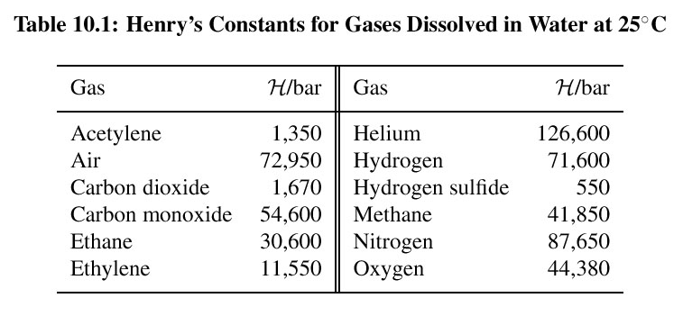

Slide 13
Raoult’s Law
Assumptions;
V phase is an ideal gas
  Applicable for low to moderate pressure
L phase is an ideal solution
  Valid only if the species are chemically similar (size, same chemical nature e.g. isomers such as ortho-, meta- & para-xylene)

Slide 14


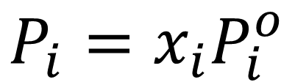
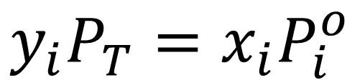
$$P_{i}=x_{i}P_{i}^{o}$$
Jika uap merupakan gas ideal
$$P_{i}=y_{i}P_{T}$$
$$y_{i}P_{T}=x_{i}P_{i}^{o}$$
maka
Hk. Raoult-Dalton

Slide 15
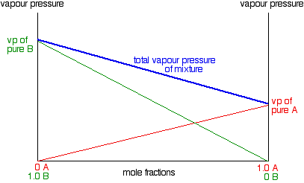

Slide 16
Data keseimbangan disajikan dalam data relatif volatilitas.

Slide 18
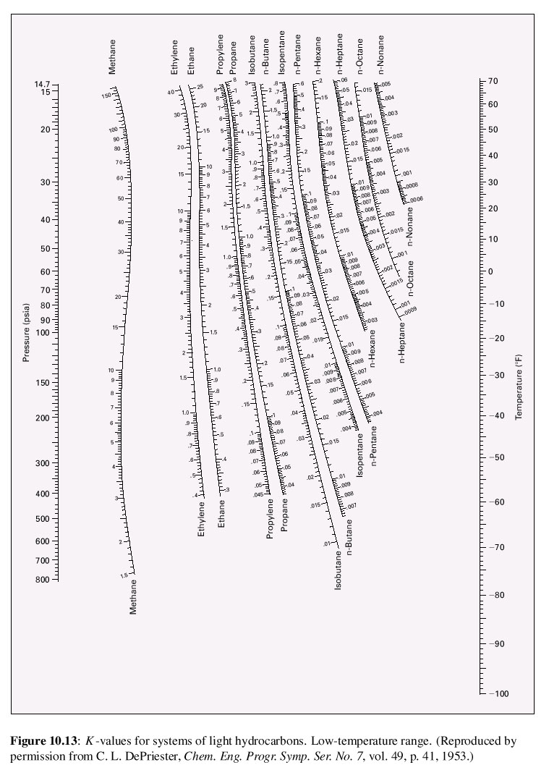
K-value from DePriester chart
-Low T range

Slide 19
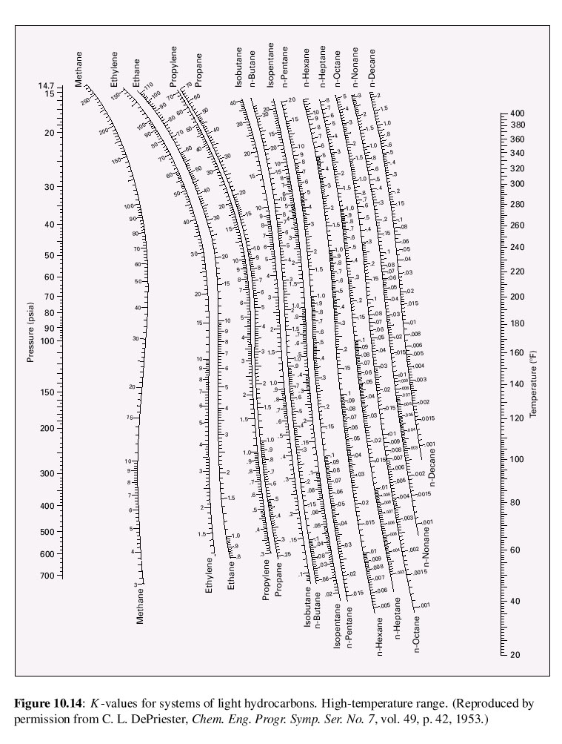
K-value from DePriester chart
-High T range

Slide 20
Dew Point dan Bubble Point : campuran biner

