Slide 1
INDONESIAN CROPS FOR VEGETABLE OIL FEEDSTOCKS

Slide 2
Indonesia is a potential vegetable oil resources.
More than 40 Indonesian plants produces vegetable oil, for both edible and non edible requirements.
Only few have been commercialized.

Slide 3
Tumbuhan Indonesia penghasil minyak-lemak (1)
Nama | Nama Latin | Sumber | Kadar, %-b kr | P / NP
Jarak kaliki | Ricinus communis | Biji (seed) | 45 – 50 | NP
Jarak pagar | Jatropha curcas | Inti biji | 40 – 60 | NP
Kacang suuk | Arachis hypogea | Biji | 35 – 55 | P
Kapok/randu | Ceiba pentandra | Biji | 24 – 40 | NP
Karet | Hevea brasiliensis | Biji | 40 – 50 | NP
Kecipir | Psophocarpus tetrag. | Biji | 15 – 20 | P
Kelapa | Cocos nucifera | Daging buah | 60 – 70 | P
Kelor | Moringa oleifera | Biji | 30 – 49 | P
Kemiri | Aleurites moluccana | Inti biji (kernel) | 57 – 69 | NP
Kusambi | Sleichera trijuga | Daging biji | 55 – 70 | NP
Nimba | Azadirachta indica | Daging biji | 40 – 50 | NP
Saga utan | Adenanthera pavonina | Inti biji | 14 – 28 | P
Sawit | Elais guineensis | Sabut + Dg buah | 45-70 + 46-54 | P

Slide 4
Nama | Nama Latin | Sumber | Kadar, %-b kr | P / NP
Akar kepayang | Hodgsonia macrocarpa | Biji | ≈ 65 | P
Alpukat | Persea gratissima | Dg buah | 40 – 80 | P
Cokelat | Theobroma cacao | Biji | 54 – 58 | P
Gatep pait | Samadera indica | Biji | ≈ 35 | NP
Kepoh | Sterculia foetida | Inti biji | 45 – 55 | NP
Ketiau | Madhuca mottleyana | Inti biji | 50 – 57 | P
Malapari | Pongamia pinnata | Biji | 27 – 39 | NP
Nyamplung | Callophyllum inophyllum | Inti biji | 40 – 73 | NP
Randu alas/agung | Bombax malabaricum | Biji | 18 – 26 | NP
Seminai | Madhuca utilis | Inti biji | 50 – 57 | P
Siur (-siur) | Xanthophyllum lanceatum | Biji | 35 – 40 | P
Tengkawang tungkul | Shorea stenoptera | Inti biji | 45 – 70 | P
Tengk. terindak | Isoptera borneensis | Inti biji | 45 – 70 | P
Wijen | Sesamum orientale | Biji | 45 – 55 | P

Slide 5
Nama | Nama Latin | Sumber | Kadar, %-b kr | P / NP
Bidaro | Ximenia americana | Inti biji | 49 – 61 | NP
Bintaro | Cerbera manghas/odollam | Biji | 43 – 64 | NP
Bulangan | Gmelina asiatica | Biji | ? | NP
Cerakin/Kroton | Croton tiglium | Inti biji | 50 – 60 | NP
Kampis | Hernandia peltata | Biji | ? | NP
Kemiri cina | Aleurites trisperma | Inti biji | ? | NP
Labu merah | Cucurbita moschata | Biji | 35 – 38 | P
Mayang batu | Madhuca cuneata | Inti biji | 45 – 55 | P
Nagasari (gede) | Mesua ferrea | Biji | 35 – 50 | NP
Pepaya | Carica papaya | Biji | 20 – 25 | P
Pulasan | Nephelium mutabile | Inti biji | 62 – 72 | P
Rambutan | Nephelium lappaceum | Inti biji | 37 – 43 | P
Sirsak | Annona muricata | Inti biji | 20 – 30 | NP

Slide 6
Nama | Nama Latin | Sumber | Kadar, %-b kr | P / NP
Srikaya | Annona squamosa | Biji | 15 – 20 | NP
Kenaf | Hibiscus cannabinus | Biji | 18 – 20 | NP
Kopi arab (Okra) | Hibiscus esculentus | Biji | 16 – 22 | NP
Rosela | Hibiscus sabdariffa | Biji | ≈ 17 | NP
Kayu manis | Cinnamomum burmanni | Biji | ≈ 30 | P
Padi | Oryza sativa | Dedak | ≈ 20 | P
Jagung | Zea Mays | Germ | ≈ 33 | P
Tangkalak | Litsea sebifera | Biji | ≈ 35 | P
? | Taractogenos kurzii | Inti biji | 48 – 55 | NP
Kursani | Vernonia anthelmintica | Biji | ≈ 19 | NP
kr ≡ kering; P ≡ minyak/lemak Pangan (edible fat/oil), NP ≡ minyak/lemak Non-Pangan (nonedible fat/oil).

Slide 7
CLASSIFY FOR EDIBLE AND NON EDIBLE OIL
EDIBLE OIL
NON EDIBLE OIL
Palm oil
…
…
…
…
…
…
...
etc
Rubberseed oil
…
…
…
…
…
…
…
etc

Slide 8
Bintaro

Slide 9
Jarak

Slide 10
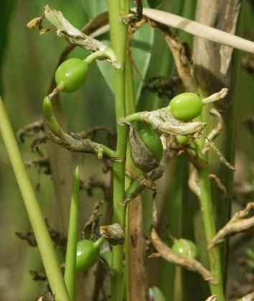
Kapulaga

Slide 11
Kecipir

Slide 12
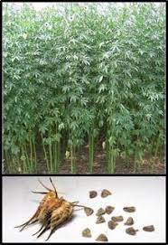
Kenaf

Slide 13
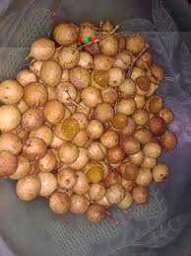
Kesambi

Slide 14
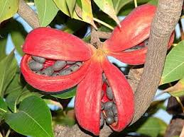
Kepuh

Slide 15
Nyamplung

Slide 16
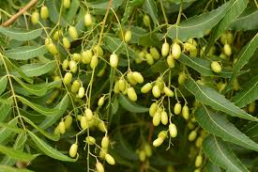
Nimba

Slide 17
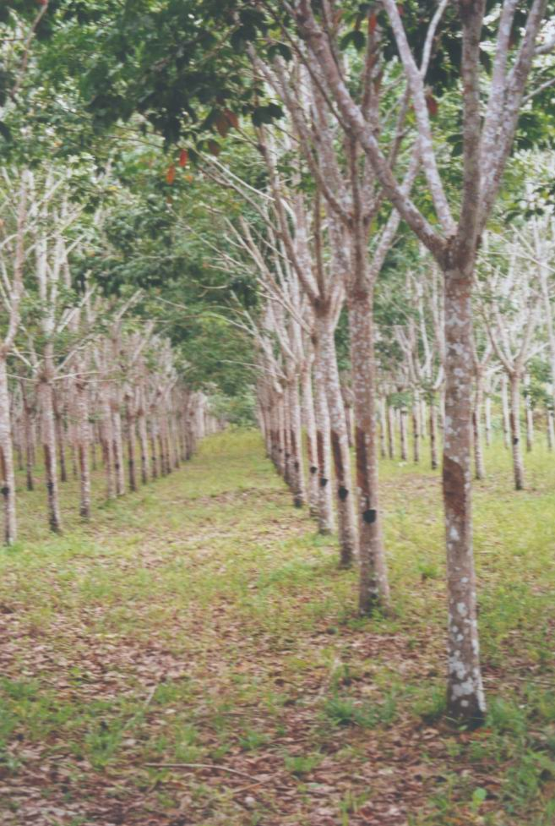
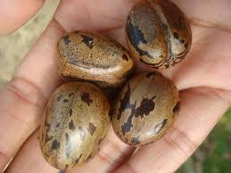
Karet

Slide 18
Wijen

Slide 19
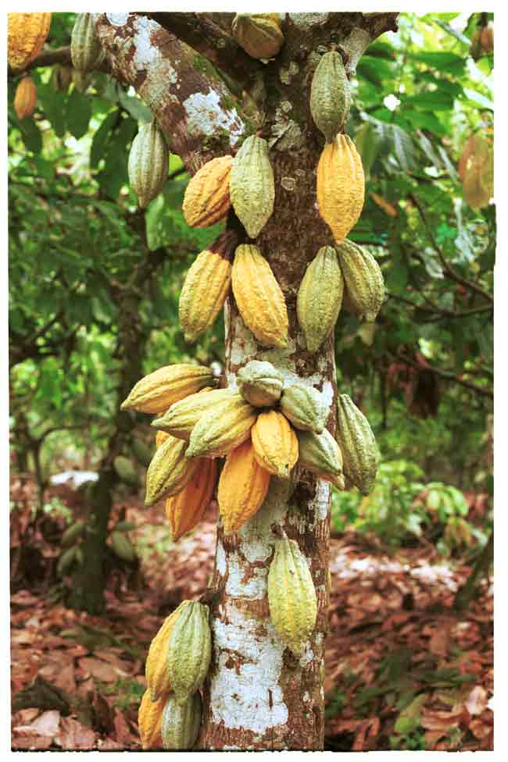
Coklat

Slide 20
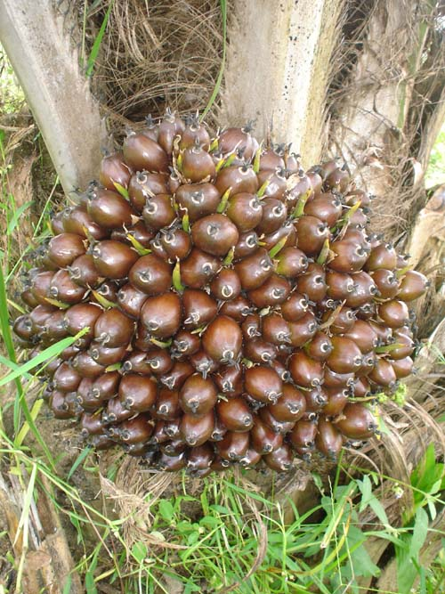
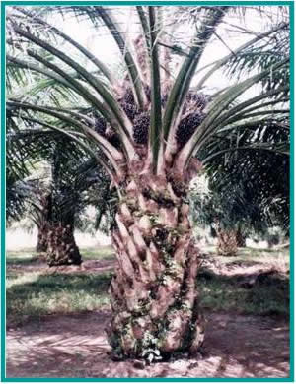
Kelapa sawit

Slide 21
Kedelai

Slide 22
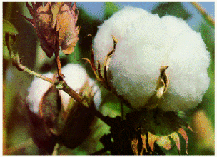
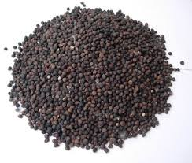
Kapas

Slide 23
Write a paper about vegetable oil (choose one) application as edible or non edible oil. Upload it on spada.
QUIZ 1

