Slide 1


Programming with Matlab

Slide 2
Review minggu lalu

Slide 5
GRAPHICS

Slide 10
M-FILES
The most common way to operate MATLAB is by entering commands one at a time in the command window.
M-files provide an alternative way of performing operations that greatly expand MATLAB.s problem-solving capabilities.

Slide 11
An M-file consists of a series of statements that can be run all at once.
Note that the nomenclature m-file. comes from the fact that such files are stored with a .m extension.
M-files come in two flavors: script files and function files.

Slide 12
Script Files
A script file is merely a series of MATLAB commands that are saved on a file.
They are useful for retaining a series of commands that you want to execute on more than one occasion.
The script can be executed by typing the file name in the command window or by invoking the menu selections in the edit window: Debug, Run.

Slide 13
Back this problem

Slide 15
Function Files
Function files are M-files that start with the word function.
In contrast to script files, they can accept input arguments and return outputs.

Slide 16
The syntax for the function file can be represented generally as
      function outvar = funcname(arglist)
      % helpcomments
      statements
      outvar = value;
where outvar = the name of the output variable,
funcname = the function’s name,
arglist = the function’s argument list (i.e., comma-delimited values that are passed into the function),
helpcomments = text that provides the user with information regarding the function (these can be invoked by typing Help funcname in the command window), and
statements = MATLAB statements that compute the value that is assigned to outvar.

Slide 21
INPUT-OUTPUT
The input Function. This function allows you to prompt the user for values directly from the command window. Its syntax is
n = input('promptstring')
The function displays the promptstring, waits for keyboard input, and then returns the value from the keyboard.

Slide 22
For example,
m = input('Mass (kg): ')
When this line is executed, the user is prompted with the message
Mass (kg):
If the user enters a value, it would then be assigned to the variable m.

Slide 23
The input function can also return user input as a string.
To do this, an 's' is appended to the function.s argument list.
For example,
name = input('Enter your name: ','s')

Slide 24
The disp Function. This function provides a handy way to display a value. Its syntax is
disp(value)
where value = the value you would like to display. It can be a numeric constant or variable, or a string message enclosed in hyphens.
Its application is illustrated in the following example.

Slide 27
The fprintf Function. This function provides additional control over the display of information.
A simple representation of its syntax is
fprintf('format', x, ...)
where format is a string specifying how you want the value of the variable x to be displayed.
The operation of this function is best illustrated by examples.

Slide 33
Next meeting

Slide 34
STRUCTURED PROGRAMMING
The simplest of all M-files perform instructions sequentially.
That is, the program statements are executed line by line starting at the top of the function and moving down to the end.
Because a strict sequence is highly limiting, all computer languages include statements allowing programs to take nonsequential paths.

Slide 35
These can be classified as
Decisions (or Selection). The branching of flow based on a decision.
Loops (or Repetition). The looping of flow to allow statements to be repeated.

Slide 36
Decisions
The if Structure.
This structure allows you to execute a set of statements if a logical condition is true.
Its general syntax is

Slide 39
The if...else Structure.
This structure allows you to execute a set of statements if a logical condition is true and to execute a second set if the condition is false.
Its general syntax is

Slide 40
The if...elseif Structure.
It often happens that the false option of an if...else structure is another decision. This type of structure often occurs when we have more than two options for a particular problem setting. For such cases, a special form of decision structure, the if...elseif has been developed.
It has the general syntax

Slide 41
The price of an apel is $ 25. If someone buy more than 5 he will get a discount of 20 %.

Slide 42
Script m-file
n = input(‘the number of apples = ‘);
price = n*25;
if n > 5
price = (1-20/100)*price;
end
t = [‘price= ‘ num2str(price)];
disp(t)

Slide 43
The students will be pass if their grade is more than 60
N = input(‘ The grade of student = ’);
if N > 60;
disp ‘passing grade’
else
disp ‘NOT passing grade’
end

Slide 44
% The grade of the students
n = input(‘The grade of student = ‘);
if n< 40
disp ‘E’
elseif n< 60
disp ‘D’
elseif n< 74
disp ‘C’
elseif n< 87
disp ‘B’
else
disp ‘A’
end

Slide 45
Loops
The for...end Structure.
Afor loop repeats statements a specific number of times.
Its general syntax is

Slide 47
Develop an M-file to compute the factorial.

Slide 49
The while Structure.
A while loop repeats as long as a logical condition is true.
Its general syntax is

Slide 51
num = 0; n = 10;
while n>1;
n=n/2
num = num+1
end

Slide 52





First check
determinant D = B² – 4*A*C
If D > 0; roots is real,
If D < 0; roots is imajiner
If D = 0; roots is the same

Slide 53
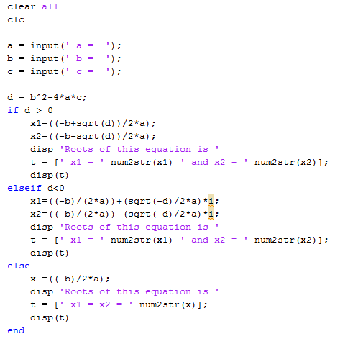
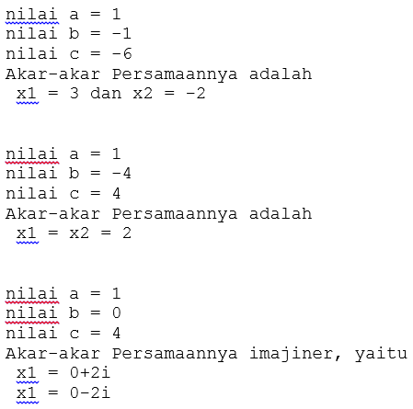

Slide 54
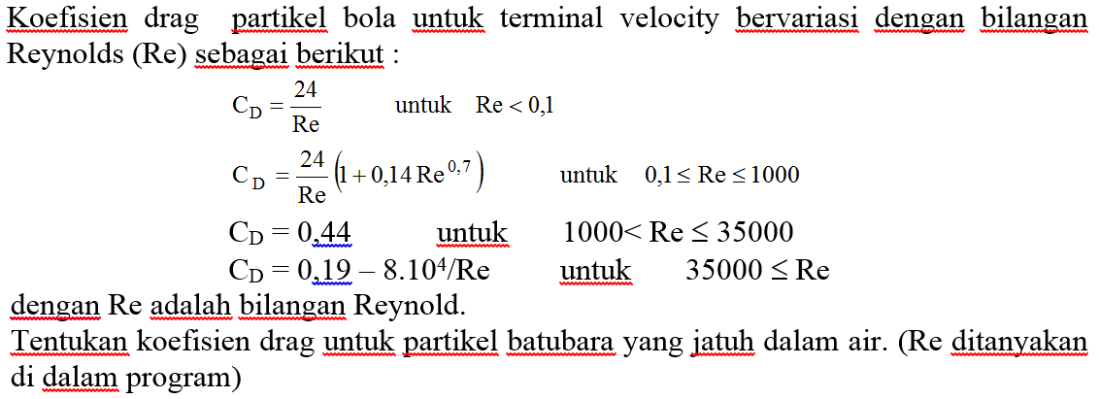

Slide 55
