Slide 1

India Urbanization
Sustainable Urbanization 2022-15th Meeting

Slide 2
General Facts: India vs China Urbanization
Total Population
Level of Urbanization
Urbanization Rate
Population in the largest city
GDP/Capita

Slide 3
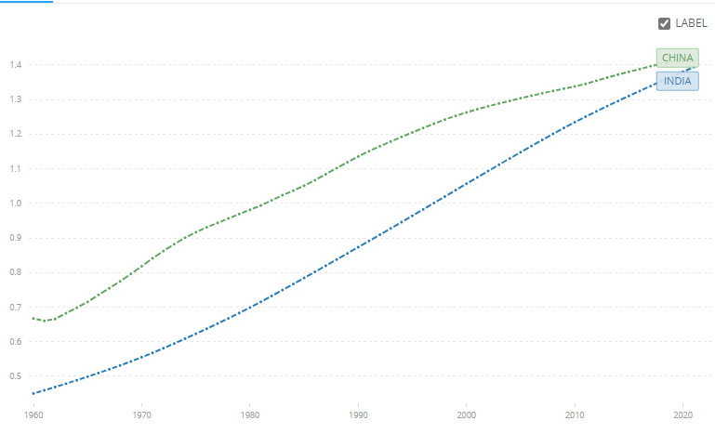
TOTAL POPULATION

Slide 4
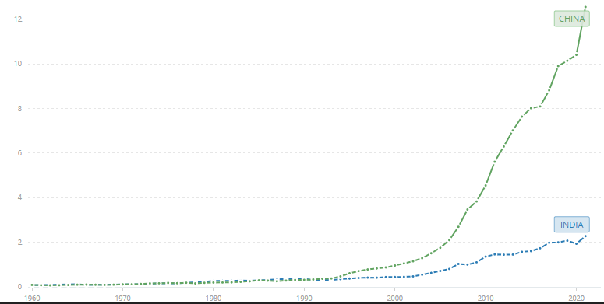
GDP/CAP

Slide 5
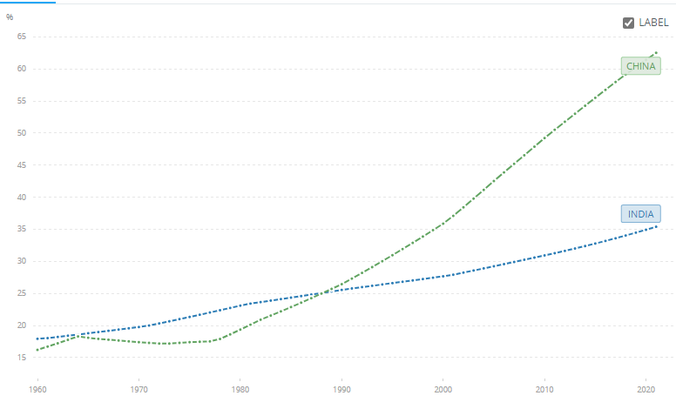
LEVEL OF URBANIZATION

Slide 6
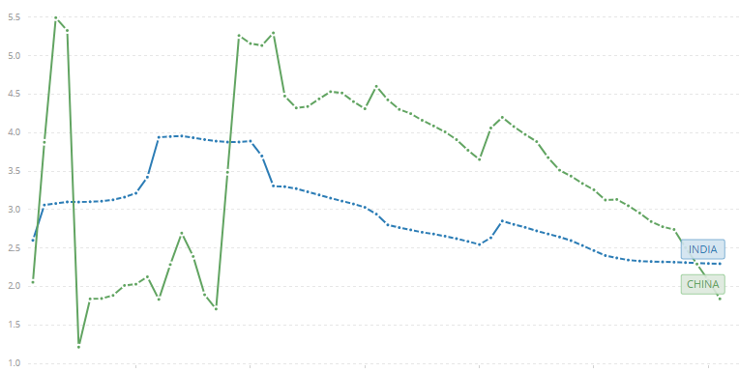
URBANIZATION RATE

Slide 7
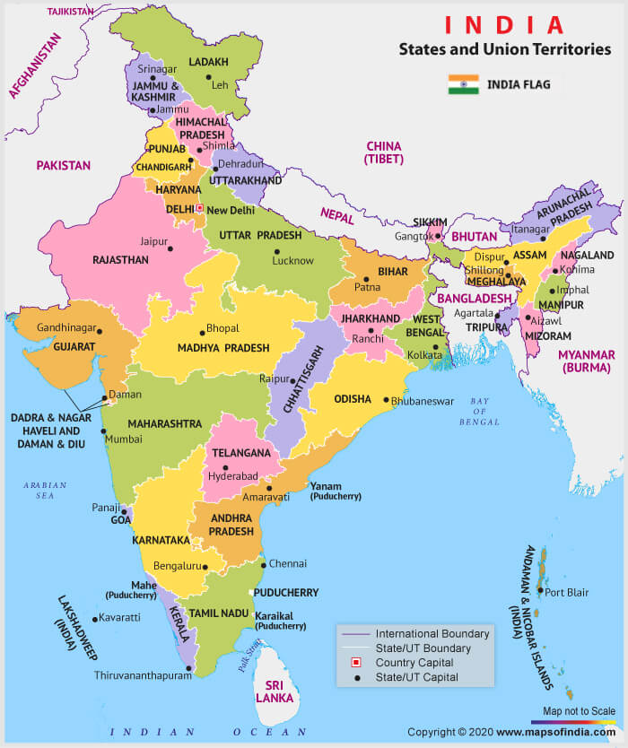
India level of urbanization 2011

Slide 8
The Problem of India Urbanization
Census Town
the role of census town in accelerating urbanization
Undercounting urbanization

Slide 9
Urban Definition by India Census
Settlements having > 5000 people
With a density of > 400 people per square kilometer
Consists of >75% of males working in non-agriculture activities

Slide 10
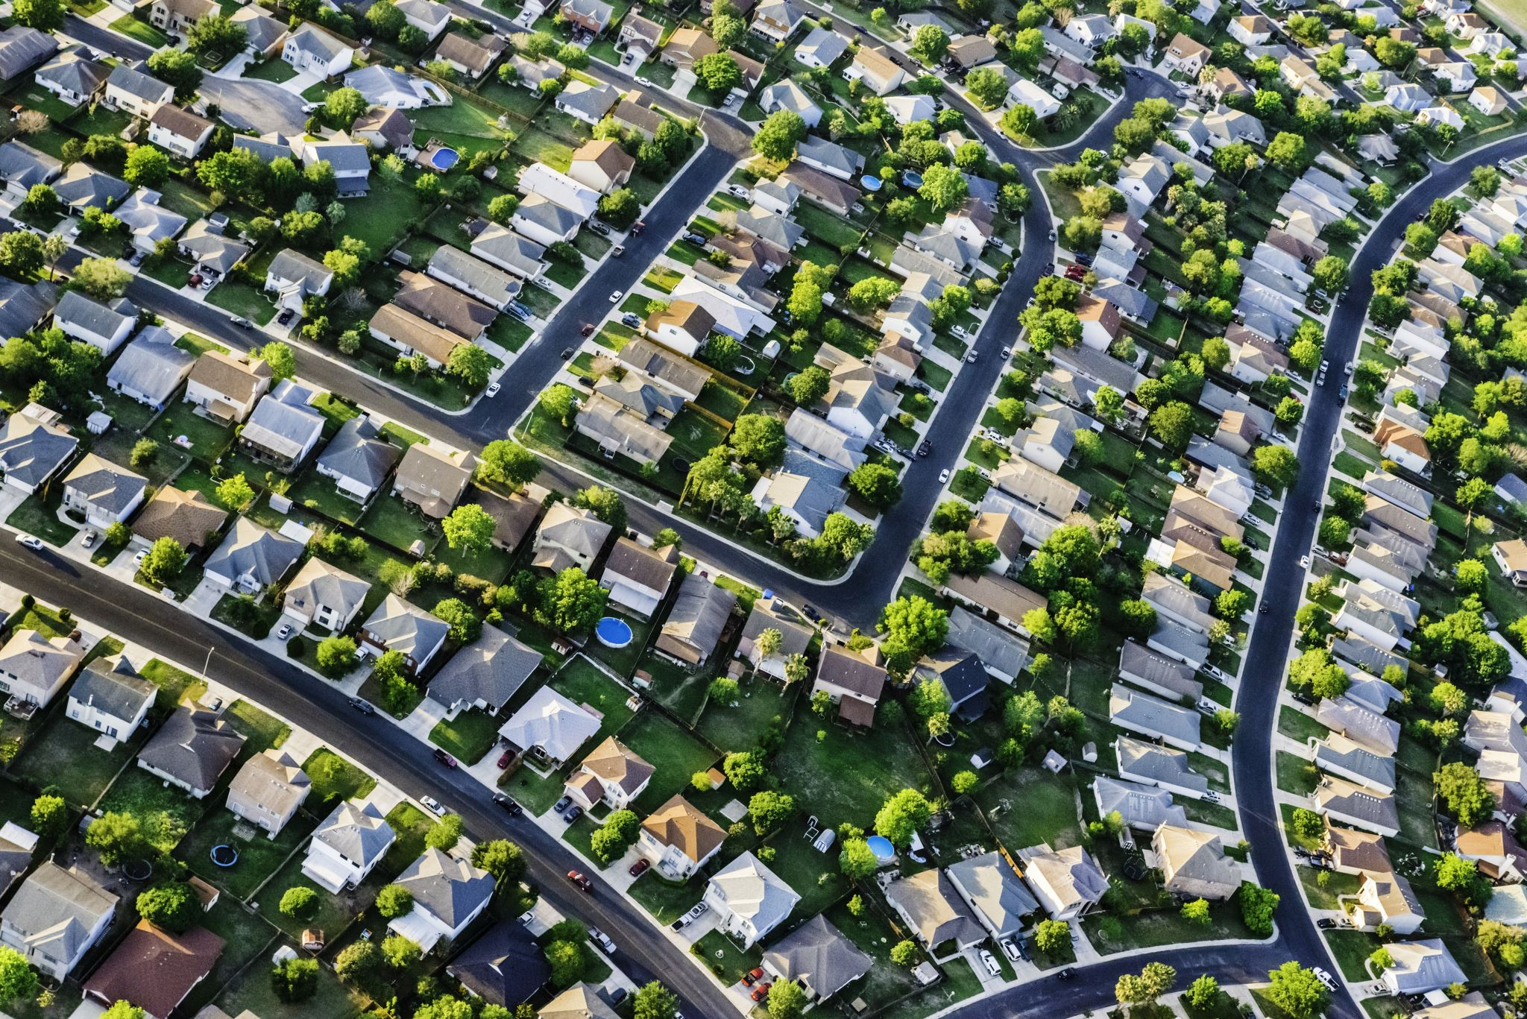
CENSUS TOWN
Settlements that are not acknowledge as urban by the state but play an important role in accommodating population growth
Census towns are settlements that despite fulfilling the census criteria for being urban are not authorized with an urban local body
Remain under rural administration called ‘Gram Panchayat’
The problem arises through the fact that most of the CTs, an urbanized area within districts, are governed by the rural administrative framework
The rapid phase of urbanization surpasses the capacity to deal with the problem

Slide 11
Statutory vs Census Towns

Slide 12
CENSUS TOWN’S PROBLEMS
POTENTIAL
Small census towns offer diverse employment opportunities and attract migrants
BUT
Infrastructure and services remain poor under the administration of rural authorities due to the lack of financial resources.

Slide 13
CENSUS TOWN’S PROBLEMS
Once governed by municipalities (declassified towns in the 2011 census enumeration) CTs are better managed in terms of urban services compared to villages newly transformed into census towns

Slide 15
India Urbanization: The census towns
Settlements possessing a municipal status are called statutory towns and are governed by urban local bodies for economic development, social justice, land use planning and regulation (GoI, 2018)
Compared to urban local bodies, the gram panchayats are only re-sponsible for preparation of plans for economic development and social justice, and for implementation of the plans as may be entrusted to them (GoI, 2018). However, they are not empowered to supervise land use planning and regulation.

Slide 16
India Urbanization: The census towns
census towns are growing in an unplanned manner.
That is why, the growth of census towns has been referred to as
non-recognised growth
un-acknowledged urbanisation
denied urbanization
unregulated growth

Slide 17
Other variables of comparison
Population growth rates are higher in census town than statutory town
The share of nonagricultural employment is significantly higher than the statutory town
The level of literacy is the same.
The provision of domestic electrical connection is also higher
These characters make them more urban than statutory towns
Census towns are lagging behind mostly in permanent road provision, primary schools and colleges as well as hospital beds

Slide 18
Writing an essay: thesis and structure
https://writingcenter.fas.harvard.edu/pages/essay-structure
https://writingcenter.fas.harvard.edu/pages/developing-thesis

Slide 19
Reference
Pradhan, K. C. (2013). Unacknowledged Urbanisation: The New Census Towns of India Unacknowledged Urbanisation New Census Towns of India Definition of Census Towns. Economic & Political Weekly EPW SEPTEMBER, XLVIII(36), 43–51. http://mpra.ub.uni-muenchen.de/41035/
Mitra, A., & Kumar, R. (2015). New patterns in Indian urbanization: Emergence of census towns. Environment and Urbanization ASIA, 6(1), 18–27. https://doi.org/10.1177/0975425315583755
Sircar, S. (2017). ‘Census Towns’ in India and what it means to be ‘urban’: Competing epistemologies and potential new approaches. Singapore Journal of Tropical Geography, 38(2), 229–244. https://doi.org/10.1111/sjtg.12193
Jain, M., & Korzhenevych, A. (2022). The concept of planetary urbanization applied to India’s rural to urban transformation. Habitat International, 129(September), 102671. https://doi.org/10.1016/j.habitatint.2022.102671

