Slide 1
Urbanization in China
Several Fundamental Factors
Sustainable Urbanization 2022: 14th Meeting

Slide 2
General Facts: China Urbanization
Total Population
Total Urban Population
Level of Urbanization
Urbanization Rate
Population in the largest city (Delhi vs Shanghai)
Population in urban agglomeration more than 1 million population
Demographic structure
GDP/Capita

Slide 3
China Urbanization
Hukou System
Economic Reform
New-type Urbanization

Slide 4
China Hukou System
China hukou system acts as an internal passport. classifies people by residential location -since 1950
People can only receive government services in the region in which they are registered
The hukou, a small red passbook, provides details on citizens, including marriages, divorces, births, and deaths, in addition to the area to which each person belongs

Slide 5
Hukou System
The hukou system in China: to restrict population migration. Early theoretical and empirical studies demonstrate that China's hukou system hinders rural-urban migration

Slide 6
Stages of Hukou System
Socilalist Era (Before 1970s)
“Food rationing system” in urban areas (ended 1992)
Rural residents were tied to the land to produce an agricultural surplus
Urban hukou were entitled to have access to state employment and key social resources and services
After 1970s: Reforms to Hukou System
Since 1990s, hukou reform was decentralized to local governments, who have the autonomy to secure resources and experiment on hukou reforms
This reform has also left a sizable migrant population in these highly urbanized cities still holding a rural hukou (rural-urban migrants, comprised 17% (221million) of total Chinese population
Notes:
(which ended in 1992), urban hukou holders were eligible for food rations that were stable across the years, greater in quantity, and more various than rural hukou holders
, such as “housing, food, water, sewage disposal, transportation, medical facilities, police protection, schools, and other essentials andamenities of life
L. Wu, 2013).
This has strengthened capacity of some major wealthy cities, such as Beijing, Shanghai, or Guangzhou, which are largest migrant receiving cities, in providing resources, social welfare and public services to their local urban hukou-holders. However, as traditional destinations of rural-urban migrants, these cities also have the strictest hukou policy and most draconian social policy towards migrant

Slide 7
Hukou System
Hukou-based classification distinguishes each person by whether he or she had or lacked a local hukou
Ties welfare entitlement (e.g., access to social welfare housing, jobs andservices) to a person's hukou status
Residents with a local hukou enjoy more job opportunities in governmental institutions and state-owned enterprises
Migrants without a local hukou rely mainly on the private or informal sectors for employment
migrants without a local hukou are excluded from subsidized housing, such as affordable housing andlow-rent housing, and denied mortgage loans.

Slide 8
Hukou System
The persistence of the hukou divisions amid rural-urban migration, generating a two-class urban society in China
has formed a structural source of discrimination against migrants
Over the past thirty years, numerous attempts to reform the hukousystem aimed at easing restrictive practices.
The hukou system continues to divide and discriminate migrants from native residents
The local versus non-local distinction has remained.
distinction between residents may remain of major significance particularly in major cities

Slide 9
(Before) Economic Reform
Socialist urban development principles:
All citizens should have equal access to facilities and services
Industries and residences should be physically separated from each other by "green belts,“
they should be located sufficiently near each other to minimize the journey to work.
Service centers should be arranged to serve the entire city and to satisfy people's daily requirements.
(the principles of classlessness and urban uniformity)
Behaviour pattern
Value
Structure of city
System Activity
Notes:
population control and resource allocation
The state also controlled 90% of the jobs. Most employment opportunities—70%— came from state work units.
The state controlled the location of investments and people through the dominance of employment by the state work units

Slide 10
Before Economic Reform
Before 1978: Centrally planned economy
Great certainty to urban planning
Urban planning: the spatial expression of the centralized economic plan
Urban planning: production and the requirement of industrial development provided by economic plan
The pace and direction of cities’ development were determined by the central government and manifested in the economic plan: allocate funds, materials, workers, and land needed for any economic projects

Slide 11
Land Use pattern: a dense core surrounded by self-sufficient satellite neighborhoods and communities
Three zones:
continuously built-up, high density city core;
newly built-up, low-density area;
suburbs and market gardens.

Slide 12
After Economic Reform
Reducing the dominance of central state planning
Permitting a more market-led economy
Adopting an "open-door policy" to open China to the world market and foreign investment.
Private, individual economy, with individuals owning their means of production and earning their living through their own labor, and the commodity economy were introduced.

Slide 13
Land Reform
Land is owned by the government and normally is allocated free of charge to users.
Changed with the economic reforms.
Cities: charging land use fees, and land use rights can be transferred and sold.
Most land use fees involve land to which foreign investment has been allocated. Land use fee was charged according to the type of use, location, and lease period
Commercial housing Enterprise zone
Urban sprawl
Multi cores
Change the structure of cities
Notes:
the economic and technical development zone (ETDZ). The rationale is to attract foreign investment, to restructure industry and foster new high technology, and to relax government control to raise incentives and autonomy in decision making. The ETDZs are very similar to "enterprise zones" in the United Kingdom, where special policy is provided to stimulate languishing local economies (Hall, 1981).

Slide 14
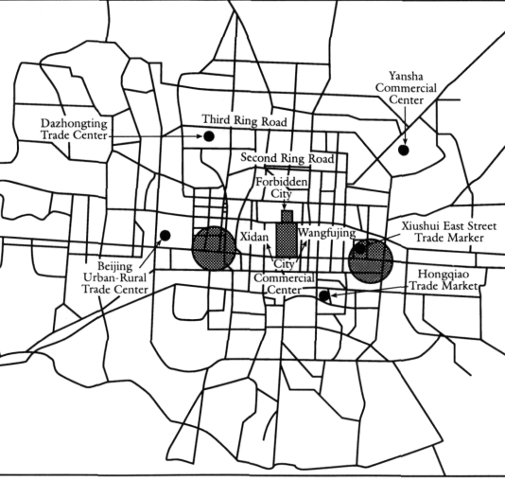
Before economic reform
After economic reform

Slide 15
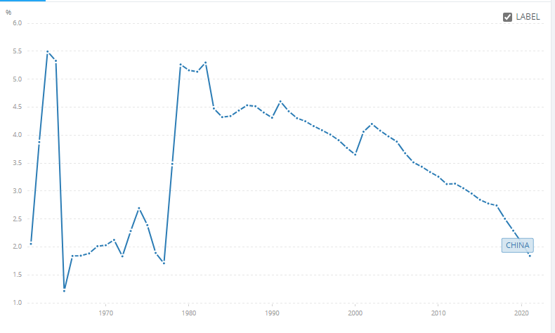
Before the reform
After the Reform

Slide 16
Notes:
Between 1979 and 2015, the portion of the nation’s population dwelling in cities increased from 17.9% to 56.1%.
The average annual growth rate of the urban population during this period,at was > 4 times higher than that of the previous period(1949–1978, 0.25%).
The urban population first reached 200 million in1981. It reached 400 million 17 years later in 1998,
passed 600 millionin 2007, after just 10 years,
and increased to nearly 800 million (770million) in 2015

Slide 17
The Process of Fast Growing Urbanization in China
Besides the open-door policy and the economic reform, China’s rapid urbanization is also due to the following reasons:
The wide spreading of the transport infrastructure that facilitates easier migration
More education opportunities in the cities
The rapid development of information technology and modern media which create new jobs
Lessons learnt from the developed countries that help China to gain efficiency and avoid making similar mistakes.
Urbanization is accompanied by the transition from a planned economy towards a market economy

Slide 18
The Problems of the Fast Growing Urbanization
There are still 234 million migrant workers lack access
Land urbanization has outpaced the urbanization of the population..
The spatial pattern and urban scales systems are unreasonable, and the distribution of cities does not match the resources and environmental carrying capacity
The management level of urban areas is still low, and big city disease isincreasingly common and serious.
Lack of respect history, and cultural heritage. Many cities plan and construct international metropolises without regard for the actual situation.
Notes:
1. education, medical treatment, and affordable housing as other urbanites with city hukou counted as urban residents living in cities and towns for > 6months, from a statistical perspective. However, they cannot access urban services
2. aggressively over-pursued wide streets, big squares, new districts,development zones, and industrial parks

Slide 19
the National New-type Urbanization Plan (NUP)
Set up in 2014
Land-centered urbanization to people-centered urbanization
Increase participation
Eco-city development
Set new developmental goals for China’s fast growing urbanization process

Slide 20
NUP
The main task is to solve the long-standing issue of farmer-workers acquiring citizenship.
China's urbanization needs to pay more attention to sustainable development (especially in three major agglomeration in China).
the coordinated development of urban and rural areas from the perspective of regions, rather than urban-rural dual development.
Notes:
1. It is very important to improve the ability of agricultural transfer populations to blend into cities and towns. The NUP also emphasizes that the will of peasants must be 2. fully respected. The change of household residents from rural to urban should be voluntary classified
2. The overgrowth of urban land expansion should be more strictly controlled,
3. New-type urbanization construction is combined withthe construction of new countryside area

Slide 21
Notes:
household registration system (HRS).

Slide 22
Notes:
1. Speeding up the pace of HRS reform; releasing the interim regulation on residence permits; and a notice on promoting 100 million people without urban hukou who settled in cities. calls for relaxing restrictions on access to urban hukou
2. supporting infrastructure, rebuilding shantytown houses (18 million) and dangerous houses (10.6 million)
3. The major driving force for urbanization and rural-to-urban migration is employment in non-agricultural industries. Therefore, industry development and industry-city integration are regarded as important factors. plot areas for industry-city integration were founded (about 60 nationwide). development of industries, complete urban services, and clear area boundaries. Secondly, migrant workers are encouraged to go back home, supported in undertaking business in urban or rural areas.
4. establishment of the Joint Committee of 15 ministries, the preparation of sub national planning. By setting experimental zones, fully use market mechanisms in resource allocation. Experimental zones were constructed jointly by the central government and local governments, in which the latter played the more important role

Slide 23
The new urban system in China
A number of cities with international and regional importance are raised
Many muti national company locate their headquarters in cities with international importance (e.g. Beijing and Shanghai) and those with regional importance (e.g. Guangzhou and Qingdao).
Enhance their economic dominance.

Slide 24
The new urban system in China
Densely urbanized regions have been developing in a fast pace
Three densely urbanized regions have been formed along China’s coast areas, i.e. the Pearl River Delta, the Yangtze River Delta and the Beijing-Tianjin-Hebei Region.
These regions have become the most dynamic and competitive economies that dominate the development orientation of the country.

Slide 25
The new urban system in China
Industries are prospering In small cities and towns
Many small cities and towns along the coast are directly participating in international production
They absorbed a great number of surplus labour from the countryside and brought the rural economy up

Slide 26
Reference
Gar-On Yeh, A., & Wu, F. (1995). Internal structure of Chinese cities in the midst of economic reform. Urban Geography, 16(6), 521–554. https://doi.org/10.2747/0272-3638.16.6.521
Yan, D., Kong, Y., Ye, B., & Xiang, H. (2021). Spatio-temporal variation and daily prediction of PM2.5 concentration in world-class urban agglomerations of China. Environmental Geochemistry and Health, 43(1), 301–316. https://doi.org/10.1007/s10653-020-00708-x
Li, B., Chen, C., & Hu, B. (2016). Governing urbanization and the New Urbanization Plan in China. Environment and Urbanization, 28(2), 515–534. https://doi.org/10.1177/0956247816647345
Chen, M., Liu, W., Lu, D., Chen, H., & Ye, C. (2018). Progress of China’s new-type urbanization construction since 2014: A preliminary assessment. Cities, 78(February 2018), 180–193. https://doi.org/10.1016/j.cities.2018.02.012
Banerjee, T., & Schenk, S. (1984). Lower order cities and national urbanization policies: China and India. Environment & Planning A, 16(4), 487–512. https://doi.org/10.1068/a160487
Jia, M., Liu, Y., Lieske, S. N., & Chen, T. (2020). Public policy change and its impact on urban expansion: An evaluation of 265 cities in China. Land Use Policy, 97(January). https://doi.org/10.1016/j.landusepol.2020.104754

