Slide 1
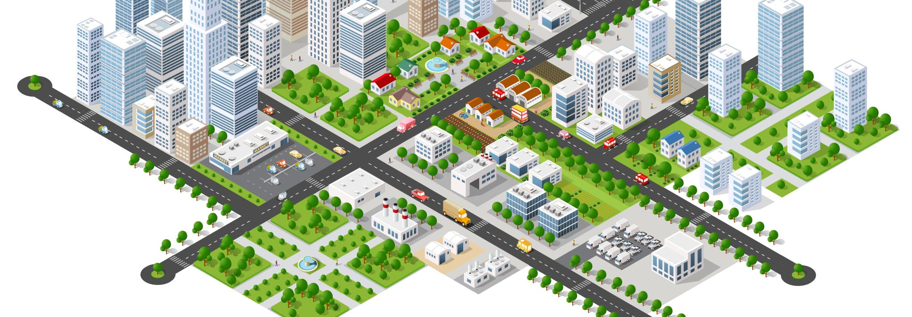
Sustainable Urbanization Strategy: The Framework
Sustainable Urbanization 13th meeting

Slide 2
UNDP
Inequitable, exclusionary, fragmented
Cities’ Vulnerability
Critical Opportunity
Notes:
The urbanization process in developing countries is often poorly managed: inequitable, exclusionary and fragmented cities and increased risk of violence
Cities’ vulnerability goes beyond exposure to climate change impacts and extreme events.
there are also critical opportunities to be seized in making growth more sustainable, inclusive and equitable, cities more resilient and their inhabitants less vulnerable

Slide 3
SDG 2030

Slide 4
SDGs 2030 and Urbanization
Promoting sustainable cities is now clearly featured in the 2030 Agenda as one of the SDGs – Goal 11: Make cities and human settlements inclusive, safe, resilient and sustainable.
Sustainable development in cities is critical to achieving most of Agenda 2030.
Notes:
cities have a clear role in ‘ending poverty’ (Goal 1); ‘reducing inequality’ (Goal 10); promoting inclusive and sustainable growth, and full and productive employment (Goal 8); and taking urgent action to combat climate change and its impacts (Goal 13). One analysis identified 11 of 17 SDGs where action in cities will be essential.1

Slide 5
UNDP: Development Issue of Urbanization
Cities and urban centers: accelerators for social and economic progress.
Cities: hubs of innovation in technology, commerce, social organization and ideas
Cities: opportunities for social mobility that are unavailable in traditional rural environments.
Cities: home to significant concentrations of the poor and marginalized. the World Bank: by 2035, most of the world’s extreme poor will be found in urban areas.

Slide 6
UNDP: Development Issue of Urbanization
Urbanization has significant impacts on the environment and the well-being of urban dwellers
Cities are key contributors to many environmental problems: air and water pollution
Globally, 3 billion urban residents generate 1.2 kg of waste a day - 1.3 billion tonnes per year.
Cities are highly vulnerable to climate change impacts: Many cities are located in highly exposed coastal areas and riverbanks, which are prone to sea level rise, typhoons, storms, and landslides
Urbanization also displaces open space such as farmland, wetlands, parks and forests and reduces water supply as excessive ground water usage depletes water tables
climate change and disasters in cities disproportionately affect the poor, w

Slide 7
UNDP’s sustainable urbanization approach
SUSTAINABILITY
TRANSPORTATION AND MOBILITY
The challenge for cities is to overcome the short-term infrastructure investment costs of efficient mass transit systems, which requires political will, effective planning and implementation and access to suitable financin
Notes:
Rapid urbanization, default choice has been expansion of the road network for cars
induces more cars onto the road
severely hampers mobility and accessibility to social and economic activities
creates a cycle of car dependency that spurs urban sprawl
increasing pollution, traffic hazards and costs to deliver public service

Slide 8
UNDP’s sustainable urbanization approach
INCLUSIVITY
The geography of urbanization: compact cities vs. sprawl
Spatial equality and social equality
Public space and land development
Job creation, informality and entrepreneurship
Notes:
the choice to invest in public transport rather than car-centric road networks encouraged the development of more compact cities, particularly when surrounding land was scarce
the links between periurban and urban areas are important, where local landholders participate in subsistence activities but try to utilize proximity to markets and services.
Cities can be made more inclusive by choosing to provide greater access to public spaces that offer opportunities for interaction and would enhance the social and cultural development
build on the comparative advantages and unique qualities of their localities. Some cities are hubs of innovation and entrepreneurship, such as Bengalore, while others are centers of manufacturing, such as Dhaka.

Slide 9
UNDP’s sustainable urbanization approach
RESILIENCE
Managing risk and investing in resilience
Rapid growth often results in development on hazard-prone sites (coastlines, river beds, hill-slopes), which increases exposure and vulnerability to climate and disaster risk.
Cities must contend with the short-term vs. the longer-term disaster risk management strategies.

Slide 10
ADB: ASIA AND LATIN AMERICA
The urbanization process in the developing world commenced and is continually occurring in the context of more open economies and is usually unfolding faster than income and governance institutions can support.
Irregular and lower density development: decreasing density, following the transformation of rural and undeveloped areas into urban land
Slum dwellers (30%)
Air and water pollution
Notes:
An open economy is a type of economy where not only domestic factors but also entities in other countries engage in trade of products (goods and services).
In Asia, close to 500 million slum dwellers, and almost 408 million people without access to improved sanitation facilities.
Latin America, where almost 24% of the urban population, or 115 million Latin Americans, are slum dwellers
Asian cities such as Beijing, Delhi, and Mumbai have triple the amount of air pollution considered tolerable by the European Union.

Slide 12
ADB: ASIA AND LATIN AMERICA
compact and contiguous cities are generally preferred given the efficiency they provide in terms of transport, infrastructure, and waste management
reduction in the fragmentation of cities is viewed as a step forward in urban development
Notes:
Discuss about the case of pandemic between developed and developing countries

Slide 13
ADB:the analysis of fragmentation
Notes:
Fragmented is detached from something else
The edge index measures the frequency with which a small built-up area is surrounded by open spaces or water. The results suggest that in Latin America, built-up areas were usually surrounded by other built-up areas, whereas in Asia, built-up areas tended to be evenly bordered by built-up areas and open spaces or water
The openness index measures the share of open space in a 1 km2 circle around each built-up square of 30-by-30 meters. Of the 120 cities
The core open space ratio takes into account the open areas in the core regions of the city
The growth of urban public space, especially in less developed countries, has been disorganized and unregulated. Consequently, most cities are fragmented, chaotic, dispersed, crowded, and environmentally unsustainable.

Slide 14
Green Space /Capita
Notes:
In Santiago de Chile, green space per capita has doubled during the last 20 years, from 2 m2 per capita to 4 m2 per capita (Moris et al. 2014). This is still less than the WHO-recommended minimum of 9 m2 per capita as a general indicator of a high quality of life (OECD 2013)

Slide 15
ADB: Moving toward Sustainable Cities
Expanding in number of population and land area
the process of de-densification needs to be managed carefully.
The density of ideas, resources, and talent has enabled cities to be tremendous engines of growth.
Moreover, the shape of the expansion or urban form needs to be monitored.
In general, the concentric expansion patterns that Latin American cities followed tend to be more efficient than the fragmented developments in Asia.
But, while Latin American cities may have more green space per capita than their Asian counterparts, most residents of the less fragmented cities generally have farther to go to access green space.
Notes:
Cities in Asia and Latin America have continued expanding in population and land area. But population increases have generally lagged behind physical expansion, resulting in decreasing densities

Slide 16
ADB: Monitoring system
The sustainable city of the future will have to develop its own systems to monitor all aspects of urban sustainability.
Managing information for the city of the future should transcend traditional statistics at aggregate spatial levels to work with geographic information system data banks and indicators capable of addressing smaller areas

Slide 17
ASEAN Strategy for Sustainable Urbanization

Slide 18
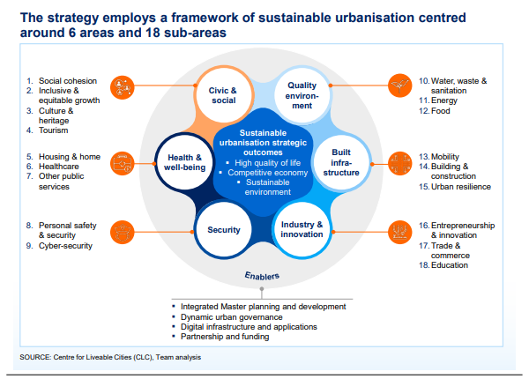
THE ASUS FRAMEWORK
Notes:
Mobility. This sub-area includes actions promoting the access, affordability and efficiency of transport as well as reducing transport-related pollutants (such as greenhouse gas emissions). It includes the development of public transport infrastructure, ride sharing, smart transport solutions, and more efficient internal combustion engines.
■ Building & construction. This sub-area focuses on improving the efficiency and sustainability of building usage and construction (e.g. optimising building space through shared offices, building energy efficiency, modular buildings, sustainable construction materials, smart buildings and construction).
■ Urban resilience. This sub-area focuses on promoting urban resilience against disaster risks and potential impacts of climate change (e.g. city flood defences, early warning systems)

Slide 19
Notes:
This tabe shows how the key trends affect area of ASUS

Slide 20
innovative actions in ASEAN
Social cohesion.
Inclusive & equitable growth
Culture & heritage
Tourism
Housing & home
Healthcare.
Other public services
Personal safety & security.
Water, waste & sanitation.
Energy
Food.
Mobility
Building & construction.
Urban resilience.
Entrepreneurship & innovation
Trade and Commerce
Education
Notes:
Explanation
Social cohesion Actions in this sub-area aim to improve the inclusion and enfranchisement of all groups of the urban population, in particular of women, racial minorities and disenfranchised age groups
Inclusive & equitable growth conditional cash transfer programmes (ex: PNPM/program nasional pemberdayaan masyarakat)
Culture & heritage. Actions in this sub-area include building cultural awareness in the city (as seen by the George Town Festival in Penang) or physically retaining historical
Tourism. According to MasterCard’s Asia Pacific Destination Index 2017, half of the top 20 most visited destinations in APAC saw more than 10 percent growth in international overnight arrivals from 2015 to 2016. A large portion of actions focuses on building tourism infrastructure – e.g. the introduction of a monorail system in Phuket and various airport expansion projects.117 Actions in this sub-area also include implementing digital innovations to better manage tourist flows
Housing & home. Actions in this sub-area mostly focus on two channels: upgrading housing or increasing home ownership
Water Waste and Sanitation upstream solutions to waste management: promoting environmentally sustainable consumption, circular economy
Mobility: improving public transport
Urban Resilience flood prevention and mitigation

Slide 21
COMMON BARRIERS TO IMPLEMENTATION OF ACTIONS BY SUB-AREAS OF SUSTAINABLE URBANISATION
Notes:
Information failures. This occurs when stakeholders do not have sufficient or adequate information about the availability of actions
Prioritisation. This barrier arises when key decision-makers consider an issue to be of low priority in relation to other issues.
Misaligned incentives. These relate to a misalignment of incentives between key stakeholders (e.g. national, regional and local government or regulators, investors/ donors, implementation agencies, private sector and local residents). One prominent example relates to residents resisting land acquisition for infrastructure projects.
Return on investment. This barrier relates to the lack of a sufficiently attractive return on investment to encourage investment
Fiscal capacity. This challenge revolves around the limited budget of cities which hinders them from seizing opportunities to invest in sustainable urbanisation actions.
the challenge is not around the lack of capital sources, but the access to them. cities are often unaware that they can access alternative forms of financing.
Strategic planning. Many cities lack a clear and robust long-term strategy to support the implementation of their sustainable urbanisation actions,
mplementation capacity. This barrier refers to the (non-financial) resource gaps that prevent the implementation of an action such as lack of adequate manpower, technology
Coordination. This relates to a lack of alignment with other actions where there may be important inter-dependencies

Slide 22
Reference
United Nations Development Programme. (2016). Sustainable Urbanization Strategy - 2016. UNDP’s Support to Sustainable, Inclusive and Resilient Cities in the Developing World, 1–54. http://www.undp.org/content/undp/en/home/librarypage/poverty-reduction/sustainable-urbanization-strategy.html
The ASEAN Secretariat. (2012). ASEAN Sustainable Urbanization Strategy. ASEAN Secretariat. Jakarta. https://asean.org/book/asean-sustainable-urbanisation-strategy/
Asian Development Bank & Inter-American Development Bank. (2014). Sustainable Urbanization in Asia and Latin America.

