Slide 1

Africa’s Urbanization
Sustainable Urbanization 2022 13th Meeting

Slide 2
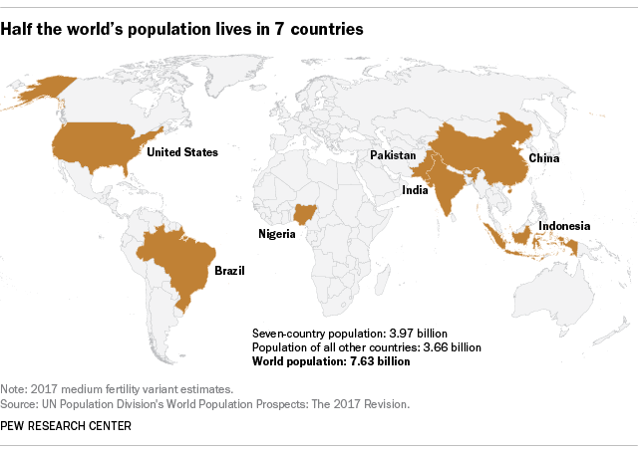

https://www.pewresearch.org/fact-tank/2018/07/11/world-population-day/
220 million
329 million
1.4 billion
1.38 billion
270 million (the fourth largest population)
212,5 million
206 million
Thrive Webinar Series September 21, 2021 URBAN AND REGIONAL PLANNING PROGRAM UNS

Slide 3
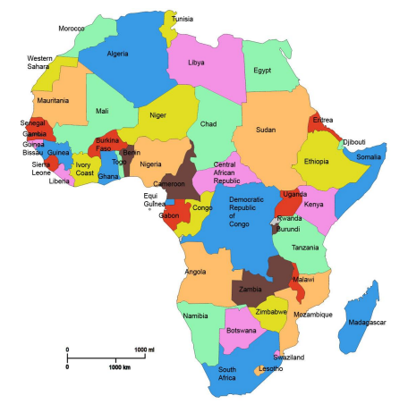
African countries (54) economic status https://worldpopulationreview.com/country-rankings/richest-african-countries

Slide 4
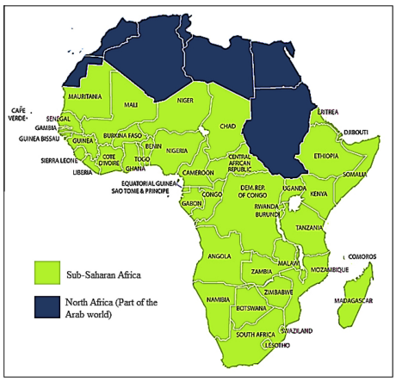
Notes:
SOMALIA competition for resources and power, repression by the military regime and the colonial legacy

Slide 5
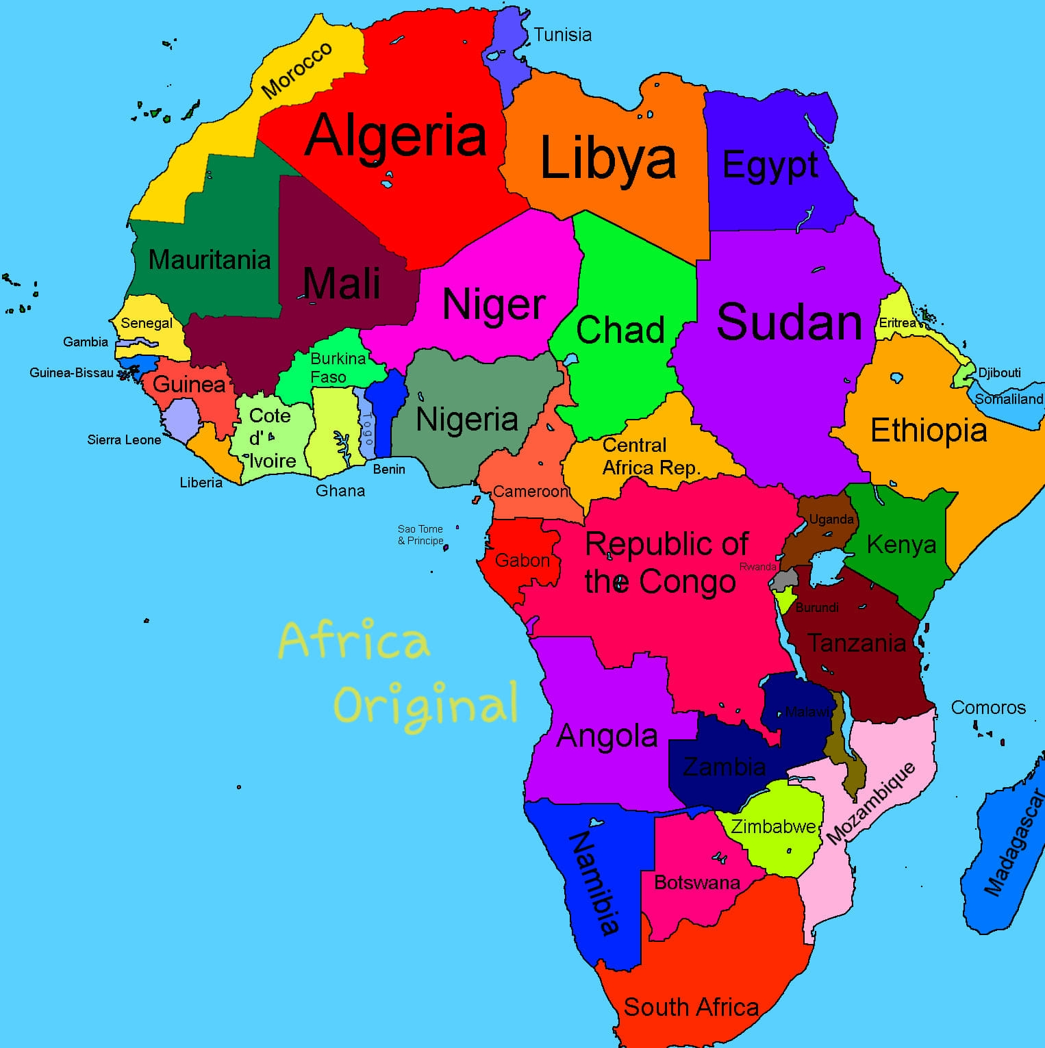

Slide 6
Facts about urbanization in Africa
In the next 35 years, Africa will need to accommodate almost 900 million new urban dwellers, which is equivalent to what Europe, USA & Japan combined have managed over the last 265 years.
75 % of Africa’s urban population is younger than 35.
Almost 50% of Africa’s urban population lives in slums & informal settlements.
Inequality in African cities is the 2nd highest in the world.

Slide 7
Facts about urbanization in Africa
Youth unemployment in Africa is 6 times higher in urban areas than in rural areas.
61% of urban employment opportunities in Africa are informal.
37 out of the 54 African countries are still more than 50% rural.
In 2050, Africa is expected to host nearly 25% of the global urban population.
Residential electricity consumption per capita in Africa is only half that of China.
In Africa, less than 50% of solid waste is collected & only 5% is contained or recycled

Slide 8
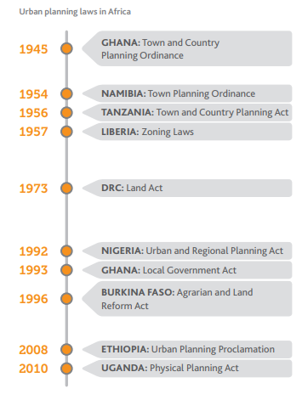
Urban Planning in African Countries: Many of Africa’s urban planning laws are outdated & fail to meet the challenges

Slide 9
INDONESIAN PLANNING: The early years
1921
1934
1938
1948
1957-1960
1903
URBAN PLANNING COMMITTEE
LAW OF SVO AND SVV ENACTED
DECENTRALIZATION IDEA
DECENTRALIZATION CONGRESS
DRAFT OF REGULATION SYSTEM OF CITY PLANNING
JAKARTA OUTLINE PLAN 1957 AND JAKARTA MASTER PLAN 1965-1985
DUTCH COLONIAL ERA
PREVIOUS SPATIAL PLANNING: City Planning Ordinance or Staadvorming Ordonantie (SVO)
The implementation ordinance known as Stadsvorming Verordening (SVV)
In response to the growing need for coordinating the management of natural resources, the Indonesia parliament passed the first spatial planning law, The Spatial Planning Law 24/1992 in October 1992---26/2007
Notes:
Greater Jakarta Area (Keppres 13/1976), Batam Island (Keppres 41/1973) and Puncak Area (Keppres 48/1983) and certain development sectors including rice field areas (Keppres 54/1980), industrial estate (Keppres 53/1989), tourism (Keppres 15/1983) and housing (Keppres 8/1985). All of these legal frameworks are presidential acts.

Slide 10
Urban Planning Challenge in Africa
Planning for urban expansion is one of the most important tasks for African governments.
Inclusive planning is important. Without that, the numbers of inhabitants without access to shelter and basic services such as water and sanitation, energy or formal employment opportunities will explode.
Unequal planning exacerbates social disparities by marginalising the urban poor from the inner most spaces of cities
Notes:
African cities are accommodating, on average, 40,000 to 50,000 people every day, putting enormous strain on urban services and the urban environment
where there are paved roads with street lamps, a regular power supply, an adequate water supply, infrastructure and amenities

Slide 11
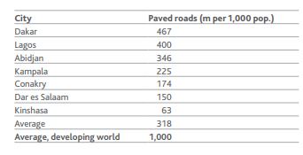
Facts about urbanization in Africa: Problem of Urban Infrastructure- Transportation

Slide 12
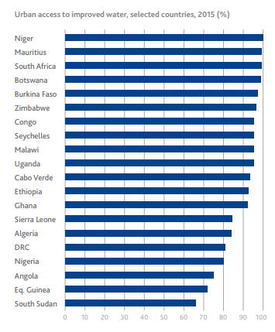
Facts about urbanization in Africa: Problem of Urban access to improved water
Improved water is access to water sources protected from outside contamination /fecal

Slide 13
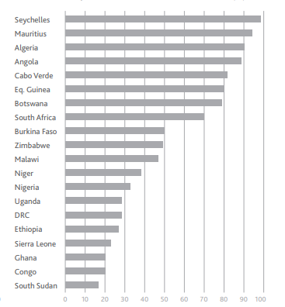
Facts about urbanization in Africa: Urban access to improved sanitation
'Improved' sanitation facilities hygienically separate human excreta from human contact.

Slide 14


Urban water and sanitation
89% of urban Africans have access to a water source that is protected from outside contamination.
However only 46% of Africa’s urban population is connected to piped networks, and 43% rely on public standpipes in 23 countries.
52% of urban Africans have access to an improved sanitation facility. However, 55% of those people have access to a shared sanitation facility only.

Slide 15
Facts about urbanization in Africa: Urban Services-water and sanitation
By 2030, water demand is likely to increase by 238% in sub-Saharan Africa, particularly in cities. This is 3 times more than any other region in the world.
Over the last 25 years, 247 million urban Africans gained access to improved water and 135 million to improved sanitation.
However, urbanisation rates are exceeding the number of urban Africans gaining access.
In the last 25 years the number of people without access to improved sanitation has increased by 134 million.

Slide 16
Public transport: high demand, high potential
BRT has been implemented in Cape Town, Johannesburg and Lagos, and will be implemented in Accra, Dar es Salaam and Kampala.
In Lagos, BRT has reduced fares and journey times for more than 200,000 passengers.
The BRT generated 2,000 jobs and reduced travel times by 40%.
In South Africa it is expected that, by 2020, most city residents will be no more than 500 m away from a BRT station.

Slide 17
Facts about urbanization in Africa: Housing
Sustained and rapid urban growth on the African continent: enormous strain on the provision and affordability of urban land and housing.
Between 2001 and 2011 over 60 million new dwellings were required to accommodate the rapidly growing number of new urban households in Africa.
Almost 1⁄2 the urban population in Africa has no alternative but to live in slums and informal settlements
In Addis Ababa, Kampala, Lagos, more than 40% of the urban population live in overcrowded houses
Kenya’s housing shortage is estimated at 2 million units, while Nigeria needs 17 million units
85% of African’s urban population is not eligible to have forma housing loan

Slide 18
The rural-urban balance: Africa’s population is still majority rural
Africa's urban population, as a share of the total population, is considerably smaller than in Asia, Europe and Latin America & the Caribbean.
The percentage of people living in urban areas in Northern Europe (82%) is more than double that of Africa.
Africa will be the last continent to become 50% urban, in 2037.
The number of people living in urban areas in Asia is 4.5 times larger than in Africa.
In 6 African countries, less than 20% of the population live in urban areas.
In the majority of North African countries, over 50% of the population lives in urban areas.

Slide 25
Cases
Ethiopia, Uganda,Nigeria

Slide 26
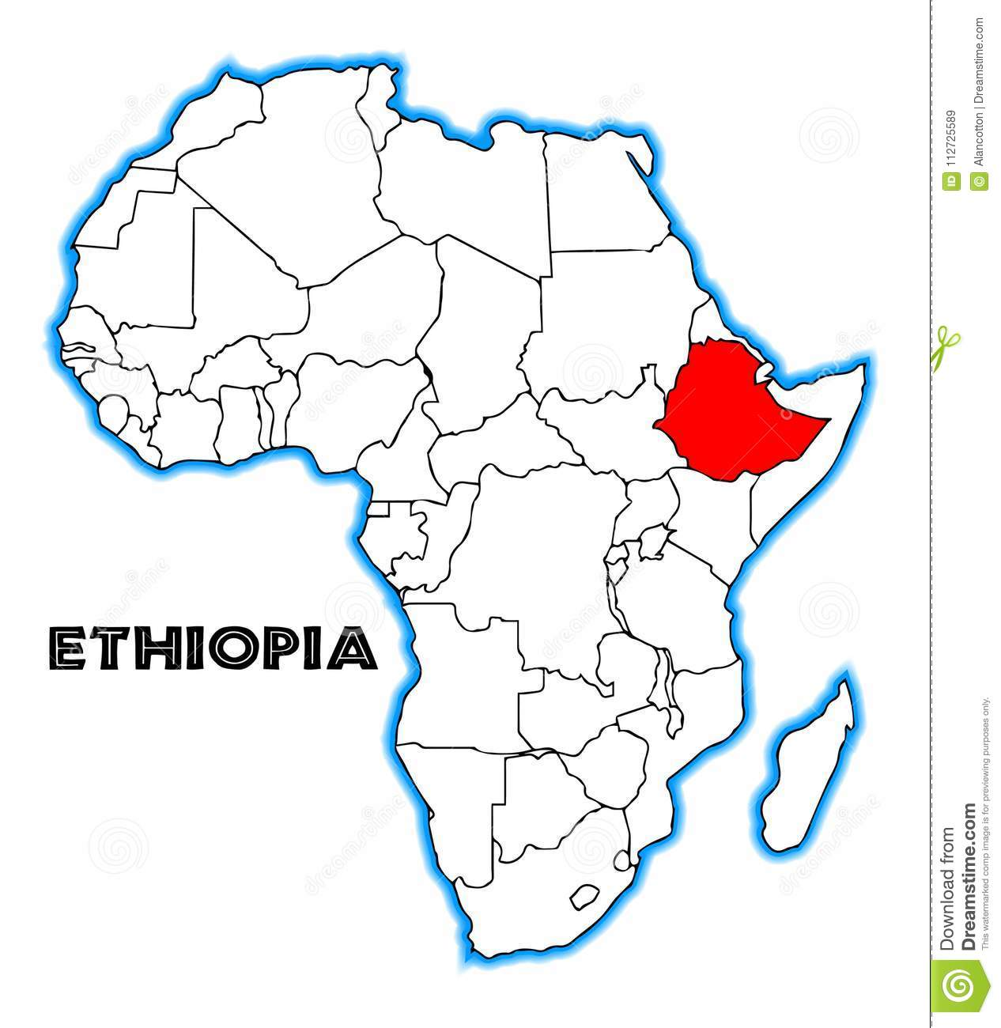
Between 2007 and 2015 nineteen million people were added to the population
Urban Ethiopia is increasing not only in population but also in desertification of big cities and land expansion

Slide 27
The Environmental Effect of Urban Growth
01
02
03
04
Urban environmental degradation
Urban environment land is overtaken
The inhospitable surface in urban area
Scarcity of groundwater
Notes:
(of an environment) harsh and difficult to live in

Slide 28
Urban Land Grabbing Caused Land Holding Insecurity
Land Grabbing
Common for the expansion of urban centers in Eastern Ethiopia
Those who fully lost their land to urban areas and displaced people are the most suffering community from serous poverty.
The community lost sense of land possession and considered land grabbing as governing bodies backing the process
Land grabbing and land dispossession are outcomes of urbanization that create problems against economic well being for the community adjacent to urban centers
Insecurity of Land Holding
Notes:
large-scale land acquisitions by force

Slide 29
East Ethiopia Urbanization
Majority of the people are dispossessed of their asset due to the urban expansion process affected the living of several communities to lose their land
The unplanned urbanization process are in fact affecting the environment itself
The problems related to expansion are partly resulted from the miss management of land and other resources in the inner cities
The rapid expansion of urban growth has an adverse impact on the socio-economic activities in the Eastern Ethiopia

Slide 30
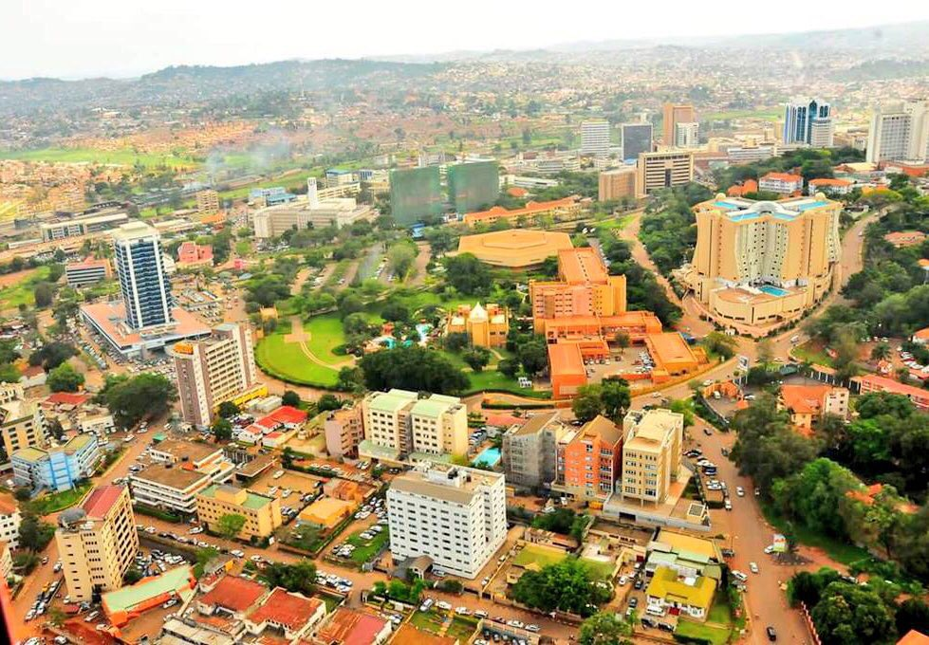
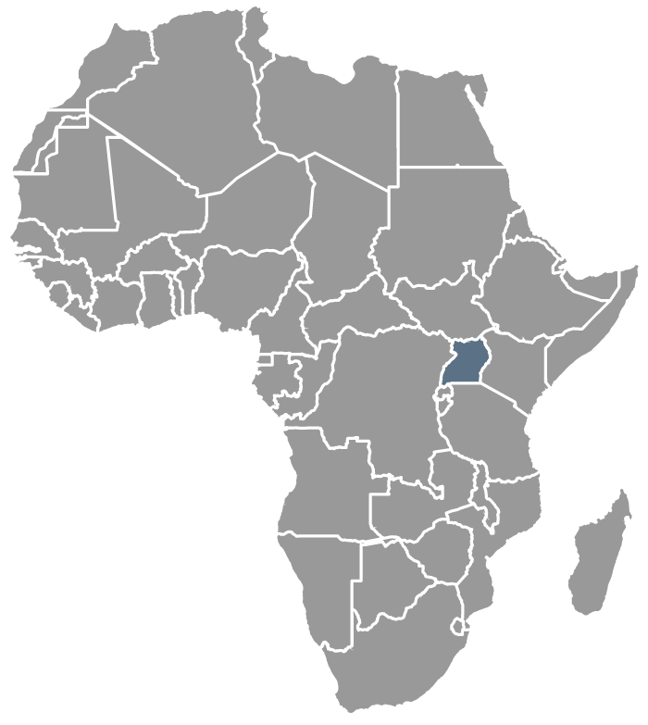

AFRICA
UGANDA

Slide 31
Uganda is currently experiencing rapid urbanization
In 2050, Uganda will be one of the most urbanized countries in Africa
Creates New Cities

Slide 32
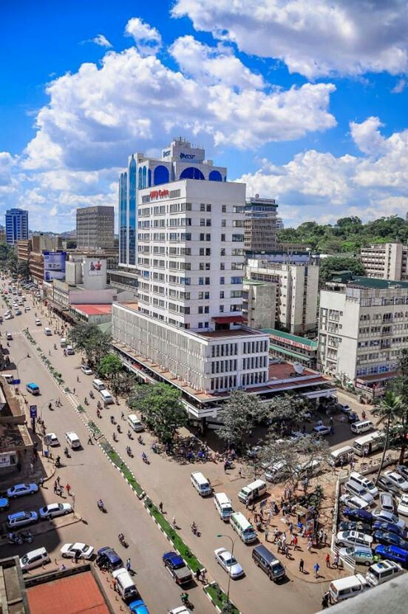
Background of Cities Making Process
Rise of urban population to 7.4 million people in 2016
Potential benefit of human resources
Creating new cities because they play important role in economic growth
On May 20, 2019 the plan for making new cities are approved

Slide 33
Prediction of New Cities Implications
Infrastructure development
Job creation
1
2
3
4
Economic development
Increase in incomes & Attract investment

Slide 34

Challenges of
Uganda’s Urbanization
Slums and informal settlements
Poor solid waste management
Deteriorating urban environment
Weak urban economy
Urban sprawl
Unplanned development and inadequate funding
Ineffective urban governance and management
Inadequate transportation and traffic management

Slide 35

Policy and Legal Implications
Each city will have 3 representatives in Parliament
Leadership transit is unclear.
Operating like a district will cause deficiencies
Lack of minimum standards
Unplanned horizontal growth
Unclear management
Land conflicts
Pressure on the national resource
Relocate of the local governments
Affect the local revenues (changes in demographics)
Creations of new administrative units.
Administrative reclassification

Slide 36
CONCLUSION
Adequate preparation is needed for creating new cities
Planning must take precedence on key areas
1
2
3
4
There should be supervision of program that is related to urbanization
New cities should be given financial autonomy

Slide 37


key factors of urbanization in Nigeria
Migration within Nigerian settlements in the past was majorly due to the efforts to seek safety of life, education opportunities and to access health facilities.
The major factor for migration in Nigeria nowadays is majorly for economic purpose.

Slide 38
Prevailing migration pattern in Nigeria is rural to urban migration, which makes population growth in major Nigerian cities like Lagos, Ibadan, Kano, and Portharcourt among others to be very alarming on annual basis.
Nearly half of the growth rate of urban areas was contributed by migrants.
Migration has a negative impact on the quality of rural life, because it reduces the number of individuals in rural areas.
rural-urban migration has a positive impact on urban growth and social development and this helps generate employment, educational facilities and transportation infrastructure for the migrants.

Slide 39
Rural to urban migration Nigeria
Between 1985 and 1990, over 3 million Nigerians migrated from rural areas to urban centres, while over 5 million Nigerians migrated between 2001 and 2005
This shows over 75% increase in the rural-urban migration in Nigeria, for every period of 5-year.
This rural-urban drift will continue to increase in Nigeria, if physical developments continue to be the urban affairs, while rural areas are left unattended to in terms of the provision of the infrastructural facilities, services, social amenities and homogenous economic activities in the rural areas.
.

Slide 40
Challange
Rural-urban drift should be addressed more at the local level
The major factor that leads to rural-urban drift in Nigeria is regional inequalities. Comprehensive development plans should be developed with citizen participation, and adopted by the local government councils.
Government should provide necessary incentives to promote agricultural activities in the countryside through zerointerest loan to farmers, low cost agricultural tools, good market for agricultural produce and other incentives.
Government should demolish all slums in urban centres and make these areas return back to green zones, by planting trees

Slide 41
Reference
2015 Facts and Figures African Urban Dynamics Mo Ibrahim Foundation
Mbabazi, J., & Atukunda, P. (2020). CREATION OF NEW CITIES IN UGANDA Social Economic and Political Implications. Advocates Coalition for Development and Environment, 2040(49), 1–11. https://www.acode-u.org/uploadedFiles/PBP49.pdf
Telila, S.T. (2020).. View of The Impact of Rapid Growth of Urbanization and Urbanism in Eastern Ethiopia http://www.newinera.com/index.php/JournalLaSociale/article/view/136/77

