Slide 1
ALAT PENUKAR PANAS DENGAN PERUBAHAN FASA

Slide 2
JENIS PERUBAHAN FASA
PENGEMBUNAN
PENGUAPAN
CONDENSER
REBOILER
VAPORIZER
EVAPORATOR

Slide 3
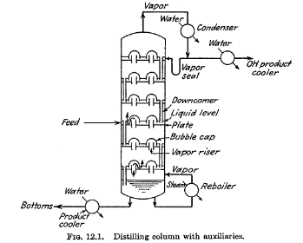
MENARA DISTILASI

Slide 4
CONDENSER

Slide 5
KLASIFIKASI
KONDENSER TOTAL
KONDENSER PARSIAL
HORIZONTAL CONDENSER
VERTICAL CONDENSER

Slide 6
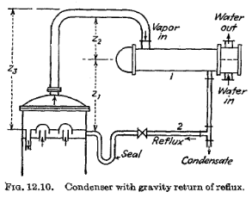
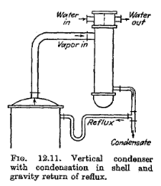
HORIZONTAL CONDENSER
VERTICAL CONDENSER

Slide 7
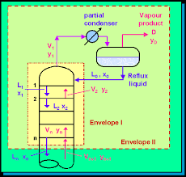
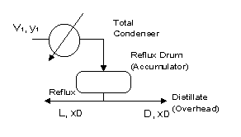
KONDENSER TOTAL
KONDENSER PARSIAL

Slide 8
Perubahan fasa uap-cair
superheat
Superheated steam
condensation
Saturated vapor
Saturated liquid
subcool
Subcooled water

Slide 9
Fungsi kondenser
Condensing
Desuperheating-condensing
Condensing-subcooling
Desuperheating-condensing-subcooling

Slide 10
Kondenser
Horisontal
Kondensasi lebih efektif bila berlangsung di luar tube (dalam shell)
Vertikal
Sebagian besar uap terkondensasi di bagian atas tube
Ketinggiannya harus tertentu agar kondensat dapat di-refluks secara gravitasi
Cocok digunakan untuk condensing sekaligus subcooling

Slide 11
Kondensasi single vapor
Saturated vapor
Superheated vapors
Total / parsial condensation outside tubes
Condensation & subcooling outside tubes
Desuperheating & condensation outside tubes

Slide 12
Condensation inside tubes
Condensation of steam
Desuperheating, condensing, subcooling

Slide 13
Kondensasi vapor mixtures
Binary mixture
Vapor mixture with long condensing range
Vapor mixture forming immiscible condensates
Single vapor / vapors with noncondensable gas
Vapor mixtures & noncondensable gases forming immiscible condensates

Slide 14

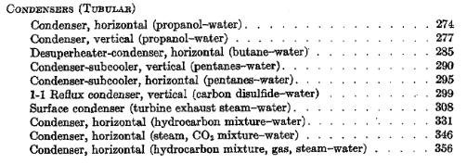
KERN’S

Slide 15
ADDITIONAL THEORY

Slide 16
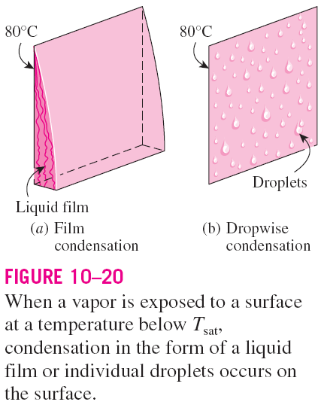
CONDENSATION HEAT TRANSFER
Occurs when a vapor contacts a surface which is at a temperature below the saturation temperature of the vapor.
When the liquid condensate forms on the surface, it will flow under the influence
of gravity.
Film condensation
The condensate wets the surface and forms a liquid film.
The surface is blanketed by a liquid film which serves as a resistance to heat transfer.
Dropwise condensation
The condensed vapor forms droplets on the surface.
The droplets slide down when they reach a certain size.
No liquid film to resist heat transfer.
As a result, heat transfer rates that are more than 10 times larger than with film condensation can be achieved.

Slide 17
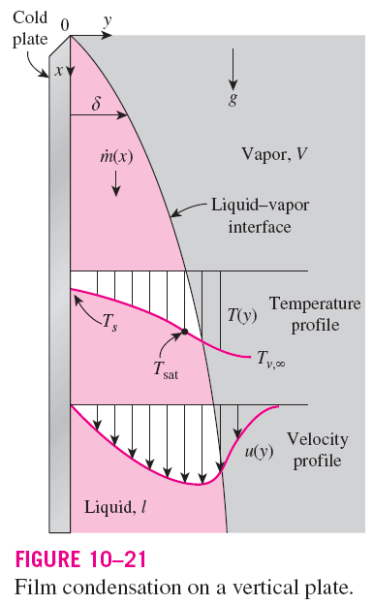
FILM CONDENSATION
Liquid film starts forming at the top of the plate and flows downward under the influence of gravity.
δ increases in the flow direction x
Heat in the amount h_{fg} is released during condensation and is transferred through the film to the plate surface.
T_{s} must be below the saturation temperature for condensation.
The temperature of the condensate is T_{sat} at the interface and decreases gradually to T_{s} at the wall.

Slide 18
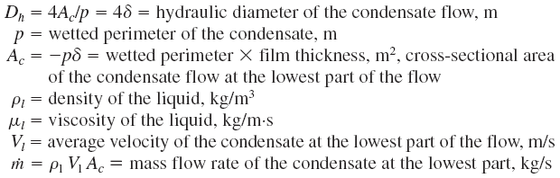
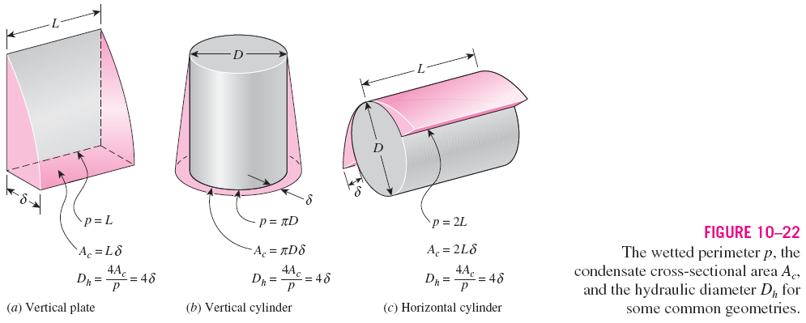
Heat transfer in condensation depends on whether the condensate flow is laminar or turbulent. The criterion for the flow regime is provided by the Reynolds number.

Slide 19




When the final state is subcooled liquid instead of saturated liquid:
Modified latent heat of vaporization
For vapor that enters the condenser as superheated vapor at a temperature T_{v} instead of as saturated vapor:
Rate of heat transfer
This relation is convenient to use to determine the Reynolds number when the condensation heat transfer coefficient or the rate of heat transfer is known.
The properties of the liquid should be evaluated at the film temperature
The h_{fg} should be evaluated at T_{sat}

Slide 20
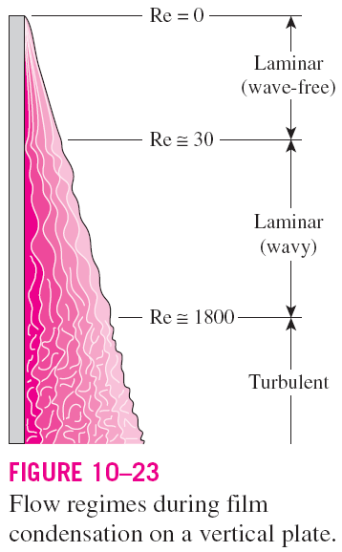
Flow Regimes
The dimensionless parameter controlling the transition between regimes is the Reynolds number defined as:
Three prime flow regimes:
  Re < 30 ─ Laminar (wave-free)
  30 < Re < 1800 ─ Laminar (wavy)
  Re > 1800 ─ Turbulent
The Reynolds number increases in the flow direction.

Slide 21
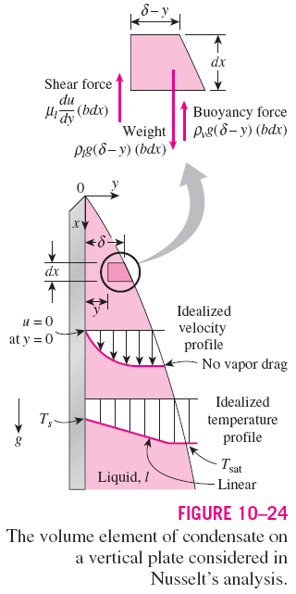
Heat Transfer Correlations for Film Condensation
1 Vertical Plates
Assumptions:
1. Both the plate and the vapor are maintained at constant temperatures of T_{s} and T_{sat}, respectively, and the temperature across the liquid film varies linearly.
2. Heat transfer across the liquid film is by pure conduction.
3. The velocity of the vapor is low (or zero) so that it exerts no drag on the condensate (no viscous shear on the liquid–vapor interface).
4. The flow of the condensate is laminar (Re<30) and the properties of the liquid are constant.
5. The acceleration of the condensate layer is negligible.

Slide 22
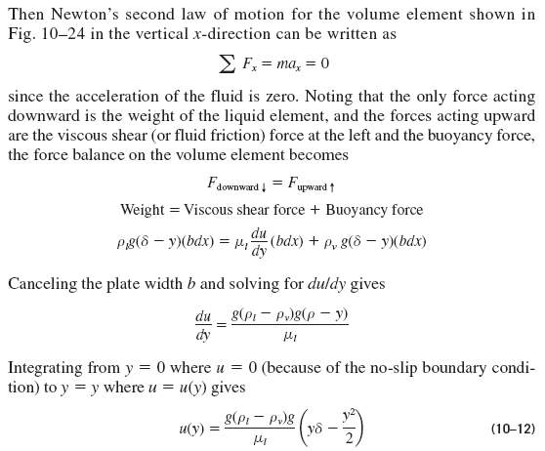
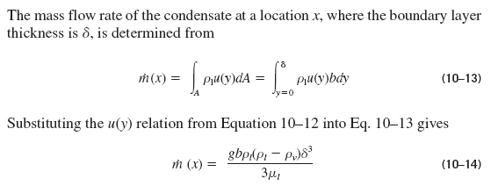

Slide 23
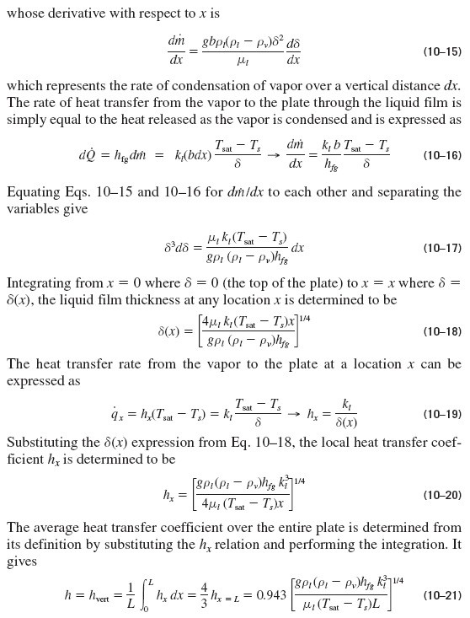

Slide 24

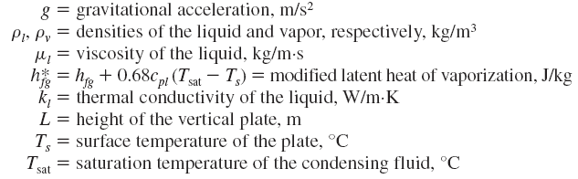
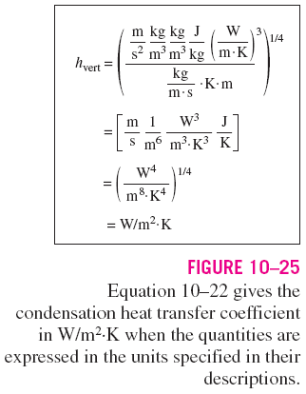



The average heat transfer coefficient for laminar film condensation over a vertical flat plate of height L is
(10-22)
All properties of the liquid are to be evaluated at the film temperature. The h_{fg} and ρ_{v} are to be evaluated at the saturation temperature T_{sat}.

Slide 25




Wavy Laminar Flow on Vertical Plates
The average heat transfer coefficient in wavy laminar condensate flow for
A simpler alternative to the relation above

Slide 26



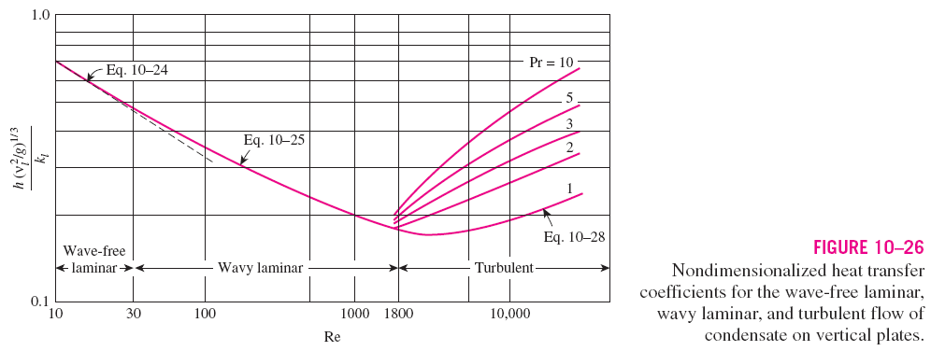
Turbulent Flow on Vertical Plates
Turbulent flow of condensate on vertical plates:
The physical properties of the condensate are again to be evaluated at the film temperature T_{f} = (T_{sat} + T_{s})/2.

Slide 27
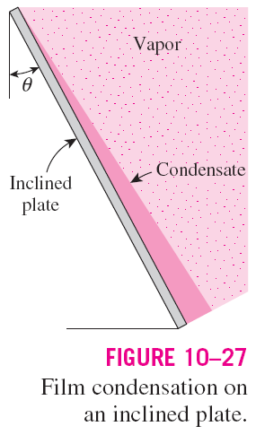
2 Inclined Plates
Equation 10–22 was developed for vertical plates, but it can also be used for laminar film condensation on the upper surfaces of plates that are inclined
by an angle θ from the vertical, by replacing g in that equation by g cosθ.
(10-22)
3 Vertical Tubes
Equation 10–22 for vertical plates can also be used to calculate the average heat transfer coefficient for laminar film condensation on the outer surfaces of vertical tubes provided that the tube diameter is large relative to the thickness
of the liquid film.

Slide 28


4 Horizontal Tubes and Spheres
The average heat transfer coefficient for film condensation on the outer surfaces of a horizontal tube is
For a sphere, replace the constant 0.729 by 0.815.
A comparison of the heat transfer coefficient relations for a vertical tube of
height L and a horizontal tube of diameter D yields
For a tube whose length is 2.77 times its diameter, the average heat transfer coefficient for laminar film condensation will be the same whether the tube is positioned horizontally or vertically.
For L > 2.77D, the heat transfer coefficient is higher in the horizontal position.
Considering that the length of a tube in any practical application is several times its diameter, it is common practice to place the tubes in a condenser horizontally to maximize the condensation heat transfer coefficient on the outer surfaces of the tubes.

Slide 29
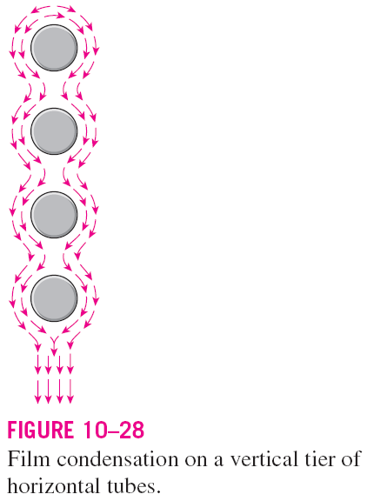


5 Horizontal Tube Banks
The average thickness of the liquid film at the lower tubes is much larger as a result of condensate falling on top of them from the tubes directly above.
Therefore, the average heat transfer coefficient at the lower tubes in such arrangements is smaller.
Assuming the condensate from the tubes above to the ones below drain smoothly, the average film condensation heat transfer coefficient for all tubes in a vertical tier can be expressed as
This relation does not account for the increase in heat transfer due to the ripple formation and turbulence caused during drainage, and thus generally yields conservative results.

Slide 30
Effect of Vapor Velocity
In the analysis above we assumed the vapor velocity to be small and thus the vapor drag exerted on the liquid film to be negligible, which is usually the case.
However, when the vapor velocity is high, the vapor will “pull” the liquid at the interface along since the vapor velocity at the interface must drop to the value of the liquid velocity.
If the vapor flows downward (i.e., in the same direction as the liquid), this additional force will increase the average velocity of the liquid and thus decrease the film thickness.
This, in turn, will decrease the thermal resistance of the liquid film and thus increase heat transfer.
Upward vapor flow has the opposite effects: the vapor exerts a force on the liquid in the opposite direction to flow, thickens the liquid film, and thus decreases heat transfer.

Slide 31
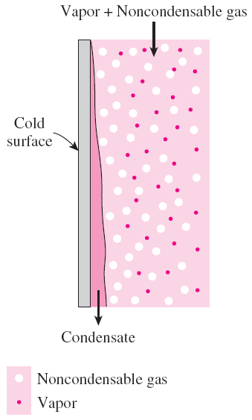
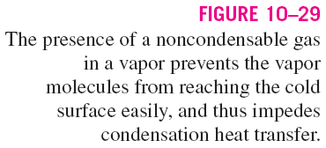
The Presence of Noncondensable Gases in Condensers
Experimental studies show that the presence of noncondensable gases in the vapor has a detrimental effect on condensation heat transfer.
Even small amounts of a noncondensable gas in the vapor cause significant drops in heat transfer coefficient during condensation.
It is common practice to periodically vent out the noncondensable gases that accumulate in the condensers to ensure proper operation.
Heat transfer in the presence of a noncondensable gas strongly depends on the nature of the vapor flow and the flow velocity.
A high flow velocity is more likely to remove the stagnant noncondensable gas from the vicinity of the surface, and thus improve heat transfer.

Slide 32
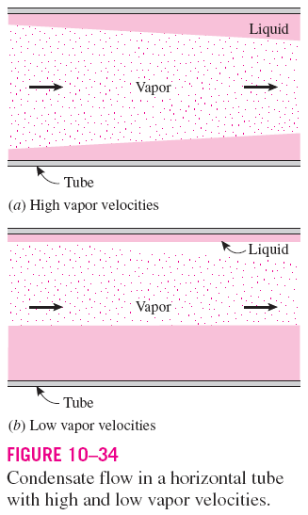


FILM CONDENSATION INSIDE
HORIZONTAL TUBES
Most condensation processes encountered in refrigeration and air-conditioning applications involve condensation on the inner surfaces of horizontal or vertical tubes.
Heat transfer analysis of condensation inside tubes is complicated by the fact that it is strongly influenced by the vapor velocity and the rate of liquid accumulation on the walls of the tubes.
For low vapor velocities:
The Reynolds number of the vapor is to be evaluated at the tube inlet conditions using the internal tube diameter as the characteristic length.

Slide 33
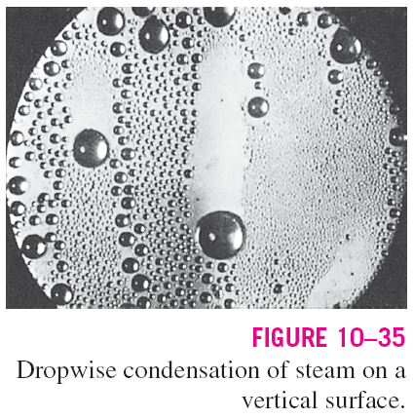

DROPWISE CONDENSATION
Dropwise condensation, characterized by countless droplets of varying diameters on the condensing surface instead of a continuous liquid film and extremely large heat transfer coefficients can be achieved with this mechanism.
The small droplets that form at the nucleation sites on the surface grow as a result of continued condensation, coalesce into large droplets, and slide down when they reach a certain size, clearing the surface and exposing it to vapor. There is no liquid film in this case to resist heat transfer.
As a result, with dropwise condensation, heat transfer coefficients can be achieved that are more than 10 times larger than those associated with film condensation.
The challenge in dropwise condensation is not to achieve it, but rather, to sustain it for prolonged periods of time.
Dropwise condensation of steam on copper surfaces:

Slide 34
Data
Perry’s Chemical Handbook, Section 11, Heat transfer equipment,
  TABLE 11-12 Characterstics of Tubing (From Standards of the Tubular Exchanger Manufacturers Association, 8th Ed., 1999)

