Slide 1
Urban Corridor
Pertemuan 6 sustainable urbanization

Slide 2
Preliminary Meaning of Urban Corridor (UC)
Linearity, to some extent-continuity, and spatial pattern at micro or inner city level

Slide 3
Preliminary Meaning of Urban Corridor (UC)
Linear City-Region: An approach to integrate urban and rural development through a linear development expansion, projecting an extended urban belt parallel to the transport lines.
Compactness: In response to the decentralized urbanization principle that resulted in particular spatial pattern (sprawl, ribbon development), the idea of “concentration of urbanization” emerged to save the landscape and reduce car mobility
Notes:
‘linearity’ was seen as an ideal solution for development and transport issues.
adopted the idea of linearity and justified placing production enterprises and schools in the same band in the 1920s,
linear structure with bands of transportation for industrial zones and for other technical and cultural infrastructure
From this point of view, corridor and axis development are criticized as they are associated with the decentralization of certain functions.

Slide 4
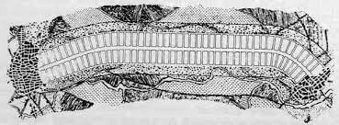
Notes:
linear development as an urban development model is the Spanish urbanist Arturo Soria y Mata (1844–1920).

Slide 5
Transformation of the Meaning of UC
Spatial pattern
Development trend
Micro (intra-urban)
Macro (inter-urban, inter-regional, transnational)
Physical
Virtual, Analytical, Policy

Slide 6
UC as Analytical Concept
corridors as structuring elements for large-scale development patterns (mega-structures);
corridors as linear urban forms
corridors as functional axes
Notes:
Shaped by the growth of cities, the division of labor, massive suburbanization and sprawl, and technological development

Slide 7
Development of the Meaning of UC
Along with the wider meaning of urban corridor, several phenomenon are then being connected in the discussion on UC concept, among others:
the spatial concentration of economic activities, polycentric urban development, multimodal transport bundles, linkage between habitat patches to allow the migration of species, etc.

Slide 8
UC as structuring elements for large-scale development patterns
the large scale development are shaped by the processes of the growth of cities
Corridor here is: as lines, as begin–end or trunk feeder networks, or as physical forms that resemble networks such as backbone or ladder networks, string of pearls, etc
ecumenopolis
megalopolis
Mega corridor
Polycentric development
Notes:
, the division of labor, massive suburbanization and sprawl, and technological development

Slide 9
An analytical concept that refers to an Utopian idea that metropolises and megalopolises would become interconnected to form a worldwide city, an universal city
Ecumenopolis

Slide 10
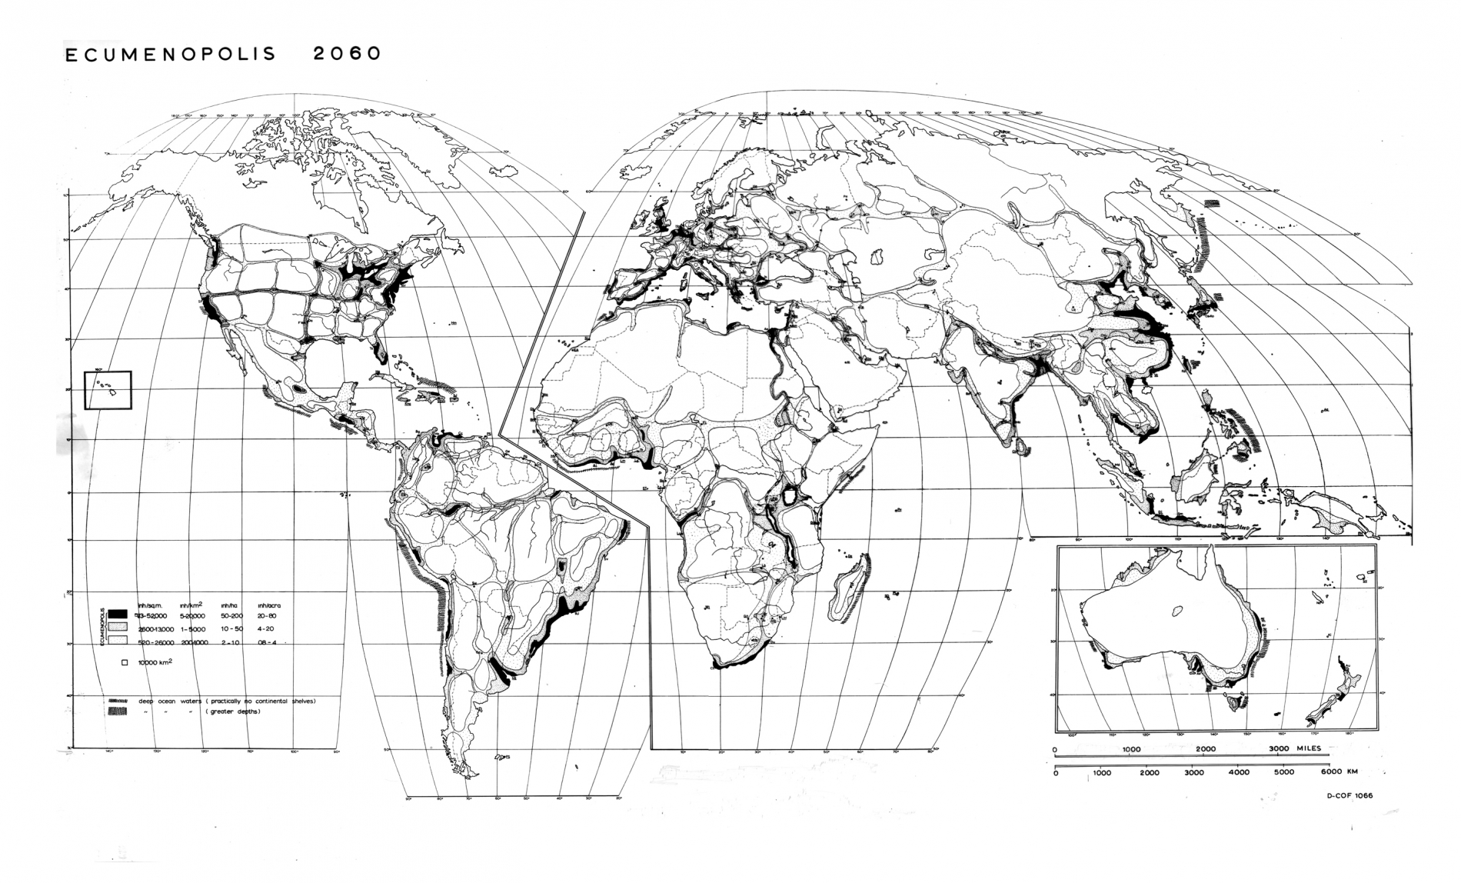
http://tomorrows.sgt.gr/x7VTuNhOKQ/index.php/en/all-projects/item/9-ecumenopolis

Slide 11
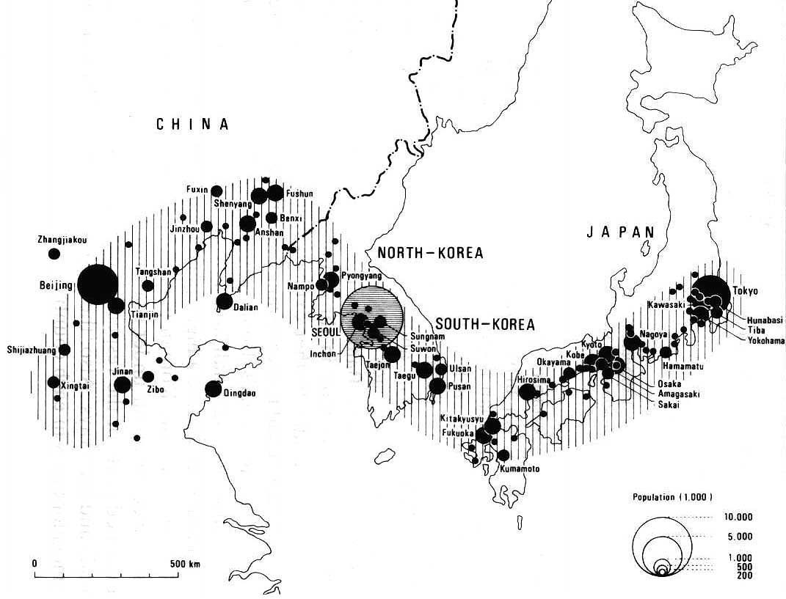
BESETO

Slide 12
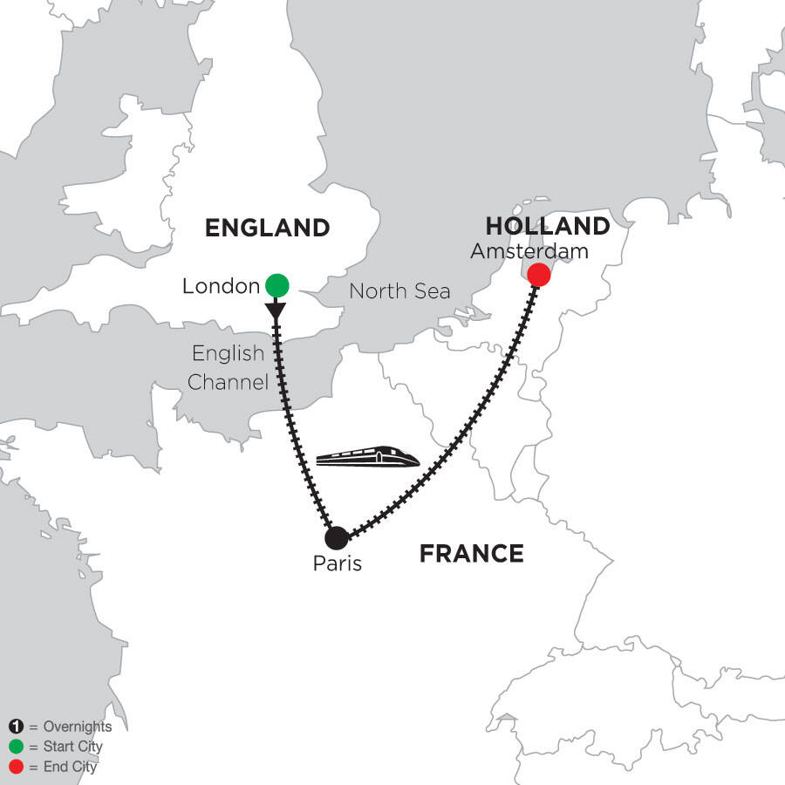
EPEROPOLIS (continent city)
https://monograms.com/vacation-package/3-nights-london-3-nights-paris-3-nights-amsterdam/dre/

Slide 13
Corridors here are physical and socioeconomic links between distant large urban agglomerations (interregional as well as transnational in scale) As a means to achieving interregional cooperation. An analytical concept developed to examine to what extent networks are spatially linked
Mega-corridor

Slide 14
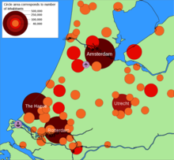
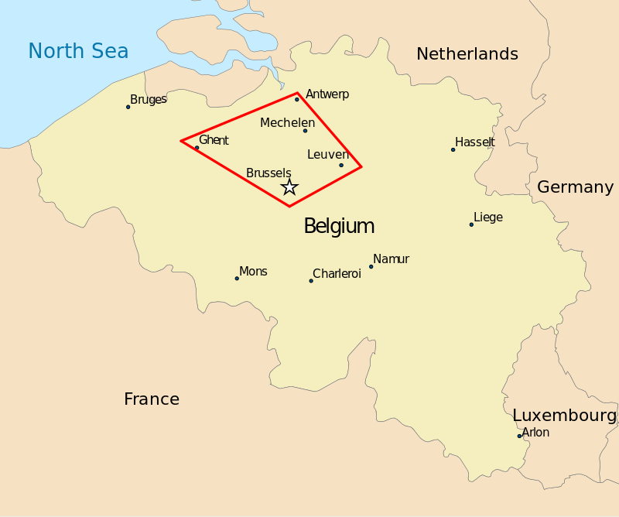
RANDSTAD
FLEMISH DIAMOND
https://en.wikipedia.org/wiki/Flemish_Diamond#/media/File:Flemish_Diamond_map.svg
https://en.wikipedia.org/wiki/Randstad

Slide 15
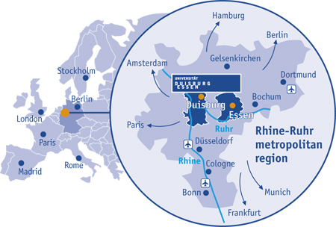
RHEIN-RHUR
https://www.uni-due.de/cenide/nanosummer/culture.shtml

Slide 16
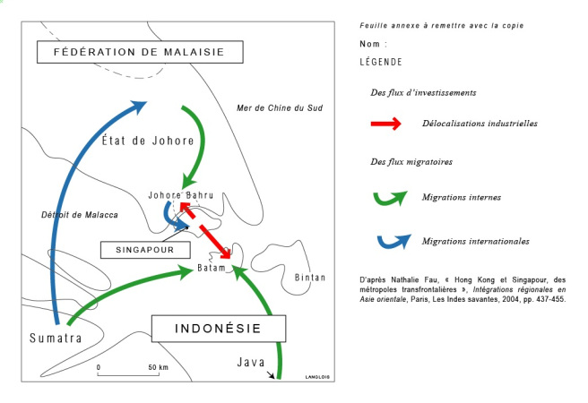
SIJORI
https://langloishg.fr/2009/12/02/delocalisations-et-flux-migratoires-dans-le-triangle-sijori/

Slide 17
Corridor as Linear Urban Form
The intra- or inter-urban scales.
Corridor and axis development was not yet directly referred to at the beginning, but initial steps were made toward defining corridors as linear urban forms in those years.
Harris and Ullman brought the element of lineation into the discussion of urban patterns with their well-known article on ‘The nature of cities in the USA around 1945.
Doxiadis argues that certain forces (natural and man-made) shape urban systems. He emphasized that linear forces tend to form linear settlements as long as these settlements are small and do not need any common services
In those years, corridor’ meant an inter-urban scale development with the linear patterns of the highly developed bundles of transport routes joining the major towns.

Slide 18
Corridor as Functional Axes
Corridor also refers to discontinuous zones of focal points at the interregional scale, largely corresponding to the exchange points of transport flows, rather than to ‘corridor’ as a continuous ribbon of industrial sites.
Silicon Valley in California: A high-tech firms that are located in the Santa Clara Valley at the southern end of San Francisco Bay.
Ecological corridors: linear green patterns/areas; linear green axes where animals can travel, plants can grow and spread continuously, and threatened species can be replenished from other areas

Slide 19
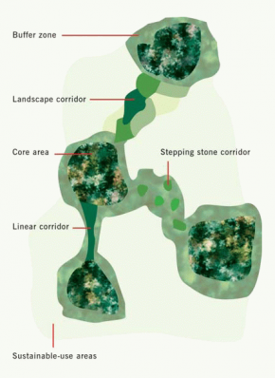
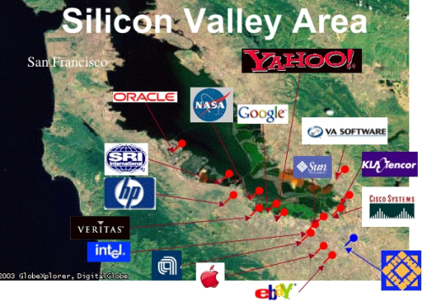
https://tbkconsult.com/silicon-valleys-rule-number-one-fake-it-to-you-make-it/silicon-valley-map-500/
http://www.sicirec.org/definitions/corridors

Slide 20
UC as Policy Approaches
The corridor as an instrument of economic development policy
The corridor as an instrument of (transnational) spatial development policy
The corridor as an instrument of transport policy
The corridor as an instrument of ecological (or environmental) policy
Notes:
Built to foster economic development
Built to foster cooperation between coutries
The transport connections between important economic regions (mega-urban regions) define the corridors as transport axes.
Ecological corridors

Slide 21
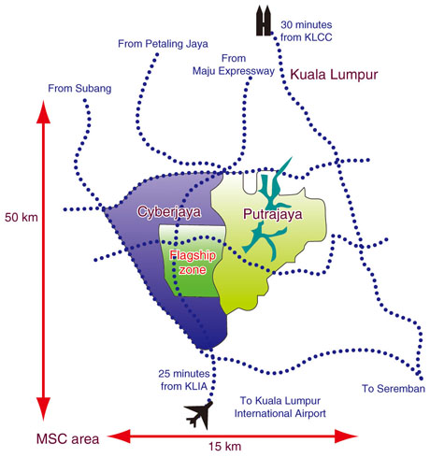
Multimedia super corridor
Notes:
50 km-long high-tech industry zone stretching southward from Kuala Lumpur, offers a 15 km-wide concentration of global information and
communication technology (ICT) industries
Special economic zone to accelerate the growth of the country's digital economy. It is a special economic zone designed to support the innovative ecosystem of IT

Slide 22
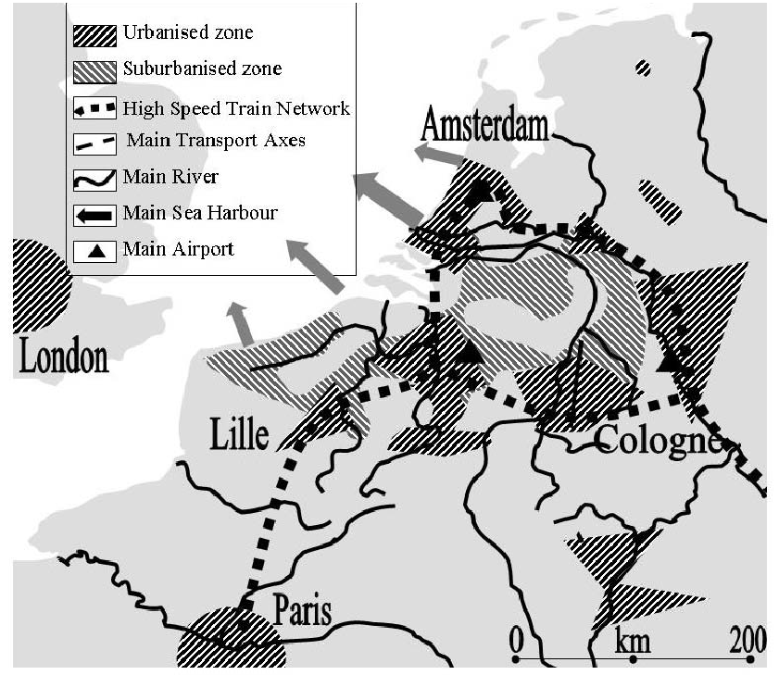
Notes:
European Spatial Development Policy (ESDP) is an organized and integrated spatial policy at a transnational level
The development of a balanced and polycentric urban system and a new urban–rural relationship is one of the targets of the territorial development strategy of the ESDP, which defines the corridor concept as a tool to reconcile economic growth, competitiveness, and sustainable development.

Slide 23
Main Reference
Albercht, L., and Tasan-kok, T. 2009. Corridor and Axis Development. International Encyclopedia of Human Geography

