Slide 1
APPLIED RESEARCH
Metopen kuantitatif

Slide 2
EVALUATION RESEARCH
Objectives based evalution
Goal free evaluation
Context Input Process Product

Slide 3
RESEARCH AND DEVELOPMENT
Need assessment
Development
Testing for appropriateness
Testing for effectiveness

Slide 4
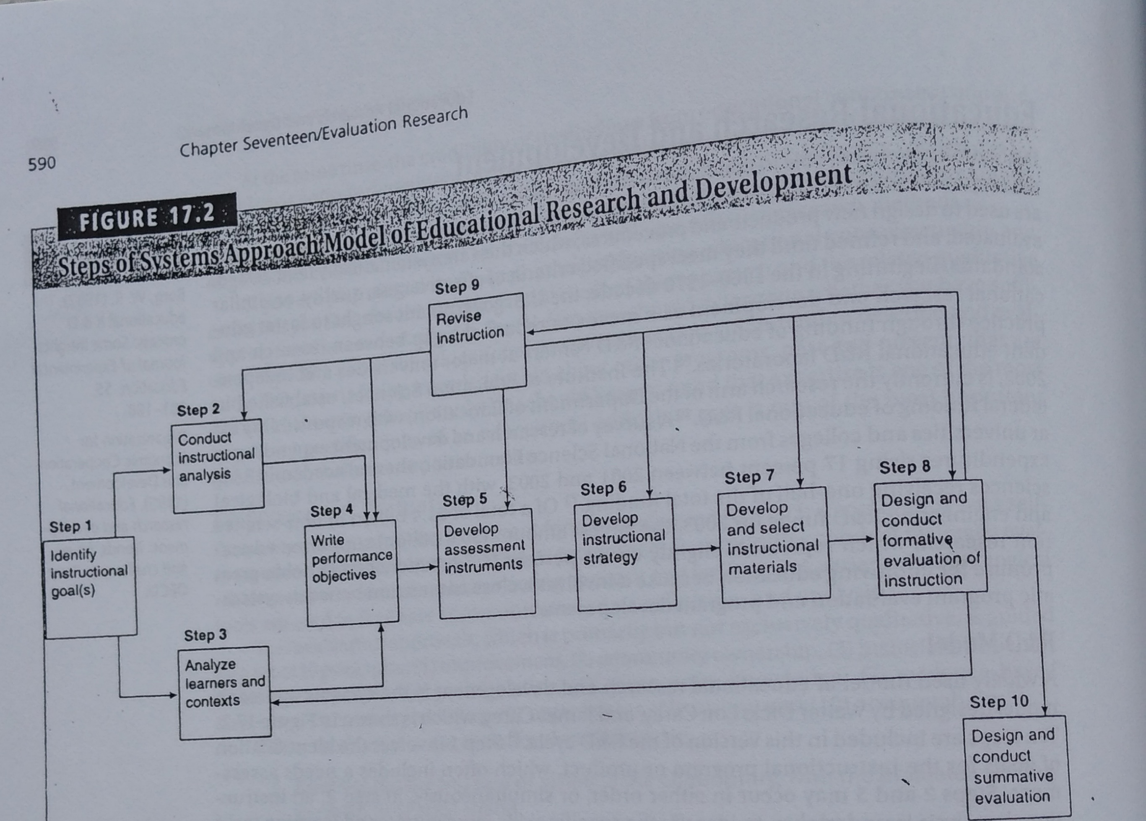
DICK, CARREY & CARREY

Slide 5
ADDIE

Slide 6
SUKMADINATA

Slide 7
SUGIYONO

Slide 8
DESIGN BASED RESEARCH

Slide 9
TERIMAKASIH

