Slide 1
Pertemuan 3 Global Trend of Urbanization
Sustainable Urbanization

Slide 2
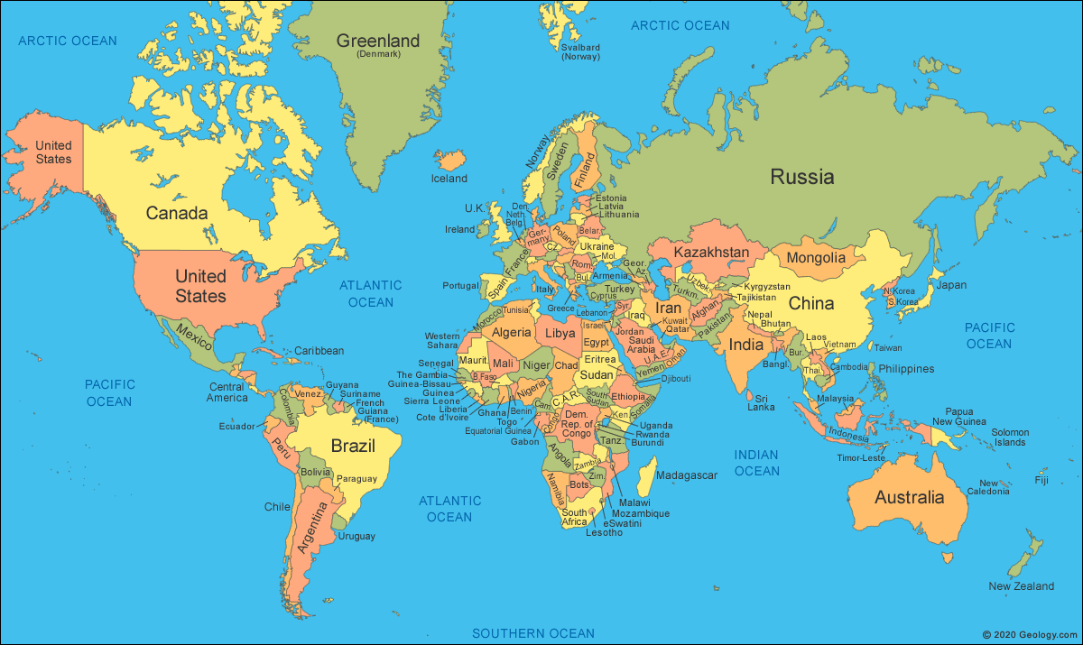
https://springfield.sch.id/wp-content/uploads/2022/02/world-map-1.gif
Notes:
Russia (Asian) and Russia Europe (Moscow)

Slide 3
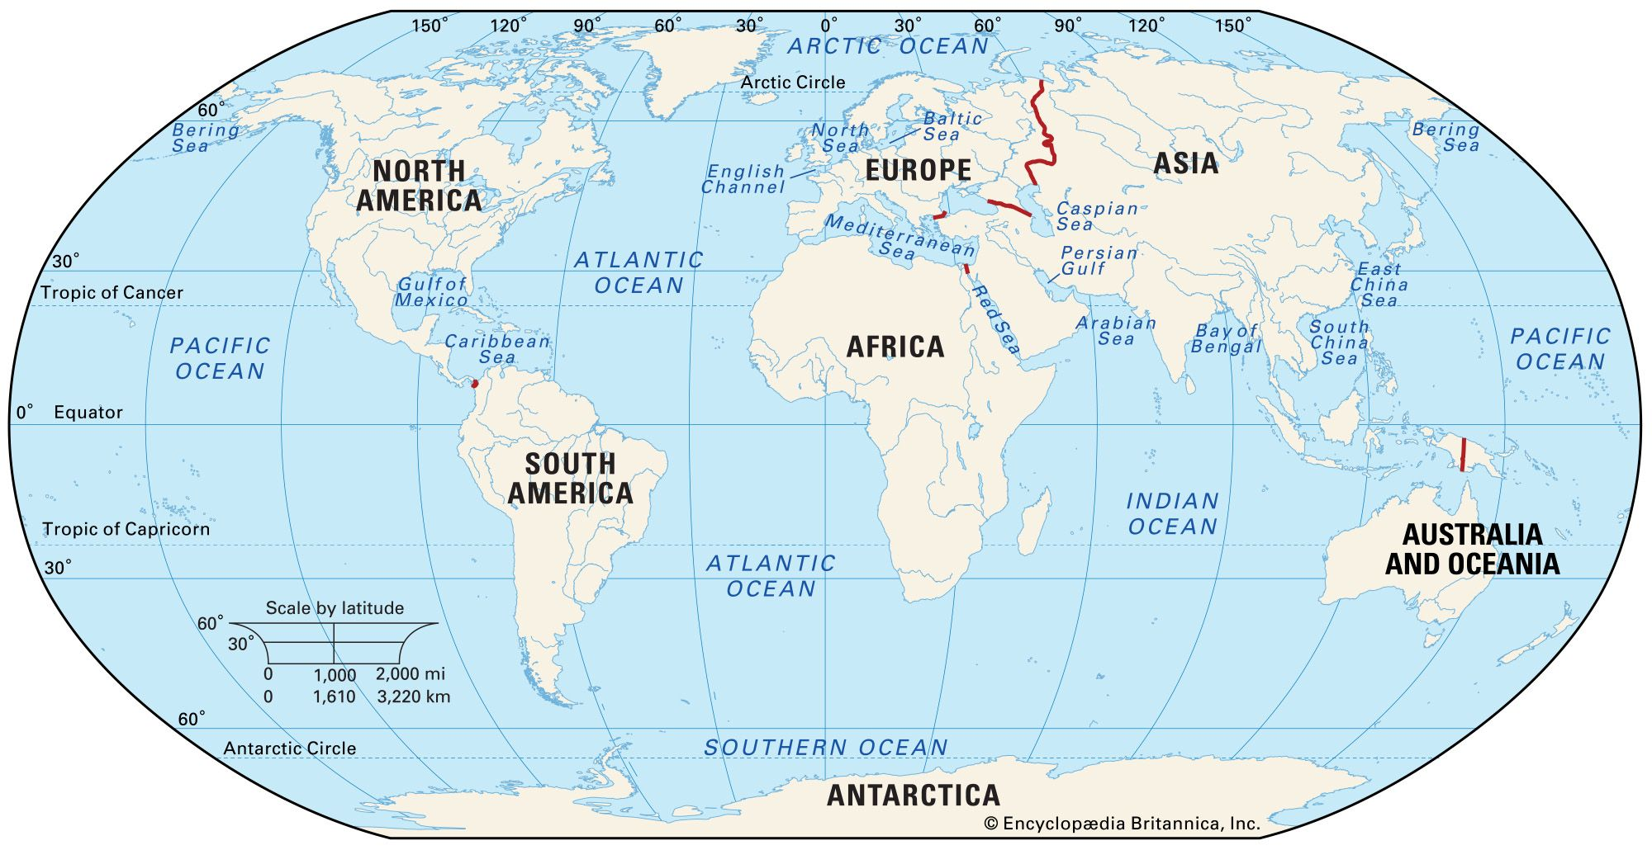
https://www.britannica.com/science/continent

Slide 4
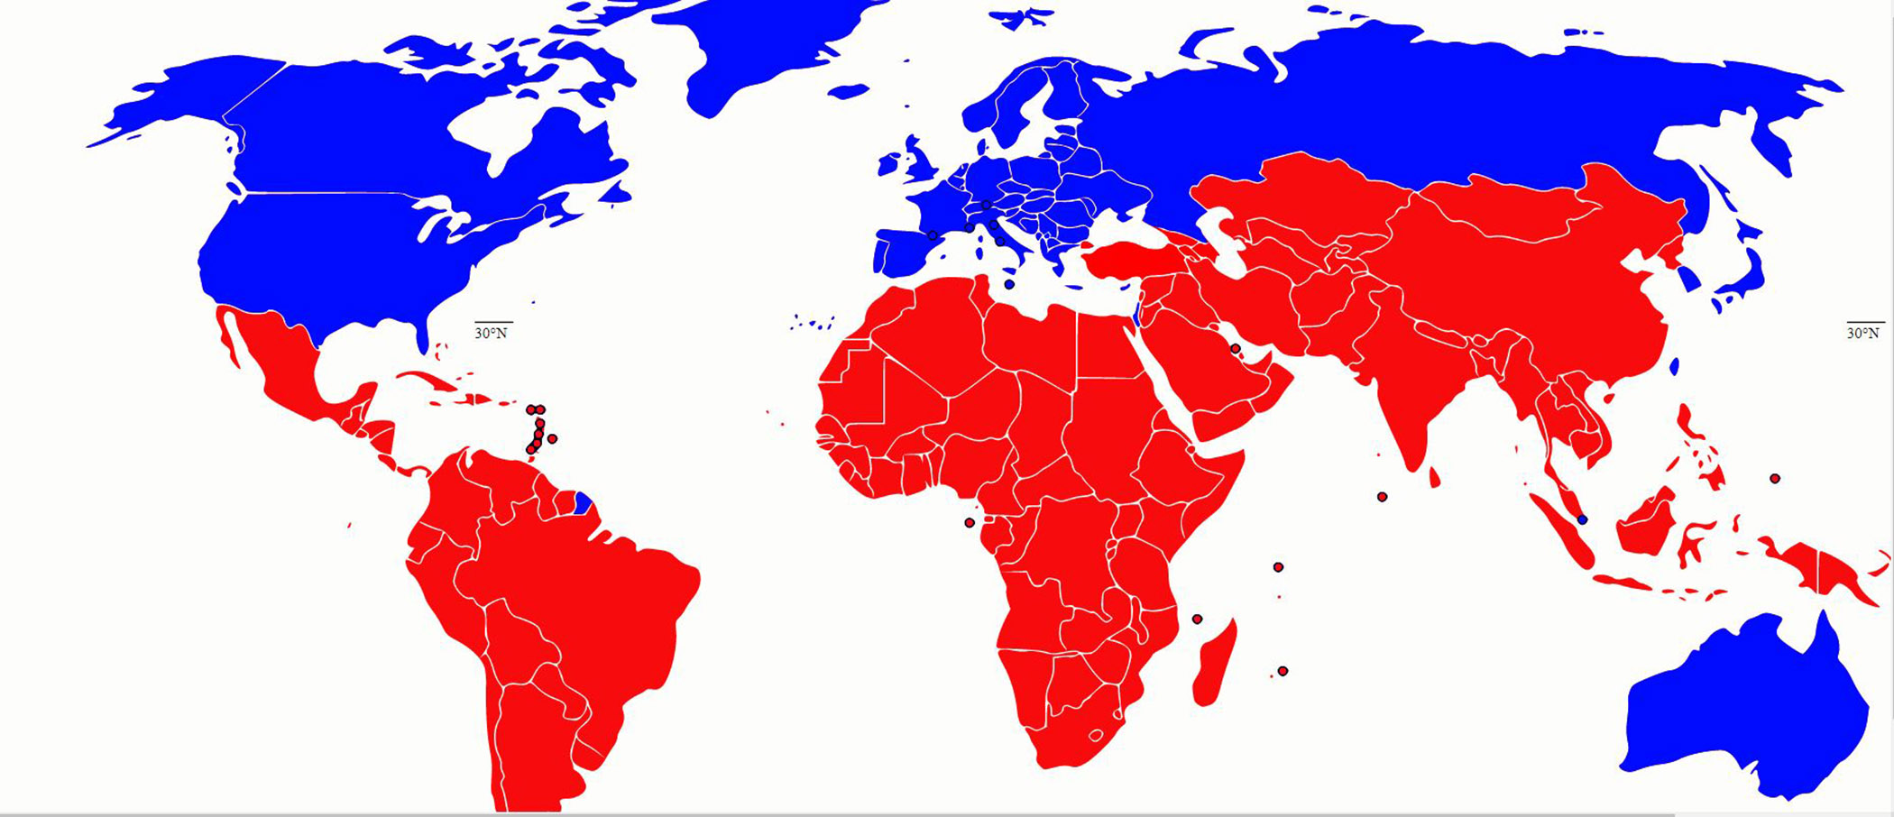
Global South vs Global North
https://milnepublishing.geneseo.edu/genderedlives/chapter/chapter-15-the-global-north-introducing-the-region/

Slide 5
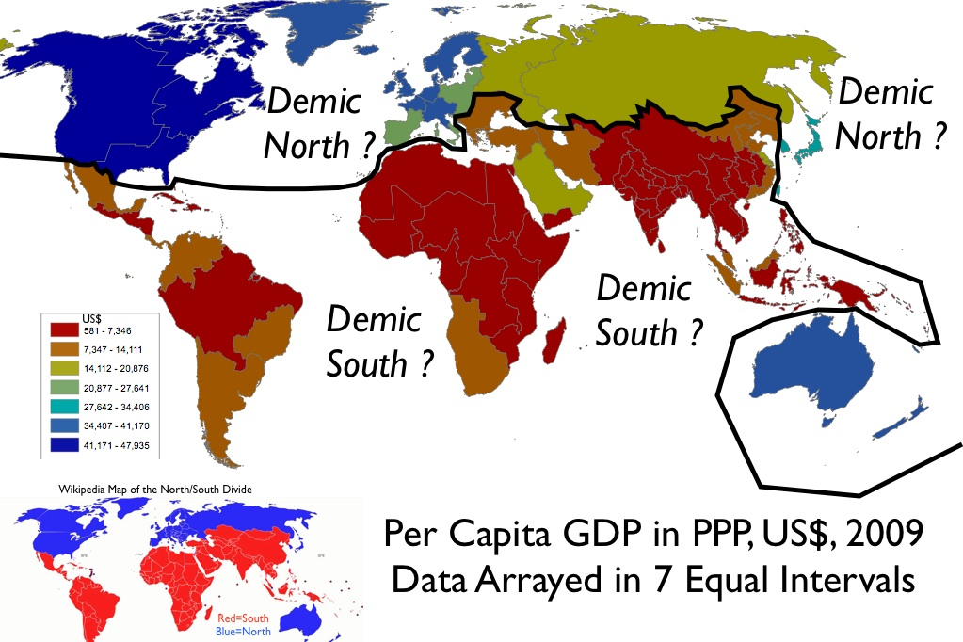
Global South vs Global North
https://www.geocurrents.info/economic-geography/a-global-northsouth-division-in-the-demic-framework
Notes:
Brandt Line (William Brant-1980).

Slide 6
IMPORTANT CHARACTERISTICS OF URBANIZATION
The level of urbanization
01
The urbanization rate
02
the distribution of population over different scale of urban settlement
03
Notes:
important characteristics of urbanization.

Slide 7
Workable definition of urbanization
Level of Urbanization
Urbanization Rate

Slide 8
OUR URBANIZED WORLD
4.35 billion urban population in 2020
2007
7.75 billion total population in 2020
Notes:
4.35 billion out of 7.75 billion of world population are living in urban settlement

Slide 9
Notes:
South Asia: Afghanistan, Bangladesh, Bhutan, India, Maldives, Nepal, Pakistan, and Sri Lanka.
EU: Germany, the Netherlands, Belgium, France, Denmark, Finland, Sweden, Italy
SS Africa: Somalia, Sudan Uganda Rwanda Mali etc (High Income Nigeria, Mauritiues, Namibia, etc)

Slide 12
Global Trend: Urbanization South vs North
The biggest process of world urbanization will take place in the Global South, especially in Asia and Africa (higher rat and number)
The current rate of urbanization globally is around 1 per cent and projected to fall to 0.56 per cent by 2050 (United Nations, 2012). However, there are significant differences predicted between urbanization growth rates in regions, with sub-Saharan Africa being the highest
Australia and New Zealand, Europe, Japan and North America are the regions where urbanization has been reaching to the saturation process.

Slide 13
Urbanization South vs North
The difference among Asia and Africa is in the absolute number of urban dwellers involved in the process of urbanization, where in Asia it involves very huge number of them.
The impact of an additional 2.6 billion people living in cities by 2050 will be enormous in terms of consumption of land, water and food, along with an increased Secondary City Urbanization Trends and Patterns demand for shelter, infrastructure and jobs.

Slide 14
% URBAN POPULATION

Slide 15
Notes:
South Asia: Afghanistan, Bangladesh, Bhutan, India, Maldives, Nepal, Pakistan, and Sri Lanka.
EU: Germany, the Netherlands, Belgium, France, Denmark, Finland, Sweden, Italy
North America:

Slide 16
Global Trend: Urbanization South vs North
In the Global North, urbanization is a concomitant of industrialization and a phenomenon embedded in commodity production.
However, in the Global South, urbanization often takes place without a parallel growth in industrialization.
As a result, the impacts on natural environments are perhaps less severe, although the infrastructure may also be missing to better control whatever impacts do occur.
As a result in the Global South the growth of poverty emerges in the process of urbanization.

Slide 17
Distribution of Population

Slide 18
Notes:
Australia largest city: Sydney (4.6 million)
Canada largest city: Toronto (5 million)
EU: London before out 14 million, Paris but restricted to admin down Berlin nearly 4 (3.6)
US: New York (10 million)
South Asia: Delhi (nearly 19 million)
China: Shanghai 25 million
SSA: Lagos Nigeria but excluded , so Kinshasha Congo (nearly 16 million)

Slide 20
Global Trends
The proportion of the global population living in cities will increase most in megacities
The proportion of those living in megacities as a proportion of total urban population is predicted to increase from 9.9 per cent to 13.6 per cent between 2010 and 2025.
The population of megacities is predicted to increase from 352 million (2010) to 630 million (2025) for the same period, a compound growth rate of almost 4 per cent per annum.

Slide 23
Shift
There will be significant shifts in the change in the proportional growth rate of cities globally and across regions.
The highest change in the proportional growth rates will occur in sub-Saharan Africa and Asia.
In Asia the megacities and secondary cities with populations of 1-5 million are likely to expand faster as a proportion of total urban growth.
In Africa, particularly sub-Saharan Africa, the largest cities will absorb a higher proportion of urban growth

Slide 24
Population by city size
smaller cities will still house most of the world’s urban population, but they will continue to lose urban growth share as people move to larger cities in search of jobs and better living prospects (Satterthwaite,

Slide 27
Systems of cities

Slide 28
Urban System
Countries have long used a hierarchy of urban settlements as an instrument for the organization and operations of government, defence and commerce.
Some countries have a system of cities that is very hierarchical, for example there is a single, very large, dominant city, such as Jakarta (population 12 million), and a long list of lessersized urban settlements, tailing down to small towns of fewer than 20,000 people.
In the order of urban-systems hierarchies, megacities prevail. The term “megacity” refers to large metropolitan, regional cities with populations of more than 10 million
Megacities are primate cities, and they sit at the top of a system of global cities.
However, in some countries, for example the USA, Brazil and China, there is more than one mega/primate city, so the apex principle of a single dominant city in a country does not apply.

Slide 31
Primacy and GDP
In the global context, not all primate cities are megacities. Many, for example Kuala Lumpur (Malaysia) and Auckland (New Zealand), have relatively small populations but demonstrate strong attributes of primacy. A primate city is likely to generate a disproportional percentage of a nation’s Gross Domestic Product (GDP) for its size
The ratio of GDP per capita in some primate cities can exceed many times the national average per capita figures. It is clear that while primacy is a significant factor in the economic geography and hierarchy of urban settlements in countries, in the context of the global urban system, some primate cities are secondary or lower-order cities.

Slide 32
Reference
Roberts, B. H. (2014). Managing systems of secondary cities: Policy responses in international development. http://www.citiesalliance.org/node/4978
https://data.worldbank.org/
Nations, U. (2018). World Urbanization Prospects. In Demographic Research (Vol. 12). https://population.un.org/wup/Publications/Files/WUP2018-Report.pdf

