Slide 1
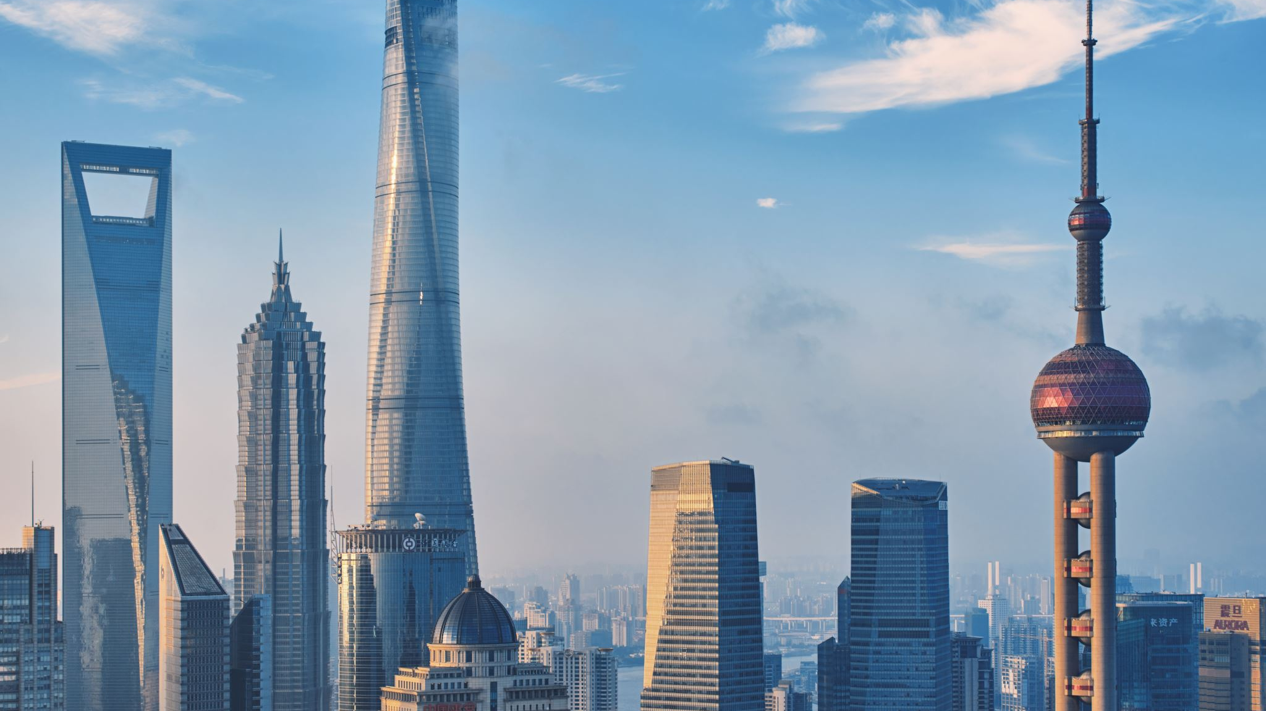
Urbanization: Meaning and challenge
Pertemuan 2-urbanisasi berkelanjutan, Program Studi Perencanaan Wilayah dan Kota FT-UNS
Paramita Rahayu

Slide 2
Points to be discussed
What is urbanization
The challenge of urbanization

Slide 3
Urbanization
EVOLUTION
Spatial settlement system
Social cultural system in a given society
growing proportion of total population into social structure and lifestyle
growing proportion of total population to settlement pattern
Expansion, Multiplication, spatial Transformation
Modification and transformation of the social system
Notes:
Memperhitungkan pertumbuhan proporsi populasi pada pola permukiman sehingga kota menjadi pusat produksi dan kehidupan sosial (example of urban services provision system)
Memperhitungkan pertumbuhan proporsi populasi pada struktur sosial dan gaya hidup tertentu (difusi nilai)

Slide 4
Urbanization (Friedmann, 1966)
Transformation
Concentration
Diffusion

Slide 5
Urbanization as a process of concentration
Demographic changes are among the most direct influences factors on urbanization and urban change.
Urbanisation is the process in which the number of people living in cities increases compared to the number of people living in rural areas
Level of urbanization: A country/region is considered to be urbanised when over 50% of its population resides in urban places

Slide 6
Urbanization as a process of concentration
A view of urbanization as a change in the ratio of the rural to urban population provides a workable conceptual link between urbanization and natural environments.
The ratio may change for many reasons:
Migration factor: direct rural to urban migrations, coming to the region
Natural factor: bigger birth rate than the mortality rate in the region
Reclassification factor: the change of the condition of many places from rural to urban places in the region

Slide 7
Larger process of urbanization
It refers to the growth of a region as the result of an interlinked factors, consists of demography, economy, location and other natural factors, technology, organization, social, cultures and ideas, etc
Urbanization is promoted by investment in the country that leads to a pattern of urban growth
Basically, its all about concentration

Slide 8
Urbanization (Brenner, 2014)
Changing role of Agglomeration Process
Capital accumulation
Diverse morphological forms and spatial configuration
Transformation
Concentration/Implosion
Dispersion/Explosion
Notes:
Konsentrasi kapital (dalam arti luas) dan transformasi territorial yang luas (large-scale urban regions, polycentric, urban corridor, inter urban networks, worldwide urban hierarchy)

Slide 9
Definition
CITY
a subset of an urban area, defined by political administrative boundaries
AGGLOMERATION
the geographic concentration of economic activity that is observed across scales—the formation of urban centers, industrial clusters, hierarchical systems of cities

Slide 10
Urban Agglomeration (source: https://doi.org/10.1371/journal.pone.0259793.g001

Slide 11
Urban Agglomeration

Slide 12
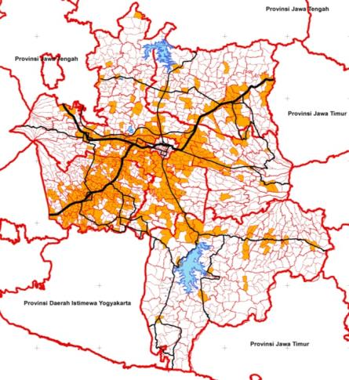
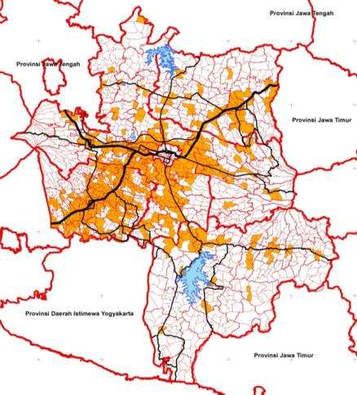
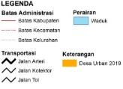
Urban Agglomeration
SKALA PETA
1:500.000
(Kurniati, dkk., 2022)
PETA DESA
URBAN 2010
PETA DESA
URBAN 2019

Slide 13
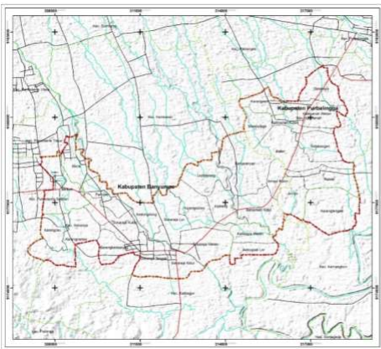
Urban Agglomeration
(Jati, dkk., 2022)

Slide 14
The Development of urbanization debates (literatures)
City-based population to total national population
Growth and industrialization
(focuses on income)
Urban problematic, searching for solution
Environmental awareness (governance, regulations, technology)

Slide 15
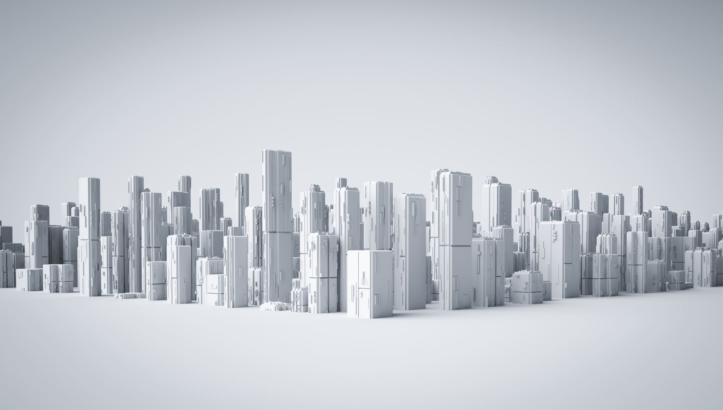
is an ongoing process, considered as an unavoidable consequences of development. Although urbanization brings serious challenges, attempts to inhibit it through exclusionary policies are likely to be economically, socially and environmentally damaging. with the right support urbanization can become an important element of sustainable development.
Urbanization….

Slide 16
1. Friedmann, J. (1966). Two Concept of Urbanization: A comment. 1(1), 78–84. 2. Jati, B. L., Rahayu, P., & Istanabi, T. (2022). Proses Urbanisasi Pada Koridor Purwokerto-Purbalingga. Desa-Kota, 4(1), 103. https://doi.org/10.20961/desa-kota.v4i1.53274.103-115 3. Kurniati,S.A., Rahayu, P., & Istanabi, T. (2022). Peri-urbanisasi dan Dinamika Perkembangan Kawasan Perkotaan Sekunder (Studi kasus: Bosukawonosraten), forthcoming. 4. Mi, X., Wang, S., Shao, C., Zhang, P., & Chen, M. (2021). Resident travel mode prediction model in Beijing metropolitan area. PLoS ONE, 16(November), 1–22. https://doi.org/10.1371/journal.pone.0259793 5. Seto, K. C., Sánchez-Rodríguez, R., & Fragkias, M. (2010). The new geography of contemporary urbanization and the environment. Annual Review of Environment and Resources, 35, 167–194. https://doi.org/10.1146/annurev-environ-100809-125336
Reference

