Slide 1

Africa’s Urbanization

Slide 2
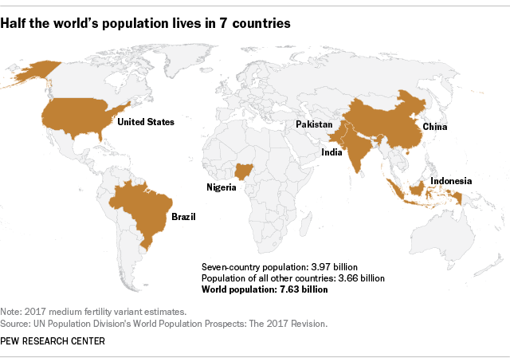

https://www.pewresearch.org/fact-tank/2018/07/11/world-population-day/
220 million
329 million
1.4 billion
1.38 billion
270 million (the fourth largest population)
212,5 million
206 million
Thrive Webinar Series September 21, 2021 URBAN AND REGIONAL PLANNING PROGRAM UNS

Slide 3
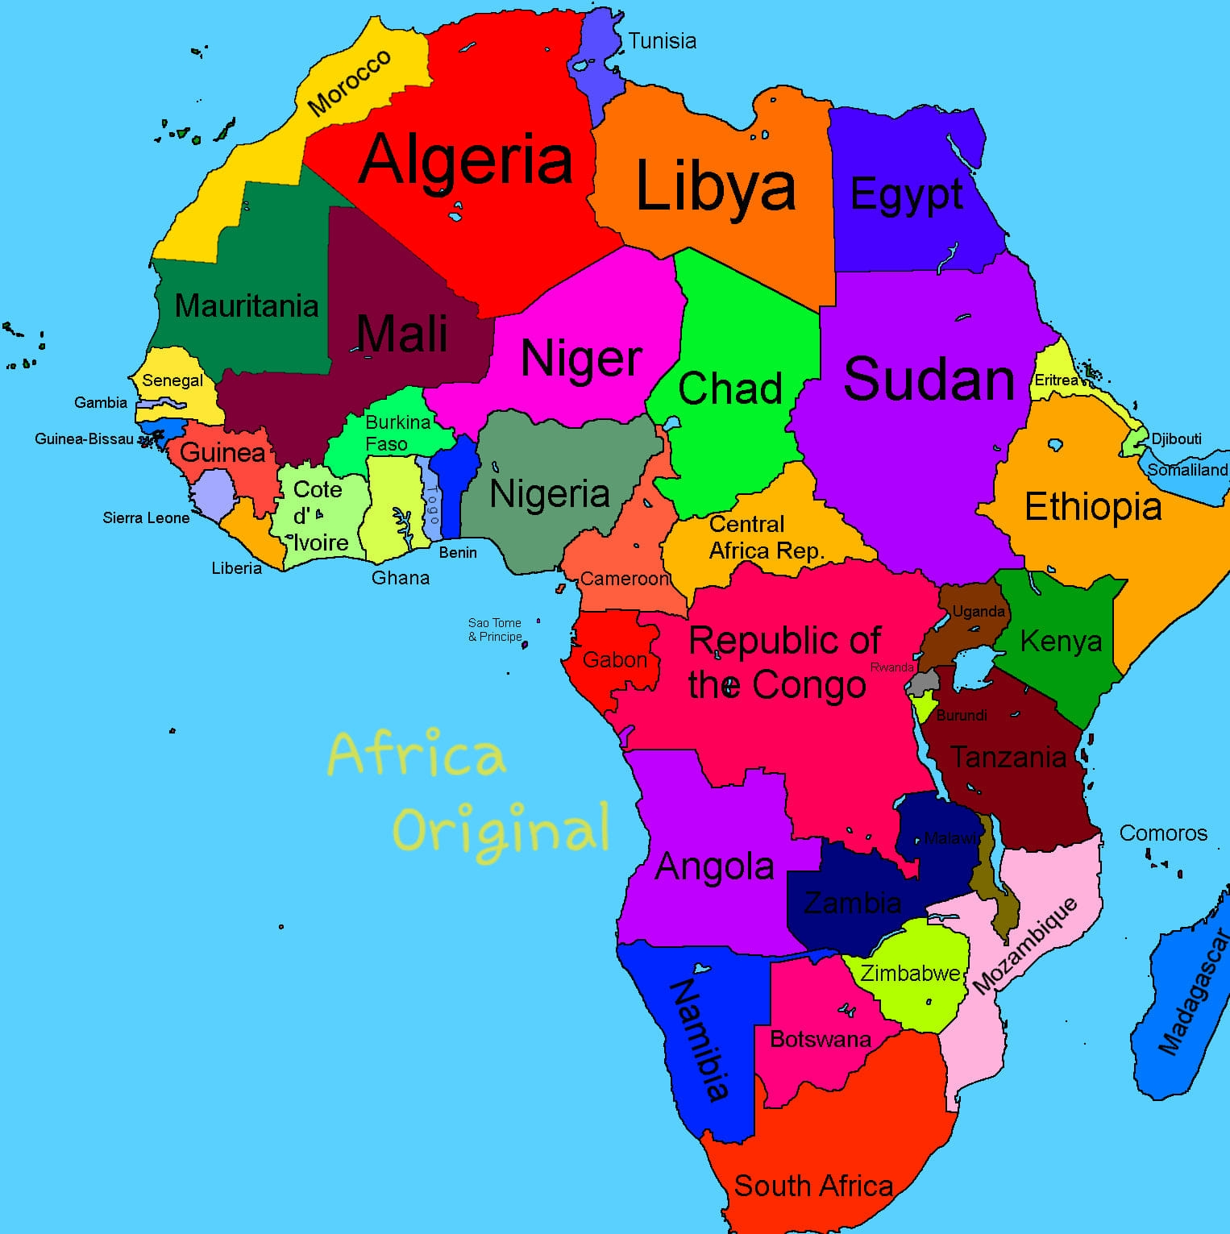
Cairo
Dakar
Kinshasha

Slide 4
Facts about urbanization in Africa
In the next 35 years, Africa will need to accommodate almost 900 million new urban dwellers, which is equivalent to what Europe, USA & Japan combined have managed over the last 265 years.
Cairo, Africa’s most populous city, manages a population that is larger than each of the 36 least populous countries on the continent.
75 % of Africa’s urban population is younger than 35.
Almost 50% of Africa’s urban population lives in slums & informal settlements.
Inequality in African cities is the 2nd highest in the world.

Slide 5
Facts about urbanization in Africa
Youth unemployment in Africa is 6 times higher in urban areas than in rural areas.
In Kinshasa, there is only 63m of paved road per 1,000 inhabitants, as opposed to 1,000m per 1,000 inhabitants in developing countries.
61% of urban employment opportunities in Africa are informal.
In Dakar, 1 million working hours are lost every day due to traffic congestion.
Around 1⁄3 of urban dwellers in sub-Saharan Africa have no access to electricity.
37 out of the 54 African countries are still more than 50% rural.
In 2050, Africa is expected to host nearly 25% of the global urban population.
Residential electricity consumption per capita in Africa is only . that of China.
In Africa, less than 50% of solid waste is collected & only 5% is contained or recycled
Nigeria’s housing shortage is estimated at 17 million units.
The total resources of local authorities in Africa were estimated in 2010 at $52 per capita per year.

Slide 10
The rural-urban balance: Africa’s population is still majority rural
Africa's urban population, as a share of the total population, is considerably smaller than in Asia, Europe and Latin America & the Caribbean.
The percentage of people living in urban areas in Northern Europe (82%) is more than double that of Africa.
Africa will be the last continent to become 50% urban, in 2037.
The number of people living in urban areas in Asia is 4.5 times larger than in Africa.
In 6 African countries, less than 20% of the population live in urban areas.
In the majority of North African countries, over 50% of the population lives in urban areas.

Slide 18
Urbanisation only occurs if the rate of urban population growth exceeds the rate of overall population growth.
Compared to Asia, although African urban population growth may be higher, the rate at which it has urbanised in recent years is slower.
In the next 30 years, even with a slowing urbanisation rate, Africa is expected to replace Asia as the fastest urbanising continent.

Slide 20
Source
2015 Facts and Figures African Urban Dynamics Mo Ibrahim Foundation

