Slide 1
Chinese Urbanisation

Slide 2
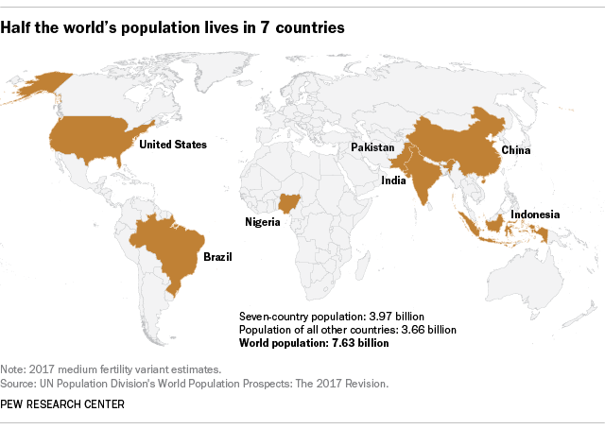

https://www.pewresearch.org/fact-tank/2018/07/11/world-population-day/
220 million
329 million
1.4 billion
1.38 billion
270 million (the fourth largest population)
212,5 million
206 million
Thrive Webinar Series September 21, 2021 URBAN AND REGIONAL PLANNING PROGRAM UNS

Slide 3
Characteristics of China Urbanisation
Unprecedented Scale and Scope
Driven by industrialization and globalization (China becomes the member of World Trade Organization)

Slide 4
Characteristics of China Urbanisation
Just after 2010, China turned into a predominantly urban country, a change that has taken place over a relatively short period. As recently as 1998, two thirds of the population (67 % was rural)

Slide 5
Characteristics of China Urbanisation

Slide 6

Overview of Urbanisation – Post 1978
In 28 years between the 1982 & 2010 population censuses, China’s urban population grew by 451 million
This number is similar to 16 million persons or a city the size of Shanghai per year.
It is expected to reach the 1 billion mark by 2030, rising at an even faster rate of 28 million per year.
Much of the growth in the urban population has been and continues to be driven by rural‐to‐urban migration.
It has gone together with a breathless expansion of the area covered by towns and cities.
The fast pace of urban expansion has compressed the time dimension and homogenise how towns look

Slide 7
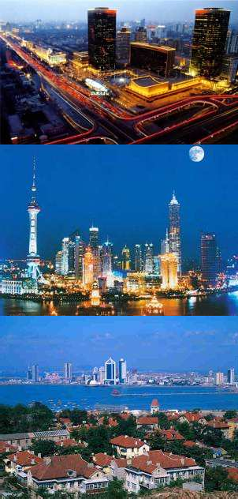
The new urban system in China
A number of cities with international and regional importance are raised
  Many MNCs locate their headquarters in cities with international importance (e.g. Beijing and Shanghai) and those with regional importance (e.g. Guangzhou and Qingdao).
  Enhance their economic dominance.

Slide 8
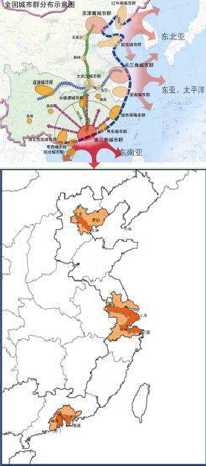
The new urban system in China
Densely urbanized regions have been developing in a fast pace
Three densely urbanized regions have been formed along China’s coast areas, i.e. the Pearl River Delta, the Yangtze River Delta and the Beijing-Tianjin-Hebei Region.
These regions have become the most dynamic and competitive economies that dominate the development orientation of the country.

Slide 9
The new urban system in China
Industries are prospering In small cities and towns
  Many small cities and towns along the coast are directly participating in international production
  They absorbed a great number of surplus labour from the countryside and brought the rural economy up

Slide 10
The new urban system in China
The marginalization of the inland cities and traditional industrial cities
The inland medium-and- small-size cities and the industrial cities formed in planned economy have lost their advantages.
They are encountering problems of slow growth, industrial degradation and insufficient employment problems of slow growth, industrial degradation and insufficient employment

Slide 11
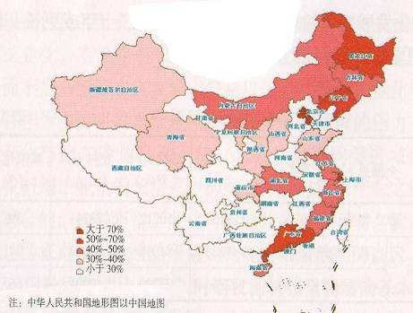
The process
In China, the general urbanization level is not so high but the absolute volume of urban population is extremely large.
China’s urbanization itself is a great contribution to the world and to its modernization.

Slide 12
The Process
Before the 1980s, rural-urban migration was generally constrained or even suppressed.
Since 1980s, China has been experiencing a rapid and continuing development in urbanization.
The annual increase of the indicator was only 0.1-0.2% prior to 1980. But after then this figure hit 0.8-1.0%

Slide 13
The Process
Besides the open-door policy and the economic reform, China’s rapid urbanization is also due to the following reasons:
The wide spreading of the transport infrastructure that facilitates easier migration
More education opportunities in the cities
The rapid development of information technology and modern media which create new jobs
Lessons learnt from the developed countries that help China to gain efficiency and avoid making similar mistakes.
Urbanization is accompanied by the transition from a planned economy towards a market economy

Slide 14

Basic Process of Urbanisation
Everywhere, urbanisation comprises two processes: a rising share of urban population in the total and a steady expansion of the urban footprint, the area covered by towns and cities.
The first is largely driven by rural‐to‐urban migration and the second takes the form of diversion of rural land for urban development

Slide 15
China Urbanisation Characteristics
  These two processes take on particular forms in China because of, first, the household registration system (hukou), and, second, public ownership of land and its division into state (urban) and collective (rural) ownership.
  The Hukou system hinders but does not stop rural‐to‐urban migration. Migration without preauthorisation has been possible since the early 1980s, This has given rise to a large population of rural migrants who are regarded as “outsiders” where they are actually living and working.
  The hukou system has the effect of dividing the urban population into “residents” (privileged) and the “migrants” (disadvantaged) . The latter are denied access to some public goods and services. Some of the disadvantages, such as denial of entry into public schools, have adverse effects that are transmitted across generations.

Slide 16
China Urbanisation Characteristics
  Pre1978 the hukou system only allowed preauthorised migration but now it permits migration but acts as an impediment to the absorption of migrants as resident. It has created a transient population that is urban and part rural.
The size of such population varies across cities. It is particularly high in large cities in the coastal belt. In Shanghai and Beijing the “outsider residents” make up 60 and 61% of the total. The figure is lower, if people from the same city but a different district are excluded.
In 2014, the % of the population living in urban areas was around 55%. But the % of the people classified as “non‐ agricultural” was 35/36%, 20 percentage point lower than the urbanisation rate.

Slide 17
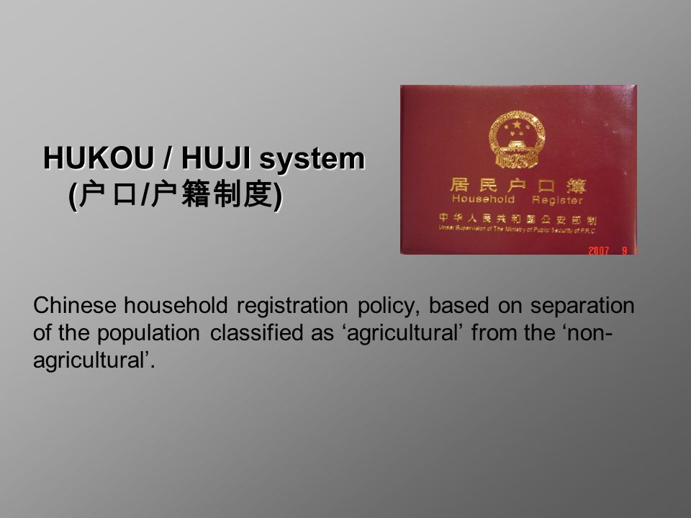
China Hukou System
China hukou system acts as an internal passport. The population divided into rural and urban residents
People can only receive government services in the region in which they are registered
The hukou, a small red passbook, provides details on citizens, including marriages, divorces, births, and deaths, in addition to the area to which each person belongs

Slide 18
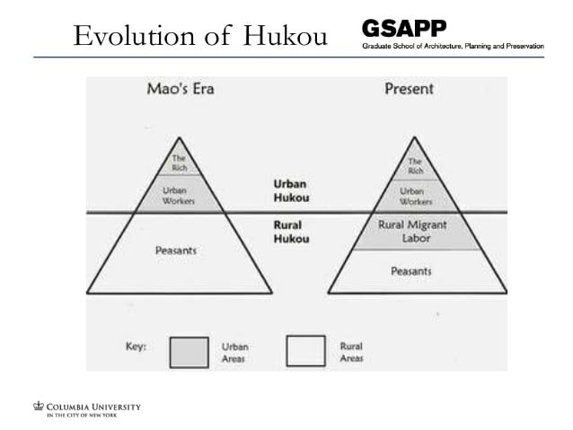

Slide 19
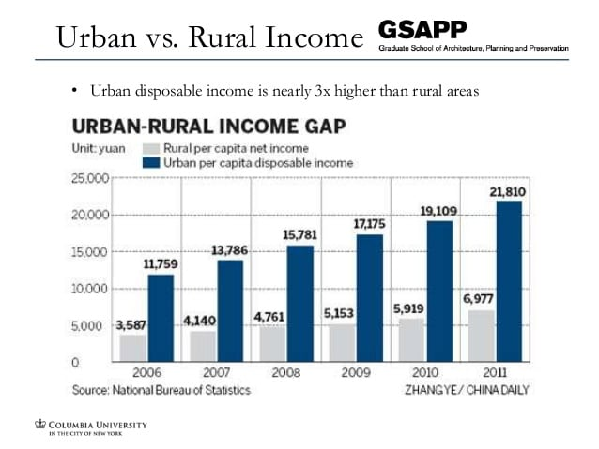

Slide 20
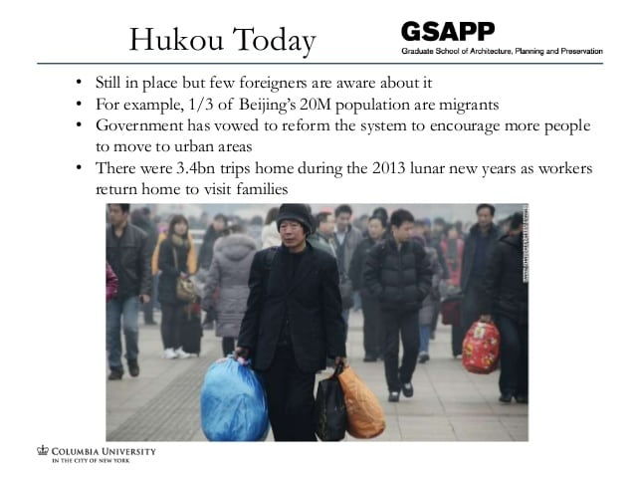

Slide 21
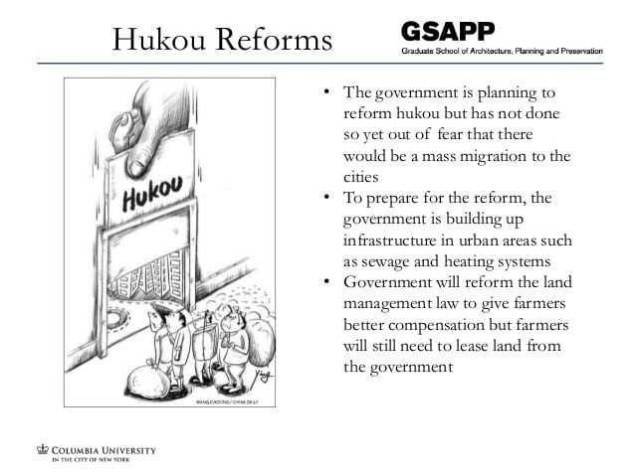

Slide 22
