Slide 1
Metabolism
Elisa Herawati, Ph.D

Slide 2
Metabolism
Metabolism is defined as the entire set of life-sustaining chemical reactions that occur in organisms.
These reactions number in the thousands and include reactions such as those responsible for getting energy from food, processing and removal of waste, building up muscles, growth, photosynthesis in plants, cell division and reproduction.

Slide 3
The entire set of metabolic reactions is organized into smaller sets of sequential reactions called metabolic pathways.
The species produced in the various reactions of a metabolic pathway are aometimes referred metabolites.
Many of the reactions in metabolic pathways require enzymes therefore organisms can control (accelerate or suppres) metabolic pathways, according to their current needs, by upregulating, downregulating, inhibiting, or activating one or more of the enzymes involved in pathway

Slide 4
Metabolic Function :
Obtain chemical energy from the degradation of energy-rich nutrients from the environment or from solar energy
Convert nutrient molecules into building blocks of macromolecular cell precursors
Formulate building blocks as cell components

Slide 5
Metabolic Pathways
Sequences of reactions that include the reactants, intermediates, products and the enzymes involved
4 major groups of biomolecules whose metabolic pathways are considered separately :
  carbohydrates
  fats
  proteins
  nucleotides

Slide 6
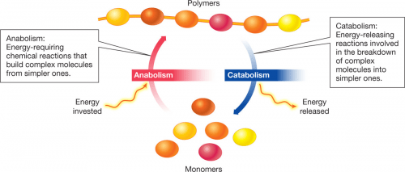
Metabolic pathways can usually be classified as catabolic (catabolism), anabolic (anabolism) or amphibolic
Anabolic pathways : involve building up of larger organic compounds from smaller one
Catabolic pathways : involve the breakdown of larger organic compounds into smaller compounds
Amphibolic pathways : some metabolic pathways are anabolism and catabolism pathways, depending on the energy conditions in the cells

Slide 7
Catabolic | Anabolic
Glycolisis Aerobically, glucose to pyruvate to acetylCoA Anaerobically, glucose to lactate | Glycogenesis Syntheis of glycogen from glucose
Beta-Oxidation Fatty acids to acetylCoA; makes NADH/H+ and FADH2 for chemiosmotic production of ATP | Gluconeogenesis Synthesis of glucose from pyruvate
Citric Acid Cycle Oxidation of acetylCoA producing NADH/H+ and FADH, for chemiosmotic production of ATP; all of three food groups converge here | Palmitate biosynthesis Synthesis of fatty acid from acetylCoA
Electron Transport System Electrons passed down to oxygen; proton gradient across mitochondrial inner membrane proton gradient tapped to make ATP from ADP and Pi (chemiosmotic coupling) | Non-essential amino acid biosynthesis Aminotransferase reactions from alpha ketoacid
Amino Acid Catabolism Redistribution of reduced nitrogen; elimination of excess by urea cycle | Purine and pyrimidine nucleotide biosynthesis Ring structures from nitrogen donors
 | Protein biosynthesis Also known as translation
 | Nucleid acid biosynthesis Replication, transcription

Slide 8
ATP – Adenosine Triphosphate
Catabolism of carbon containing substrates generates high energy biomolecules

Slide 9
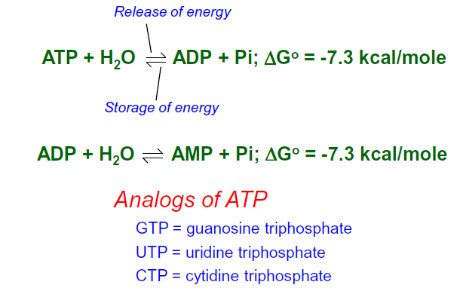
ATP – Reactions

Slide 10
ATP – Energy Currency of the Cell

Slide 11
NAD+ and NADP+
Nucleotide derivates that accept H+ and e- during oxidation I reduction reactions
Transfer e- to O2 during respiration

Slide 12
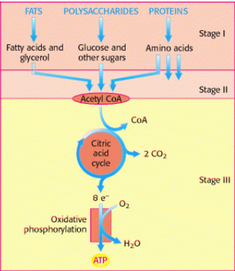
Three Stages of Catabolism

Slide 13
Step 1
Hydrolysis ( Animal : Digestion )
CH₂OH
CH₂OH
CH₂OH
CH₂OH
C
O
C
O
C
O
C
O
H
H
H
H
H
H
H
H
H
H
H
H
C
C
C
OH
H
C
C
OH
H
C
C
OH
H
C
OH
OH
H
O
O
O
OH
C
C
C
C
C
C
C
C
H
OH
H
OH
H
OH
H
OH
Amilase
CH₂OH
C
O
H
H
H
C
C
OH
H
OH
OH
C
C

Slide 14
Step 2 and 3
Catabolism : cellular level
The breakdown of the KH molecule produces ATP; occur in the cytosol and mitochondria :
  Glycolysis
  Krebs cycle
  Electron transport chain

Slide 15
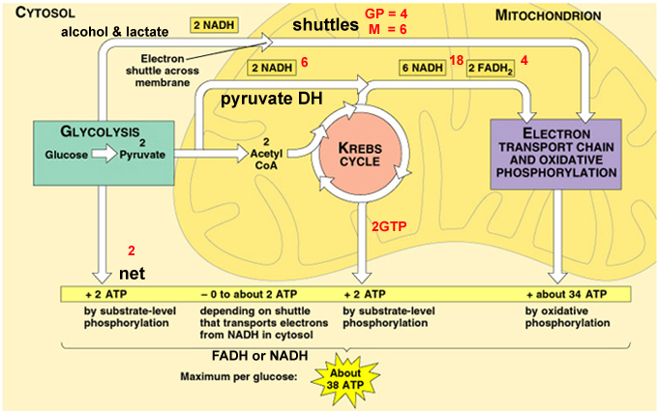
Catabolism of Carbohydrates

Slide 16
Glycolysis
Glucose is the major fuel for most organism > its rich in the potential energy : its complete oxidation to CO2 and water has a standard free-energy change of -2840 kJ/mol
Glucose is stored in big polymers like starch of glycogen
When energy demand increases, it can be released quickly and used to produce ATP either aerobically (using oxygen) or anaerobically (fermentation)
Glucose is aldo a versatile molecule for building the basic carbon skeleton of other molecules like fatty acids, amino acids etc.

Slide 17
Glycolysis
For each molecule glucose : 2 ATP molecules are spent in the activation/preparatory phase, but 4 ATP molecules are produced in the payoff phase.

Slide 18
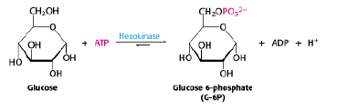
Three stages of Glycolysis
Step 1 : phosphorylation – isomeration - phosphorylation
Phosphorylation 1 :
Glucose is phosphorylated (addition of phosphate groups) to glucose 6-phosphate
Enzyme : hexokinase, source : ATP
Phosphorylation function :
  Glucose 6-phosphate cant diffuse through the membrane because the charge is negative so it doesn’t exit the cell
  Addition of phosphate groups : glucose destabilization occurs, easily broken down

Slide 19
Isomerization
Glucose 6-phosphate is converted into its isomer fructose 6-phosphate
Conversion of aldose to ketose
Enzyme : phosphoglucoseisomerase
Phosphorylation 2
Addition P from ATP
Phosphofructokinase enzymes

Slide 20
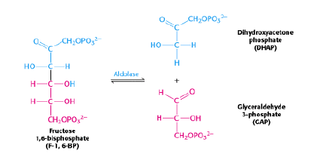
Stages II
6C sugar is broken down into 3C by the enzyme Aldolase

Slide 21
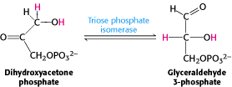
Glyceraldehyde 3-phosphate enters the direct route of glycolysis while dihydroxyacetone is converted to Glyceraldehyde 3-phosphate by the enzyme Triose phosphate isomerase

Slide 22
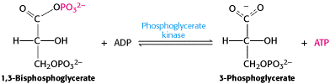
Stages III
Oxidation of 3C units to pyruvate
  Produces ATP
  ATP formation from 1,3-Biophosphoglycerate
The formation of ATP called substrate level phosphorylation because the donor group P is 1,3-BPG which is a substrate with high phosphoryl-transfer potential

Slide 23
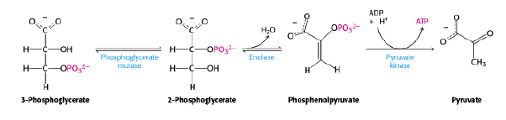
Additional ATP formation and pyruvate formation

Slide 24
Tahap I
Tahap II
Tahap III
Glycolysis

Slide 25
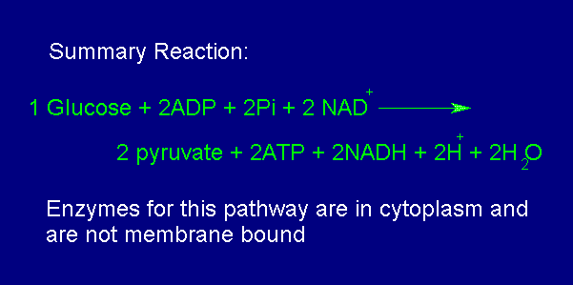

Slide 26
Regulation of Glycolysis
Local control : regulation that is affected by various concentrations of substrates of intermediate compounds involved in the metabolic pathway
Global control : regulation originates from the whole organism system, involving hormone-activated signal cascades
Liver cells (liver) play a major role in the regulation of metabolism : maintaining blood nutrition levels incluging glucose

Slide 27
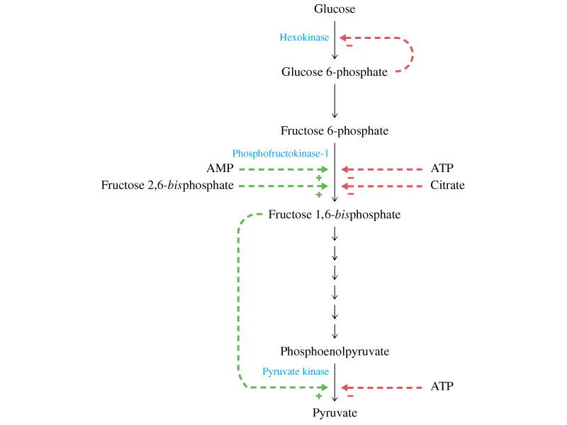
Regulation of Glycolysis
The glycolysis pathway is regulated by control of 3 enzymes that catalyze spontaneous reactions Hexokinase, Phosphofructokinase and Pyruvate Kinase

Slide 28
Phosphofructokinase is a key enzyme in the process of glycolysis control
Allosterically inhibited by ATP by binding to the regulatory side of the enzyme which is different from the active side
AMP has the opposite role : enzyme activity rises if the ATP/AMP ratio is low

Slide 29
Hexokinase products are inhibited glucose-6-phosphate : competitively and allosterically
Glucokinase : hexokinase present in the liver; acive when blood glucose level is high; glucose-6-phosphate products are not inhibited; insulin triggered synthesis

Slide 30
Pyruvate Kinase
Controlled in the liver through modulation of the amount of enzymes
High glucose level in the liver : causes the transcription factor ChREBP (carbohydrate responsive element binding protein) to be transferred to the nucleus, and will activate the transcription of the Pyruvate Kinase encoding gene

Slide 31
Formation of Acetyl Coenzyme A from Pyruvate
Aerobic conditions, pyruvate is transported to the mitochondria by the pyruvate carrier
In the mitochondrial pyruvate matrix undergo oxidative decarboxylation by the enzyme pyruvate dehydrogenase complex to from acetyl CoA

Slide 32
Formation of Acetyl Coenzyme A from Pyruvate
Under Aerobic conditions, pyruvate is converted to ethanor or lactic acid
    alcoholic fermentation
    glucose + 2 NAD⁺ + 2 ADP + 2 P_{i} →
    2 ethanol + 2 CO₂ + 2 ATP + 2 H₂O
    Lactic Acid fermentation:
    glucose + 2 ADP + 2 P_{i} → 2 lactate + 2 ATP
Anaerobic catabolism produces 2 ATP, in aerobic conditions more ATP is produced through the krebs cycle and electon transport system

Slide 33
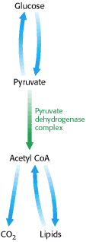
Regulation
The pyruvate dehydrogenase complex is regulated allosterically by Reversible Phosphorylation
The synthesis of acetyl CoA by the pyruvate dehydrogenae complex is a key irreversible step in the metabolism of glucose
Pyruvate dehydrogenase is switched off when the energy charge is high and biosynthetic intermediate are abundant

Slide 34
Regulation of the Pyruvate Dehydrogenase Complex
The complex is inhibited by its intermediate products, NADH and acety CoA
The pyruvate dehydrogenase component is also regulated by covalent modification
A spesific kinase phosphorylates and inactivates pyruvate dehydrogenase
Phosphate actives the dehydrogenase by removing the phosphoryl. The kinase and the phosphate also are highly regulated enzymes

Slide 35
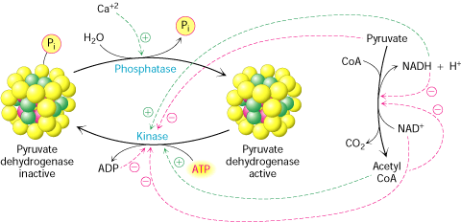

Slide 36
Krebs or TCA Cycle
In mitochondria of eucaryotes
Provides NADH and ultimately energy/ATP for biosynthesis
Provides intermediates for amino acid synthesis
Generates enery/GTP

Slide 37
Krebs or TCA Cycle

Slide 38
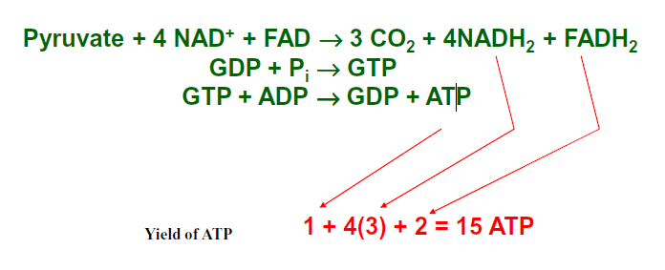
Krebs or TCA Cycle

Slide 39
“Thank You”

