Slide 1
DATA STRUCTURES AND ALGORITHMS

Slide 2
ASYMPTOTIC ANALYSIS

Slide 3
Mathematical Review

Slide 4
Recurrence Relations
Functions that are defined using themselves (think recursion but mathematically):
F(n) = n ∙ F(n-1), F(0) = 1
G(n) = G(n-1) + G(n-2), G(1)=G(2) = 1
H(n) = 1 + H( ⌊ n/2 ⌋ ), H(1)=1
Some recurrence relations can be written more simply in closed form (non-recursive)
⌊ x ⌋ is the floor function (first integer ≤x)
⌈ x ⌉ is the ceiling function (first integer ≥x)

Slide 5
Example Closed Form
H(n) = 1 + H( ⌊ n/2 ⌋ ), H(1)=1
H(1) = 1
H(2) = 1 + H(⌊ 2/2 ⌋ ) = 1 + H(1) = 2
H(3) = 1 + H(⌊ 3/2 ⌋ ) = 1 + H(1) = 2
H(4) = 1 + H(⌊ 4/2 ⌋ ) = 1 + H(2) = 3
...
H(8) = 1 + H(⌊ 8/2 ⌋ ) = 1 + H(4) = 4
…
H(n) = 1 + ⌊ log₂ n ⌋

Slide 6
Mathematical Induction
Suppose P(n) is some predicate (with integer n)
Example: n ≥ n/2 + 1
To prove P(n) for all n ≥ c, it suffices to prove
P(c) – called the “basis” or “base case”
If P(k) then P(k+1) – called the “induction step” or “inductive case”
When we will use induction:
To show an algorithm is correct or has a certain running time no matter how big a data structure or input value is
Our “n” will be the data structure or input size.

Slide 7
Induction Example
The sum of the first n powers of 2 (starting with zero) is given the by formula:
P(n) = 2^{n}-1
Theorem: P(n) holds for all n ≥ 1
Proof: By induction on n
Base case: n=1.
Sum of first power of 2 is 2⁰ , which equals 1.
And for n=1,
2^{n}-1 = 2¹-1 = 2-1 = 1

Slide 8
Induction Example
The sum of the first n powers of 2 (starting with zero) is given the by formula:
P(n) = 2^{n}-1
Inductive case:
Assume: sum of the first k powers of 2 is 2^{k}-1
Show: sum of the first (k+1) powers is 2^{k+1}-1
P(k+1) = 2⁰+2¹+…+2^{k+1-2}+2^{k+1-1} = (2⁰+2¹+…+2^{k-1})+2^{k} = (2^{k}-1)+2^{k} since P(k)=2⁰+2¹+…+2^{k-1}= 2^{k}-1 = 2∙2^{k}-1 = 2^{k+1}-1

Slide 9
Powers of 2
A bit is 0 or 1
n bits can represent 2^{n} distinct things
For example, the numbers 0 through 2^{n}-1
Rules of Thumb:
2¹⁰ is 1024 / “about a thousand”, kilo
2²⁰ is “about a million”, mega
2³⁰ is “about a billion”, giga
In C++ / Java:
int is 32 bits and signed, so “max int” is 2³¹ - 1 which is about 2 billion

Slide 10
Therefore…
One can give a unique id to:
Every person in the U.S. with 29 bits
Every person in the world with 33 bits
Every person to have ever lived with ≈38 bits
Every atom in the universe with 250-300 bits
So if a password is 128 bits long and randomly generated, do you think you could guess it?

Slide 11
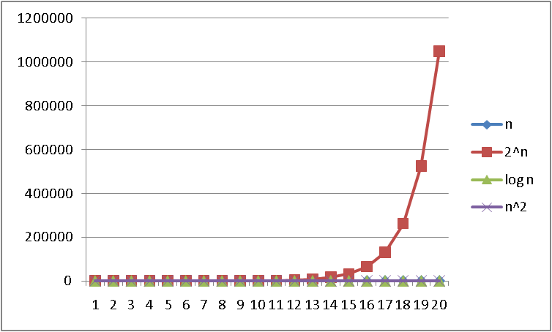
Logarithms and Exponents
Since so much in CS is in binary, log almost always means log₂
Definition: log₂ x = y if x = 2^{y}
So, log₂ 1,000,000 = “a little under 20”
Just as exponents grow very quickly, logarithms grow very slowly

Slide 12
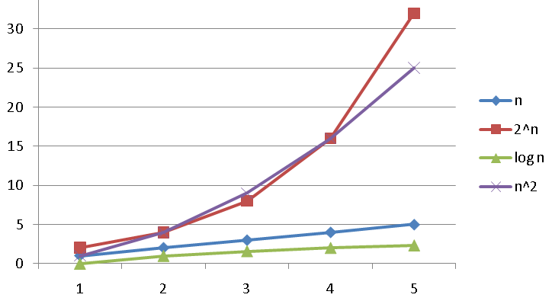
Logarithms and Exponents
Since so much in CS is in binary, log almost always means log₂
Definition: log₂ x = y if x = 2^{y}
So, log₂ 1,000,000 = “a little under 20”
Just as exponents grow very quickly, logarithms grow very slowly

Slide 13
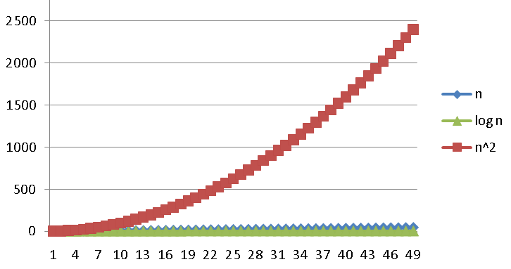
Logarithms and Exponents
Since so much in CS is in binary, log almost always means log₂
Definition: log₂ x = y if x = 2^{y}
So, log₂ 1,000,000 = “a little under 20”
Just as exponents grow very quickly, logarithms grow very slowly

Slide 14
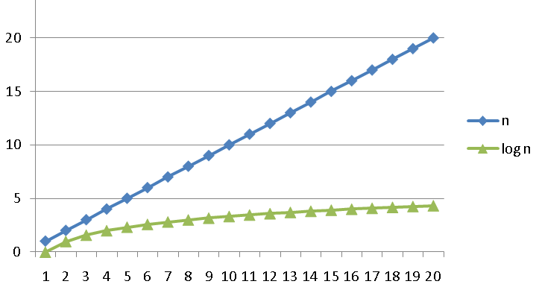
Logarithms and Exponents
Since so much in CS is in binary, log almost always means log₂
Definition: log₂ x = y if x = 2^{y}
So, log₂ 1,000,000 = “a little under 20”
Just as exponents grow very quickly, logarithms grow very slowly

Slide 15
Logarithms and Exponents
log(A*B) = log A + log B
log(N^{k})= k log N
log(A/B) = log A – log B
log(log x) is written log log x
Grows as slowly as $2^{2^{x}}$grows fast
(log x)(log x) is written log² x
It is greater than log x for all x > 2

Slide 16
Logarithms and Exponents
Any base B log is equivalent to base 2 log within a constant factor
In particular,
log₂ x = 3.22 log₁₀ x
In general,
log_{B} x = (log_{A} x) / (log_{A} B)
This matters in doing math but not CS!
In algorithm analysis, we tend to not care much about constant factors

Slide 17
Why don’t we care about exact constants?
Not enough information to compute precise constants
Depends on too many factors (underlying hardware, background processes, temperature etc…)
We really care about the growth of the function
Big O…

Slide 18
Algorithm Analysis

Slide 19
Algorithm Analysis
As the “size” of an algorithm’s input grows (array length, size of queue, etc.):
Time: How much longer does it run?
Space: How much memory does it use?
How do we answer these questions?
For now, we will focus on time only.

Slide 20
One Approach to Algorithm Analysis
Why not just code the algorithm and time it?
Hardware: processor(s), memory, etc.
OS, version of programming language, libraries, drivers
Programs running in the background
Implementation dependent
Choice of input
Number of inputs to test

Slide 21
The Problem with Timing
Timing doesn’t really evaluate the algorithm but merely evaluates a specific implementation
At the core of CS is a backbone of theory & mathematics
Examine the algorithm itself, not the implementation
Reason about performance as a function of n
Mathematically prove things about performance
Yet, timing has its place
In the real world, we do want to know whether implementation A runs faster than implementation B on data set C
Ex: Benchmarking graphics cards

Slide 22
Basic Lesson
Evaluating an algorithm?
Use asymptotic analysis
Evaluating an implementation?
Use timing

Slide 23
Goals of Comparing Algorithms
Many measures for comparing algorithms
Security
Clarity/ Obfuscation
Performance
When comparing performance
Use large inputs because probably any algorithm is “plenty good” for small inputs (n < 10 always fast)
Answer should be independent of CPU speed, programming language, coding tricks, etc.
Answer is general and rigorous, complementary to “coding it up and timing it on some test cases”

Slide 24
Asymptotic Analysis
asymptotic analysis – the process of mathematically representing runtime of a algorithm in relation to the number of inputs and how that relationship changes as the number of inputs grow
Two step process
Model – the process of mathematically representing how many operations a piece of code will run in relation to the number of inputs n
Analyze – compare runtime/input relationship across multiple algorithms
Graph the model of your code where x = number of inputs and y = runtime
For which inputs will one perform better than the other?

Slide 25
Worst-Case Analysis
In general, we are interested in three types of performance
Best-case / Fastest
Average-case
Worst-case / Slowest
When determining worst-case, we tend to be pessimistic
If there is a conditional, count the branch that will run the slowest
This will give a loose bound on how slow the algorithm may run

Slide 26
Function growth
Imagine you have three possible algorithms to choose between.
Each has already been reduced to its mathematical model
$$f\left(n\right)=n$$
$$g\left(n\right)=4n$$
$$h\left(n\right)=n^{2}$$
$$T\left(n\right)$$
$$T\left(n\right)$$
$$T\left(n\right)$$
$$n$$
$$n$$
$$n$$
The growth rate for f(n) and g(n) looks very different for small numbers of input
…but since both are linear eventually look similar at large input sizes
But for very small input values h(n) actually has a slower growth rate than either f(n) or g(n)
whereas h(n) has a distinctly different growth rate

Slide 27
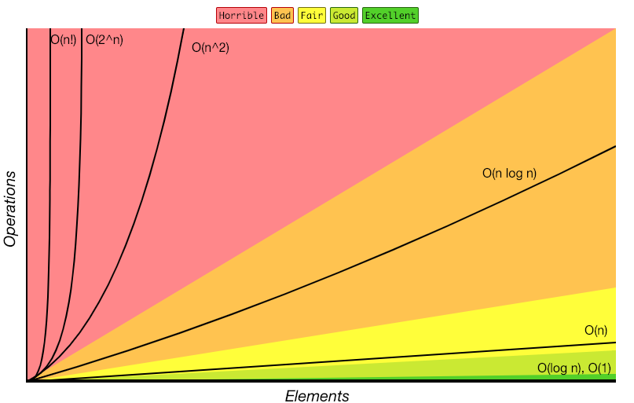
Review: Complexity Classes
complexity class – a category of algorithm efficiency based on the algorithm’s relationship to the input size N
Class | Big O | If you double N… | Example algorithm
constant | O(1) | unchanged | Add to front of linked list
logarithmic | O(log₂n) | Increases slightly | Binary search
linear | O(n) | doubles | Sequential search
log-linear | O(nlog₂n) | Slightly more than doubles | Merge sort
quadratic | O(n²) | quadruples | Nested loops traversing a 2D array
cubic | O(n³) | Multiplies by 8 | Triple nested loop
polynomial | O(n^{c})
exponential | O(c^{n}) | Multiplies drastically
http://bigocheatsheet.com/

Slide 28
O(1): Time complexity of a function (or set of statements) is considered as O(1) if it doesn’t contain loop, recursion and call to any other non-constant time function.
Example:
int n = 1000;
printf ("Hey - your input is: " + n);

Slide 29
O(n): Time Complexity of a loop is considered as O(n) if the loop variables is incremented / decremented by a constant amount. For example following functions have O(n) time complexity.
Example:
for (int i = 0; i < n; i++) {
printf ("Hey - I'm busy looking at: " + i);
}

Slide 30
O(n^{c}): Time complexity of nested loops is equal to the number of times the innermost statement is executed.
Example:
for (int i = 1; i <= n; i++) {
for(int j = 1; j <= n; j++) {
printf ("Hey - I'm busy looking at: " + i + " and " + j);
}
}

Slide 31
O(Log n) Time Complexity of a loop is considered as O(Logn) if the loop variables is divided / multiplied by a constant amount.
Example:
for (int i = 1; i < n; i = i * 2){
printf ("Hey - I'm busy looking at: " + i);
}

Slide 32
O(LogLogn) Time Complexity of a loop is considered as O(LogLogn) if the loop variables is reduced / increased exponentially by a constant amount.Example:
for (int i = 2; i <=n; i = pow(i, c)) {
// some O(1) expressions
} //Here fun is sqrt or cuberoot or any other constant root
for (int i = n; i > 0; i = fun(i)) {
// some O(1) expressions
}

Slide 33
O(k^{n}) algorithms triple with every additional input, O(k^{n}) algorithms will get k times bigger with every additional input..Example
for (int i = 1; i <= Math.pow(2, n); i++){
printf ("Hey - I'm busy looking at: " + i);
}

Slide 34
Moving from Model to Complexity Class
Say an algorithm runs 0.4N³ + 25N² + 8N + 17 statements
17 is quickly dwarfed in the context of thousands of inputs
We ignore constants like 25 because they are tiny next to N
N³ is so powerful it dominates the overall runtime
O(N³)
$10n\log{n}+3n$
$5n^{2}\log{n}+13n^{3}$
$20n\log{\log{n}+2 n\log{n}}$
$2^{3n}$
Consider the runtime when N is extremely large
Lower order terms don’t matter – delete them.
Multiplying by constant factors has little effect on growth rate
Highest order term dominates the overall rate of change
Gives us a “simplified big-O”
$$O(n\log{n)}$$
$$O\left(n^{3}\right)$$
$$O(n\log{n})$$
$$O(8^{n})$$

Slide 35
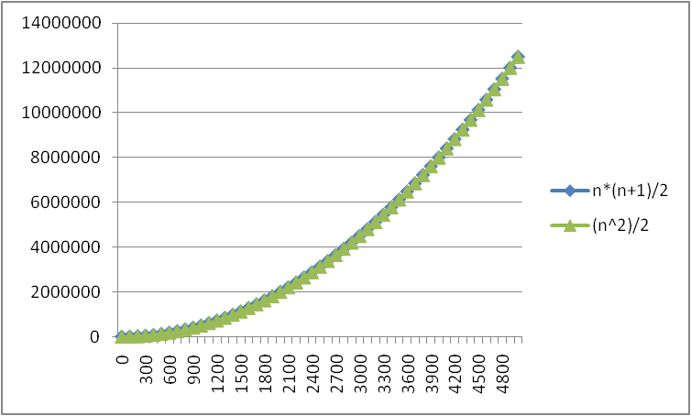
Example of No Need To Be So Exact: N*(N+1)/2 VS just N²/2
We need a better notation for performance that focuses on the dominant terms
only

Slide 36
Definition: Big-O
Given two functions f(n) & g(n) for input n, we say f(n) is in O(g(n) ) iff there exist positive constants c and n₀ such that f(n) ≤ c g(n) for all n ≥ n₀
Basically, we want to find a function g(n) that is eventually always bigger than f(n)
g
f
n₀
n

Slide 37
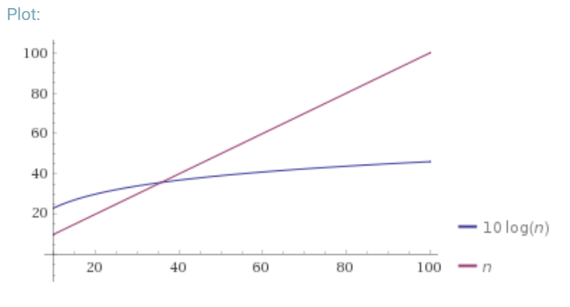
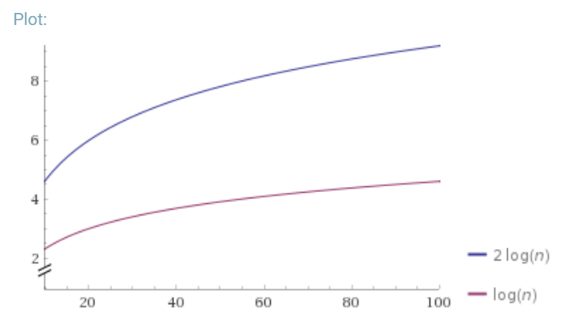
Definition: Big-O
Why $n_{0}$?
We wanted to find an upper bound on our algorithm’s running time, but
We don’t want to care about constant factors.
We only care about what happens as $n$ gets large.
$f(n)$ is $O(g\left(n\right))$ if there exist positive constants $c, n_{0}$ such that for all $n≥n_{0}$,
$$f\left(n\right)≤c⋅g\left(n\right)$$
Big-O
Why $c$?
We also say that $g\left(n\right)$ “dominates” $f(n)$
O(g(n)) is the “family” or “set” of all functions that are dominated by g(n)

Slide 38
Applying Big O Definition
$f(n)$ is $O(g\left(n\right))$ if there exist positive constants $c, n_{0}$ such that for all $n≥n_{0}$,
$$f\left(n\right)≤c⋅g\left(n\right)$$
Big-O
Show that
$$f\left(n\right)=10n+15$$
is
$$O\left(n\right)$$
Apply definition term by term
$$10n≤c・n when c=10 for all values of n$$
$$15≤c・n when c=15 for n≥1$$
Add up all your truths
$$10n+15≤10n+15n≤25n for n≥1$$
Select values for c and n0 and prove they validate the definition
Take $c=25$ and $n_{0}=1$
$$10n≤25n for all values of n$$
$$15≤25n for n≥1$$
Thus because a c and n0 exist, f(n) is O(n)

Slide 39
Exercise: Proving Big O
3 Minutes
Demonstrate that 5n² + 3n + 6 is dominated by n² by finding a c and n₀ that satisfy the definition of domination
5n² + 3n + 6 ≤ 5n² + 3n² + 6n² when n ≥ 1
5n² + 3n² + 6n² = 14n²
5n² + 3n + 6 ≤ 14n² for n ≥ 1
14n² ≤ c*n² for c = ? n >= ?
$\frac{14}{n}$ -> c = 14 & n >= 1
$f(n)$ is $O(g\left(n\right))$ if there exist positive constants $c, n_{0}$ such that for all $n≥n_{0}$,
$$f\left(n\right)≤c⋅g\left(n\right)$$
Big-O

Slide 40
Function comparison: exercise
True – all linear functions are treated as equivalent
f(n) = n ≤ g(n) = 5n + 3?
f(n) = 5n + 3 ≤ g(n) = n?
f(n) = 5n + 3 ≤ g(n) = 1?
f(n) = 5n + 3 ≤ g(n) = n²?
f(n) = n² + 3n + 2 ≤ g(n) = n³?
f(n) = n³ ≤ g(n) = n² + 3n + 2 ?
True
False
True – quadratic will always dominate linear
True
False

Slide 41
O, Omega, Theta
Big-O is an upper bound
My code takes at most this long to run
Big-Omega is a lower bound
Big Theta is “equal to”
$Ω\left(f\left(n\right)\right)≤f\left(n\right)== θ\left(f\left(n\right)\right)≤O(f\left(n\right))$
f(n)
O(1)
O(log n)
O(n)
O(n²)
O(n³)
Is dominated by
f(n) ∈ O(g(n))
Dominates
f(n) ∈ Ω(g(n))
$f(n)$ is $Ω(g\left(n\right))$ if there exist positive constants $c, n_{0}$ such that for all $n≥n_{0}$,
$$f\left(n\right)≥c⋅g\left(n\right)$$
Big-Omega
$f(n)$ is $Θ(g\left(n\right))$ if
$f\left(n\right)$ is $O(g\left(n\right))$ and $f\left(n\right)$ is $Ω(g\left(n\right))$.
Big-Theta

Slide 42
Viewing O as a class
Sometimes you’ll see big-O defined as a family or set of functions.
$O(g\left(n\right))$ is the set of all functions $f\left(n\right)$ such that there exist positive constants $c, n_{0}$ such that for all $n≥n_{0}$, $f\left(n\right)≤c⋅g\left(n\right)$
Big-O (alternative definition)
For that reason, some people write $f\left(n\right)∈O\left(g\left(n\right)\right)$ where we wrote “$f\left(n\right)$ is $O(g\left(n\right))$”.
Other people write “$f\left(n\right)=O\left(g\left(n\right)\right)$” to mean the same thing.
The set of all functions that run in linear time (i.e. $O(n)$) is a “complexity class.”
We never write $O(5n)$ instead of $O(n)$ – they’re the same thing!
It’s like writing $\frac{6}{2}$ instead of $3$. It just looks weird.

Slide 43
Examples
$f(n)$ $∈$ $O(g\left(n\right))$ if there exist positive constants $c, n_{0}$ such that for all $n≥n_{0}$,
$$f\left(n\right)≤c⋅g\left(n\right)$$
Big-O
4n² ∈ Ω(1)
true
4n² ∈ Ω(n)
true
4n² ∈ Ω(n²)
true
4n² ∈ Ω(n³)
false
4n² ∈ Ω(n⁴)
false
4n² ∈ O(1)
false
4n² ∈ O(n)
false
4n² ∈ O(n²)
true
4n² ∈ O(n³)
true
4n² ∈ O(n⁴)
true
$f(n)$ $∈ Ω(g\left(n\right))$ if there exist positive constants $c, n_{0}$ such that for all $n≥n_{0}$,
$$f\left(n\right)≥c⋅g\left(n\right)$$
Big-Omega
$f(n)$ $∈$ $Θ(g\left(n\right))$ if
$f\left(n\right)$ is $O(g\left(n\right))$ and $f\left(n\right)$ is $Ω(g\left(n\right))$.
Big-Theta

Slide 44
Practice
$f(n)$ $∈$ $O(g\left(n\right))$ if there exist positive constants $c, n_{0}$ such that for all $n≥n_{0}$,
$$f\left(n\right)≤c⋅g\left(n\right)$$
Big-O
5n + 3 ∈ O(n)
n ∈ O(5n + 3)
5n + 3 = O(n)
O(5n + 3) = O(n)
O(n²) = O(n)
n² ∈ O(1)
n² ∈ O(n)
n² ∈ O(n²)
n² ∈ O(n³)
n² ∈ O(n¹⁰⁰)
True
True
True
$f(n)$ $∈ Ω(g\left(n\right))$ if there exist positive constants $c, n_{0}$ such that for all $n≥n_{0}$,
$$f\left(n\right)≥c⋅g\left(n\right)$$
Big-Omega
True
False
False
False
$f(n)$ $∈$ $Θ(g\left(n\right))$ if
$f\left(n\right)$ is $O(g\left(n\right))$ and $f\left(n\right)$ is $Ω(g\left(n\right))$.
Big-Theta
True
True
True

Slide 45
Caveats
Asymptotic complexity focuses on behavior for large n and is independent of any computer/coding trick, but results can be misleading
Example: n^{1/10} vs. log n
Asymptotically n^{1/10} grows more quickly
But the “cross-over” point is around 5 * 10¹⁷
So if you have input size less than 2⁵⁸, prefer n^{1/10}
Similarly, an O(2^{n}) algorithm may be more practical than an O(n⁷) algorithm

Slide 46
Caveats
Even for more common functions, comparing O() for small n values can be misleading
Quicksort: O(n log n) (expected)
Insertion Sort: O(n²)(expected)
In reality Insertion Sort is faster for small n’s so much so that good QuickSort implementations switch to Insertion Sort when n<20

