Slide 1
Yunastiti Purwaningsih

Slide 2
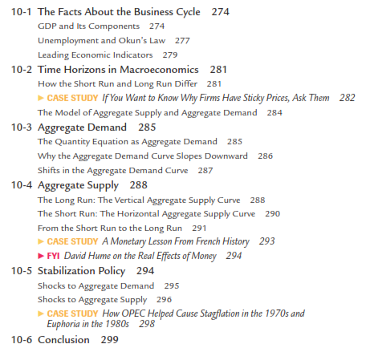

Slide 3
Economists call these short-run ﬂuctuations in output and employment the business cycle.
Recessions are actually as irregular as they are common. Sometimes they occur close together, while at other times they are much farther apart.

Slide 4
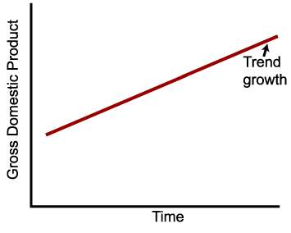
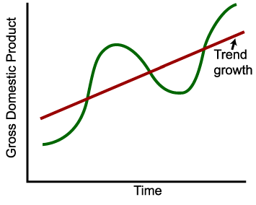
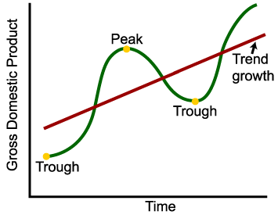
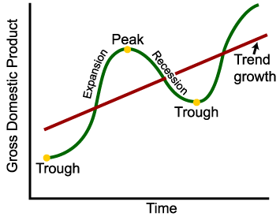
Economists call these short-run ﬂuctuations in output and employment the business cycle
Kegiatan perekonomian dalam memproduksi barang dan jasa, naik turun mengikuti siklus bisnis
Ekspansi atau ledakan : periode dalam siklus bisnis dari lembah naik ke puncak, dimana pada periode itu output dan kesempatan kerja meningkat.
Kontraksi, resesi, atau penurunan : periode dari puncak turun ke lembah, dimana selama periode itu output dan kesempatan kerja menurun.
Kegiatan perekonomian dalam memproduksi barang dan jasa → GDP (Gross Domestic Product) = PDB (Produk Domestik Bruto)

Slide 5
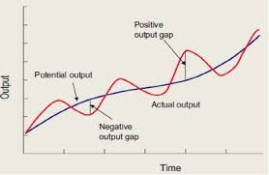
Economists call these short-run ﬂuctuations in output and employment the business cycle
Kegiatan perekonomian dalam memproduksi barang dan jasa, naik turun mengikuti siklus bisnis
Kegiatan perekonomian dalam memproduksi barang dan jasa → GDP (Gross Domestic Product) = PDB (Produk Domestik Bruto)
Output gap: positif atau negatif

Slide 6
Economists call these short-run ﬂuctuations in output and employment the business cycle
For example:
The United States fell into recession in 1982, only two years after the previous downturn.
By the end of that year, the unemployment rate had reached 10.8 percent—the highest level since the Great Depression of the 1930s.
But after the 1982 recession, it was eight years before the economy experienced another one.

Slide 7
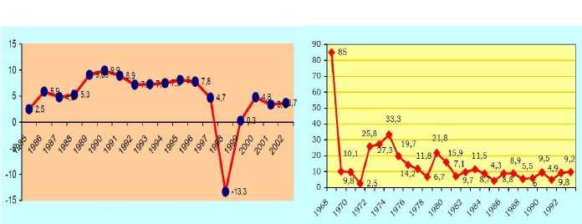
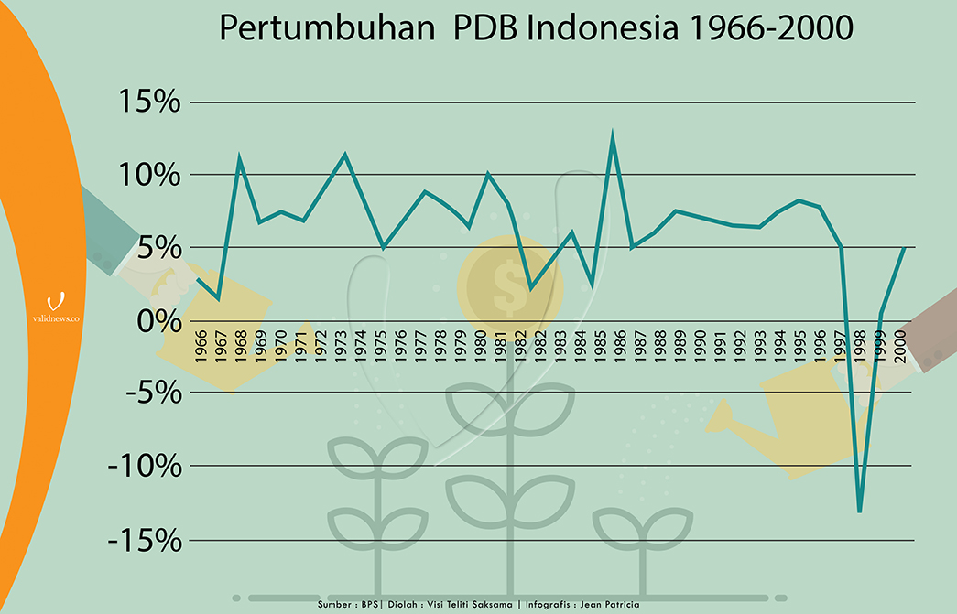
Economists call these short-run ﬂuctuations in output and employment the business cycle
Contoh: Indonesia tahun 1998
Pertumbuhan Ekonomi

Slide 8
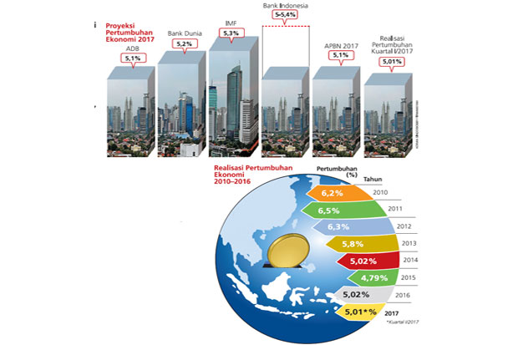
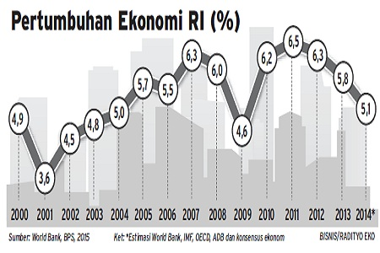

Slide 9
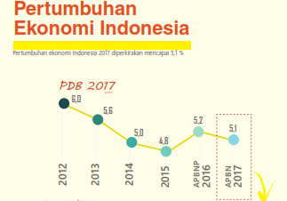
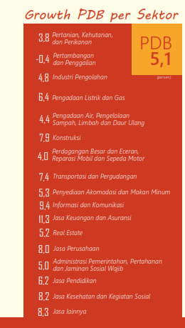
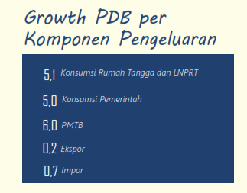
PDB dan komponennya

Slide 10
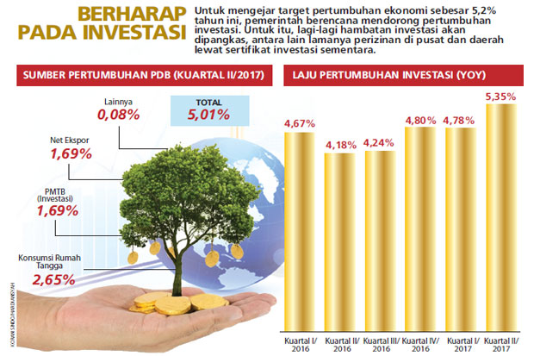

Slide 11
PDB dan komponennya

Slide 12
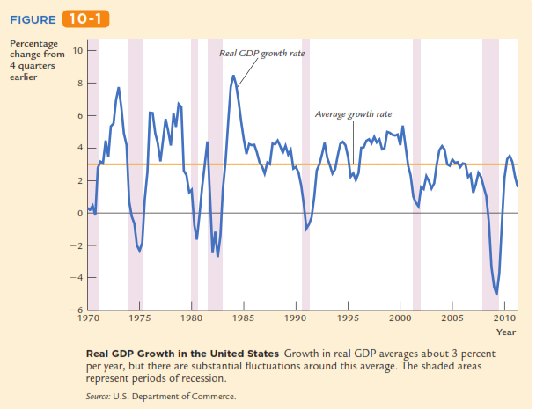
Real GDP Growth in the United States

Slide 13
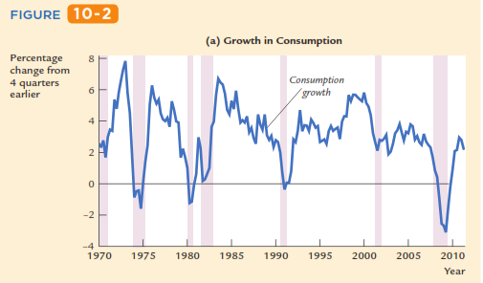
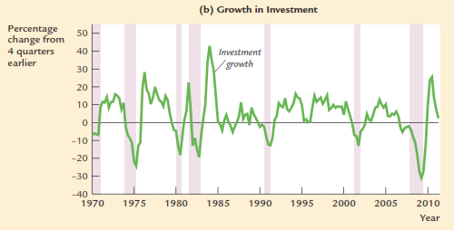
Real GDP Growth in the United States
PDB dan komponennya
Growth in Consumption and Investment When the economy heads
into a recession, growth in real consumption and investment spending both decline. Investment spending, shown in panel (b), is considerably more volatile than consumption spending, shown in panel (a). The shaded areas represent periods of recession.
Source: U.S. Department of Commerce.

Slide 14
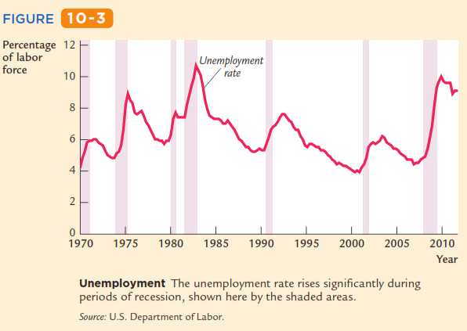
Real GDP Growth in the United States
PDB dan komponennya

Slide 15
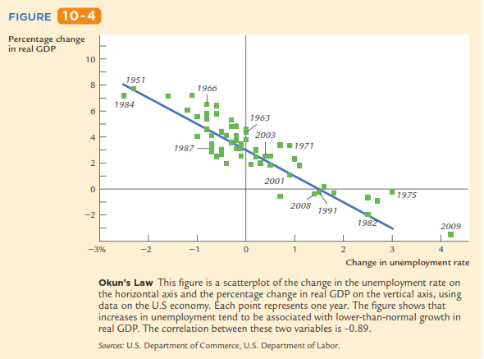
Tingkat Pengangguran dan Hukum Okun
This negative relationship between unemployment and GDP is called Okun’s law, after Arthur Okun, the economist who ﬁrst studied it.
Figure 10-4 uses annual data for the United States to illustrate Okun’s law. In this scatterplot, each point represents the data for one year.

Slide 16
Indonesia

Slide 17
Tingkat Pengangguran dan Hukum Okun
This negative relationship between unemployment and GDP is called Okun’s law, after Arthur Okun, the economist who ﬁrst studied it
if the unemployment rate remains the same, real GDP grows by about 3 percent; this normal growth in the production of goods and services is due to growth in the labor force, capital accumulation, and technological progress.

Slide 18
Tingkat Pengangguran dan Hukum Okun
This negative relationship between unemployment and GDP is called Okun’s law, after Arthur Okun, the economist who ﬁrst studied it
In this case, Okun’s law says that GDP would fall by 1 percent, indicating that the economy is in a recession.
The declines in the production of goods and services that occur during recessions are always associated with increases in joblessness.

Slide 19
Leading Economic Indicators
Many economists, particularly those working in business and government, are engaged in the task of forecasting short-run ﬂuctuations in the economy.
Business economists are interested in forecasting to help their companies plan for changes in the economic environment.
Government economists are interested in forecasting for two reasons.
First, the economic environment affects the government; for example, the state of the economy inﬂuences how much tax revenue the government collects.
Second, the government can affect the economy through its use of monetary and ﬁscal policy.
Economic forecasts are, therefore, an input into policy planning.
One way that economists arrive at their forecasts is by looking at leading indicators, which are variables that tend to ﬂuctuate in advance of the overall economy.
Forecasts can differ in part because economists hold varying opinions about which leading indicators are most reliable.

Slide 20
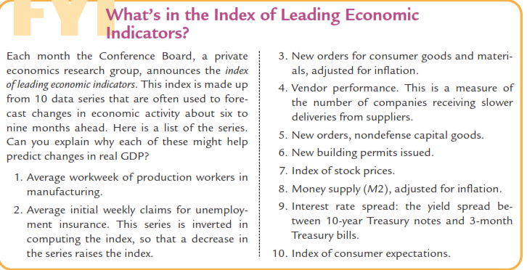
Leading Economic Indicators
The index of leading economic indicators.
This index includes ten data series that are often used to forecast changes in economic activity about six to nine months into the future. Here is a list of the series:

Slide 21
Leading Economic Indicators
The index of leading economic indicators.
Rata-rata produksi per pekerja per minggu di industri manufaktur
Rata-rata klaim asuransi pengangguran per minggu
Order baru untuk barang konsumsi dan bahan baku, yang disesuaikan dengan inflasi
Kinerja vendor, mengukur jumlah perusahaan yang menerima kiriman yang lambat dari supplier
Order baru untuk barang modal (bukan untuk pertahanan/militer)
Isu ijin pembangunan gedung baru
Indeks harga saham
Jumlah unag beredar dalam arti luas (M2), yang disesuaikan dengan inflasi
Spread suku bunga : spread hasil saham 10 tahun dan tagihan obligasi 3 bulan
Indeks ekspektasi konsumsi

Slide 22
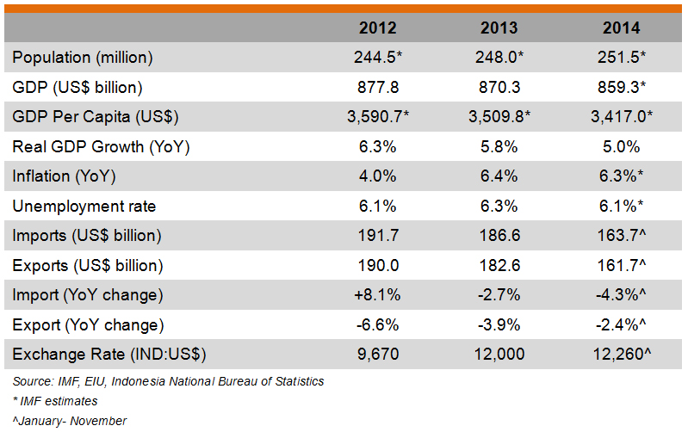
Leading Economic Indicators
INDONESIA

Slide 23
Long run: Prices are flexible, respond to changes in supply or demand
Short run: many prices are “sticky” at some predetermined level
The economy behaves much differently when prices are sticky.

Slide 24
In Classical Macroeconomic Theory: (what we studied in chapters 3-8)
Output is determined by the supply side:
supplies of capital, labor
technology
Changes in demand for goods & services (C, I, G ) only affect prices, not quantities.
Complete price flexibility is a crucial assumption,
So classical theory applies in the long run.
Notes:
Classical macroeconomic theory is what we learned in chapters 3-8. This slide recaps an important lesson from classical theory, which stands in sharp contrast to what we’re about to cover now.

Slide 25
When prices are sticky
…output and employment also depend on demand for goods & services, which is affected by:
fiscal policy (G and T )
monetary policy (M )
other factors, like exogenous changes in C or I.
Variabel Kebijakan:
Pemerintah: G dan T
Bank Sentral (BS): M
Variabel Eksogen:
Rumah Tangga: C
Perusahaan: I
Notes:
…and, in an open economy, net exports. (See chapter 12.)

Slide 26
The model of aggregate demand and supply
the paradigm that most mainstream economists & policymakers use to think about economic fluctuations and policies to stabilize the economy
shows how the price level and aggregate output are determined.
shows how the economy’s behavior is different in the short run and long run.

Slide 27
The aggregate demand (AD) curve shows the relationship between the price level and the quantity of output demanded.
For this chapter’s intro to the AD/AS model, we use a simple theory of aggregate demand based on the Quantity Theory of Money.
Chapters 10-12 develop the theory of aggregate demand in more detail.

Slide 28
The Quantity Equation as Aggregate Demand
From Chapter 4, recall the quantity equation
M V = P Y
and the money demand function it implies:
(M/P )^{d} = k Y where V = 1/k = velocity.
For given values of M and V, these equations imply an inverse relationship between P and Y:

Slide 29
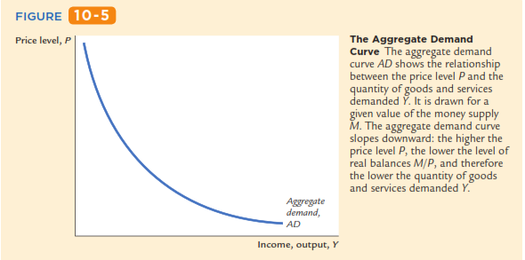
An increase in the price level causes a fall in real money balances (M/P ), causing a decrease in the demand for goods & services: P ↑→ (M/P) ↓ → D for goods & services ↓ → Y ↓

Slide 30
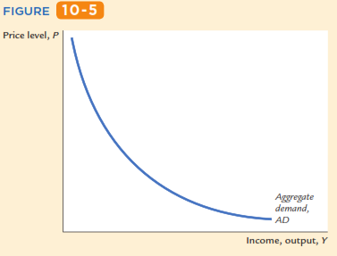
M V = P Y
The money supply M and the velocity of money V determine the nominal value of output PY.
Once PY is ﬁxed, if P goes up, Y must go down.
1
2
M V tetap = P ↑ Y ↓
3
P2
1
P1
Y2
Y1
2

Slide 31
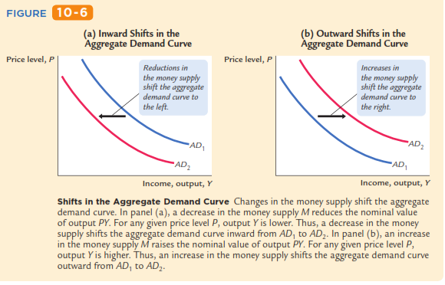

Slide 32
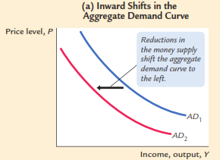
M ↓ → PY ↓ dengan P tertentu → Y ↓
M ↓ → geser AD kekiri
P1
Y2
Y1

Slide 33
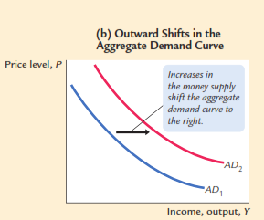
M ↑ → PY ↑ dengan P tertentu → Y ↑
M ↑ → geser AD kekanan
P1
Y1
Y2

Slide 34
Aggregate Supply in the Long Run
Recall from chapter 3: In the long run, output is determined by factor supplies and technology
is the full-employment or natural level of output, the level of output at which the economy’s resources are fully employed.
“Full employment” means that unemployment equals its natural rate.
Notes:
Some textbooks also use the term “potential GDP” to mean the full-employment level of output.

Slide 35
Aggregate Supply in the Long Run
Recall from chapter 3: In the long run, output is determined by factor supplies and technology
Full-employment output does not depend on the price level,
so the long run aggregate supply (LRAS) curve is vertical:
Notes:
Some textbooks also use the term “potential GDP” to mean the full-employment level of output.

Slide 36
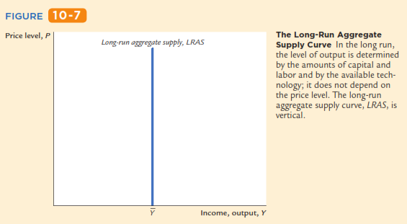
Aggregate Supply in the Long Run
The LRAS curve is vertical at the full-employment level of output (Ybar).

Slide 37
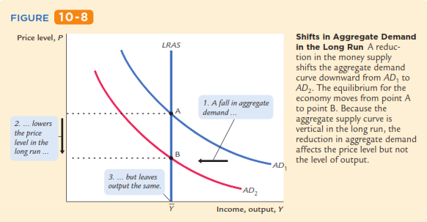
Shifts in Aggregate Supply in the Long Run
P1
P1

Slide 38
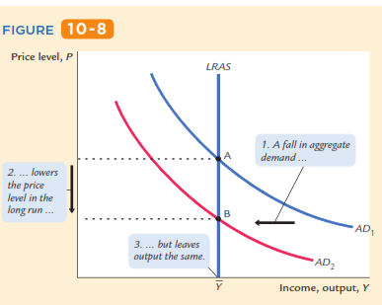
Shifts in Aggregate Supply in the Long Run
LRAS dan AD1→ A: P1 dan Ybar
M ↓ → AD ↓ geser kiri: AD1 ke AD2; LRAS tetap
P1
LRAS dan AD2 →B: P2 dan Ybar
P1
M ↑ → P ↑ dan Y tetap (Ybar)

Slide 39
Long-run effects of an increase in M
LRAS dan AD1→ A: P1 dan Ybar
M ↑ → AD ↑ geser kanan: AD1 ke AD2 ; LRAS tetap
P
LRAS
An increase in M shifts the AD curve to the right.
In the long run, this increases the price level…
P₂
B
P₁
AD₂
A
AD₁
…but leaves output the same.
Y
LRAS dan AD2 →B: P2 dan Ybar
M ↑ → P ↑ dan Y tetap (Ybar)
Notes:
[The textbook does a fall in AD (Figure 9-5 on p.246); these slides do an increase.]
Notice that the results in this graph are exactly as we learned in chapters 3-8: a change in the money supply affects the price level, but not the quantity of output. Here, we are seeing these results on a graph with different variables on the axes (P and Y), but it’s the same model.

Slide 40
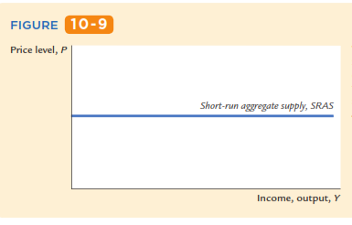
The SRAS curve is horizontal:
The price level is fixed at a predetermined level, and firms sell as much as buyers demand.
P

Slide 41
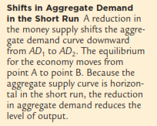
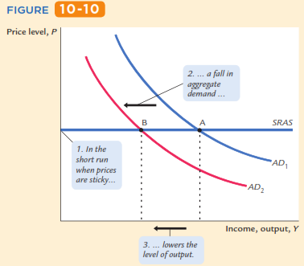
Shifts in Aggregate Demand in the Short Run
P
M ↑ → AD ↑ geser kanan: AD1 ke AD2 → SRAS tetap → P tetap → Y ↑ dari Y1 ke Y2

Slide 42
Short-run effects of an increase in M
P
In the short run when prices are sticky,…
…an increase in aggregate demand…
M ↑ → AD ↑ geser kanan: AD1 ke AD2 → SRAS tetap → P tetap pada Pbar → Y ↑ dari Y1 ke Y2
SRAS
AD₂
AD₁
Y
…causes output to rise.
Y₁
Y₂
Notes:
[The textbook (Figure 9-7 on p.248) does a decrease in AD, these slides do an increase.]
What about the unemployment rate? Remember from chapter 2: Okun’s law says that unemployment and output are negatively related. In the graph here, in order for firms to increase output, they require more workers. Employment rises, and the unemployment rate falls.

Slide 43
We can summarize our analysis so far as follows:
Over long periods of time, prices are ﬂexible, the aggregate supply curve is vertical, and changes in aggregate demand affect the price level but not output.
Over short periods of time, prices are sticky, the aggregate supply curve is ﬂat, and changes in aggregate demand do affect the economy’s output of goods and services.

Slide 44
We can summarize our analysis so far as follows:
Over long periods of time, prices are ﬂexible, the aggregate supply curve is vertical, and changes in aggregate demand affect the price level but not output.
Over short periods of time, prices are sticky, the aggregate supply curve is ﬂat, and changes in aggregate demand do affect the economy’s output of goods and services.
Jangka Panjang:
P fleksibel.
AS vertikal, ∆AD → ∆P; Y tetap
Jangka Pendek:
P tetap.
AS horinsontal, ∆AD → P tetap; ∆Y

Slide 45
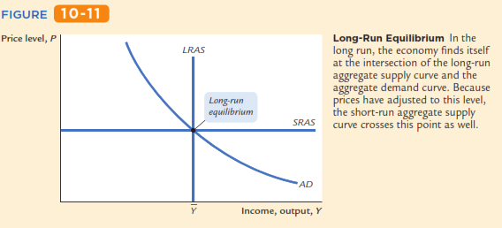
P1
A

Slide 46
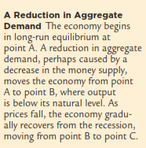
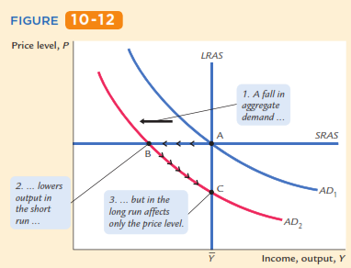
Pada titik A: M ↓ → AD ↓ geser kiri: AD1 ke AD2 → AD2 dan SRAS → titik B: P tetap pada P1 dan Y ↓ dari Ybar ke Y1 (Y1<Ybar); AD2 dan LRAS → kelebihan AS → P turun sampai pada tingkat Y bar → titik C: P2 dan Y bar
P1
P
P2
Y1

Slide 47
The SR & LR effects of ΔM > 0
Pada titik A: ……………→ titik B: ……………… → titik C: P2 dan Ybar
M↑
P
LRAS
A = initial equilibrium
B = new short-run eq’m after Fed increases M
P₂
C
B
SRAS
A
AD₂
AD₁
C = long-run equilibrium
Y
Y₂
Notes:
This slide puts together the pieces that have been developed over the previous slides: the short-run and long-run effects, as well as the adjustment of prices over time that causes the economy to move from the short-run equilibrium at point B to the long-run equilibrium at C.
The economy starts at point A; output and unemployment are at their “natural” rates. The Fed increases the money supply, shifting AD to the right. In the short run, prices are sticky, so output rises. The new short-run equilibrium is at point B in the graph.
In order for firms to increase output, they hire more workers, so unemployment falls below the natural rate of unemployment, putting upward pressure on wages. The high level of demand for goods & services at point B puts upward pressure on prices.
Over time, as prices become “unstuck,” they begin to rise in response to these pressures. The price level rises and the economy moves up its (new) AD curve, from point B toward point C.
This process stops when the economy gets to point C: output again equals the “natural rate of output,” and unemployment again equals the natural rate of unemployment, so there is no further pressure on prices to change.

Slide 48
shocks: exogenous changes in aggregate supply or demand. → pergeseran AD dan atau AS
Shocks temporarily push the economy away from full-employment. → Y menjauh dari Y FE
An example of a demand shock: exogenous decrease in velocity. → Contoh shock di AD: V ↓
If the money supply is held constant, then a decrease in V means people will be using their money in fewer transactions, causing a decrease in demand for goods and services. → M tetap, V ↓ (transaksi ↓) → AD barang dan jasa ↓

Slide 49
One goal of the model of aggregate supply and aggregate demand is to show how shocks cause economic ﬂuctuations.
Another goal of the model is to evaluate how macroeconomic policy can respond to these shocks.
Economists use the term stabilization policy to refer to policy actions aimed at reducing the severity of short-run economic ﬂuctuations.
Because output and employment ﬂuctuate around their long-run natural levels, stabilization policy dampens the business cycle by keeping output and employment as close to their natural levels as possible.

Slide 50
Consider an example of a demand shock: the introduction and expanded availability of credit cards.
Because credit cards are often a more convenient way to make purchases than using cash, they reduce the quantity of money that people choose to hold.
This reduction in money demand is equivalent to an increase in the velocity of money. When each person holds less money, the money demand parameter k falls.
This means that each dollar of money moves from hand to hand more quickly, so velocity V (= 1/k) rises

Slide 51
If the money supply is held constant, the increase in velocity causes nominal spending to rise and the aggregate demand curve to shift outward. → M tetap, V ↑ (transaksi ↑) → AD barang dan jasa ↑ → AD geser kanan
In the short run, the increase in demand raises the output of the economy—it causes an economic boom. →jangka pendek: AD barang dan jasa ↑ → perekonomian boom
At the old prices, ﬁrms now sell more output. Therefore, they hire more workers, ask their existing workers to work longer hours, and make greater use of their factories and equipment. → Pada P semula: perusahaan menjual banyak output → meningkatkan pengerjaan dengan menambah jam kerja; menambah pengerjaan mesin dan peralatan.

Slide 52
Over time, the high level of aggregate demand pulls up wages and prices. As the price level rises, the quantity of output demanded declines, and the economy gradually approaches the natural level of production. → sepanjang waktu: AD yang tinggi → upah (w) dan harga (P); P ↑ → jumlah agregat yang diminta ↓ → perkeonomian secara perlahan menuju ke tingkat output alamiah (Ybar)
But during the transition to the higher price level, the economy’s output is higher than its natural level. → selama transisi ke tingkat harga yang lebih tinggi, Y > Ybar

Slide 53
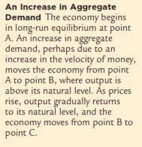
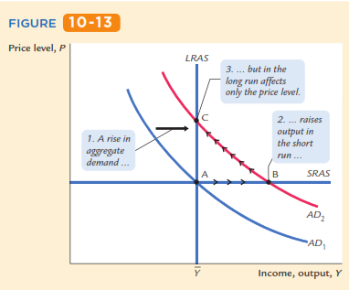
Pada titik A: credit card → V ↑ → AD ↑ geser kanan: AD1 ke AD2 → AD2 dan SRAS → titik B: P tetap pada P1 dan Y ↑ dari Ybar ke Y1 (Y1>Ybar); AD2 dan LRAS → kelebihan AD → P naik → sampai pada tingkat Y bar → titik C: P2 dan Ybar
P₂
P1
Y1

Slide 54
Pada titik A: credit card → V ↑ → AD ↑ geser kanan: AD1 ke AD2 → AD2 dan SRAS → titik B: P tetap pada P1 dan Y ↑ dari Ybar ke Y1 (Y1>Ybar); AD2 dan LRAS → kelebihan AD → P naik → sampai pada tingkat Y bar → titik C: P2 dan Ybar
What can the Fed do to dampen this boom and keep output closer to the natural level?
The Fed might reduce the money supply to offset the increase in velocity. Offsetting the change in velocity would stabilize aggregate demand.
Thus, the Fed can reduce or even eliminate the impact of demand shocks on output and employment if it can skillfully control the money supply.
Whether the Fed in fact has the necessary skill is a more difﬁcult question, which we take up in Chapter 18.

Slide 55
Pada titik A: credit card → V ↑ → AD ↑ geser kanan: AD1 ke AD2 → AD2 dan SRAS → titik B: P tetap pada P1 dan Y ↑ dari Ybar ke Y1 (Y1>Ybar); M di ↓ kan → AD ↓ geser kiri: AD2 ke AD1 → AD1 dan LRAS-SRAS → titik A: P tetap pada P1 dan Y ↓ dari Y1 ke Ybar
P1
Y1

Slide 56
The effects of a negative demand shock
Pada titik A: ……………→ titik B: ……………… → titik C: P2 dan Ybar
The shock shifts AD left, causing output and employment to fall in the short run
P
LRAS
B
A
SRAS
Over time, prices fall and the economy moves down its demand curve toward full-employment.
C
AD₁
P₂
AD₂
Y
Y₂
Notes:
Note the economy’s “self-correction” mechanism:
When in a recession, the economy --- left to its own devices --- “fixes” itself: the gradual adjustment of prices helps the economy recover from the shock and return to full employment.

Slide 57
Over time, prices gradually become “unstuck.” When they do, will they rise or fall?
In the short-run equilibrium, if
then over time, the price level will
rise
fall
remain constant
This adjustment of prices is what moves the economy to its long-run equilibrium.
Notes:
You might want to discuss the intuition for the price adjustment in each case.
First, suppose aggregate demand is higher than the full-employment level of output in the economy’s initial short-run equilibrium. Then, there is upward pressure on prices: In order for firms to produce this above-average level of output, they must pay their workers overtime and make their capital work at a high intensity, which causes more maintenance, repairs, and depreciation. For all these reasons, firms would like to raise their prices. In the short run, they cannot. But over time, prices gradually become “unstuck,” and firms can increase prices in response to these cost pressures.
Instead, suppose that output is below its natural rate. Then, there is downward pressure on prices: Firms can’t sell as much output as they’d like at their current prices, so they would like to reduce prices. With lower than normal output, firms won’t need as many workers as normal, so they cut back on labor, and the unemployment rate rises above the “natural rate of unemployment.” The high unemployment rate puts downward pressure on wages. Wages and prices are “stuck” in the short run, but over time, they fall in response to these pressures.
Finally: if output equals its normal (or “natural”) level, then there is no pressure for prices to rise or fall. Over time, as prices become “unstuck,” they will simply remain constant.

Slide 58
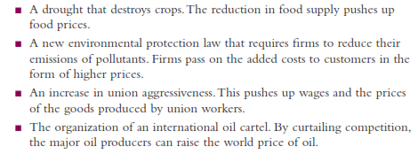
Cost ↑ → shock AS → P ↑ ➔ shock P
(Favorable supply shocks lower costs and prices)

Slide 59
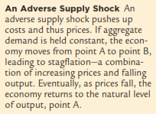
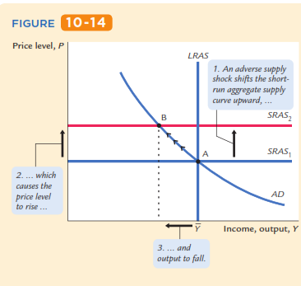
P2
Pada titik A: AD dan SRAS1→ P1 dan Ybar
SRAS ↓ dari SRAS1 ke SRAS2
SRAS2 dan AD: titik B: P ↑ dari P1 ke P2 dan Y ↓ dari Ybar ke Y1 (Y1<Ybar)
SRAS ↓ → P ↑ dan Y ↓ ➔ stagflasi
P1
Y1
SRAS ↓ karena ?

Slide 60
CASE STUDY AS: The 1970s oil shocks
The oil price shock shifts SRAS up, causing output and employment to fall.
P
LRAS
B
SRAS₂
In absence of further price shocks, prices will fall over time and economy moves back toward full employment.
A
A
SRAS₁
AD
Y
Y₂
Notes:
And, as output falls from Ybar to Y2 in the graph, we would expect to see unemployment increase above the natural rate of unemployment. (Recall from chapter 2: Okun’s law says that output and unemployment are inversely related.)
Note the phrase “in absence of further price shocks.” As we will see shortly, just as the economy was recovering from the first big oil shock, a second one came along.

Slide 61
CASE STUDY AS: The 1970s oil shocks
Early 1970s: OPEC coordinates a reduction in the supply of oil.
Oil prices rose 11% in 1973 68% in 1974 16% in 1975
Such sharp oil price increases are supply shocks because they significantly impact production costs and prices.
Notes:
Oil is required to heat the factories in which goods are produced, and to fuel the trucks that transport the goods from the factories to the warehouses to the Walmarts. A sharp increase in the price of oil, therefore, has a substantial effect on production costs.

Slide 62
Stabilization policy
def: policy actions aimed at reducing the severity of short-run economic fluctuations.
Example: Using monetary policy to combat the effects of adverse supply shocks:
Notes:
Chapter 14 is devoted to stabilization policy.

Slide 63
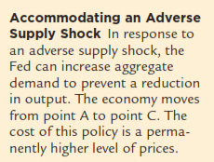
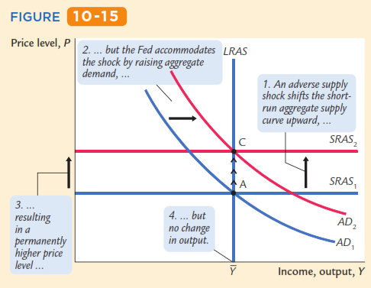
Stabilization policy with monetary policy
Pada titik A: AD dan SRAS1→ P1 dan Ybar
SRAS ↓ dari SRAS1 ke SRAS2
M di ↑ kan → AD ↑ geser kanan dari AD1 ke AD2
AD2 - SRAS2 – LRAS: titik C: P ↑ dari P1 ke P2 dan Y tetap di Ybar
SRAS ↓ dan M di ↑ kan: P ↑ dan Y tetap
P2
P1
Notes:
Chapter 14 is devoted to stabilization policy.

Slide 64
Stabilizing output with monetary policy
But the Fed accommodates the shock by raising agg. demand.
P
LRAS
B
C
SRAS₂
A
results: P is permanently higher, but Y remains at its full-employment level.
AD₂
AD₁
Y
Y₂
Notes:
Note: If the Fed correctly anticipates the sign and magnitude of the shock, then the Fed can respond as the shock occurs rather than after, and the economy never would go to point B - it would go immediately to point C.

Slide 65
Chapter Summary
Long run: prices are flexible, output and employment are always at their natural rates, and the classical theory applies.
Short run: prices are sticky, shocks can push output and employment away from their natural rates.
Aggregate demand and supply: a framework to analyze economic fluctuations
The aggregate demand curve slopes downward

Slide 66
Chapter Summary
The long-run aggregate supply curve is vertical, because output depends on technology and factor supplies, but not prices.
The short-run aggregate supply curve is horizontal, because prices are sticky at predetermined levels.
Shocks to aggregate demand and supply cause fluctuations in GDP and employment in the short run.
The Fed can attempt to stabilize the economy with monetary policy.

Slide 67
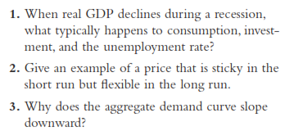

Slide 68
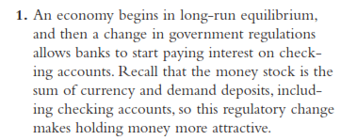

Slide 69
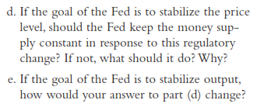

Slide 70
