Slide 1
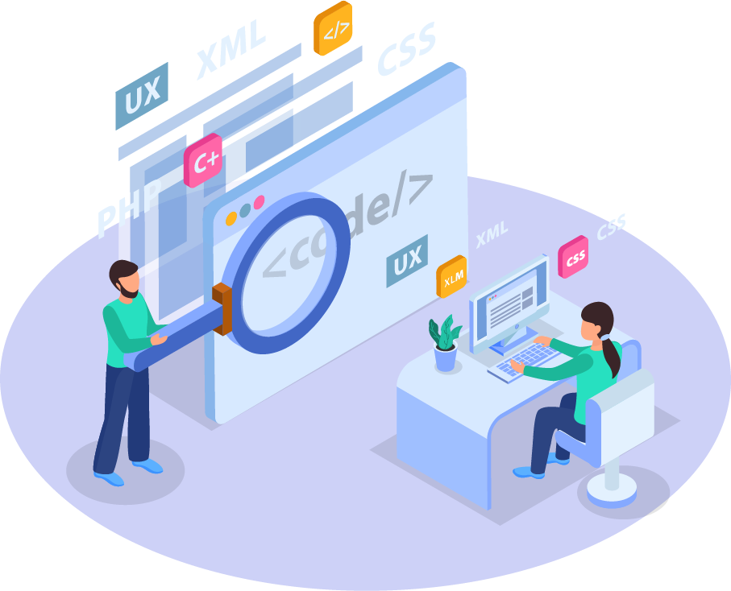
BACK END DEVELOPMENT
👋👋
PHP Introduction
ICT 2nd Semester

Slide 2
Coffee Shop Analogy

Slide 3
Coffee Shop Analogy
Beverages
Friendly Barista
Foods and Snacks
Aesthetic Cafe interior
Cozy atmosphere
Jazz Music
Front-end

Slide 4
Coffee Shop Analogy
Kitchen stuff
Barista techniques
How to operate coffee machine
Financial Reports
store rental
operational costs
Back-end

Slide 5
What is Front-End & Back-End dev ???
Front-end
Front-End merupakan bagian dari aplikasi yang terlihat dan digunakan langsung oleh pengguna (end-user)
Back-end
Back-End merupakan bagian dari aplikasi yang bertanggung jawab untuk menyediakan kebutuhan yang tak terlihat oleh pengguna

Slide 6
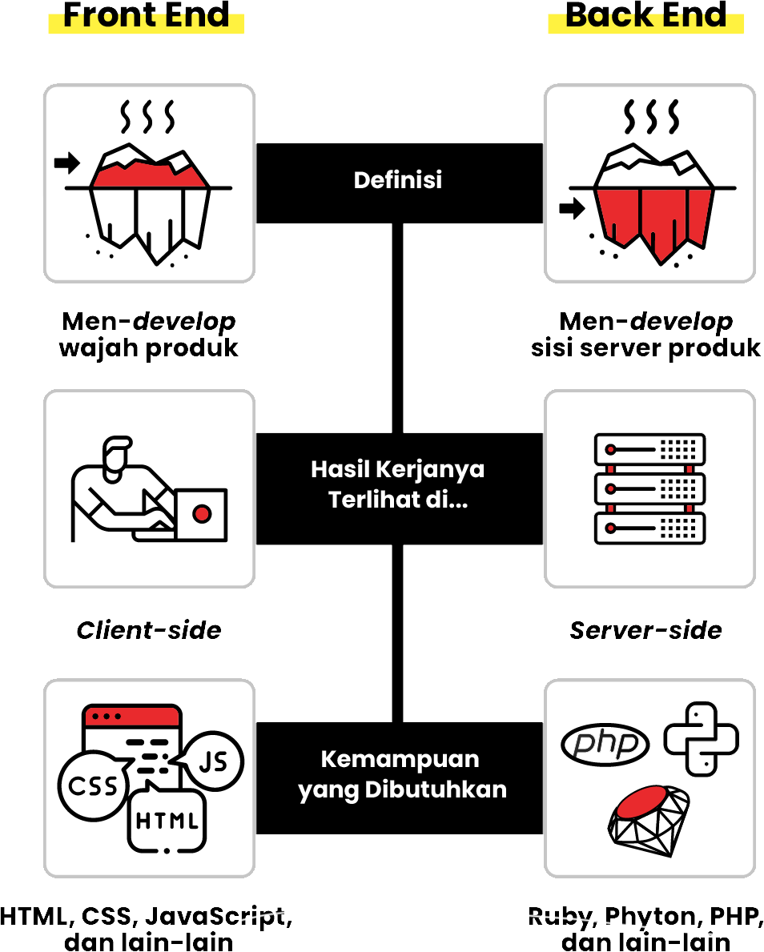
Differences
Front-end vs Back-end
Tampilan Produk
Client-side
HTML, CSS, JS
Server Produk
Server-side
PHP, Python, Ruby

Slide 7
what can i do with the back-end?
It focuses on database, scripts, website architecture as it relates to the behind the scenes of the website.
It can be an account login or making a purchase from an online store, etc.

Slide 8
PHP
Programming
What will we learn in class?
Database Management
MySQL

Slide 9
The tools we use!
Alternative
Free
XAMPP 7.2.2
Google Chrome
Visual Code
Studio
Sublime Text

Slide 10
Download and Install!!!
XAMPP 7.2.2

Slide 11
Chapter 1
Getting Started with PHP!

Slide 12
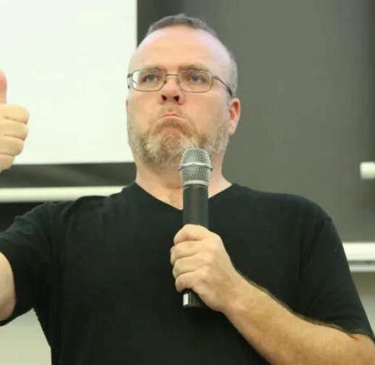
Who is he?
Rasmus Lerdorf
Founder of PHP programming language
PHP was created by Rasmus Lerdorf in 1994. It’s currently maintained by the PHP Development Team.

Slide 13
HyperText Preprocessor
P
H
PHP is a server-side programming language that is widely used and specifically suited for web development.
By the end, you will be able to write your first Hello World program in PHP.
P

Slide 14
let's code php
P
.php extension
The script is a text file, which can be created using a plain text file editor program
H
Opening Tag
<?php
PHP code goes here;
?>
P
Penulisan PHP bisa digabung dengan HTML
Closing Tag

Slide 15
Let’s code
Hello World!
Open your modul Chapter 1 and do the Practice Section

Slide 16
Embedded Script
P
an HTML document that will be generated using a PHP program/script
H
<html>
<body>
<?php echo “SMA ABBS Surakarta” ?>;
</body>
</html>
P

Slide 17
Non-Embedded Script
P
HTML tags generated to create documents are part of the PHP script.
H
<?php
echo “<h1>SMA ABBS Surakarta</h1>”;
?>
P
Tag <h1> di-generate dengan menggunakan php script

Slide 18
Case Sensitive
P
Aturan penulisan yang mengarah pada cara sistem merespon penggunaan huruf besar dan huruf kecil
H
$number
$NUMBER
$Number
P
Variables are case-sensitive. e.g., $number and $NUMBER are different variables.

Slide 19
Statements
P
A PHP script typically consists of one or more statements. A statement is a code that does something,
H
<?php
$message = "Hello";
?>
Biasa digunakan untuk menentukan value pada variable, dll.
P
A statement always ends with a semicolon (;).

Slide 20
Exercise
Let’s do the exercise 1 on paper in pairs
Kerjakan latihan 1 di selembar kertas secara berpasangan

