Slide 1
Comparison of Urbanization Process and Distribution of Cities
Pertemuan 4
Sustanable Urbanization 2022

Slide 2
Notes:
South Asia: Afghanistan, Bangladesh, Bhutan, India, Maldives, Nepal, Pakistan, and Sri Lanka.
EU: Germany, the Netherlands, Belgium, France, Denmark, Finland, Sweden, Italy
North America:

Slide 3
Notes:
Australia largest city: Sydney (4.6 million)
Canada largest city: Toronto (5 million)
EU: London before out 14 million, Paris but restricted to admin down Berlin nearly 4 (3.6)
US: New York (10 million)
South Asia: Delhi (nearly 19 million)
China: Shanghai 25 million
SSA: Lagos Nigeria but excluded , so Kinshasha Congo (nearly 16 million)

Slide 5
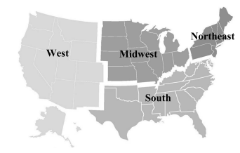
Case study: Urbanization in the US
industrialization and urbanization in the US (Fastest period: 1880-1929): especially in the Northeast and Midwest
Industrialization: meaning manufacturing in factory settings using machines plus a labor force with unique, divided tasks to increase production (assembly line)
After 1880, industrialization depended much more on mechanization—the replacement of people with machines—to increase production and maximize profits
stimulated urbanization (the growth of cities in both population and physical size)
the total manufacturingoutput of the United States was twenty-eight times greater in 1929 than it was 1859

Slide 6
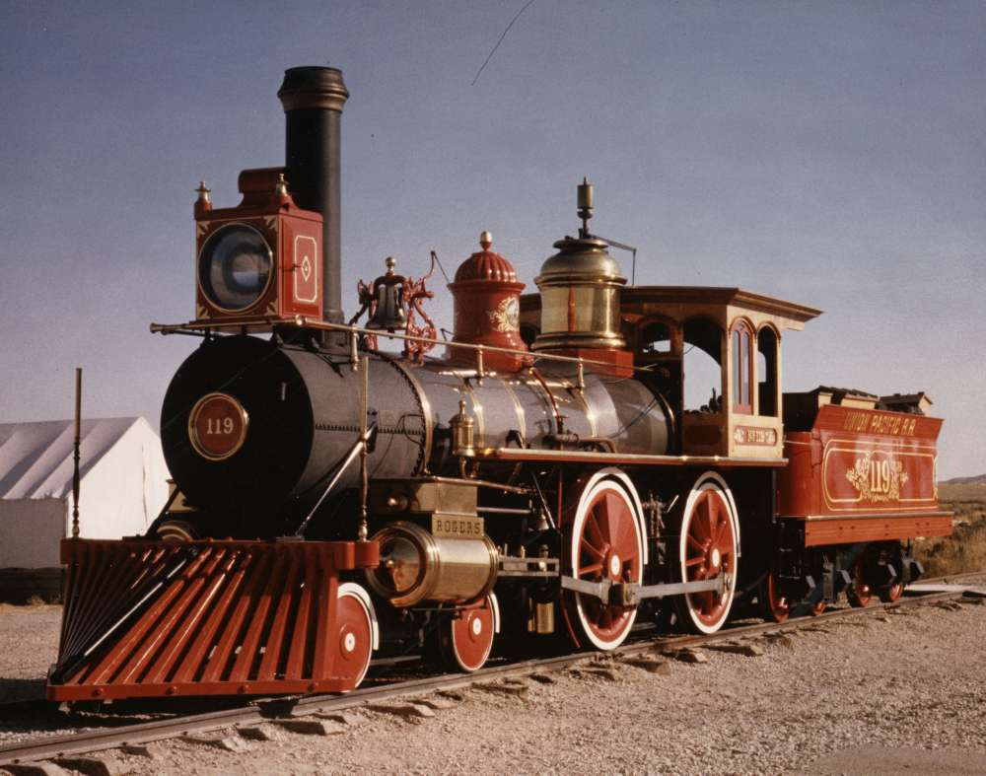
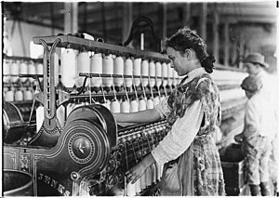
the refrigerated railroad car, meat processing became enormous industry that the vast majority of the meat that Americans ate was processed in the stockyards on Chicago’s south side
The largest cities in the Midwest (Chicago) the largest city in the Midwest, processing natural resources from the Western then sent to traveled eastward as finished products. Grain and lumber—two industries that had been crucial for Chicago’s early growth—relied on Chicago for marketing and storage
The largest cities in the Northeast (NY) were manufacturing powerhouses: large factories building railroad locomotives to small shops producing textiles in people’s apartments
Differentiate function—building specialization since the early era of urbanization
Cotton Mill
Iron and steel manufacturing
(1870s)
Became important textile industry in the 20th

Slide 7
Case study: Urbanization in the US-Tranportation and electricity
Improvement of power source (huge increase in electricity-electric power became readily available in cities when the first commercial power plants began to open in 1882)
Power became cheaper, cleaner compared to steam engine (coal) or water wheels: electric power for factory operations: during 1900-1930
Intracity transportation for employers (Prior to the 1880s Omnibus horse-drawn carriage/1887 electric trolley/1873 electric cars)—people travel further----trigger sub urbanization (employers)
Expansive railroad system establishment for manufacturing—connecting cities----growth of new factories----in raw material available (factories were established near port or railroad stops)
Structural steel and skycraper: industrial age example of coordination between labour and materials
Assembly line: More efficient mass production.

Slide 8
Case study: Urbanization in the US
1850
15.3 percent of Americans lived in cities in 1850.
1900
increased to 39.7
1920
Americans lived in cities than the countryside for the first time

Slide 9
Urban Primacy (Jefferson, 1939)
The degree of concentration of urban development factors in the biggest city in the urban system
For more precise analysis there are four cities ratio and eleven cities ratio
Primacy ratio : S= P1/P2
Four city ratio : S = P1/(P2+ P3 + P4)
Eleven city ratio: S = P1/(P2+ P3 + P4…P11)

Slide 10
Urban Primacy
P is the urban population size
Pi is the size of the city ranking i.
For the primacy ratio, S = 2 is the ideal value of the city size distribution structure;
for the four-city ratio and the eleven-city ratio, S =1 is the ideal value of the city size distribution structure

Slide 11
Factors Encouraging Urban Primacy
Colonialism
Strong centralized government
Industrial agglomeration
Migration

Slide 12
Advantage of Primate Cities
Economies of large scale can be achieved because they attract investment and benefits that will benefit the entire country
Attractive place for migration
Resources, services, and infrastructure available on a large scale

Slide 13
Problems faced by primacy
House shortage
Traffic congestion
Pollution
Inequalities
Increased land value

Slide 14
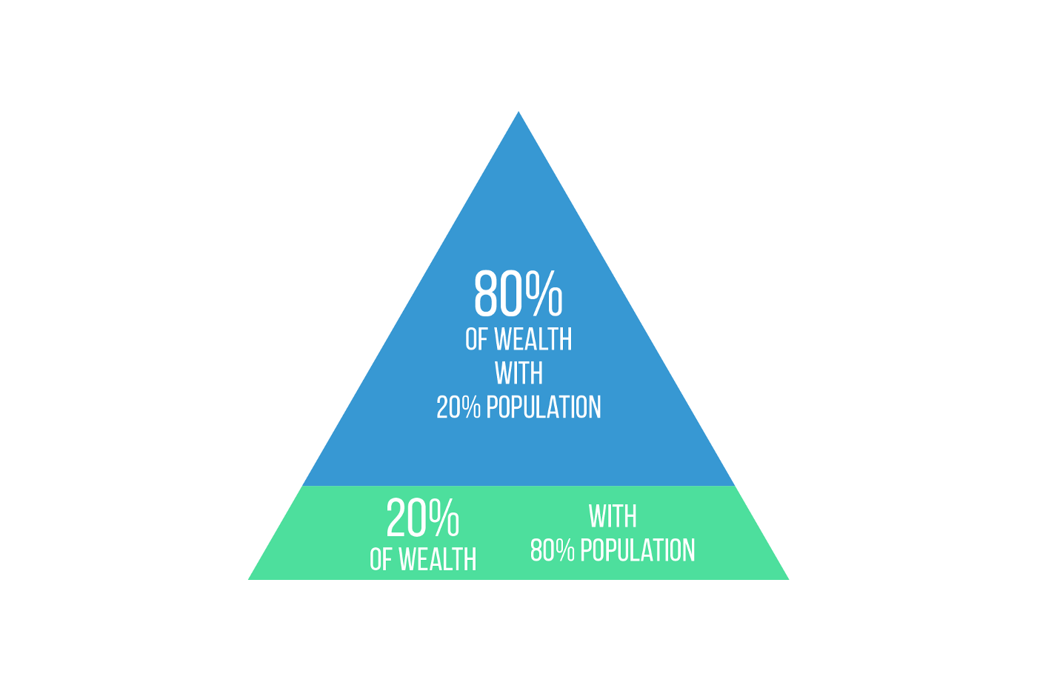
Zipf’s Law
Distribution of Cities not only follows Pareto Distribution
Zipf Law: suggested that the city size distribution not only follows the Pareto distribution but also takes a Pareto exponent equal to 1 (Zipf, 1949) such that an ideal rectangular hyperbolic relationship exists between the city's rank and its size
Countries' city size distribution: the frequency of cities with different size and their rank are connected through a power-law function (Zipf, 1949)
Zipf's law has been described as the relationship between the city size and its rank, which is why it is often referred to as the “Rank Size Law”
Zipf’s Law is the rank size rule: the population of the N th largest city is 1/N times the population of the largest city

Slide 15
Zipf’s Law
q is the Zipf dimension: reflecting the concentration of population distribution
r is the rank of a city (sorted according to descending city size)
P1 is the size of the largest city
Pr is the size of a city ranking r

Slide 16
Zipf’s Law
q = 1, the city size distribution satisfies Zipf's law (indicating that in the urban system, the concentration ratio of population distribution and the dispersion ratio of population are completely equal. This means that a relatively balanced urban population distribution exists)
q < l, urban population concentrates mainly in medium and small cities, that is, the monopoly status of the primate city or large cities is not strong enough and the medium and small cities develop relatively well
q > 1, it means that in the urban system, urban population concentrates mainly in large cities and the development of medium and small cities are relatively insufficient
the greater the q, the stronger the monopoly capacity of the primate city. Notably, if q/∞, there would be only one city in the urban system; if q = 0, the size of all cities are the same in the urban system

Slide 17
Primacy Ratio

Slide 18
Zipf ’s Law across Four Countries
The plots show the relationship between the logarithm of the city rank and the logarithm of the area population
(Chauvin, et al., 2016)

Slide 19
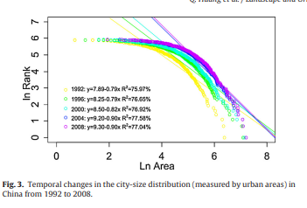
(Huang et al., 2015)

Slide 20
Reference
Chauvin, J. P., Glaeser, E., Ma, Y., & Tobio, K. (2017). What is different about urbanization in rich and poor countries? Cities in Brazil, China, India and the United States. Journal of Urban Economics, 98, 17–49. https://doi.org/10.1016/j.jue.2016.05.003
Drahos, J., Wu, M., Anderson, W. F., Trivers, K. F., King, J., Rosenberg, P. S., Eheman, C., & Cook, M. B. (2013). Regional Variations in Esophageal Cancer Rates by Census Region in the United States, 1999-2008. PLoS ONE, 8(7). https://doi.org/10.1371/journal.pone.0067913
Fang, C., Pang, B., & Liu, H. (2017). Global city size hierarchy: Spatial patterns, regional features, and implications for China. Habitat International, 66, 149–162. https://doi.org/10.1016/j.habitatint.2017.06.002
Huang, Q., He, C., Gao, B., Yang, Y., Liu, Z., Zhao, Y., & Dou, Y. (2015). Detecting the 20 year city-size dynamics in China with a rank clock approach and DMSP/OLS nighttime data. Landscape and Urban Planning, 137, 138–148. https://doi.org/10.1016/j.landurbplan.2015.01.004
https://data.worldbank.org/
Rees, J. (2016). Industrialization and Urbanization in the United States, 1880–1929. Oxford Research Encyclopedia of American History, July 2016, 1–14. https://doi.org/10.1093/acrefore/9780199329175.013.327

