Slide 1
FISIKA DASAR
14 CAHAYA
UNIVERSITAS
SEBELAS MARET

Slide 2
Nature of light: particles?
Until the end of the 19th century, light was considered to be a stream of particles.
The particles were either emitted by the object being viewed or emanated from the eyes of the viewer
Isaac Newton (1642-1727) was the chief architect of the particle theory of light
– He believed the particles left the object and stimulated the sense of sight upon entering the eyes
This was the view at the end of the 18th century

Slide 3
Nature of light: waves?
Christian Huygens (1629-1695) argued that light might be some sort of a wave motion
Thomas Young (1801) provided the first clear demonstration of the wave nature of light
– He showed that light rays interfere with each other
– Such behavior could not be explained by particles
During the nineteenth century, other developments led to the general acceptance of the wave theory of light
Maxwell asserted that light was a form of high-frequency electromagnetic wave
Hertz confirmed Maxwell’s predictions
– This was the view at the end of 19th century!

Slide 4
Nature of light: particle or wave? - or both?
Some experiments could not be explained by the wave nature of light
The photoelectric effect was a major phenomenon not explained by waves
– When light strikes a metal surface, electrons are sometimes ejected from the surface
– The kinetic energy of the ejected electron is independent of the frequency of the light

Slide 5
According to Einstein’s theory, the energy of a photon is proportional to the frequency of the electromagnetic wave
where the constant of proportionality h = 6.63 x 10⁻³⁴ Js is Planck’s constant

Slide 6
Reflection
When a light ray traveling in one medium encounters a boundary with another medium, part of the incident light is reflected.

Slide 7
Reflection of light from such a smooth surface is called specular reflection.
Reflection from any rough surface is known as diffuse reflection.

Slide 8
the law of reflection
the angle of reflection equals the angle of incidence

Slide 9
Ex. 1. The Double-Reflected Light Ray
Two mirrors make an angle of 120° with each other, as illustrated in Figure. A ray is incident on mirror M1 at an angle of 65° to the normal. Find the direction of the ray after it is reflected from mirror M2.

Slide 10
Refraction
When a ray of light traveling through a transparent medium encounters a boundary leading into another transparent medium, part of the energy is reflected and part enters the second medium.

Slide 12
The angle of refraction depends on the properties of the two media and on the angle of incidence through the relationship
where v1 is the speed of light in the first medium and v2 is the speed of light in the second medium.

Slide 13
Index of Refraction
light travels at its maximum speed in vacuum.
index of refraction n of a medium to be the ratio

Slide 15
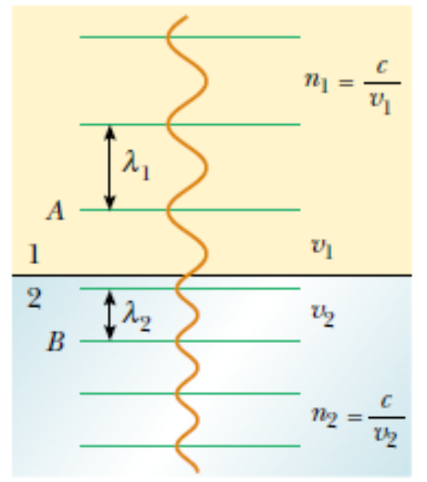
As light travels from one medium to another, its frequency does not change but its wavelength does.

Slide 17
Ex 2. An Index of Refraction Measurement
A beam of light of wavelength 550 nm traveling in air is incident on a slab of transparent material. The incident beam makes an angle of 40.0° with the normal, and the refracted beam makes an angle of 26.0° with the normal. Find the index of refraction of the material.

Slide 19
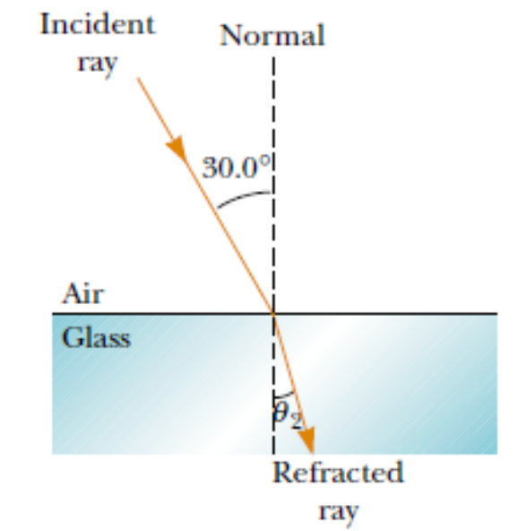
Ex 3. Angle of Refraction for Glass
A light ray of wavelength 589 nm traveling through air is incident on a smooth, flat slab of crown glass at an angle of 30.0° to the normal, as sketched in Figure 35.15. Find the angle of refraction.

Slide 21
Ex 4. Laser Light in a Compact Disc
A laser in a compact disc player generates light that has a wavelength of 780 nm in air.
Find the speed of this light once it enters the plastic of a compact disc (n = 1.55).
What is the wavelength of this light in the plastic?

Slide 23
Ex 5. Light Passing Through a Slab
A light beam passes from medium 1 to medium 2, with the latter medium being a thick slab of material whose index of refraction is n2. Show that the emerging beam is parallel to the incident beam.

Slide 26
Interference
Interference in light waves occurs whenever two or more waves overlap at a given point. An interference pattern is observed if (1) the sources are coherent and (2) the sources have identical wavelengths.

Slide 27
If light waves did not spread out after passing through the slits, no interference would occur.
light waves from the two slits overlap as they spread out, filling what we expect to be shadowed regions with light and producing interference fringes on a screen placed to the right of the slits.

Slide 29
Diffraction
Diffraction is the deviation of light from a straight-line path when the light passes through an aperture or around an obstacle. Diffraction is due to the wave nature of light.

Slide 31
Two point sources far from a narrow slit each produce a diffraction pattern.
The angle subtended by the sources at the slit is large enough for the diffraction patterns to be distinguishable.
The angle subtended by the sources is so small that their diffraction patterns overlap, and the images are not well resolved.

Slide 32
Individual diffraction patterns of two point sources (solid curves) and the resultant patterns (dashed curves) for various angular separations of the sources. In each case, the dashed curve is the sum of the two solid curves.
The sources are far apart, and the patterns are well resolved.
The sources are closer together such that the angular separation just satisfies Rayleigh’s criterion, and the patterns are just resolved.
The sources are so close together that the patterns are not resolved.

