Slide 1
Yunastiti Purwaningsih

Slide 2
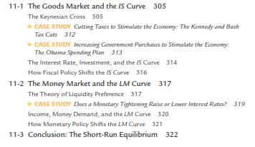

Slide 3
Classical theory seemed incapable of explaining the Depression. According to that theory, national income depends on factor supplies and the available technology, neither of which changed substantially from 1929 to 1933.
After the onset of the Depression, many economists believed that a new model was needed to explain such a large and sudden economic downturn and to suggest government policies that might reduce the economic hardship so many people faced.
In 1936 the British economist John Maynard Keynes revolutionized economics with his book The General Theory of Employment, Interest, and Money.

Slide 4
Keynes proposed a new way to analyze the economy, which he presented as an alternative to classical theory. His vision of how the economy works quickly became a center of controversy. Yet, as economists debated The General Theory, a new understanding of economic ﬂuctuations gradually developed.
Keynes proposed that low aggregate demand is responsible for the low income and high unemployment that characterize economic downturns. He criticized classical theory for assuming that aggregate supply alone—capital, labor, and technology—determines national income.

Slide 5
Economists today reconcile these two views with the model of aggregate demand and aggregate supply introduced in Chapter 10.
In the long run, prices are ﬂexible, and aggregate supply determines income.
But in the short run, prices are sticky, so changes in aggregate demand inﬂuence income.
Keynes’s ideas about short-run ﬂuctuations have been prominent since he proposed them in the 1930s, but they have commanded renewed attention in recent years.
In the aftermath of the ﬁnancial crisis of 2008–2009, the United States and Europe descended into a deep recession, followed by a weak recovery. As unemployment lingered at high levels, policymakers around the world debated how best to increase aggregate demand.

Slide 6
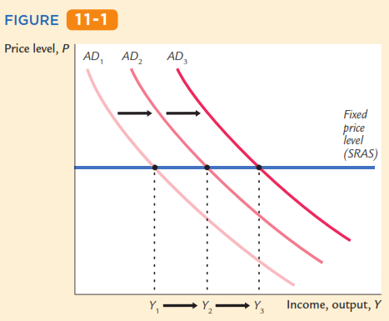
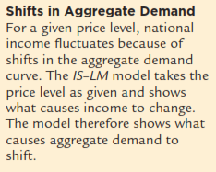
This chapter develops the IS-LM model, the theory that yields the aggregate demand curve.
We focus on the short run and assume the price level is fixed.

Slide 7
A simple closed economy model in which income is determined by expenditure. (due to J.M. Keynes)
Notation:
I = planned investment
PE = C + I + G = planned expenditure
Y = real GDP = actual expenditure
Difference between actual & planned expenditure: unplanned inventory investment

Slide 8
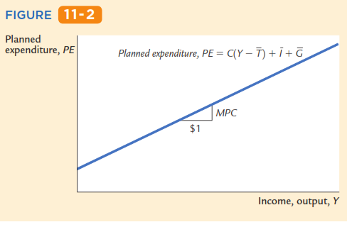
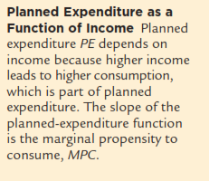
The slope of this line is the marginal propensity to consume, MPC: it shows how much planned expenditure increases when income rises by $1

Slide 9
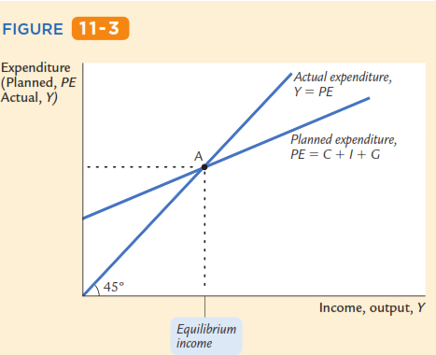
The Economy in Equilibrium
PE
C = 80 – 0,6 (Y-T)
I = 100
G = 60
T = 50
Yeq
Yeq = ?

Slide 10
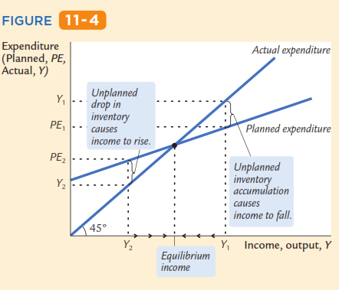
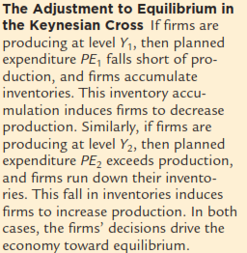
The Adjustment to Equilibrium in the Keynesian Cross
E
Yeq
Yeq

Slide 11
The Adjustment to Equilibrium in the Keynesian Cross
Pada Y2<Yeq: PE2>Y2 → perusahaan menjual inventori → inventori ↓ → perusahaan menambah pengerjaan → produksi ↑ → Y ↑ sampai menuju Yeq
E
Pada Y1>Yeq: PE1<Y2 → perusahaan menjual lebih sedikit dibanding yang produksi → inventori ↑ → perusahaan mengurangi pengerjaan → produksi ↓ → Y ↓ sampai menuju Yeq
Yeq

Slide 12
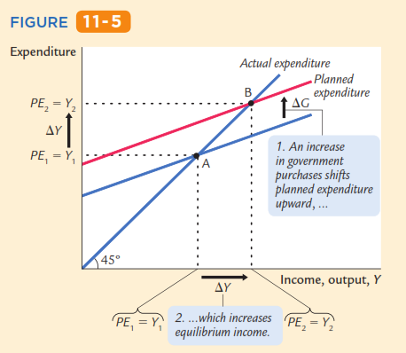
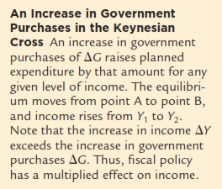
An Increase in Government Purchases in the Keynesian Cross

Slide 13
An Increase in Government Purchases in the Keynesian Cross
PE1= C + I + G1 → PE = Y → titik A → (PE1 = Y1)
PE2
PE1
G ↑ dari G1 ke G2
G ↑ → PE ↑ dari PE1 = C + I + G1 → ke PE2 = C + I + G2 → PE2 = Y → titik B → (PE2 = Y2)
G ↑ → Y ↑ dari Y1 ke Y2 → ∆Y = Y1 Y2

Slide 14
An increase in government purchases
G ↑ dari G1 ke G2
PE
PE =Y
At Y₁, there is now an unplanned drop in inventory…
PE2=C +I +G₂
B
PE1=C +I +G₁
ΔG
A
…so firms increase output, and income rises toward a new equilibrium
Y
PE₁ = Y₁
ΔY
PE₂ = Y₂
Notes:
Explain why the vertical distance of the shift in the E curve equals ΔG:
At any value of Y, an increase in G by the amount ΔG causes an increase in E by the same amount.
At Y₁, there is now an unplanned depletion of inventories, because people are buying more than firms are producing (E > Y).

Slide 15
Solving for ΔY
G ↑ dari G1 ke G2
∆G → ∆Y → ∆C → ∆Y
equilibrium condition
in changes
because I exogenous (I tetap)
because ΔC = MPC ΔY

Slide 16
Solving for ΔY
equilibrium condition
in changes
because I exogenous (I tetap)
because ΔC = MPC ΔY
Finally, solve for ΔY :
∆Y – (MPC x ∆Y) = ∆G

Slide 17
The government purchases multiplier
Example: MPC = 0.8
The increase in G causes income to increase by 5 times as much!... G ↑ → Y ↑ 5 kalinya

Slide 18
The government purchases multiplier
Definition: the increase in income resulting from a $1 increase in G.
In this model, the G multiplier equals
In the example with MPC = 0.8,
Notes:
The textbook defines the multiplier as the increase in income resulting from a $1 increase in G. However, G is a real variable (as is Y ). So, if you wish to be more precise, then you might consider defining the multiplier as “the increase in income resulting from a one-unit increase in G.”

Slide 19
Why the multiplier is greater than 1
Initially, the increase in G causes an equal increase in Y: ΔY = ΔG.
But ↑Y ⇒ ↑C
⇒ further ↑Y
⇒ further ↑C
⇒ further ↑Y
So the final impact on income is much bigger than the initial ΔG.
Notes:
Students are better able to understand this if given a more concrete example. For instance,
Suppose the government spends an additional $100 million on defense. Then, the revenues of defense firms increase by $100 million, all of which becomes income to somebody: some of it is paid to the workers and engineers and managers, the rest is profit paid as dividends to shareholders. Hence, income rises $100 million (ΔY = $100 million = ΔG ). The people whose income just rose by $100 million are also consumers, and they will spend the fraction MPC of this extra income. Suppose MPC = 0.8, so C rises by $80 million. To be concrete, suppose they buy $80 million worth of Chevy Trailblazers. Then, General Motors sees its revenues increase by $80 million, all of which becomes income to somebody - either GM’s workers, or its shareholders (ΔY = $80 million). And what do these folks do with this extra income? They spend the fraction MPC (0.8) of it, causing ΔC = $64 million (8/10 of $80 million). Suppose they spend all $64 million on Hershey’s chocolate bars, the ones with the bits of mint cookie inside. Then, Hershey Foods Corporation experiences a revenue increase of $64 million, which becomes income to somebody or other. (ΔY = $64 million). So far, the total impact on income is $100 million + $80 million + $64 million, which is much bigger than the government’s initial increase in spending. But this process continues, and the final impact on Y is $500 million (because the multiplier is 5).

Slide 20
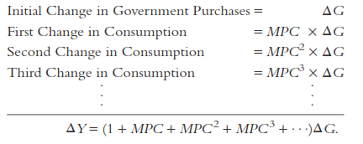
Solving for ΔY

Slide 21
Solving for ΔY

Slide 22
Solving for ΔY

Slide 23
I = 160 ; G = 40 ; T = 20

Slide 24
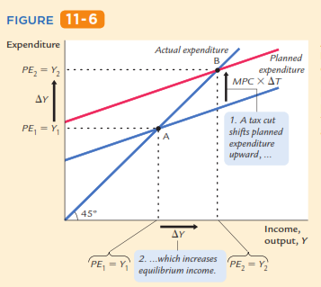
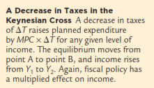
Fiscal Policy and the Multiplier: Taxes
A Decrease in Taxes in the Keynesian Cross

Slide 25
Fiscal Policy and the Multiplier: Taxes
A Decrease in Taxes in the Keynesian Cross
PE1 = C (Y-T1) + I + G → PE1 = Y → titik A → (PE1 = Y1)
PE2
PE1
T ↓ dari T1 ke T2
T ↓ → PE ↑ dari PE1 = C (Y-T1) + I + G → ke PE2 = C (Y-T2) + I + G → PE2 = Y → titik B → (PE2 = Y2)
T ↓ → Y ↑ dari Y1 ke Y2 → ∆Y = Y1 Y2

Slide 26
An increase in taxes
yst
T ↑ → C ↓ dari C1 ke C 2
PE
PE =Y
Initially, the tax increase reduces consumption, and therefore E:
PE 1=C₁ +I +G
A
PE2 =C₂ +I +G
ΔC = −MPC ΔT
B
At Y₁, there is now an unplanned inventory buildup…
…so firms reduce output, and income falls toward a new equilibrium
Y
PE₂ = Y₂
ΔY
PE₁ = Y₁
Notes:
Experiment: An increase in taxes (note: the book does a decrease in taxes)
Suppose taxes are increased by ΔT. Because I and G are exogenous, they do not change. However, C depends on (Y−T). So, at the initial value of Y, a tax increase of ΔT causes disposable income to fall by ΔT, which causes consumption to fall by MPC × ΔT. Because consumption falls, the change in C is negative: ΔC = − MPC × ΔT
C is part of planned expenditure. The fall in C causes the E line to shift down by the size of the initial drop in C.
At the initial value of output, there is now unplanned inventory investment: Sales have fallen below output, so the unsold output adds to inventory.
In this situation, firms will reduce production, causing total output, income, and expenditure to fall.
The new equilibrium is at Y₂, where planned expenditure once again equals actual expenditure/output, and unplanned inventory investment is again equal to zero.

Slide 27
Solving for ΔY
eq’m condition in changes
I and G exogenous
(I dan G tetap)
Solving for ΔY :
Final result:

Slide 28
The Tax Multiplier
def: the change in income resulting from a $1 increase in T :
If MPC = 0.8, then the tax multiplier equals

Slide 29
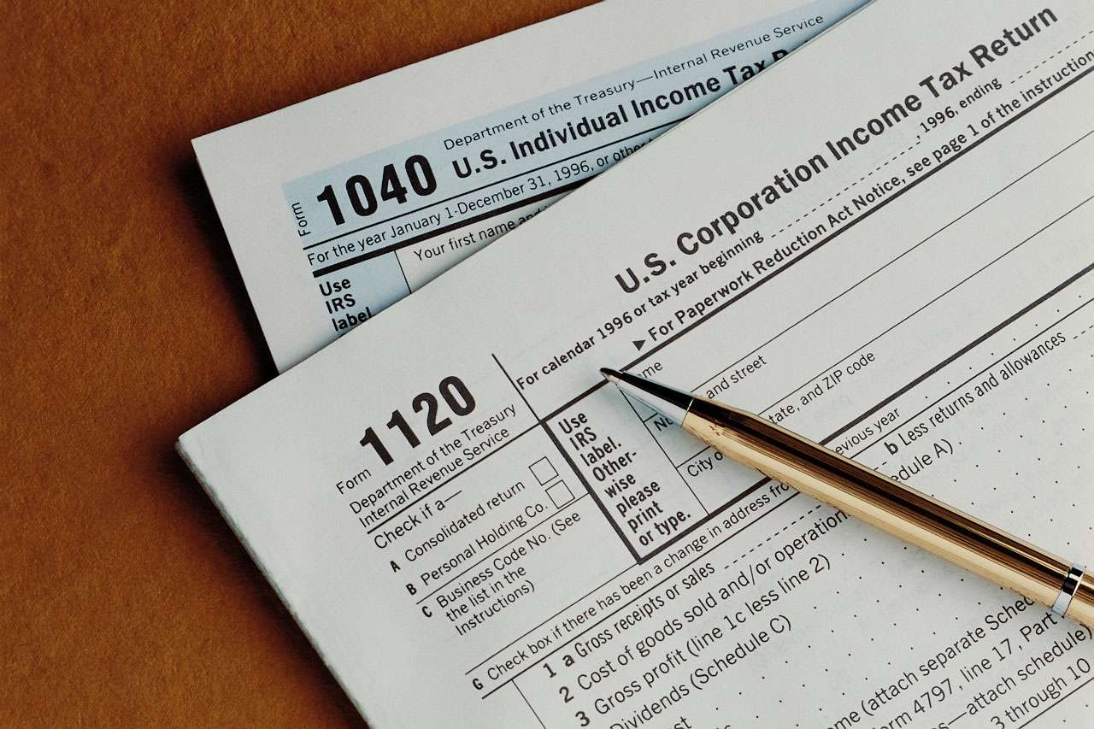
The Tax Multiplier
…is negative: A tax hike reduces consumer spending, which reduces income.
…is greater than one (in absolute value): A change in taxes has a multiplier effect on income.
…is smaller than the govt spending multiplier: Consumers save the fraction (1-MPC) of a tax cut, so the initial boost in spending from a tax cut is smaller than from an equal increase in G.

Slide 30
The Tax Multiplier
…is negative:
T ↑ → C ↓ [ C = C (Y-T)] → Y equilibrium ↓
…is greater than one (in absolute value): ∆T → ∆Y melalui multiplier (multiplier T > 1)
…is smaller than the govt spending multiplier: multiplier T < multiplier G

Slide 31
Exercise:
Use a graph of the Keynesian Cross to show the impact of an increase in investment on the equilibrium level of income/output… gunakan perpotongan Keynesian untuk menunjukkan dampak kenaikan investasi terhadap pendapatan equilibrium
Notes:
This in-class exercise not only gives students practice with the model, it also helps them understand the next topic: the IS curve.

Slide 32
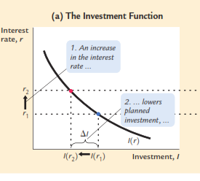
-
r ↑ ↓ → I ↓ ↑

Slide 33
The IS curve
def:
a graph of all combinations of r and Y that result in goods market equilibrium,
i.e. actual expenditure (output) = planned expenditure
The equation for the IS curve is:
+
-

Slide 34
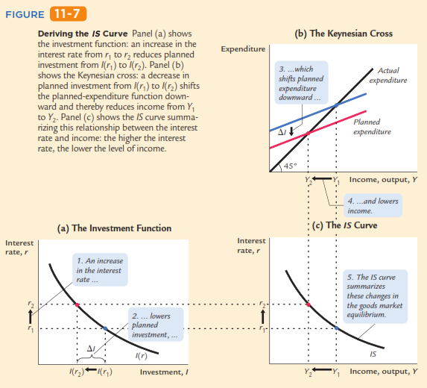
The IS curve

Slide 35
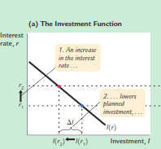
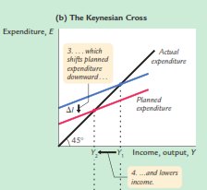
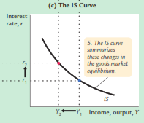
Gb (a): r1 → I (r1) → titik A → gb (b): pada I (r1) → PE1 = C (Y-T) + I (r1) + G → Y = PE1 → titik A → Y1 → gb (c): r1 dan Y1 (titik A)
B
Gb (a): r1 ↑ → r2 → I (r1) ↓ ke I (r2) → titik B → gb (b): pada I (r2) → PE1 ↓ ke PE2 = C (Y-T) + I(r2) + G → Y = PE2 → titik B → Y2 → gb (c): r2 dan Y2 (titik B)
A
Gb (c) :
titik A dan titik B → kurva IS
A
PE1
PE2
B
B
A
The IS curve

Slide 36
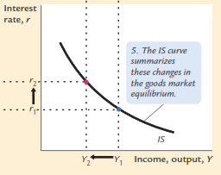
Understanding the IS curve’s slope
The IS curve is negatively sloped
Intuition: A fall in the interest rate motivates firms to increase investment spending, which drives up total planned spending (PE ).
To restore equilibrium in the goods market, output (a.k.a. actual expenditure, Y ) must increase.
Berlawanan arah = negatif
r ↓ ↑ → I ↑ ↓ → PE ↑ ↓ → Y ↑ ↓
The IS curve
r ↓ ↑ → I (r) ↑ ↓ → PE ↑ ↓[PE = C (Y-T) + I (r) + G] → Y ↑ ↓(PE = Y)

Slide 37
The IS curve and the Loanable Funds model
(a) The L.F. model
(b) The IS curve
r
S2 (Y2)
S₁ (Y1)
r
r₂
r₂
r₁
r₁
I (r )
IS
S, I
Y₂
Y₁
Y
S1 = S (Y1)
S2 = S (Y2)
Notes:
The IS curve can also be derived from the (hopefully now familiar) loanable funds model from chapter 3.
A decrease in income from Y1 to Y2 causes a fall in national saving. (Recall, S = Y-C-G)
The fall in saving causes a reduction in the supply of loanable funds. The interest rate must rise to restore equilibrium to the loanable funds market.
Now we can see where the IS curve gets its name:
When the loanable funds market is in equilibrium, investment = saving. The IS curve shows all combinations of r and Y such that investment (I) equals saving (S). Hence, “IS curve.”

Slide 38
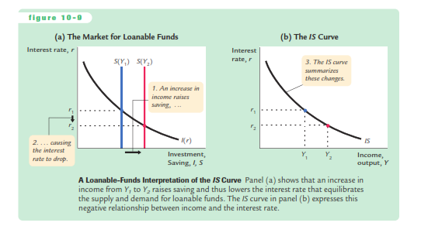

Slide 39
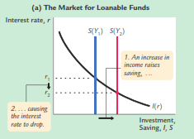
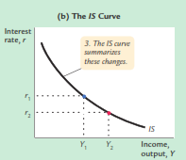
Gb (a): S (Y1) → S (Y1) = I (r) → r1 → titik A → gb (b): pada r1 dan Y1 → titik A
A
B
Gb (a): Y1 ↑ ke Y2 →S (Y1) geser kanan ke S (Y2) = I (r) → r2 → titik B → gb (b): pada r2 dan Y2 titik B
Gb (b) :
titik A dan titik B → kurva IS
A
B

Slide 40
We can use the IS-LM model to see how fiscal policy (G and T ) can affect aggregate demand and output.
Let’s start by using the Keynesian Cross to see how fiscal policy shifts the IS curve…

Slide 41
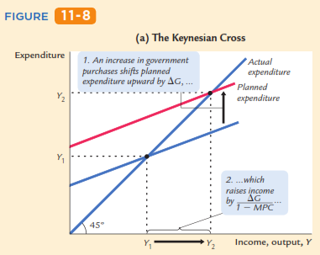
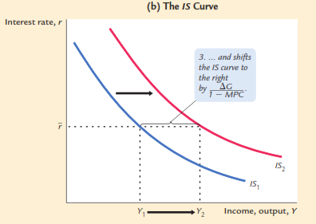
An Increase in Government Purchases Shifts the IS Curve Outward
Panel (a) shows that an increase in government purchases raises planned expenditure.
For any given interest rate, the upward shift in planned expenditure of G leads to an increase in income Y of G/(1 – MPC). Therefore, in panel (b), the IS curve shifts to the right by this amount

Slide 42
An Increase in Government Purchases Shifts the IS Curve Outward
E2
PE2 =C +I (r₁ )+G₂
PE1 =C +I (r₁ )+G₁
E2
E2
E2
Gb (a): PE1 = C + I (r) + G1 → PE = Y → titik E1 → (Y1) → r1 danY1 → gb (b): IS1 (biru)
Gb (a): G ↑ dari G1 ke G2 → PE ↑ dari
PE1 = C + I (r) + G1 ke PE2 = C + I (r) + G2 → PE = Y → titik E2 → (Y2) → r1 danY2 → gb (b): IS2 (merah)
G ↑ dari G1 ke G2 → IS geser kanan dari IS1 ke IS2
G ↑ dari G1 ke G2

Slide 43
An Increase in Government Purchases Shifts the IS Curve Outward
E2
PE2 =C +I (r₁ )+G₂
PE1 =C +I (r₁ )+G₁
E2
E2
E2
G ↑ dari G1 ke G2 → IS geser kanan dari IS1 ke IS2
G ↑ → IS geser kanan dari IS1 ke IS2 → Y1 ↑ ke Y2 → ∆Y = Y1 Y2 = multiplier x ∆Y

Slide 45
Exercise: Shifting the IS curve
Use the diagram of the Keynesian Cross or Loanable Funds model to show how an increase in taxes shifts the IS curve… gunakan perpotongan Keynesian atau model dana pinjaman untuk menunjukkan bagaimana kenaikan pajak menggeser kurva IS

Slide 46
due to John Maynard Keynes.
A simple theory in which the interest rate is determined by money supply and money demand.
Ms >< L → r
Ms : penawaran uang
L : permintaan uang
r : suku bunga

Slide 47
Money Supply
The supply of real money balances is fixed:
r
interest
rate
M/P
real money balances
Notes:
We are assuming a fixed supply of real money balances because
P is fixed by assumption (short-run), and M is an exogenous policy variable.

Slide 48
Money Demand
Demand for real money balances:
r
interest
rate
r₂
L (r)
r₁
-
L (r )
r ↑ → L ↓
M/P
real money balances
Money Demand: Demand for real money balances
(jumlah uang tunai yang ingin dipegang)
Notes:
As we learned in chapter 4, the nominal interest rate is the opportunity cost of holding money (instead of bonds).
Here, we are assuming the price level is fixed, so π = 0 and r = i.

Slide 49
Equilibrium
The interest rate adjusts to equate the supply and demand for money:
r
interest
rate
r₁
eq
L (r )
M/P
real money balances

Slide 50
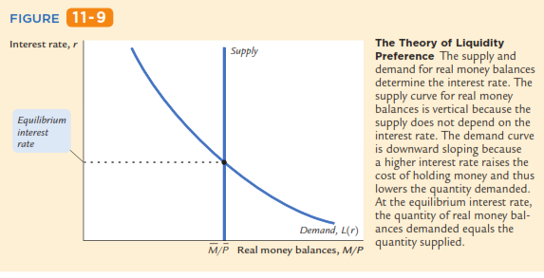
Equilibrium
M^{s} (M/P)
A

Slide 51
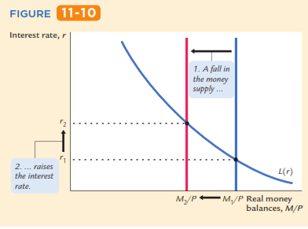
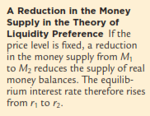
How the Bank Sentral raises
the interest rate
A Reduction in the Money Supply in the Theory of Liquidity Preference
M^{s} (M2/P)
M^{s} (M1/P)
B
A

Slide 52
How the Bank Sentral raises
the interest rate
A Reduction in the Money Supply in the Theory of Liquidity Preference
Eq: M^{s} (M1/P) = L(r) pada Y tertentu → r1
M^{s} ↓ → dari M1/P ke M2/P → Ms geser kiri → M^{s} (M2/P) dan L(r) tetap → r2
M^{s} ↓ dengan L (r) tetap → r ↑
M^{s} (M2/P)
M^{s} (M1/P)
B
A

Slide 53
Money Demand
-
r
∆Y → pergeseran L
Y ↑ → L ↑ (L geser kanan)
Y ↓ → L ↓ (L geser kiri)
r₁
eq1
eq2
L (r , Y₂ )
L geser (kanan): pada suku bunga yang sama (r1) → jumlah uang yang ingin dipegang berubah (L naik)
L (r , Y₁ )
M₁
M₂
M/P

Slide 54
The LM curve
Now let’s put Y back into the money demand function:
The LM curve is a graph of all combinations of r and Y that equate the supply and demand for real money balances.
The equation for the LM curve is:

Slide 55
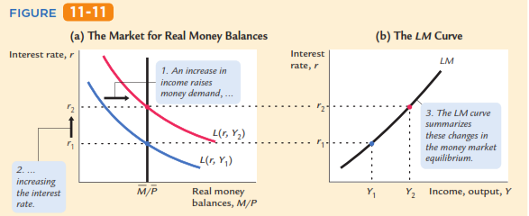
The LM curve

Slide 56
The LM curve
E2
E2
E1
E1
Gb(a): M/P = L(r, Y1) → E1: r1 dan Y1 ➔ Gb(b): E1 (r1,Y1)
Gb(a): Y ↑ dari Y1 ke Y2 → L(r, Y1) ↑ geser kanan ke L(r, Y2) → M/P = L(r, Y2) → E2: r2 dan Y2 ➔ Gb(b): E2 (r2,Y2)

Slide 57
Understanding the LM curve’s slope
The LM curve is positively sloped.
Intuition: An increase in income raises money demand.
Since the supply of real balances is fixed, there is now excess demand in the money market at the initial interest rate.
The interest rate must rise to restore equilibrium in the money market.
Y ↑ → L ↑ ; M^{s} tetap → r ↑ untuk mempertahankan equilibrium di pasar uang

Slide 58
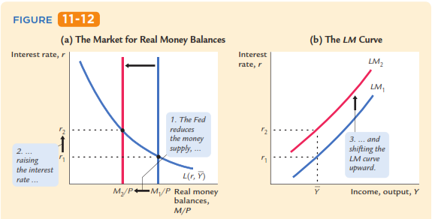
A Reduction in the Money Supply Shifts the LM Curve Upward

Slide 59
A Reduction in the Money Supply Shifts the LM Curve Upward
M^{s}2
M^{s}1
B
B
A
A
Gb (a): M^{s}1 (M1/P) dan L (r, Ybar) → titik A: r1,Ybar → gb (b): r1 dan Ybar → titik A → LM1
M^{s} ↓ dari M^{s}1 (M1/P) ke M^{s}2 (M2/P) → M^{s}2 (M2/P) dan L (r, Ybar) → titik B: r2 → gb (b): r2 dan Ybar → titik B → LM2
M^{s} ↓ → LM geser atas dari LM1 ke LM2

Slide 60
In summary:
The LM curve shows the combinations of the interest rate and the level of income that are consistent with equilibrium in the market for real money balances.
The LM curve is drawn for a given supply of real money balances.
Decreases in the supply of real money balances shift the LM curve upward.
Increases in the supply of real money balances hift the LM curve downward.

Slide 61
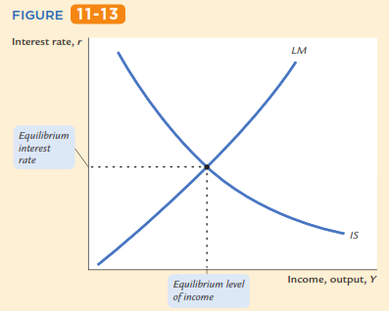
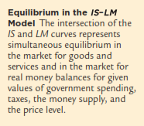
A

Slide 62
The short-run equilibrium
The short-run equilibrium is the combination of r and Y that simultaneously satisfies the equilibrium conditions in the goods & money markets:
r
LM
eq
r₁
IS
+ -
Y
Y₁
Equilibrium
interest
rate
Equilibrium
level of
income
-

Slide 64
Chapter summary
Keynesian Cross
basic model of income determination
takes fiscal policy & investment as exogenous
fiscal policy has a multiplied impact on income.
IS curve
comes from Keynesian Cross when planned investment depends negatively on interest rate
shows all combinations of r and Y that equate planned expenditure with actual expenditure on goods & services

Slide 65
Chapter summary
Theory of Liquidity Preference
basic model of interest rate determination
takes money supply & price level as exogenous
an increase in the money supply lowers the interest rate
LM curve
comes from Liquidity Preference Theory when money demand depends positively on income
shows all combinations of r and Y that equate demand for real money balances with supply
IS-LM model
Intersection of IS and LM curves shows the unique point (Y, r ) that satisfies equilibrium in both the goods and money markets.

Slide 67
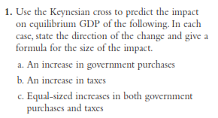

Slide 68
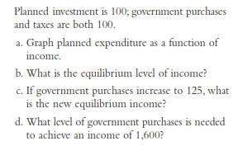

Slide 69
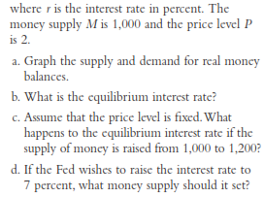

Slide 70
