Slide 1
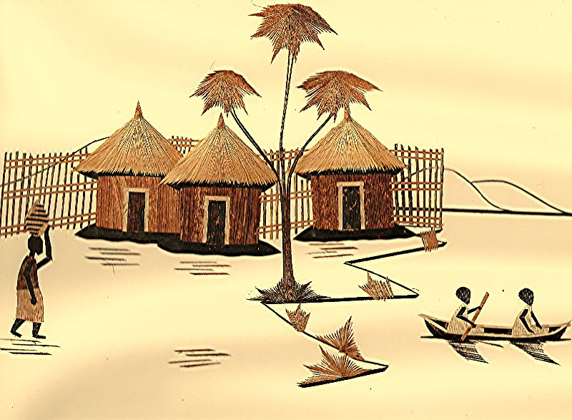
Capturing the Creative Economy in Developing Countries
Edna dos Santos-Duisenberg (edna.dos.santos@unctad.org)
Chief, Creative Economy & Industries Programme
Henri Laurencin (henri.laurencin@unctad.org)
Chief, Statistics and Information Retrieval Branch
UNCTAD, Geneva, December 2006

Slide 2
Creative Economy
Is an evolving concept based on creative assets embracing economic, cultural, social and tecnological aspects
It has linkages at macro and micro levels with the overall economy, hence an important development dimension
It can foster economic growth, job creation, export earnings while promoting social inclusion, cultural diversity and human development.
It is a feasible policy option to diversify economies and improve trade and development gains in developing countries
(UNCTAD)

Slide 3
Development Dimensions of the Creative Economy
Multi- Dimensional development, cultural, economic and social policies
Omni-present
education
labour
culture, arts and leisure
Cross-cutting
culture
labour
industry
trade
technology
tourism
Aesthetic and Ethnic Values
anthropology / history
cultural diversity and heritage
Society Inclusive
public/private sectors
all social classes
profit and non-profit (NGOs)
In-temporal
past traditions
present technologies
future vision
UNCTAD - E.DOS SANTOS

Slide 4
Creative Industries
A set of knowledge-based economic activities making intensive use of creativity as primary input to produce marketable value-added creative products and services
Creative products and services are centred but not restricted to arts and culture
Are tangible products or intangible services with creative content, economic value and market objectives
They are able to generate income from trade and property rights
It is a new dynamic sector in world trade
(UNCTAD)

Slide 5
The scope of creative industries
Is a vast field dealing with the interplay of various sub-sectors from traditional art crafts to technology-oriented multi-media services
Traditional knowledge
Visual Arts
Music
Paintings, sculptures and photograpy
Art crafts, festivals and cultural activities
Concerts, CDs, tapes, digitalized music
Literature and Publishing
Creative Industries
Performing Arts
Books, newspapers and periodicals
Theatre, dance, opera, puppetry, circus
Design
Audio-Visuals
Architecture, interior objects, fashion and jewellery
Digital Animation and Multi-media
Broadcasting, cinema, television, radio
Software, videogames and advertising
(UNCTAD)

Slide 6
How to capture the potential of the creative economy for development ?
Main issues :
Economic linkages and externalities
Growth prospects and trade flows
Supply and value-chain cycle
Cross-cutting nature of creative industries
Tangible products and intangible services
Formal and informal sectors
Measuring creative content
Dealing with connectivity and multi-media

Slide 7
UNCTAD’s Integrated Development Approach Main economic indicators
- Macro-economic : % GDP, income generation
- Trade : imports/exports – products/services/content
value / units /content (not a commodity)
tariffs and non-tariffs (quantitative/qualitative)
- Investment : % FDI, % domestic, incentives by sectors
- Industry: % creative, % returns, value-added chain
- Technology : ICT tools, IPRs , R&D, technology transfer
- Enterprise : SMEs/independent, micro-credit, youth, gender
- Tourism : earnings tourists, diasporas, links tourism/culture

Slide 8
A new dynamic sector in world trade
UNCTAD figures indicate that world exports of :
Visual arts Cinema industry
-US$ 7.3 billion in 1996 - US$ 354 million in 1996
-US$ 14.4 billion in 2004 - US$ 653 million in 2004
Trend: export earnings nearly doubled in eight years
Exports is only part of total revenue
excluding copyrights, licenses, marketing and distribution
Are those figures meaningful ?
Can exports of visual arts be much higher than the film industry?
How to relate 653 million with 75 billion worth film market ?
Digital films, need to start new statistical series ?

Slide 9
Developing countries marginal trade players in the world market for creative products
In 2004, share of developing countries in world exports of visual arts estimated at 3%
Are we comparing comparable creative products ?
What art-work is covered under sculptures ? (Code 8963?)
Are wooden-made African sculptures visual arts ?
Pictures, designs and photographs are
publishing materials or visual arts ? (Code 89287 ? )
UN COMTRADE – SITC REV.3 : 8961, 8963, 63549, 6662, 696782, 89911, 8826 ? VISUAL ARTS

Slide 10
Dealing with connectivity : music industry
In 2005, 16% of world population have access to internet
34% are mobile phone subscribers
Music/internet a near-perfect match…
Digital sales of music reached US$ 1,1 billion in 2005 ?
Digital distribution of music 420 million downloaded (IIFP)
What are the codes for legal digital music ?
Global music market annual revenues of over US$ 1 billion
Sales of CDs + concerts + tours + festivals
Copyrights composers + songwriters + interpreters +musicians
Royalties for music publishes + marketing/distribution
How to capture total value of creative content + services+ IPRs ?

Slide 11
Difficulties in measuring creative services
Not all creative products have creative content (blank CDs)
Capturing figures for architecture, design and advertising services identifying and adding up physical and digital distribution?
How to get reliable trade flows in broadcasting content in developing countries?
Any universal alternative for EBOPS for trade in services ?
Film producers in developing countries no longer use 35mm, distribution problems, drop in figures captures shift to DVDs?
How to distinguish standard computer services from creative or cultural digital services ?

Slide 12
Challenges for mapping creative economies
Lack of precise and consensual definitions
Limitations of current methodologies/statistical codes
Differences among data collecting practices
Existing models not suitable for developing countries
What and how to access different creative sectors
Gaps in existing statistical data by int/nat institutions
How to define comparability across sectors and countries
Lack of financial and human resources for surveys

Slide 13
Looking for possible worldwide solutions
No all-fits-one approach but shared perceptions on models
Harmonize views on main definitions/sectoral classification
Identify similarities in countries data collecting practices
Customs data only can no longer reflect trade flows
Keep pace with technological advances and digital content
Review discrepancies between SITC Rev3 and HS 96
Up-date UNESCO Cultural Statistics Framework

Slide 14
Creative Economy: the way ahead
Any new or revised statistical classification framework of economic and cultural activities has to incorporate data related to the creative economy
Universality and comparability of creative content/services/products has to be ensured
Strengthening collaboration and complementarities among international data collecting institutions

Slide 15
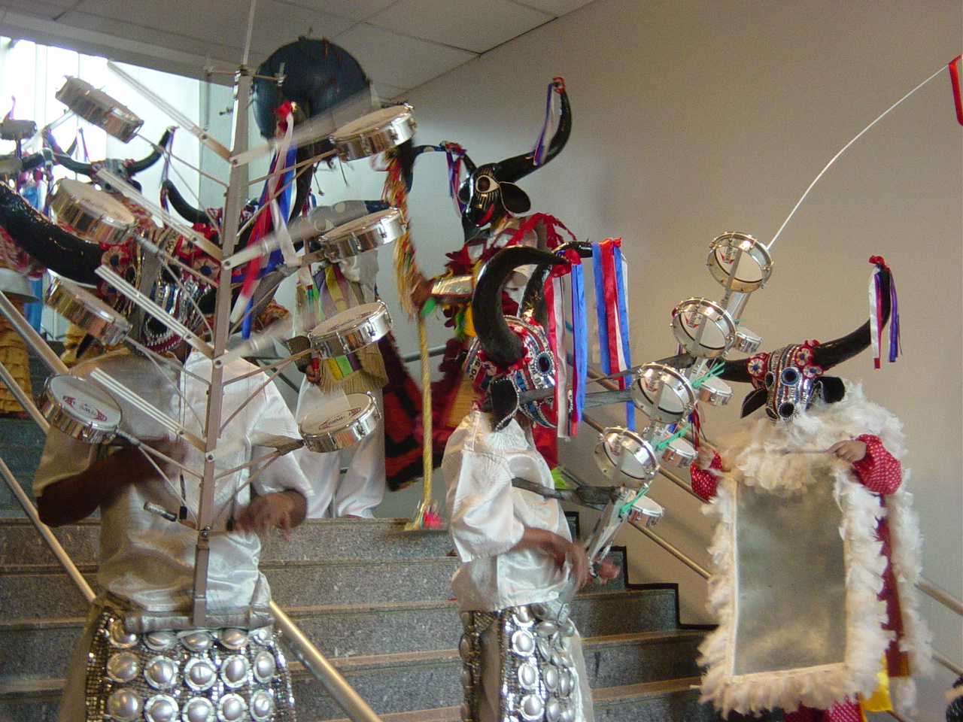
Thank you for your attention
Reproduction or use of data/information authorized with source acknowledgement UNCTAD (E. dos Santos)

