Slide 1
Administrasi Jaringan Komputer
Pertemuan 9
Linux Operating System for Computer Network Administration
Puspanda Hatta, M.Eng.

Slide 2
Introduction to Linux - What is Linux?
General operating system, which actually functions to run computational processes on digital technology that is used in everyday life
https://www.guru99.com/introduction-linux.html

Slide 3
Everyday Computing
Linux operating system is used all the time, without us knowing it

Slide 4
Why Should Learn Linux?
App Development Environment
Cloud computing environment
Mobile App
IoT ecosystems
Most of IT job vacancies require linux skills (CI/CD)
Open Source

Slide 5
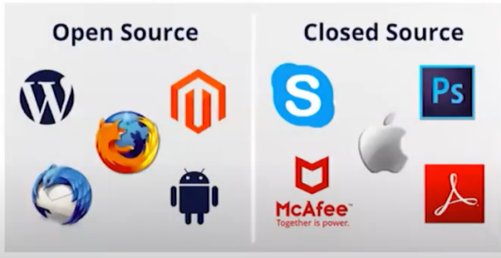
What is Open Source Software?
A label or development license whose management is not controlled by an individual or an organization, but is coordinated by users who work together in a community for the use of source code.

Slide 6
Linux Distribution
Distrowatch

Slide 7
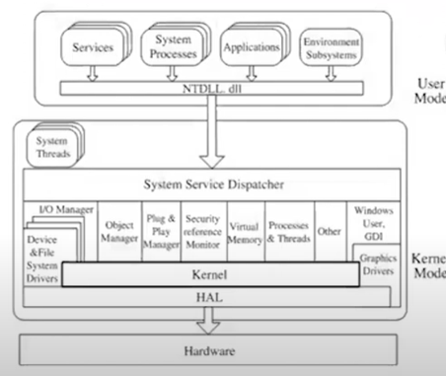
Linux Architecture

Slide 8
Kernel
As the main component of the Linux OS and connecting between the hardware and the process.
Memory management: Provides information on how much memory is used, remaining memory, and memory location
Process management: Determine which processes can use the CPU, duration of use, and duration of use
Device drivers
System calls and security

Slide 9
Installation
Preparation
OS
Hardware
Installation
Install
Reboot
Basic Configuration
Optimize
Implementation
3rd party software/services
Daily computational needs
Further information on https://distrowatch.com/

Slide 10
Learning Resources
https://www.belajarlinux.org/
https://www.tutorialspoint.com/unix/index.htm
https://www.webminal.org/
https://www.javatpoint.com/linux-tutorial
https://www.guru99.com/unix-linux-tutorial.html
https://ubuntu.com/tutorials/command-line-for-beginners#1-overview

Slide 11
ISO Linux
Ubuntu
https://ubuntu.com/download/desktop
https://ubuntu.com/download/server
CentOS
https://www.centos.org/download
RHEL
https://developers.redhat.com/products/rhel/download

Slide 12
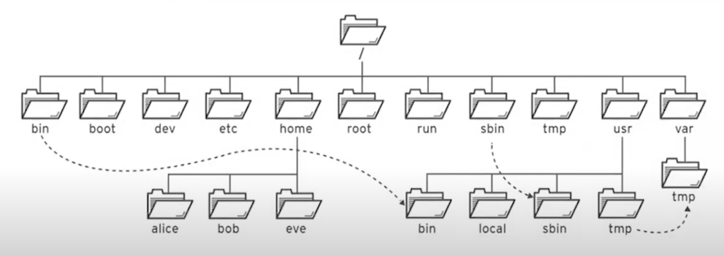
Linux File Hierarchy

Slide 13
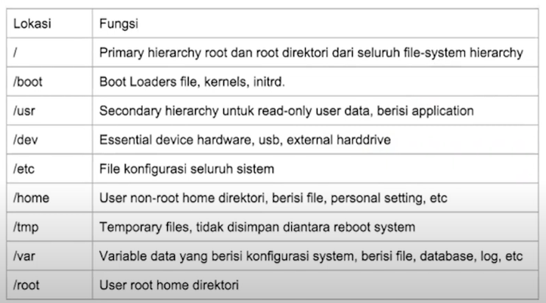

Slide 14
Things to Do After Installing Ubuntu
General:
https://www.tecmint.com/things-to-do-after-installing-ubuntu-20-04/
Security:
https://www.liquidweb.com/kb/things-to-do-after-installing-a-ubuntu-server/
Networking:
Configure the IP Addresses
Configure DNS
Ensure local and internet connection

