Slide 1
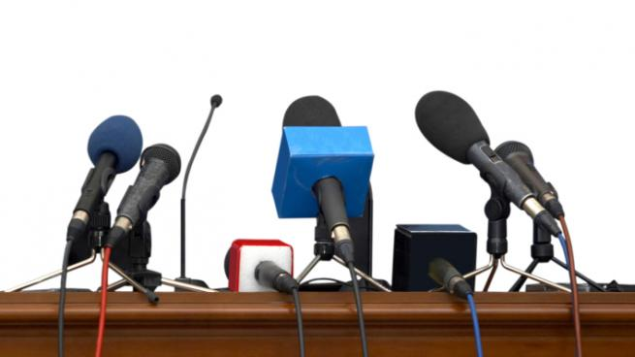
Arranging a Press Conference

Slide 2
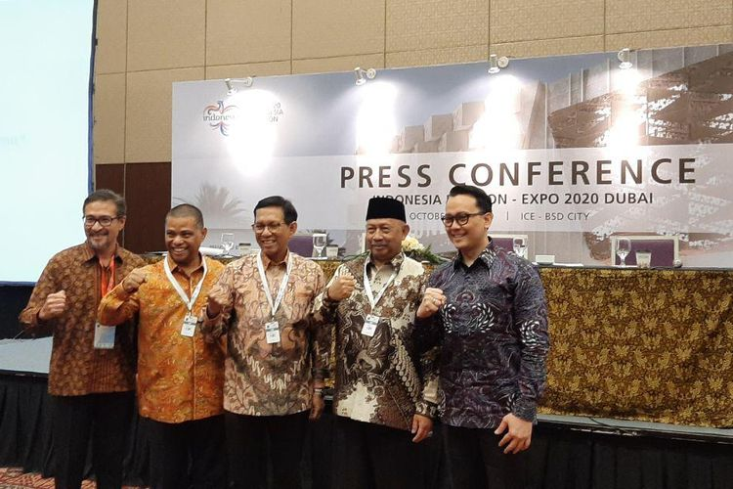
A news conference or press conference is a media event in which newsmakers invite journalists to hear them speak and, most often, ask questions. A joint press conference instead is held between two or more talking sides.

Slide 3
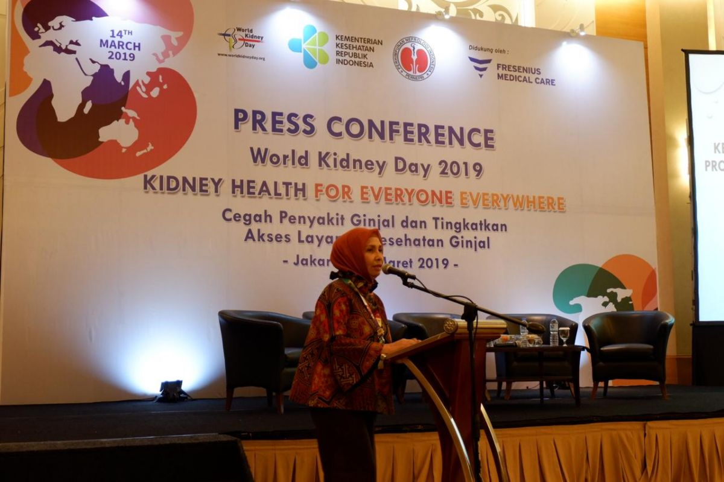
Holding a press conference is a simple, effective way to communicate your message with the media. Holding a successful press conference can generate news about your cause and awareness about your project. This section looks at the elements of planning a successful press conference, when to hold a press conference, and how best to communicate with the media and the public at a press conference.

Slide 4
What is a press conference?
You and your group members have probably seen them on television before or after a major local or national event. On the evening news there’s a short television clip of a speaker surrounded by a crowd of reporters asking questions. So, you may know what press conferences look like, in general.
But what exactly is a press conference? A press conference is a tool designed to generate news – in particular, hard news that can advance the cause of your organization. Hard news is defined as a story in the print or electronic media which is timely, significant, prominent, and relevant.

Slide 5
WHY SHOULD YOU HOLD A PRESS CONFERENCE?
Press releases, interviews, and informal media contacts are excellent ways of getting your message across. They are the bread and butter of your media relations, and often of your entire outreach effort. A press conference is an additional media technique, for special occasions, when you really want to make an impression. More specifically, why hold a press conference? Because:
You can give more information than in a press release.
A press conference is interactive; you can answer questions from the press, and emphasize points you might not otherwise have a chance to make.
You can announce an important development, and explain its significant local and wider implications.

Slide 6
You can set the record straight if your group received negative publicity.
You can often generate the kind of notice or publicity – a spot on the 6:00 TV news, for instance – that you’d otherwise have to pay a large amount for.
When many media representatives are present, it makes your conference seem really newsworthy -- the media presence itself adds to the importance.
A successful media conference can not only generate news, but can also boost the morale of your own group -- that is, your group can take pride in knowing that the press will really turn out to hear what you have to say.

Slide 7
WHEN SHOULD YOU HOLD A PRESS CONFERENCE?
You and your organization could hold a press conference whenever there is an event your organization wants to inform the community about. However, in some cases, you will want to hold a press conference for fast breaking news. For example, if an education funding bill were introduced in the state legislature, you might want to convene a press conference that same morning to react to the bill's implications. This will leave little time for elaborate preparations--you should just phone the press at a few hours notice.
Remember, you don't want to hold a press conference too often. It is a special event, and should be treated as such.

Slide 8
But here are some cases when a press conference might be a good idea:
When the event includes a prominent individual to whom the media should have access.
When you have significant announcements to make, such as a campaign start-up or a lobbying victory.
When there is an emergency or crisis centered around your group or the issues it deals with.
When a number of groups are participating in an action, and the show of support will emphasize that this action is news.
When you want to react to a related event; for example, when a national report relevant to your issue is released.

Slide 9
HOW DO YOU HOLD A PRESS CONFERENCE?
BEFORE THE PRESS CONFERENCE:
As we’ve discussed, you may have to schedule a press conference on short notice. If you do have lead time, however, you and your group will want to start planning at least a week or two before the press conference is to take place. The following steps should help you plan for your press conference:

Slide 10
DEFINE THE MESSAGE.
Define the key message(s) that you and your group are trying to get out to the community. Your goal may be to introduce or shed more light on your issue, to announce a new program or event, to react to a news story or to a criticism of or attack on your effort, or to draw attention to an honor or award your effort has earned. Whatever the message, it should be summarized in clear 3-5 key points to the press.
If a date, a time, an address or phone number, or other specific information is part of the message – if the purpose of the press conference is to announce an upcoming event, for example – make sure to give it more than once, and to have it displayed prominently in your press kit (see #7 below.) Double- or triple-check any such information to make sure you have it right, both in speech and in print.

Slide 11
SCHEDULE THE DATE AND TIME.
You and your group will need to determine a date and time for the press conference, and make sure it doesn't conflict with other press events or media deadlines. One way to find this out is to check with the local media and the wire services, who will know if your press conference conflicts with another. Here are some other tips for scheduling your press conference:
Tuesdays, Wednesdays and Thursdays are the best days for press conferences, as they are considered slower news days. Try to have your press conference on one of these days if at all possible.
The best time to schedule your press conference is between 10:00 a.m. and 11:00 a.m, to ensure maximum coverage by the media. If you schedule it later, you risk missing the afternoon paper or evening news.
Remember, you are competing with all the other news of the day; so don't be too worried if everyone doesn't show up.

Slide 12
PICK THE SITE.
Make sure you pick a location for the press conference that has adequate parking and is not too far away for reporters to travel. Also, pick a site that provides visual interest and relationship to each topic--such as the state capitol building, city courthouse, or a local clinic or other site where the activities you’re talking about are actually going on.
Other considerations include picking a location relatively free from high levels of background noise (e.g., traffic, telephones, aircraft), and one which has adequate electrical outlets and extension cords for lighting, etc.

Slide 13
SELECT AND TRAIN YOUR PARTICIPANTS.
At this stage of your planning process, you probably won't want to have just anyone from your group participate in the press conference. You will want your participants to be knowledgeable and articulate about the issue. They should be able to handle press questioning and scrutiny as well. People with high credibility, such as local politicians, the director of a local health promotion organization, or a physician may make effective spokespeople. Firsthand testimony from people from the community affected by the issue can be extremely powerful and convincing.

Slide 14
Here are a few tips for participants:
Be clear and concise – avoid using jargon, rhetoric, or inflammatory language, and stifle "ums" and "ahs." You want to draw attention to the issue, not distract the audience with your words.
Assume the audience is intelligent – avoid sounding patronizing.
Don't fiddle with or clutch anything -- it's distracting and makes you appear nervous.
Appearance counts – participants should be dressed neatly and appropriately for the occasion.
Always tell the truth. If you don't know the answer to a question, say so. Don’t exaggerate or give figures that aren’t backed up by evidence, and don’t state opinions as fact, or make charges that can’t be proven.

Slide 15
In addition to the press conference participants, you will need to find a moderator who is experienced with the press and the issue. He or she will be in charge of convening the press conference by introducing the issue and participants. The moderator also answers questions or directs them to the appropriate participants.
If you and your group are new at this, you may want to attend at least one other press conference to get a feeling for what they are like. Even if you are very experienced in this area, it may be a good idea to conduct a dress rehearsal. Speakers should have scripts to memorize the 3-5 key points, and to make sure to speak no longer than 3-5 minutes each. A dress rehearsal is very helpful in training new participants, and a good time to try to anticipate tough or hostile questions. Have someone from your group play devil's advocate and see how participants respond.
For example, a suitable response to a tough or misguided question might be, "That's a good question, but it is not within the scope of this press conference. Our focus today is on...” If the question is legitimate but you don't know the answer to it, it's okay to call on someone else from your group who might know, or check out the answer and get back to that reporter later.

Slide 16
CONTACT THE MEDIA.
The first step in contacting the media is to create a comprehensive mailing list of assignment editors at television stations, news directors at radio stations, and at major newspapers, and editors at weekly newspapers. You may even want to include the wire services (AP, UPI). Others you'll want to be sure to include on your list are reporters you have worked with before, contacts in the media you may have, and reporters who may have covered the issue in recent months.
If your organization has had occasion to work with the media before, you should have personal contacts with a number of media people. If you haven’t made those contacts, this is a good time to start. The media aren’t things – they’re made up of human beings doing their jobs. If you can make human contact with those folks, and especially if you can make their jobs easier, they’ll return the favor.

Slide 17
You will also want to have a press advisory prepared and mailed about one week ahead of time to inform the media about the press conference. A press advisory is similar to a press release, with the difference being that press advisories can be used for background information to your media contacts. The format is basically the same as that of a press release. For an example of a press advisory, see the Tools section.

Slide 18
FOLLOW UP WITH THE MEDIA.
After you and your group have mailed the press advisories to the media, you will want to follow up your press advisory with phone contact to the major media outlets. Give your press advisory three days to arrive, then begin your telephone follow-ups with the people you sent your press advisory to (if they say they never got one, offer to bring or email one to them). Also, follow up a second time the morning of the press conference.

Slide 19
DEVELOP A PRESS KIT.
A press kit is a folder of information to give reporters background information about your issue or program. Press kits are very useful, if your group can afford it. If a press kit is beyond your budget, a press advisory will do. Your press kit should contain the following:
A list of press conference participants.
A press release, which should state your group's position on the issue, highlights of the press conference, and a few quotes from participants (for more, see Preparing Press Releases).

Slide 20
Background information about the issue (i.e., statistics, historical background, case histories, or reprints of news stories).
A few black & white glossy photographs (action photos are most interesting).
Short (less than a page) biographies of participants.
Related news stories from prestigious national publications (e.g., New York Times, Wall Street Journal, etc.).
Putting the kit together: The press release goes in the right side of the folder, and the other information goes in the left side of the folder.

Slide 21
PREPARE THE ROOM.
There are a number of things you can do to prepare the room you're holding the press conference in. Here are some tips:
Check the location of electrical outlets for microphones and lights.
Set up the room with a table long enough to seat all your spokespeople, with name cards.
Provide enough seating in the room for reporters, and enough room for their supporting equipment (e.g., cameras, microphone).
Display visuals as a backdrop to your speaker's table: charts, posters, etc.

Slide 22
Have a sign-in pad for attendance.
Provide a podium for the moderator, perhaps with your organization's logo on it.
Have coffee, tea,water, and any other refreshments set up.
At the Press Conference:
When the big day finally arrives, there are a number of things you and your group can do to help your press conference run as smoothly as possible. We will go through these, step by step:

Slide 23
Welcome members of the press as they arrive.
Have members of the press sign in, with their affiliation, and give each of them a press kit.
Seat the press conference participants behind the table facing the seated reporters.
Check the sign in pad to see which media outlets are represented. You may also want to make personal contact with major media representatives before or after the press conference.
Start approximately on time -- no later than 5 minutes after the scheduled time.

Slide 24
Record the event, for your own records, and for possible media use.
Have the moderator welcome the press, and introduce the issue and participants.
Each participant should present for no more than 3-5 minutes, making his/her 3-5 key points.
After all the presentations, the moderator should entertain any questions from the press, and direct questions to the appropriate participants.
After about 45 minutes, bring the formal conference to an end. Thank the participants for presenting, and the media for attending. In many cases, you may want to encourage the media to stay for further informal conversation with the participants.

Slide 25
After the Press Conference
To the extent that you can, make personal contact with representatives at least of the major media outlets represented. In a small town, this could mean one or two people; in a big city, there might be 20 or more. If you can have a short, pleasant conversation with these folks and make a good impression, they’ll remember you when they need information or a story about your issue, and they’ll respond when you contact them.
By looking through your attendance register, you should be able to determine which major media were not represented. Not everyone may arrive, as your conference may be pre-empted by some late breaking news story elsewhere. You may want to hand deliver a press release and press packet to these people, send an audio or video feed, or, try to schedule an interview with a reporter and one of the press conference participants.

Slide 26
You might also review the press conference with others from your organization that attended. What went well? What could you have done better? And how will you improve the next press conference you hold?
Contributor
Eric Wadud

Slide 27
RESOURCES
Online Resources
How to Hold a Press Conference, from the Western Organization of Resource Councils, is a comprehensive guide to help you prepare for a press conference. It includes 10 steps for a successful press conference as well as other related checklists (e.g., setting up a press conference).
Print Resources
Center for Community Change. (1996) How to tell and sell your story, Washington, DC.
League of Women Voters of the United States (1997) Getting into print. Washington, DC: League of Women Voters.
Martinez, B.F. (1979). Guide to public relations for nonprofit organizations and public agencies. The Grantsmanship Center. Los Angeles, CA.
Taplin, S. (1993) Holding press conferences: Why, when, and how. Palo Alto, CA: Stanford University School of Medicine, Health Promotion Resource Center.
Wallack, L.(1993) Media advocacy and public health. Newbury Park, CA: Sage

