Slide 1
PEREKONOMIAN INDONESIA (EKA 510)
Yogi Pasca Pratama, SE., ME.

Slide 2
Tujuan
Memperluas pemahaman mahasiswa terhadap perkembangan perekonomian Indonesia melalui pembahasan berbagai topik ekonomi baik domestik maupun internasional dengan menerapkan kerangka teori ekonomi yang telah diberikan sebelumnya, khususnya teori ekonomi makro.

Slide 3
Rincian Materi Perkuliahan
1 . Pendahuluan dan konsep lingkup perkuliahan Perekonomian Indonesia
2 . Sejarah perkembangan perekonomian Indonesia
3 . Sistem perekonomian Indonesia
4 . Ujian Kompetensi Dasar 1 (UKD 1) ; Pendapatan Nasional, pertumbuhan, dan struktur ekonomi
5 . Distribusi pendapatan dan kemiskinan
6 . Kependudukan, ketenagakerjaan, kesempatan kerja, pengangguran
7 . Indeks Pembangunan Manusia
8. Ujian Kompetensi Dasar 2 (UKD 2)
9 . Investasi
10 . Pengeluaran konsumsi masyarakat dan pengeluaran pemerintah
11 . Perdagangan luar negeri
12 . Ujian Kompetensi Dasar 3 (UKD 3) ; Neraca pembayaran, arus modal asing, dan utang luar negeri
13. Perkembangan sektor industri dan pertanian
14. Perkembangan usaha kecil dan koperasi
15. Demokrasi Ekonomi dan Globalisasi Ekonomi
16. Ujian Kompetensi Dasar 4 (UKD 4)

Slide 4
KEHADIRAN
BUDI PEKERTI (adab bertegur sapa, adab di dalam/luar kelas, adab mengetuk pintu, adab SMS, adab bimbingan, kejujuran akademis, dsb.)
TUGAS TERSTRUKTUR DAN/ATAU TIDAK TERSTRUKTUR
PENYAJIAN DAN DISKUSI
UJIAN KOMPETENSI DASAR 1, 2, 3, 4

Slide 5
Tinjauan Pustaka
Sengupta, Jati. 2011. Understanding Economic Growth: Modern Theory and Experience. ISBN 978-1-4419-8025-0.DOI 10.1007/978-1-4419-8026-7. New York : Springer Science Business Media
OECD. 2010. Southeast Asian Economic Outlook 2010. OECD Publishing. http://dx.doi.org/10.1787/9789264096004-en
Olievera, Jose Antonio Puppim de.2008. Upgrading Clusters and Small Enterprises in Developing Countries : Environmental, Labor, Innovation and Social Issues. England : Ashgate Publising Limited
North, Douglass Cecil. 2005. Understanding the Process of Economic Change. Princeton :Princeton University Press
Aidt, Toke & Zafiris Tzannatos. 2002. Unions and Collective Bargaining : Economic Effects in a Global Environment. Washinton DC : The World Bank

Slide 6
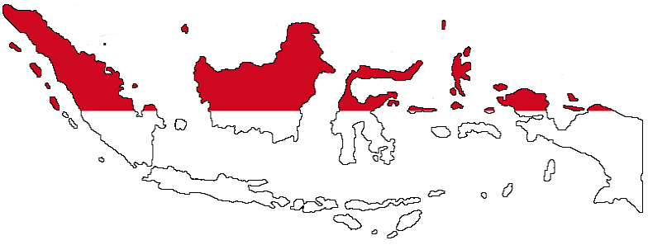
Pendahuluan & Konsep Perekonomian Indonesia

Slide 7
The econ. history of Indonesia (Touwen,2010)
Basic Facts
Indonesia is situated in Southeastern Asia and consists of a large archipelago between the Indian Ocean and the Pacific Ocean, with more than 13.000 islands.
Indonesia's total land area measures 1.9 million square kilometers (750,000 square miles). This is three times the area of Texas, almost eight times the area of the United Kingdom and roughly fifty times the area of the Netherlands.
Indonesia has a tropical climate, but since there are large stretches of lowland and numerous mountainous areas, the climate varies from hot and humid to more moderate in the highlands. Apart from fertile land suitable for agriculture
Indonesia is rich in a range of natural resources, varying from petroleum, natural gas, and coal, to metals such as tin, bauxite, nickel, copper, gold, and silver.
The size of Indonesia's population is about 230 million (2002), of which the largest share (roughly 60%) live in Java.

Slide 8
Important aspect of Indonesian econ. history
“Missed Opportunities”
its rich natural resources and great variety of cultural traditions but the Indonesian economy has been underperforming for large periods of its history.
“Unity in Diversity”

Slide 9
A chronological Survey of Indonesian Economic History
The pre colonial economy
Sixteenth and seventeenth century
The nineteenth century
The heyday of the colonial export economy (1900-1942)
The post-1945 period
From 1998 until present

Slide 10
Sixteenth and seventeenth century
the role of the Dutch in the Indonesian archipelago, which began in 1596 when the first expedition of Dutch sailing ships arrived in Bantam. In the seventeenth and eighteenth centuries the Dutch overseas trade in the Far East, which focused on high-value goods, was in the hands of the powerful Dutch East India Company

Slide 11
The nineteenth century
Cultivation system
Table 1 . Financial Results of Government Cultivation, 1840-1849 ('Cultivation System') (in thousands of guilders in current values)
Source: Fasseur 1975: 20.
 | 1840-1844 | 1845-1849
coffe | 40278 | 24549
sugar | 8218 | 4136
indigo | 7836 | 7726
Pepper,tea | 647 | 1725
TOTAL | 39341 | 35057

Slide 12
Estimates of Total Profits ('batig slot') during the Cultivation System,
1831/40 – 1861/70 (in millions of guilders)
Tabel 2. Estimates of Total Profits ('batig slot') during the Cultivation System,1831/40 – 1861/70 (in millions of guilders)
 | 1831/40 | 1841/50 | 1851/60 | 1861/70
Gross revenues of sale of colonial product | 227.0 | 473.9 | 652.7 | 641.8
Cost of transfer etc (NHM) | 88.0 | 165.4 | 138.7 | 114.7
Sum of expenses | 59.2 | 175.1 | 275.3 | 276.6
Total net profit | 150.6 | 215.6 | 289.4 | 276.6
Source: Van Zanden and Van Riel 2000: 223.

Slide 13
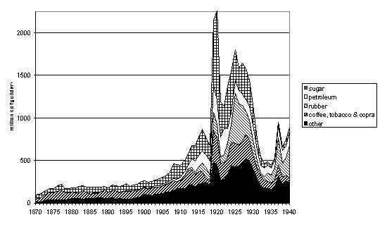
The heyday of the colonial export economy (1900-1942)

Slide 14
The post-1945 period
Exchange rate problems and absence of foreign capital were detrimental to economic development, after the government had eliminated all foreign economic control in the private sector in 1957/58. Sukarno aimed at self-sufficiency and import substitution and estranged the suppliers of western capital even more when he developed communist sympathies.

Slide 15
From 1998 until present
Today, the Indonesian economy still suffers from severe economic development problems following the financial crisis of 1997 and the subsequent political reforms after Soeharto stepped down in 1998.

Slide 16
Additional Themes in the Indonesian Historiography
The indigenous economy and the dualist economy (traders and peasant)
The characteristics of Dutch imperialism (political, economic and military motives )
The impact of the cultivation system on the indigenous economy (Non-farm employment and purchasing power increased in the indigenous economy, although there was much regional inequality)
Regional diversity in export-led economic expansion
The development of the colonial state and the role of Ethical Policy

Slide 17
Terimakasih
Pertemuan II : Sejarah perkembangan perekonomian Indonesia

