Slide 2
Ruang Lingkup Kimia Organik Fisik

Slide 3
Pengertian Kimia Organik Fisik
Physical organic chemistry is the study of the relationship between structure and reactivity of organic molecules.
More specifically, physical organic chemistry applies the experimental tools of physical chemistry to the study of the structure of organic molecules and provides a theoretical framework which interprets how structure influences both mechanisms and rates of organic reactions
It can be thought of as a subfield that bridges organic chemistry with physical chemistry.
The term physical organic chemistry was itself coined by Louis Hammett in 1940 when he used the phrase as a title for his textbook

Slide 4
Cakupan Materi Kimia Organik Fisik
Physical organic chemists use experimental techniques such as spectroscopy, spectrometry, crystallography, computational chemistry, and quantum theory to study both the rates of organic reactions and the relative chemical stability of the starting materials, transition states, and products.
Chemists in this field work to understand the physical underpinnings of modern organic chemistry, and therefore physical organic chemistry has applications in specialized areas including polymer chemistry, supramolecular chemistry, electrochemistry, and photochemistry

Slide 5
Koordinat Reaksi

Slide 6
In chemistry, a reaction coordinate is an abstract one-dimensional coordinate which represents progress along a reaction pathway. It is usually a geometric parameter that changes during the conversion of one or more molecular entities. In molecular dynamics simulations a reaction coordinate is called collective variable.
These coordinates can sometimes represent a real coordinate system (such as bond length, bond angle...), although, for more complex reactions especially, this can be difficult (and non geometric parameters are used, e.g., bond order).

Slide 7
Reaction coordinates are often plotted against free energy to demonstrate in some schematic form the potential energy profile (an intersection of a potential energy surface) associated to the reaction.
In the formalism of transition-state theory the reaction coordinate is that coordinate in set of curvilinear coordinates obtained from the conventional ones for the reactants which, for each reaction step, leads smoothly from the configuration of the reactants through that of the transition state to the configuration of the products.
The reaction coordinate is typically chosen to follow the path along the gradient (path of shallowest ascent/deepest descent) of potential energy from reactants to products

Slide 8
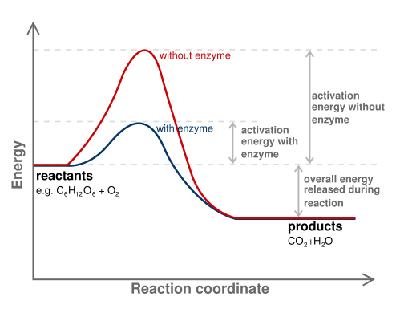

Slide 9
Postulat Hammond
In physical organic chemistry, Hammond's postulate, also referred to as the Hammond–Leffler postulate, is a hypothesis concerning the transition state of organic chemical reactions, proposed by George S. Hammond.
The postulate helps chemists by providing information about the structure of transition state, which generally cannot be directly characterized experimentally.

Slide 10
The postulate, first published in a Journal of the American Chemical Society paper in 1955, states that:
If two states, as, for example, a transition state and an unstable intermediate, occur consecutively during a reaction process and have nearly the same energy content, their interconversion will involve only a small reorganization of the molecular structures.

Slide 11
In other words, species with similar energies along the reaction will also have similar structures. The postulate allows us to accurately predict the shape of a reaction coordinate diagram, and has been used extensively, for example, to explain the effects of aromatic substituents in electrophilic aromatic substitution.

Slide 12
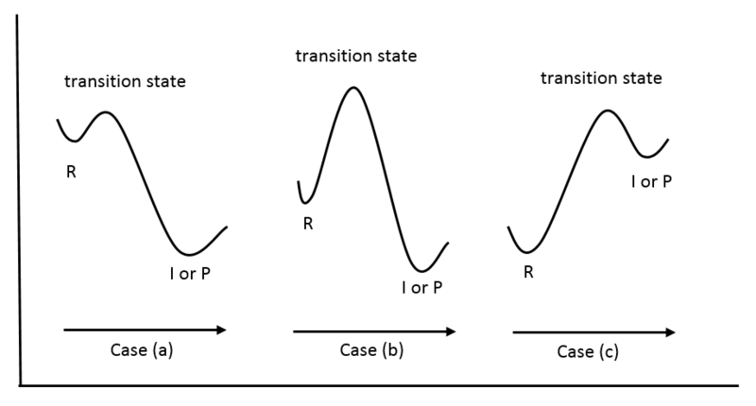
Assume that the transition states for reactions involving unstable intermediates can be closely approximated by the intermediates themselves

Slide 13
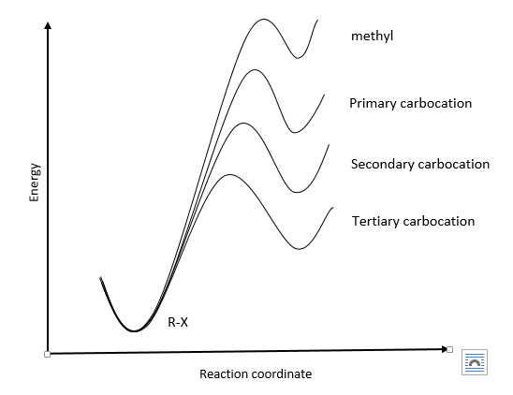
Energy diagrams showing the transition states for SN1 reactions as related to Hammond's postulate

Slide 14
