Slide 1
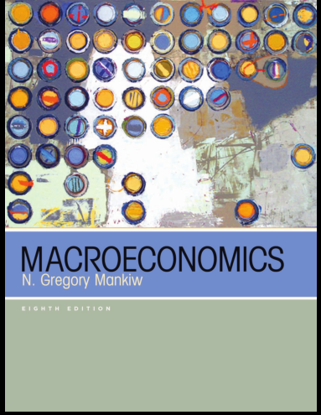
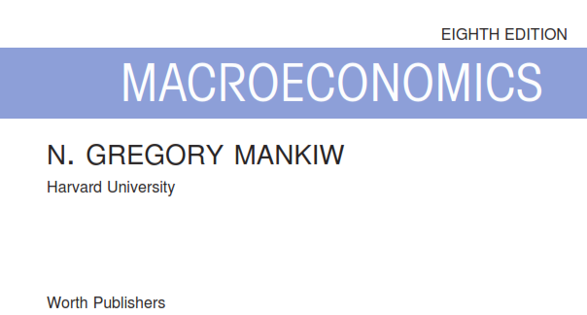
Yunastiti Purwaningsih

Slide 2
Chapter 10: Introduction to Economic Fluctuations
Chapter 11: Aggregate Demand I: Building the IS–LM Model
UK1
Chapter 12: Aggregate Demand II: Applying the IS–LM Model
UTS
Chapter 13: The Open Economy Revisited: The Mundell–Fleming Model and the Exchange-Rate Regime
UK3
Chapter 14: Aggregate Supply and the Short-Run Tradeoff Between Inflation and Unemployment
UAS

Slide 4
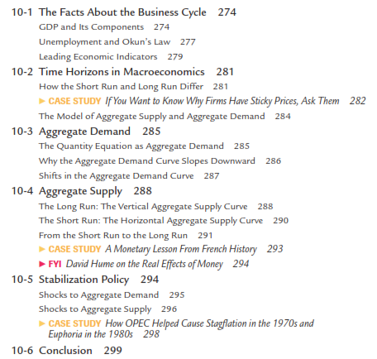

Slide 5
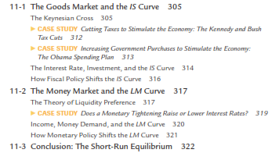

Slide 6
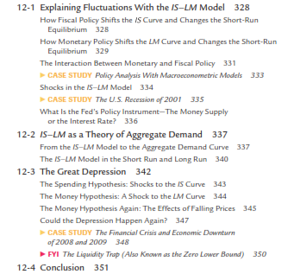

Slide 7
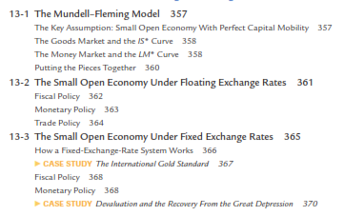

Slide 8
