Slide 1
LANDASAN FILOSOFI

Slide 2
LANDASAN KEILMUAN

Slide 3
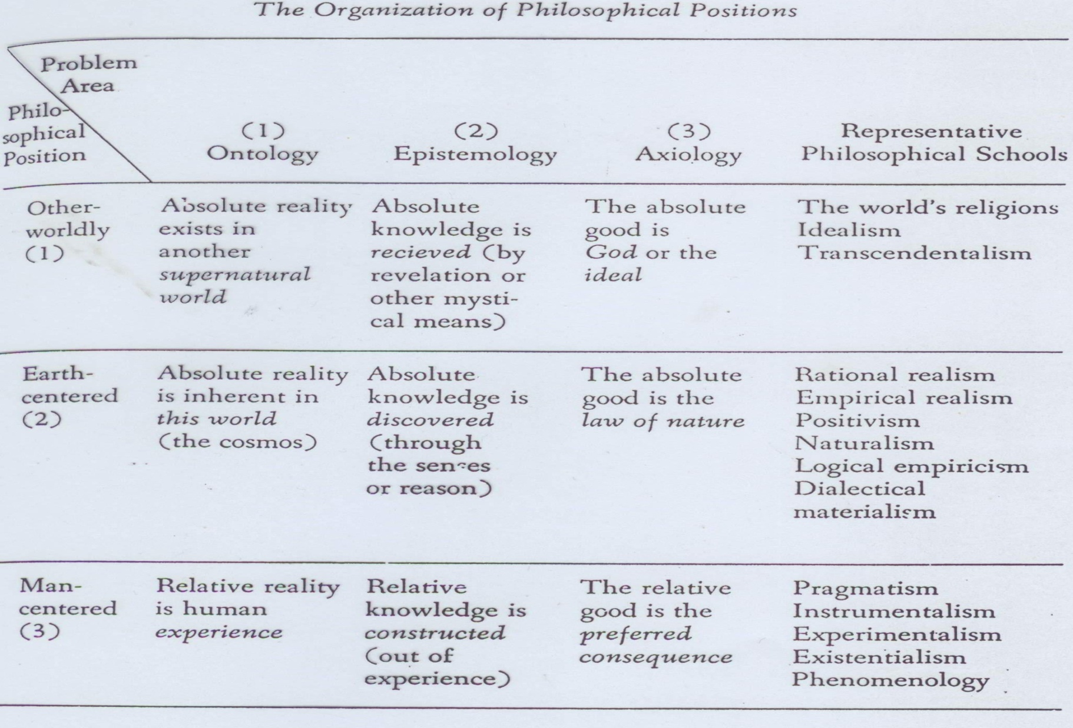
LANDASAN FILOSOFIS

Slide 4
FILSAFAT UMUM

Slide 5
FILSAFAT UMUM (1): idealism dan realisme
Philosophy | Reality | Knowledge | Values | Teacher’s Role | Emphasis on Learning | Emphasis on Curriculum
Idealism | Spiritual, moral, or mental; unchanging | Rethinking latent ideas | Absolute and eternal | To bring latent knowledge and ideas to consciousness; to be a moral and spiritual leader | Recalling knowledge and ideas; abstract thinking is the highest form | Knowledge based; subject based; classics or liberal arts; hierarchy of subjects: philosophy, theology, and mathematics are most important
Realism | Based on natural laws; objective and composed of matter | Consists of sensation and abstraction | Absolute and eternal; based on nature’s laws | To cultivate rational thought; to be a moral and spiritual leader; to be an authority | Exercising the mind; logical and abstract thinking are highest form | Knowledge based; subject based; arts and sciences; hierarchy of subjects: humanistic and scientific subjects

Slide 6
FILSAFAT UMUM (2): Pragmatisme dan Eksistensialisme
Philosophy | Reality | Knowledge | Values | Teacher’s Role | Emphasis on Learning | Emphasis on Curriculum
Pragmatism | Interaction of individual with environment; always changing | Based on experience; use of scientific method | Situational and relative; subject to change and verification | To cultivate critical thinking and scientific processes | Methods for dealing with changing environment and scientific explanations | No permanent knowledge or subjects; appropriate experiences that transmit culture and prepare individuals for change; problem-solving activities
Existentialism | Subjective | Knowledge for personal choice | Freely chosen; based on individuals’ perception | To cultivate personal choice and individual self-definition | Knowledge and principles of the human condition; acts of choosing | Choices in subject matter, electives; emotional, aesthetic, and philosophical subjects

Slide 7
FILSAFAT PENDIDIKAN

Slide 8
FILSAFAT PENDIDIKAN (1): Perenialisme dan Esensialisme
Educational Philosophy | Philosophical Base | Aim of Education | Knowledge | Role of Education | Curriculum Focus | Related Curriculum Trends
Perennialism | Realism | To educate the rational person; to cultivate the intellect | Focus on past and permanent studies; mastery of facts and timeless knowledge | Teacher helps students think rationally; based on Socratic method, oral exposition; explicit teaching of traditional values. | Classical subjects; literary analysis; constant curriculum | Great books; Paideia proposal; returning to the liberal arts
Essentialism | Idealism, realism | To promote the intellectual growth of the individual; to educate the competent person | Essential skills and academic subjects; mastery of concepts and principles of subject matter | Teacher is authority in particular subject area; explicit teaching of traditional values | Essential skills (three R’s) and essential subjects (English, science, history, math, and foreign languages) | Back to basics; cultural literacy; excellence in education

Slide 9
FILSAFAT PENDIDIKAN (2): Progresivisme dan Rekonstruksionisme
Educational Philosophy | Philosophical Base | Aim of Education | Knowledge | Role of Education | Curriculum Focus | Related Curriculum Trends
Progressivism | Pragmatism | To promote democratic, social living | Knowledge leading to growth and development; a living-learning process; focus on active and relevant learning | Teacher is guide for problem solving and scientific inquiry. | Based on students’ interests; addresses human problems and affairs; interdisciplinary subject matter; activities and projects |  | Relevant curriculum; humanistic education; radical school reform
Reconstructionism | Pragmatism | To improve and reconstruct society; to educate for change and social reform | Skills and subjects needed to identify and ameliorate society’s problems; active learning concerned with contemporary and future society | Teacher serves as an agent of change and reform; acts as a project director and research leader; helps students become aware of problems confronting humankind. | Emphasis on social sciences and social research methods; examination of social, economic, and political problems; focus on present and future trends as well as on national and |  | international issues International education; reconceptualism; equality of educational opportunity

Slide 10
TERIMAKASIH

