Slide 1
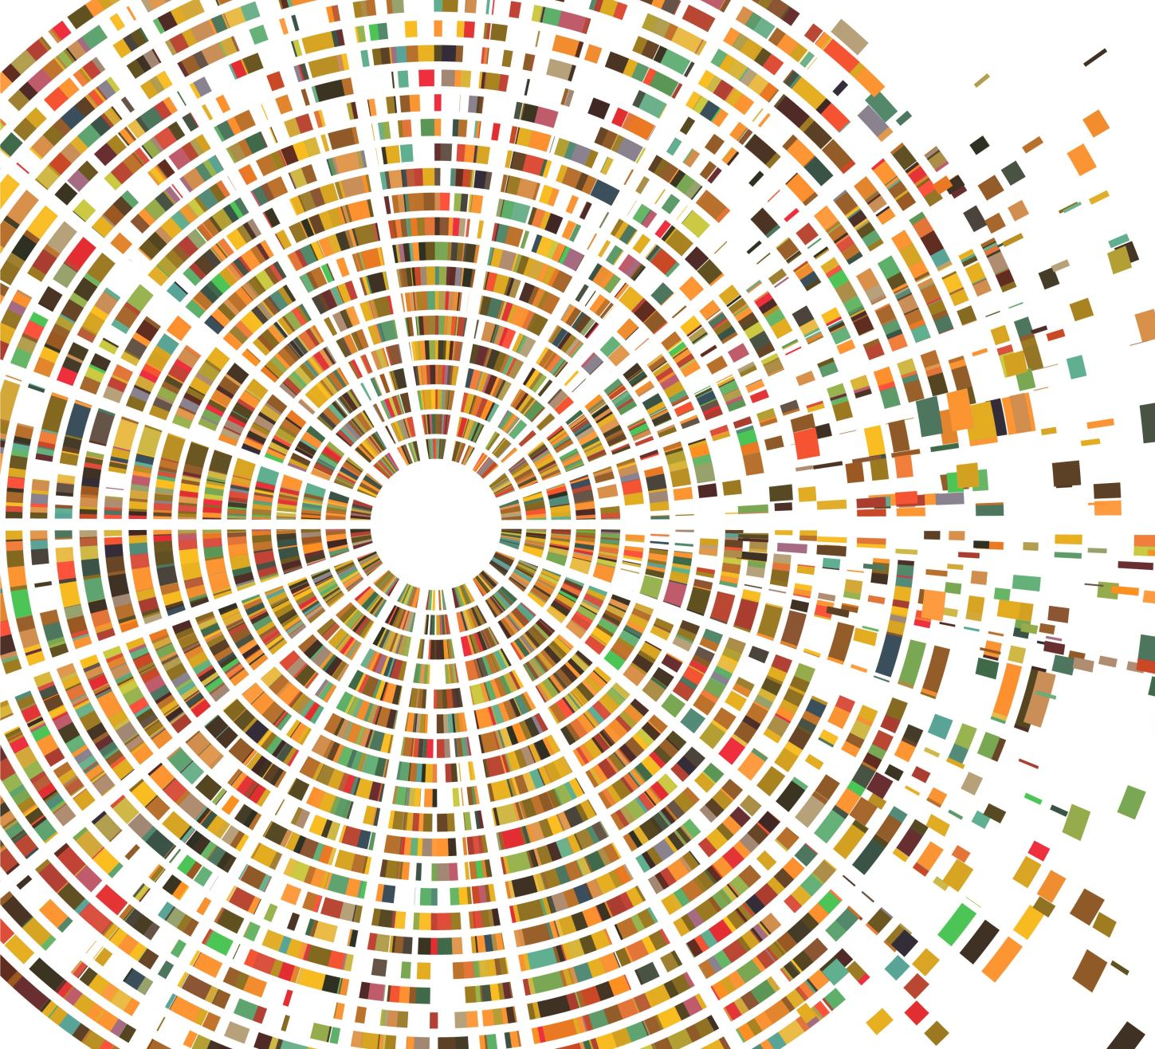
Basic Concept: what do we mean by Urban?
Sustainable Urbanization: Introduction

Slide 2
Urban & Rural Differences: How do we define?

Slide 3
What is an urban place, and what is urban?
There is no international consensus on how to determine or identify when a settlement is ‘urban’.
A simple, standardized definition of ‘urban’: based on population size and density criteria.
Some other countries have multiple criteria, including size, density and administrative level, but also extending to indicators of what could be considered urban employment (e.g. non-agricultural workers), facilities (e.g. higher-level schools), infrastructure (e.g. street lighting).
However, as well as varying between countries, the countries’ definitions also change over time.

Slide 4
Example of defining URBAN

Slide 5
INDONESIA: Defining urban
The classification of urban areas in Indonesia starts from the decision to allocate status to each of the desa (village, or kelurahan) in Indonesia.
BPS (Biro Pusat Statistik or National Statistical Bureau) categorizes all villages into two groups:
urban villages (desa perkotaan), and
non-urban villages (desa non-perkotaan).
It differs to the allocation of towns and cities for being municipalities.
The implication: the majority urban areas in Indonesia are the cities without municipality status.

Slide 6
Four principal methods are employed to identify urban places:
Population size: this urban population threshold varies over time and space:
In Sweden, more than 200 inhabitants; whereas in the USA the population minimum for urban status is 2,500; in Switzerland it is 10.000; in Japan rising to 30.000; etc.
Economic base:
In India, for example, a urban settlement must have more than 75 per cent of the adult male population engaged in non-agricultural work.
Administrative criteria:
Most towns and cities in the world are defined according to legal or administrative criteria.
Functional definitions:
The ‘functional urban regions’ which reflect the real extent of urban influence (the concept of the extended urban area)

Slide 7
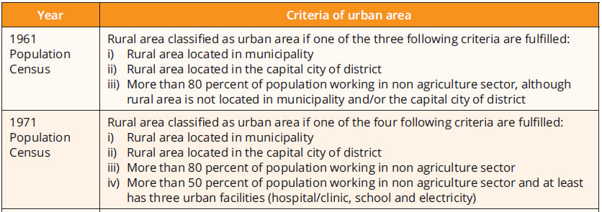
Change of Criteria in Defining Urban Villages and Non-urban Villages in Indonesia since 1961 to 2010

Slide 8
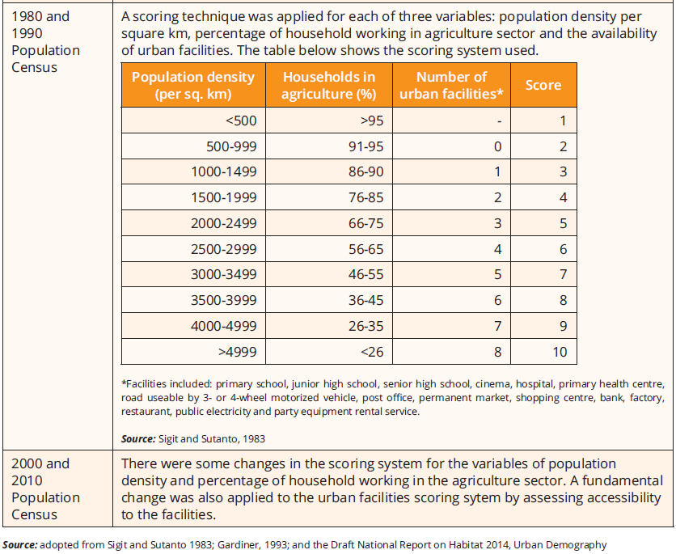
Change of Criteria in Defining Urban Villages and Non-urban Villages in Indonesia since 1961 to 2010

Slide 9
Categories of Urban Areas in Indonesia
Three administrative categories of urban areas referred to in Law No. 32/2004 on Local Governance (administrative decentralization):
urban areas as autonomous regions, known as city governments (kota),
urban areas within district boundaries (district capital towns), and
urban areas spilling over into one or more adjacent administrative areas.

Slide 10
Categories of Urban Areas in Indonesia
Based on administrative status:
Statutory cities: Daerah Kota (cities?)
Non-statutory cities: Kota-kota kabupaten (towns?)
Based on Population : City size
Metropolitan
Big cities
Medium Cities
Small cities

Slide 11
Categories of Urban Areas in Indonesia (Spatial Planning Law)
Small urban area is an urban area with minimum total population of 50.000 inhabitants and maximum of than100.000 inhabitants.
Medium urban area is an urban area with minimum total population of more than 100.000 inhabitants and maximum of 500.000 inhabitants
Large urban area is an area with minimum total population of more than 500.000
Metropolitan area is an urban area with more than 1 million inhabitants

Slide 12
Categories of Urban Areas in Indonesia (cont.)
Metropolitan Areas is urban areas that consist of one single urban area or urban area consisting of a core city and its surrounding urban areas that has functional relations and connected with integrated urban services and minimum population size of one million.
Megapolitan Area: Urban area formed by two or more metropolitan areas with functional relations and forming an urban system.

Slide 13
Categories of Urban Areas in Indonesia
Based on National Urban Development Strategy (NUDS-1980s):
Metropolitan: more than 1.000.000 inhabitants
Big Cities: 500.000 – 1.000.000 inhabitants
Medium Cities: 200.000 – 500.000 inhabitants
Small cities: 20.000 – 200.000 inhabitants
Small cities of sub-district: 3.000 – 20.000 inhabitants

Slide 14
Are urban and rural separated clearly?
the fact that in general there is rarely, either physically or socially, a sharp division, a clearly marked boundary between the two, with one part of the population wholly urban, the other wholly rural

