Slide 1
Techniques of Scoring Students’ Learning

Slide 2
Objectives of this course
After attending this course, you are expected to have the ability to:
Provide scores to various test methods
Convert the raw scores into the standard scores by following criterion-referenced approach (CRA)
Convert the raw scores into the standard scores by following norm-referenced approach (NRA)
Understand the descriptive statistics of scores

Slide 3
Four steps in scoring :
Providing the raw scores on the test results achieved by the students
Converting the raw scores into the standard scores based on a given norm
Converting the standard scores into a given grades
Analyzing the test items to determine the degree of test validity, reliability, difficulty index, and discriminating power.

Slide 4
Scoring
Scoring means to provide the raw scores on the test results achieved by students
To obtain the raw scores, the teacher needs the key answers, the scoring keys, and the conversion guidelines.
The raw scores still do not give any meanings to the students’ learning outcomes.
The raw scores, then, need to be converted into the standard scores in order that the scores are meaningful for students’ learning.

Slide 5
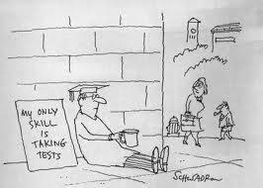
The scoring techniques for cognitive domain:

Slide 6
1. The scoring techniques for multiple choice test
Three different techniques of scoring for multiple choice test:
Scoring without any correction
Scoring with the correction
Scoring with the different item weights

Slide 7
a. Scoring without any response correction
It means that every single item about which the student answered correctly is awarded score ‘one’ and ‘null’ for every single item answered incorrectly.
The scoring formula:
B : The number of items answered correctly
N : Total items

Slide 8
Example of scoring
There were 50 items for an English test. Budi answered 25 items correctly. What is the score obtained by Budi?
Then, Budi’s score is achieved:

Slide 9
b. Scoring with response correction
It refers to the process of scoring by giving a consideration to the items about which the student answered correctly, incorrectly, and that of not being answered.
Every single item answered correctly is awarded score ‘one’; that of which is not answered is awarded score ‘null’; and that of which is answered incorrectly is awarded ‘-1’.
The scoring formula:
B : The number of items answered correctly
S : The number of items answered incorrectly
p : The number of options for every single item
N: Total items

Slide 10
Example of scoring
A multiple choice test consists of 40 items with four alternatives for every single items. Amir answered correctly 20 of 40 items, answered incorrectly 12 of 40 items and there were 8 items which were not answered by Amir. What’s score achieved by Amir?

Slide 11
b. Scoring with different item weights
It refers to the process of providing score with a consideration to the different weights or points for each item group.
The weight of items usually in accordance with the students’ cognitive levels (knowledge, comprehension, application, analysis, evaluation, creation).
The scoring formula:
B_{i} : The number of items answered correctly
b_{i} : Weight or point for every single item
S_{t} : Theoretical scores (maximum scores that might be achieved if all items are answered correctly)

Slide 12
Example of scoring
A 40 item-English test consists of six different levels of the cognitive domains and is weighted as follows: 1 point for knowledge domain, 2 for understanding domain, 3 for application, 4 for analysis, 5 for synthesis, and 6 for evaluation. Yoyo can answer correctly 8 items of 12 items for knowledge domain; 12 of 20 items for understanding domain are correct; 2 items of 4 items for application domain are correct; 1 item of 2 items for analysis domain is correct; 1 item of the synthesis domain is correct; and 1 item for evaluation domain is also correct. What is the score obtained by Yoyo?

Slide 13
To make it easier to score, draw a table as the following:
Cognitive domains | Number of items | Item weight (b_{i} ) | Num. of item x b_{i} | B_{i}
Knowledge | 12 | 1 | 12 | 8
Comprehension | 20 | 2 | 40 | 12
Application | 4 | 3 | 12 | 2
Analysis | 2 | 4 | 8 | 1
Synthesis | 1 | 5 | 5 | 1
Evaluation | 1 | 6 | 6 | 1
Total | 40 |  | S_{t} = 83 | 25

Slide 14
Latihan 1
Coba Anda tentukan kembali berapakah skor yang diperoleh Yoyok apabila bobot pada setiap komponen dirubah menjadi sebagai berikut: pengetahuan diberi bobot 0,5; pemahaman bobot 1, penerapan, analisis, dan sintesis masing-masing diberi bobot 2, serta evaluasi 3. Tentukan juga berapakah skor teoritis perangkat tes tersebut!
Latihan 2
Tentukan berapakah skor yang diperoleh Yoyok apabila menggunakan penskoran tanpa ada koreksi.

Slide 15
2. Scoring techniques for essay test
Weighting system is usually used in providing the raw scores for essay test.
There are two ways of weighting essay test:
No. of items | Dif. Level | Answers | Scores (X)
1. | Easy | True | 6
2. | Moderate | True | 7
3. | Difficult | True | 10
Total scores |  |  | 23
No. of items | Dif. level | Answers | Scores (X) | Weight (B) | XB
1. | Easy | True | 10 | 3 | 30
2. | Moderate | True | 10 | 4 | 40
3. | Difficult | True | 10 | 5 | 50
Total scores |  |  |  | 12 | 120
X = Score for each item
B = Weight for each item

Slide 16
Weighting for composite items
There is sometimes the test group as a combination between multiple choice and essay test.
A test consists of n₁ multiple choice items and n₂ essay items. The weight for multiple choice items is b₁ and the weight for essay items is b₂. If students answered correctly n₁ for multiple choice test, and answered correctly n₂ for essay test, so the student’s score is:
b₁ = Weight for test 1 (multiple choice)
b₂ = Weight for test 2 (essay)

Slide 17
Example of scoring
Suatu tes terdiri dari 20 bentuk pilihan ganda dengan 4 pilihan, dan 4 buah soal bentuk uraian. Titi dapat menjawab benar soal pilihan ganda 16 butir dan salah 4 butir, sedang bentuk uraian bisa dijawab benar 20 dari skor maksimum 40. Apabila bobot pilihan ganda adalah 0,40 dan bentuk uraian 0,60, maka skor yang diperoleh Titi dapat dihitung sebagai berikut.
a. Skor pilihan ganda tanpa koreksi jawaban dugaan : (16/20)x100 = 80
b. Skor bentuk uraian adalah : (20/40)x100 = 50
c. Skor akhir adalah : 0,4 x (80) + 0,6 x (50) = 62

Slide 18
Converting the Scores with criterion-referenced approach (CRA)

Slide 19
Criterion-referenced assessment approach (Penilaian acuan patokan/PAP) is also called an absolute-based assessment.
Criterion-referenced assessment means comparing the scores obtained by the students with criteria or standards that were absolutely set by teachers.
In criterion-referenced assessment, the student’s scores is not compared with that of the group’s scores but the scores will be converted to given scores ​​based on theoretical score (maximum scores).
A teacher who uses criterion-referenced assessment approach should have developed a guidelines for converting the raw scores into standard scores before the test begins.

Slide 20
Steps of applying CRA
1. Determining a score (raw score) based on the proportion.
B : The number of items answered correctly (for multiple choice tests) or a total score of correct answers on each item (for essay tests)
S_{t} : Theoretical score (maximum score)
2. Determining a passing grade.
A Passing grade is a score that describes the proportions and the qualifications of learners’ mastery about the contracted competencies in learning. (E.g. 60; 70; or 75)

Slide 21
Example of CRA
Diketahui skor mentah bahasa Inggris bagi 52 siswa adalah sebagai berikut:
32 20 35 24 17 30 36 27 37 50
36 35 50 43 31 25 44 36 30 40
27 36 37 32 21 22 42 39 47 28
50 27 43 17 42 34 38 37 31 32
22 31 38 46 50 38 50 21 29 33
34 29
Tentukan skor standar (baik untuk skala 5 maupun skala 10) dari skor-skor mentah tersebut dengan menggunakan PAP (CRA) jika skor teoretis (skor maksimum) ditetapkan 60!

Slide 22
Tips to convert the scores for the scale of 5
1. Determining the conversion guidelines.
Scale of 5 usually uses the following conversion guidelines :
Level of mastery Standard score
90% - 100% A
80% - 89% B
70% - 79% C
60% - 69% D
≤ 59% E

Slide 23
2. Determining the table of conversion.
If the theoretical score (maximum score) is 60, the mastery of 90% is calculated 0.9 x 60 = 54; the mastery of 80% is 0.8 x 60 = 48; the mastery of 70% is 0.7 x 60 = 42; the mastery of 60% is 0.6 x 60 = 36. So, the table of conversion can be arranged as follows:
Raw scores Standard scores
54 – 60 A
48 – 53 B
42 – 47 C
36 – 41 D
≤ 35 E
Conclusion:
A student with raw score 50 means he/she got B; a student with raw score 43 means he/she got C; a student with raw score 17 means he/she got E, etc.

Slide 24
Tips to convert the scores for the scale of 10
1. Determining the conversion guidelines.
Scale of 10 usually uses the following conversion guidelines :
Level of mastery Standard score
95% - 100% 10
85% - 94% 9
75% - 84% 8
65% - 74% 7
55% - 64% 6
45% - 54% 5
35% - 44% 4
25% - 34% 3
15% - 24% 2
05% - 14% 1

Slide 25
2. Determining the table of conversion.
If the theoretical score (maximum score) is 60, the mastery of 95% is calculated 0.95 x 60 = 57; the mastery of 85% is 0.85 x 60 = 51; the mastery of 75% is 0.75 x 60 = 45; and so on. So, table of conversion can be arranged as follows:
Raw scores Standard scores
57 – 60 10
51 – 56 9
45 – 50 8
39 – 44 7
33 – 38 6
27 – 32 5
21 – 26 4
15 – 20 3
09 – 14 2
03 – 08 1
Conclusion:
A student with raw score 50 means he/she got 8; a student with raw score 43 means he/she got 7; a student with raw score 17 means he/she got 3, etc.

Slide 26
Converting the Scores with Norm-Referenced Approach (NRA)

Slide 27
This approach (NRA) or Pendekatan Acuan Norma / PAN (in bahasa Indonesia) is used to compare the student’s achievement or raw scores with his/her fellows in his/her group.
The meaning of the score, either quantitatively or qualitatively, is relative.
If you have determined a conversion guidelines based on tests carried out in a given group, then it is useful as guidelines for that group only and it is probably not useful as guideline for another group because the distribution of students’ scores will also be different.

Slide 28
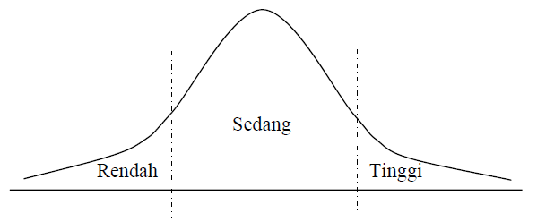
Norm-referenced approach uses the basic assumption of normality. It means that the scores should be in normal distribution as the following condition:

Slide 29
Steps of applying NRA
1. Calculating the average score ( x̅ ). There are two ways to calculate the average score:
a.
x_{i} : the i^{th} students’ score
n : number of students
b.
x_{i} : sign of group
f_{i} : frequency corresponding to x_{i}

Slide 30
2. Calculating standard deviation (s) of scores. There are two ways to calculate standard deviation:
a.
x_{i} : the i^{th} score
b. (for grouped data)
x_{i} : the i^{th} score
f_{i} : the i^{th} frequency
i : test length
x_{i}’ : cryptic score

Slide 31
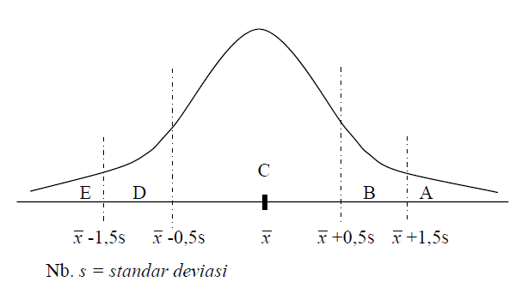
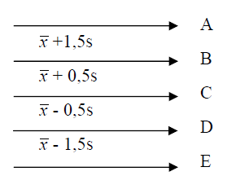
3. Creating a conversion guideline to convert the raw score to a standard score (stanfive, stanine, stanel, and Z_{score}).
a. Standard five (stanfive) guideline.

Slide 32
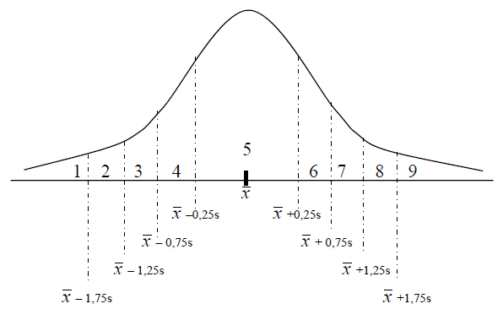
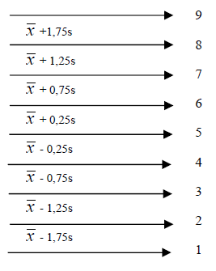
b. Standard nine (stannine) guideline

Slide 33
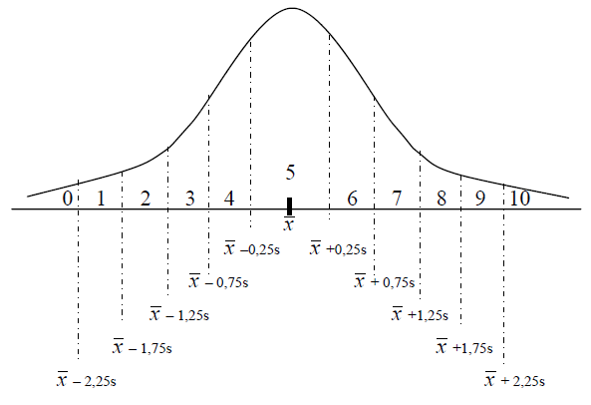
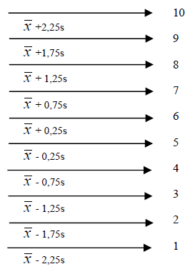
c. Standard eleven (stanel) guideline.

Slide 34
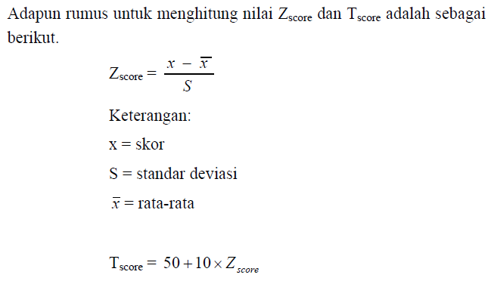
d. Conversion guidelines for Z_{score} or T_{score}
You can directly convert the raw scores into standard scores using the two scores, those are ​​Z_{score} and T_{score}.
Z_{score} means changing raw score into a standard score of Z.

Slide 35
Example of NRA (PAN) aplication
Contoh-1 (untuk data tidak berkelompok):
Seorang guru bahasa Inggris membina sepuluh orang peserta didik. Ia berencana mengolah dengan Pendekatan Acuan Norma (PAN) skor akhir bahasa Inggris menjadi nilai standar. Skornya seperti pada tabel berikut.
Pertanyaan:
Susunlah pedoman konversi skala-5, skala-9 dan skala-11 dan konversikan sepuluh skor tersebut menjadi nilai standar!

Slide 36
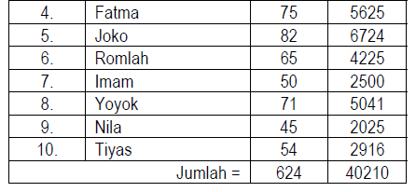
Cara menjawab

Slide 37
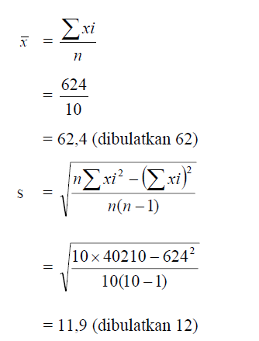

Slide 38
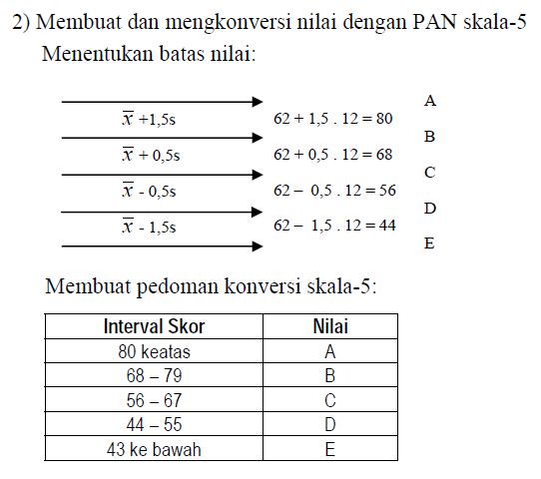

Slide 39
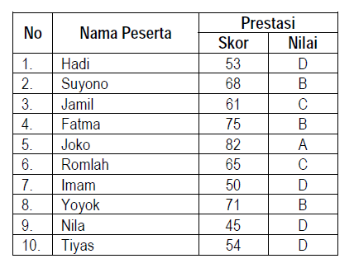
Mengkonversi skor menjadi nilai skala-5:

Slide 40
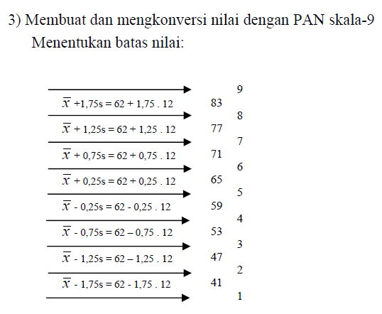

Slide 41
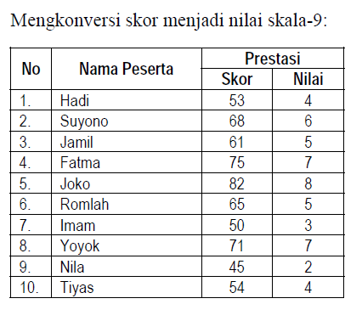

Slide 42
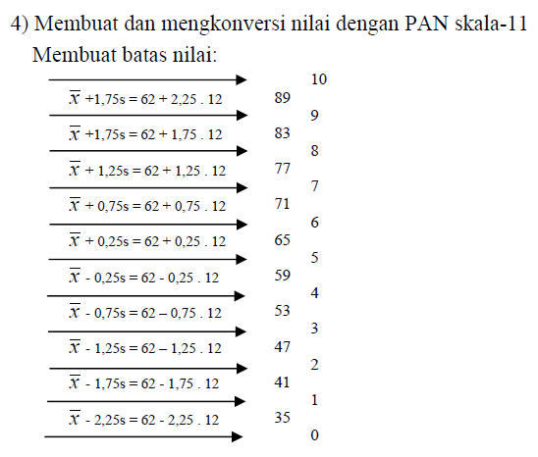

Slide 43
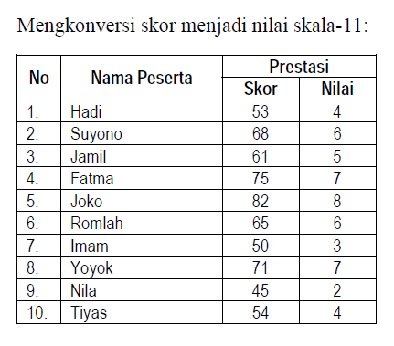

Slide 44
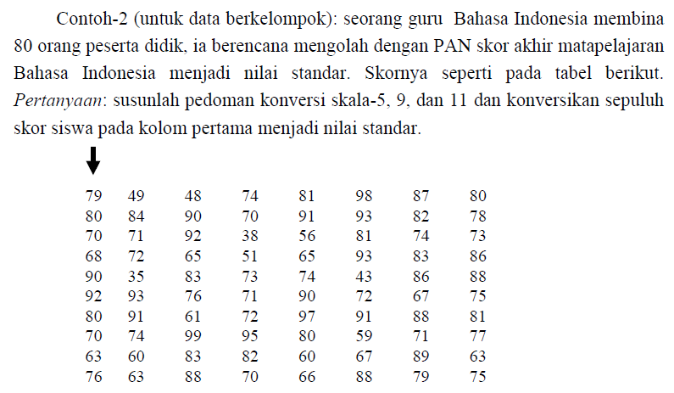

Slide 45
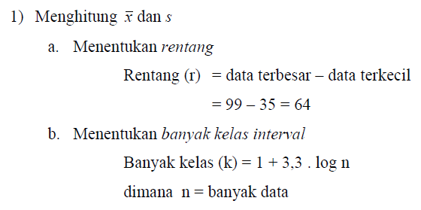
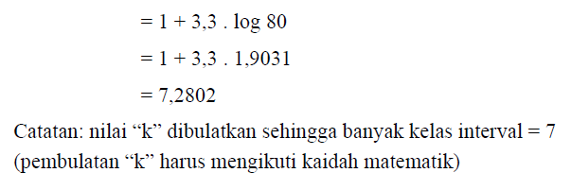

Slide 46
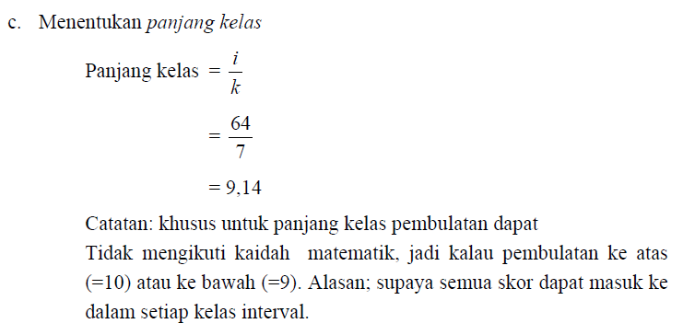

Slide 47
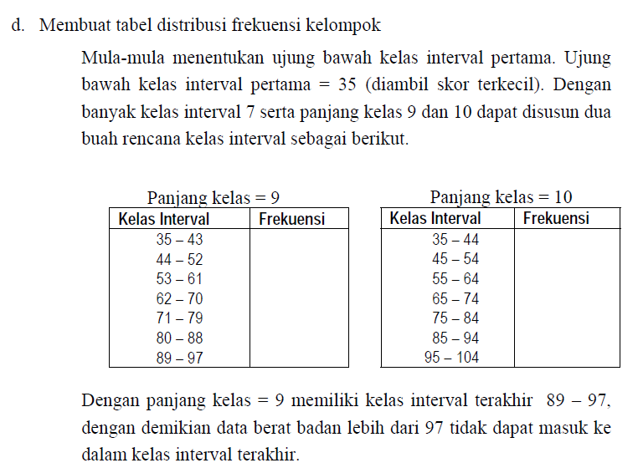

Slide 48
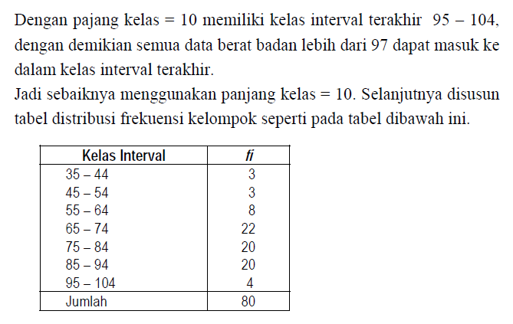

Slide 49
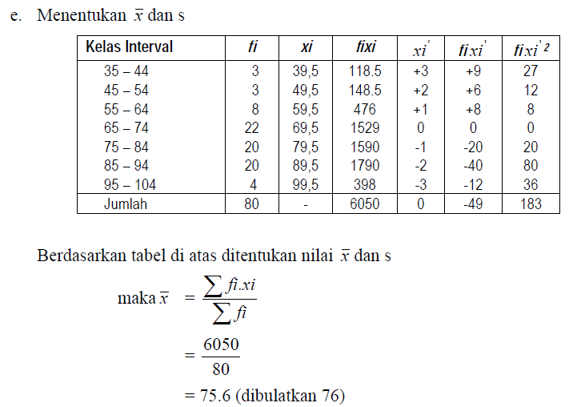
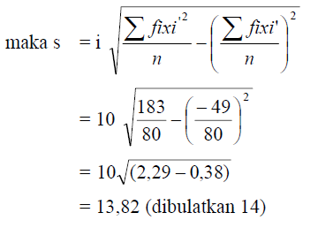

Slide 50
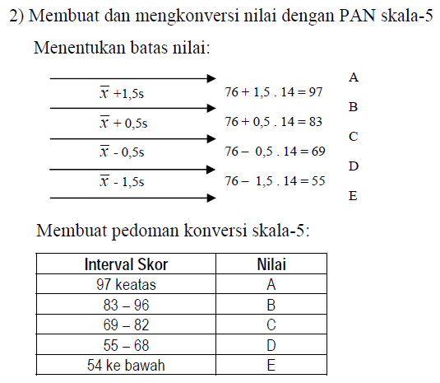
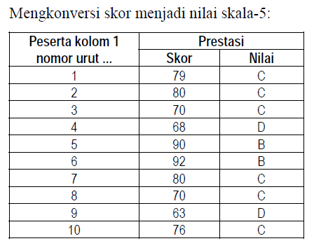

Slide 51
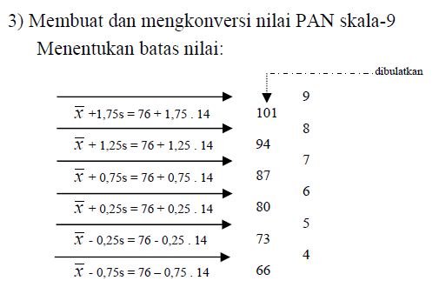
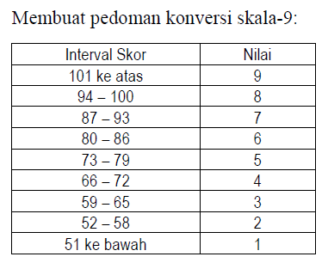

Slide 52
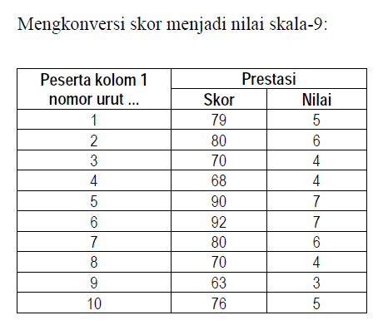

Slide 53
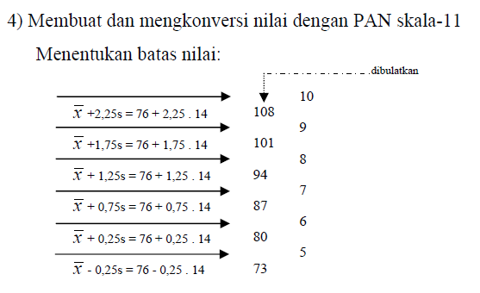
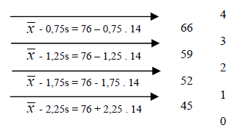
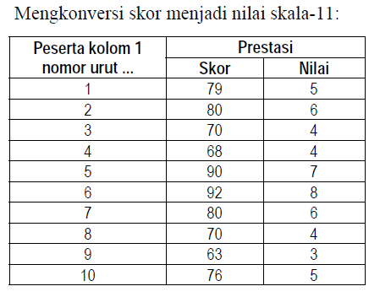

Slide 54
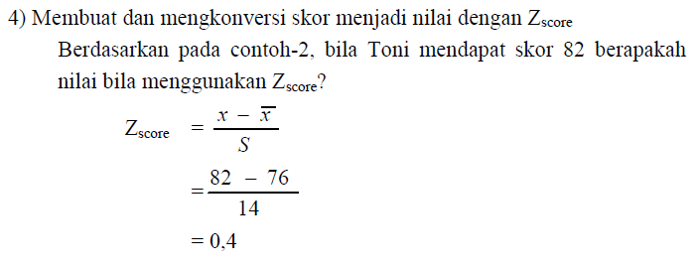

Slide 55
Descriptive statistics of scores
The descriptive statistics of scores most commonly describes two properties; those are central tendency and variability.
The central tendency of a score distribution indicates where the center of the score distribution lies.
The variability indicates the degree to which the score distribution is asymmetrical.

Slide 56
Central tendency
The central tendency uses commonly three indexes; those are mode, median, and mean.
The mode is the most frequently occurring scores.
The median is the score that half the examinees score at or below.
The mean is the arithmetic average of scores

Slide 57
No | Scores | Frequency
1 | 10 | 0
2 | 11 | 0
3 | 12 | 2
4 | 13 | 5
5 | 14 | 3
6 | 15 | 1
7 | 16 | 6
8 | 17 | 1
9 | 18 | 2
10 | 19 | 0
Based on the above score data, we know that :
The mode is 16 (the most frequently scores).
The median of the frequency distribution could any value above 14 and less than 15. Conventionally, the median would set at 14.5.
The mean can be defined:
so, the mean of scores is 14.75

Slide 58
Variability
There are three common measures of variability, those are the range, the variance, and the standard deviation.
Each reflects the extend to which the scores in a set differ among themselves.
The range is the difference between the largest and the smallest scores in the distribution. So, the range of above scores is 19 – 10 = 9

Slide 59
The variance is the average squared deviation from the mean.
The variance can be expressed as:
So, based on the above table the variance can be calculated as the following:
Σx².f = 10²(10) + 11²(2) + 13²(5) + 14²(3) + 15²(1) + 16²(6) + 17²(1) + 18²(2) + 19²(0)
= 4419
Then :
s² = [4419 – 20(14.75)²] / 20 = 3.39

Slide 60
The standard deviation is a measure of how spread out your scores are.
The standard deviation of the above scores is:
SD = √3.39 = 1.84

Slide 61
Thank you …

