Slide 1
Modul1 Some Basic Concepts and Terminology

Slide 2
Type of Educational Research
Historical research
Descriptive research
Correlational research
Causal research
Experimental research
Case study research
Research and development research

Slide 3
Three types of research questions in educational planning
Descriptive questions
What is the physical state of school buildings in the country? Do some dictricts or regions have better or worse school buildings than others?
Where systems of education have teacher housing, how adequate is the housing?
Do the supplies and equipment in classrooms in the schools match the legislated standards set by ministry?

Slide 4
Correlational questions
Do students in poorer school buildings have lower achievement scores than those in better buildings?
Do male students do better than female students in the scientific/technical subject areas?

Slide 5
Causal Questions
All other factors being equal do students with textbook A achieve better than students with textbook B?
What is the relative effect on school achievement of the following factors: the sosio-economic level of students in the school; the general parental help given to the children with their homework?

Slide 6
Identifying research issues for education planning
It is important to be sure of the facts before making suggestions for changes in educational politics and practices.

Slide 7
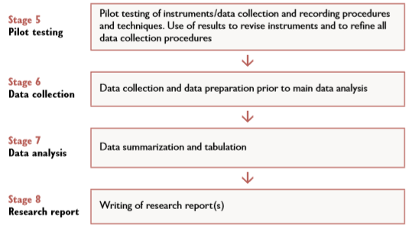
Sequential stages in the research process

