Slide 1
Pertemuan 3 Global Trend of Urbanization
Sustainable Urbanization

Slide 2
The Process of Urbanisation
In developed countries like in the north-western Europe as well as in US, urbanization is a concomitant of industrialization and a phenomenon embedded in commodity production.
However, in the developing countries, urbanization often takes place without a parallel growth in industrialization.
As a result, the impacts on natural environments are perhaps less severe, although the infrastructure may also be missing to better control whatever impacts do occur.
Other impact in the developing countries is the growth of poverty in the process of urbanisation.

Slide 3
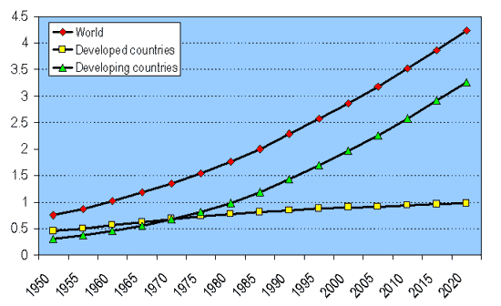
World Urban Population

Slide 4
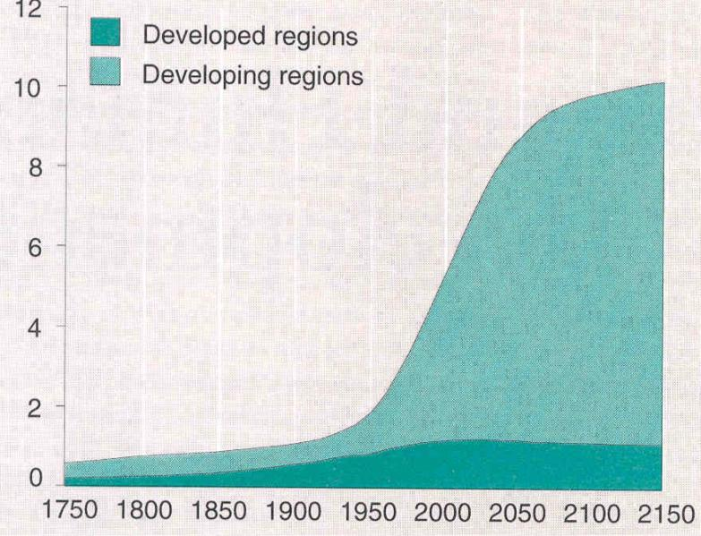
World Urban Population

Slide 6
The World’s Urbanization Prospects
1970s : The urban population of developing countries began to exceed the number in developed countries
2008: urban population of the world is estimated begin to exceed the number of non-urban population for the first time in history
2010s: for the first time in history, more than half of urban population in developing countries will be living in their urban areas
The 21st century is the century became an urban century
Most of the world's urban population will live in cities in developing countries, especially in Asia

Slide 7
The World’s Urbanization Prospects
Australia and New Zealand, Europe, Japan and North Americaare the regions where urbanisation has been reaching to the saturation process.
Latin America is the region where urbanisation process has also been reaching to the saturation process.
Africa and Asia experience very high growth rate of urbanisation process.
The difference among Asia and Africa is in the absolute number of urban dwellers involved in the process of urbanisation, where in Asia it involves very huge number of them.
The biggest process of world urbanisation will take place in developing countries, especially in Asia

Slide 8
More Global Trends

Slide 9
Global Trends
Cities account for more than 53 per cent of the world’s population.
This figure is probably underestimated, given that there is no universal agreement on what constitutes “urban” and many people living in peri-urban areas close to major urban centres are often not included in counts of city population.
The current rate of urbanization globally is around 1 per cent and projected to fall to 0.56 per cent by 2050 (United Nations, 2012). However, there are significant differences predicted between urbanization growth rates in regions, with sub-Saharan Africa being the highest.
The impact of an additional 2.6 billion people living in cities by 2050 will be enormous in terms of consumption of land, water and food, along with an increased Secondary City Urbanization Trends and Patterns demand for shelter, infrastructure and jobs.

Slide 11
Global Trends
The proportion of the global population living in cities will increase most in megacities
The proportion of those living in megacities as a proportion of total urban population is predicted to increase from 9.9 per cent to 13.6 per cent between 2010 and 2025.
The population of megacities is predicted to increase from 352 million to 630 million for the same period, a compound growth rate of almost 4 per cent per annum.
The biggest absolute growth in the population will be in the secondary cities of those of 1-5 million

Slide 13
Shift
There will be significant shifts in the change in the proportional growth rate of cities globally and across regions.
The highest change in the proportional growth rates will occur in sub-Saharan Africa and Asia.
In Asia the megacities and secondary cities with populations of 1-5 million are likely to expand faster as a proportion of total urban growth.
In Africa, particularly sub-Saharan Africa, the largest cities will absorb a higher proportion of urban growth

Slide 14
Shift
In North America and Oceania medium-sized cities are expected to win an increased share of urban population growth.
However, in Europe, overall population increases will remain low, but the megacities will absorb the most significant proportion of urban population growth

Slide 16
Population by city size
It is apparent from the analysis of the data that while smaller cities will still house most of the world’s urban population, they will continue to lose urban growth share as people move to larger cities in search of jobs and better living prospects (Satterthwaite,

Slide 19
Systems of cities

Slide 20
Urban System
Countries have long used a hierarchy of urban settlements as an instrument for the organization and operations of government, defence and commerce.
Some countries have a system of cities that is very hierarchical, for example there is a single, very large, dominant city, such as Jakarta (population 12 million), and a long list of lessersized urban settlements, tailing down to small towns of fewer than 20,000 people.
In the order of urban-systems hierarchies, megacities prevail. The term “megacity” refers to large metropolitan, regional cities with populations of more than 10 million
Megacities are primate cities, and they sit at the apex of a system of global cities.
However, in some countries, for example the USA, Brazil and China, there is more than one mega/primate city, so the apex principle of a single dominant city in a country does not apply.

Slide 23
Global Urbanization and Urban Footprint

Slide 25
Global Urbanization and GDP

Slide 26
Primacy and GDP
In the global context, not all primate cities are megacities. Many, for example Kuala Lumpur (Malaysia) and Auckland (New Zealand), have relatively small populations but demonstrate strong attributes of primacy. A primate city is likely to generate a disproportional percentage of a nation’s Gross Domestic Product (GDP) for its size
The ratio of GDP per capita in some primate cities can exceed many times the national average per capita figures. It is clear that while primacy is a significant factor in the economic geography and hierarchy of urban settlements in countries, in the context of the global urban system, some primate cities are secondary or lower-order cities.

