Slide 1
EKOLOGI MANUSIA: PENGANTAR

Slide 2
WHAT IS HUMAN ECOLOGY?
Ecology is the science of relationship between living organisms and their environment.
Human ecology is about relationships between people and their environment
In human ecology, the environment is perceived as an ecosystem
An ecosystem is everything in a specified area-the air, soil, water, living organisms and physical structures, including everything built by humans
The living parts of an ecosystem-microorganisms, plants, and animals (including humans)-are its Biological community

Slide 3
WHAT IS HUMAN ECOLOGY?
Ecosystems can be any size:
A small pond in a forest
The entire forest
A single farm
A rural landscape
Villages, towns, and large cities
A region of thousands of square kilometres
The planet earth

Slide 4
WHAT IS HUMAN ECOLOGY?
Social system is everything about people, their population and the psychology and social organization that shape their behaviour
The social system is a central concept in human ecology because human activities that impact on ecosystems are strongly influenced by the society in which people live
Values and knowledge-which together form our worldview as individuals and as a society
Technology
Social organization
Social institution

Slide 5
WHAT IS HUMAN ECOLOGY?
The ecosystem provides services to the social system by moving materials, energy and information to te social system to meet people’s need.
The ecosystem services include water, fuel, food, material for clothing, construction materials, and recreation.
Materials, energy, and information move from social system to ecosystem as a consequence of human activities that impact the ecosystem
People affect ecosystems when they use resources such as water, fish, timber, and livestock grazing land
After using materials from ecosystems, people return the materials to ecosystems as waste
People intentionally modify or reorganize existing ecosystems, or create new ones, to better serve their needs

Slide 6
Interaction of human social system with the ecosystem
SOCIAL SYSTEM
Human Activities: Energy, material, information
ECOSYSTEM
Knowledge
Population
Values
Social organization
technology
Plants
Human-built structures
soil
Water
air
Animals
Microorganisms
Ecosystem services: Energy, material, information

Slide 7
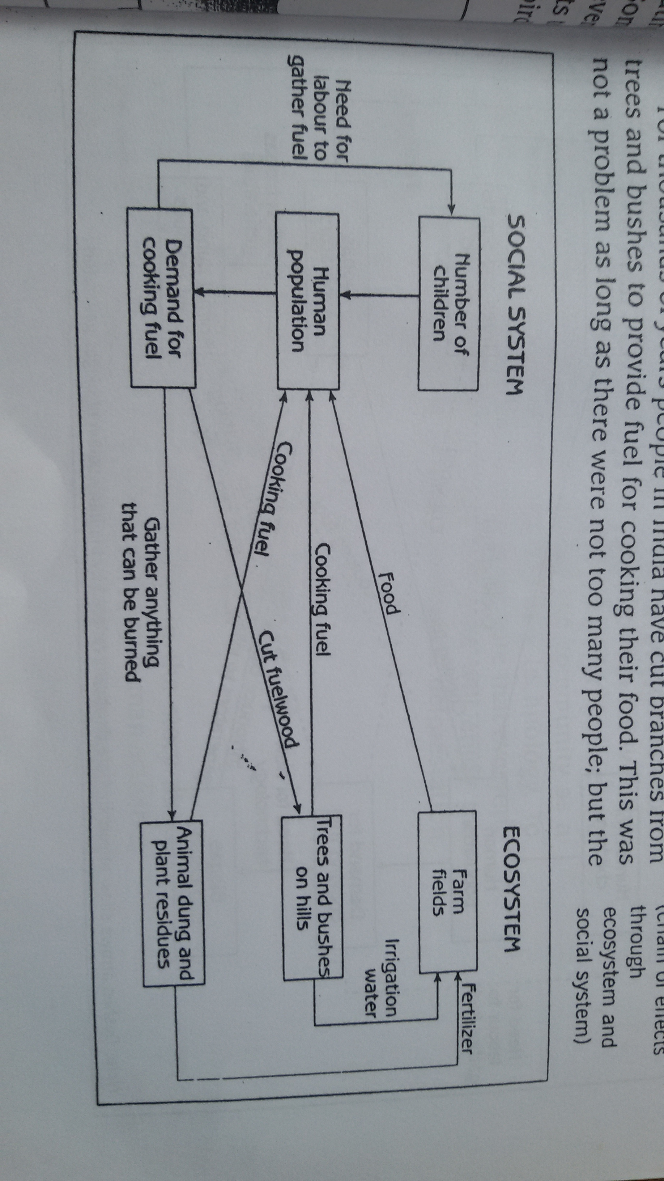
Cooking fuel and deforestation in India

Slide 8
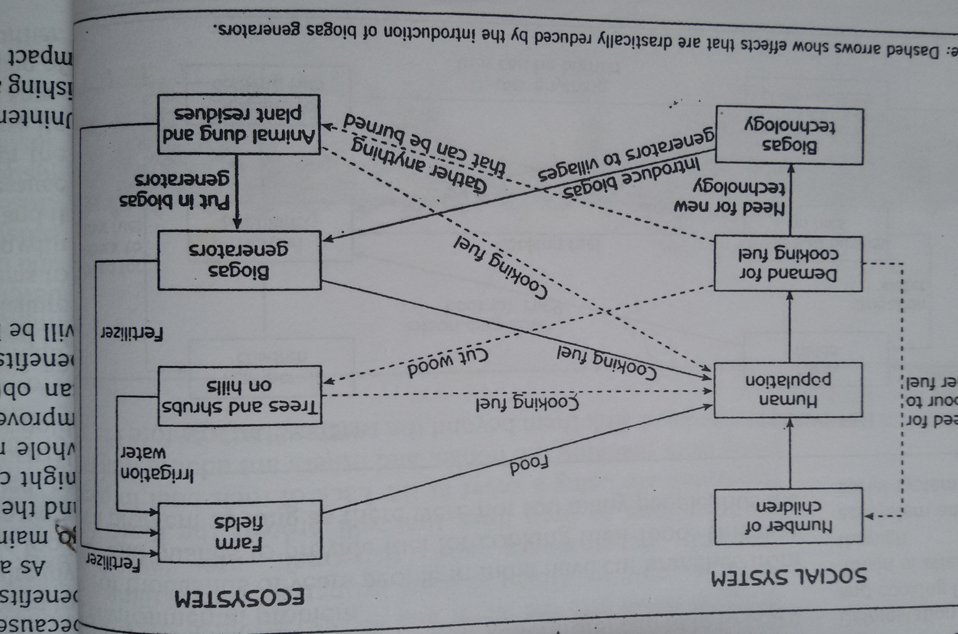

Slide 9
SUSTAINABLE DEVELOPMENT
Minamata Disease in Japan
Deforestation in North Korea
Sustainable Development can be defined as meeting present needs without compromising the ability of future generations to meet their own needs

Slide 10
SUSTAINABLE DEVELOPMENT
Sustainable Development:
It is about:
leaving the opportunity for a decent life to our children and grandchildren
keeping ecosystem healthy
interacting with ecosystems in ways that allow them to maintain sufficient functional integrity to continue providing humans and all other creatures in the ecosystem the food, water, shelter, and other resources that they need

