Slide 1
PHP FUNDAMENTALS
👋👋
Variable, Data Type, Operator
ICT 2nd Semester

Slide 2
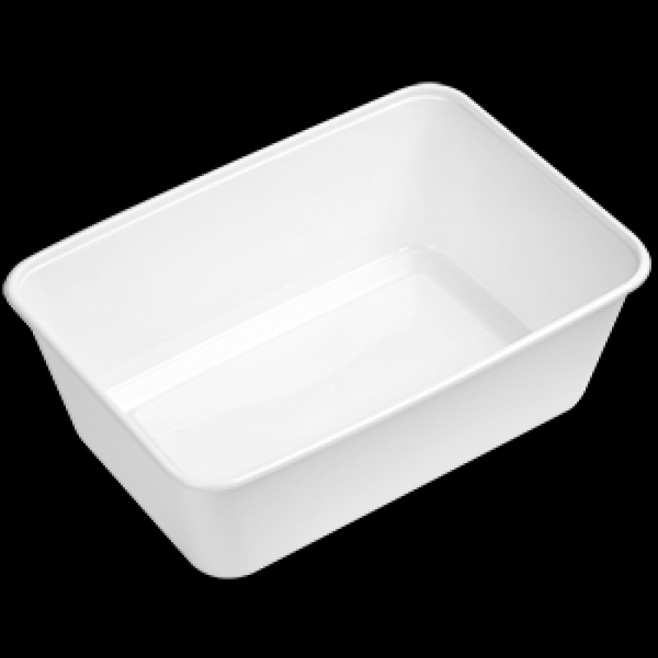
Apa ini?? Fungsi nya apa?

Slide 3
Menyimpan Makanan
Menjaga aroma makanan tidak keluar
Menyimpan Barang
Menyimpan rasa yang tak bisa diutarakan :D
Menjaga makanan biar tidak tumpah
Wadah/Tempat

Slide 4
What is Variable?
P
A variable in a program is used to store a value or data that can be used later in a program.
H
formula
$variable_name = value;
P
$number = 10;
$submit = $_POST[‘submit’]

Slide 5
Rules of Variable
P
The variable name must start with the dollar sign ($).
The first character after the dollar sign ($) must be a letter (a-z) or the underscore ( _ ).
The remaining characters can be underscores, letters, or numbers.
The first character after the dollar sign ($) cannot be a number
H
P

Slide 6
Rules of Variable
$number
$NUMBER
$nama_siswa
$_siswa
$12number
$13-chair
$alamat siswa

Slide 7
Value/ Data
Mempunyai beberapa tipe
Variable

Slide 8
Data Type of the value
Variables can store data of different types
Integer
Float
String
Boolean
Array
Object
NULL
Resource

Slide 9
Integer (angka)
P
An integer data type is a numeric data type used to express integers.
H
Example
$number = 12;
$nis = 990221;
P

Slide 10
Float (desimal)
P
A float is a number with a decimal point or a number in exponential form
H
Example
$number = 0.5;
$discount = 0.75;
float dituliskan dengan titik (.) bukan koma (,)
P

Slide 11
String (text)
P
A string is a sequence of characters, like "Hello world!"
H
Example
$student_name = “Amara Shafa”;
$class = ‘X MIPA 12’;
P
Bisa menggunakan kutip satu (‘ ‘) atau dua (“ “)

Slide 12
Boolean (binary)
P
Boolean data types are data types that are used to declare true or false values
H
Example
$benar = true;
$salah = false;
P
Boolean lebih sering digunakan untuk Operasi Logika

Slide 13
QUICK QUESTION!
Mention the variables' writing rules!

Slide 14
Code Demo
Variable and Data Type
Open your XAMPP and Code Editor. Then Create a new folder “chapter2” in htdocs folder

Slide 15
4 x 3 = ???
a = 12
b = 5
a + b = ???
apakah
a > b ??

Slide 16
4 x 3 = ???
Operand
Operator
nilai asal yang digunakan didalam proses operasi
instruksi yang diberikan untuk mendapatkan hasil dari proses tersebut.

Slide 17
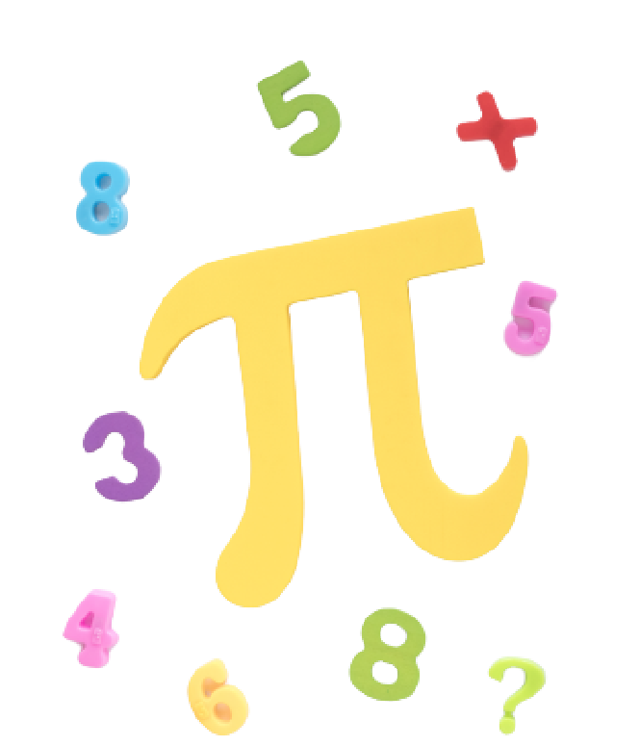
Operators
Operators are the symbols used to perform operations on a value and a variable.
Arithmetic operators
Assignment operators
Comparison operators
Increment/Decrement operator
Logical operators
String operators

Slide 18
Arithmetic Op.
P
The arithmetic operators require numeric values.
H
Operator | Name | Example | Description
+ | Addition | $a + $b | Return the sum of two operands
- | Subtraction | $a - $b | Return the difference between two operands
* | Multiplication | $a * $b | Return the product of two operands
/ | Division | $a / $b | Return the quotient of two operands
% | Modulus | $a % $b | Return the remainder of the division of the first operand by the second one
P

Slide 19
Assignment Op.
P
Assignment operator ( = ) assigns a value to a variable and returns a value
H
Operator | Name | Same as…
a = b | equal | a = b
a += b | plus-equal | a = a + b
a -= b | minus-equal | a = a - b
a *= b | multiplication-equal | a = a * b
a /= b | divide-equal | a = a / b
P

Slide 20
Assignment Op.
P
Example
H
$number = 10;
$number += 40;
echo $number;
$number = 10
$number_{baru} = $number_{lama} + 40
$number_{baru} = 10 + 40
$number_{baru}= 50
P

Slide 21
Comparison Op.
P
Comparison operators allow you to compare two operands. A comparison returns a Boolean value
H
Operator | Name | Description
== | Equal to | Return true if both operands are equal; otherwise, it returns false.
=== | Identical to | Return true if both operands have the same data type and equal; otherwise, it returns false.
!= | Not equal to | Return true if both operands are equal; otherwise, it returns false.
!== | Not identical to | Return true if both operands are not equal or not have the same data type; otherwise, it returns false.
P

Slide 22
Comparison Op.
P
Operator | Name | Description
< | Less than | Return true if the operand on the left is less than the operand on the right; otherwise, it returns false.
> | Greater than | Return true if the operand on the left is greater than the operand on the right; otherwise, it returns false.
<= | Less than or equal | Return true if the operand on the left is less than or equal to the operand on the right; otherwise, it returns false.
>= | Greater than or equal to | Return true if the operand on the left is greater than or equal to the operand on the right; otherwise, it returns false.
H
P

Slide 23
Comparison Op.
Example #1
Example #2
$first = 10;
$second = 50;
$logic = $first > $second;
//Jawaban: FALSE
$x = 50;
$logic = $x > 50;
//Jawaban: FALSE

Slide 24
Logical Op.
P
Logical operators allow you to construct logical expressions. A logical operator returns a Boolean value.
H
Operator | Name | Description
&& | Logical AND | Return true if both operands are true, otherwise return false. If the first operand is false, it will not evaluate the second operand because it knows for sure that the result is going to be false. This is known as short-circuiting.
|| | Logical OR | Return true if one of the operands is true, otherwise returns false. If the first operand is true, it will not evaluate the second one.
! | Not | returns true if the operand is false, and returns false if the operand is true.
P

Slide 25
AND (&&)
P
The logical AND operator accepts two operands and returns true if both operands are true; otherwise, it returns false.
H
exp1 | exp2 | exp1 && exp2
TRUE | TRUE | TRUE
TRUE | FALSE | FALSE
FALSE | TRUE | FALSE
FALSE | FALSE | FALSE
Logika AND hanya menerima “perintah” ketika semua kondisi bernilai BENAR / TRUE
P

Slide 26
Case AND
Ibu ingin menggoreng Tahu. Kamu diminta untuk membeli Minyak dan Tahu ke Warung sebelah karena persediaan Minyak dan Tahu di rumah habis
Apakah kalian cukup membeli Tahu saja untuk membuat Tahu Goreng?
TIDAK!
Kalian harus membeli keduanya untuk membuat tahu goreng
Apakah kalian cukup membeli Minyak saja untuk membuat Tahu Goreng?
(Minyak && Tahu):
Tahu Goreng

Slide 27
OR (||)
P
The logical OR operator accepts two operands and returns true if either operand is true; otherwise, it returns false.
H
exp1 | exp2 | exp1 || exp2
TRUE | TRUE | TRUE
TRUE | FALSE | TRUE
FALSE | TRUE | TRUE
FALSE | FALSE | FALSE
True jika minimal satu atau kedua pernyataan bernilai true. False jika keduanya bernilai false.
P

Slide 28
Case OR
Kamu ingin membeli Lauk untuk makan siang berupa Ayam Goreng atau Telur Dadar. Apabila salah satu lauk tersebut habis, kamu masih bisa makan dengan salah satu lauk tersebut
Apakah bisa beli Ayam Goreng saja walaupun Telur dadarnya habis untuk makan siang?
Boleh sekali
Kalian bisa pilih salah satu lauk untuk makan siang karena Pilihannya OR
Apakah bisa beli Telur dadar saja walaupun Ayam gorengnya habis untuk makan siang?

Slide 29
Code Demo
Operators
Open your XAMPP and the Code Editor.

Slide 30
Let’s code
PHP FUNdamentals
Open your modul Chapter 2 and do the Practice Section

Slide 31
Exercise
Let’s do the exercise 1 in Chapter 2
Kerjakan latihan 1 di selembar kertas

