Slide 1
Yunastiti Purwaningsih

Slide 2
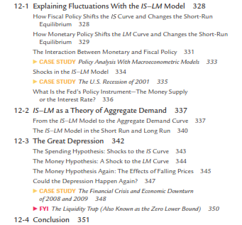

Slide 3
Equilibrium in the IS-LM Model
The IS curve represents equilibrium in the goods market.
r
LM
The LM curve represents money market equilibrium.
r₁
E
IS
Y
Y₁
The intersection determines the unique combination of Y and r that satisfies equilibrium in both markets.

Slide 4
Policy analysis with the IS-LM Model
r
LM
Policymakers can affect macroeconomic variables with
fiscal policy: G and/or T
monetary policy: M
We can use the IS-LM model to analyze the effects of these policies.
r₁
E
IS
Y
Y₁
-

Slide 5
Policy analysis with the IS-LM Model
IS :
+
-
LM :
-
Policy
Fiscal: G and/or T
Monetary: M
Shock = disturbance: gangguan
C ; I ; L

Slide 6
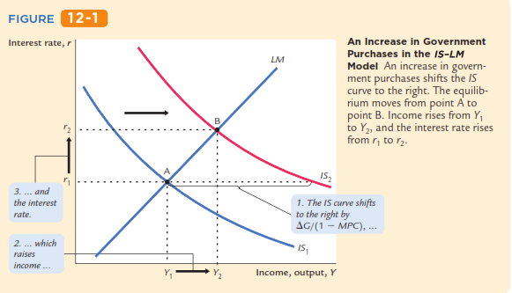
Changes in Government Purchases
An Increase in Government Purchases in
the IS–LM Model
C
Titik A → titik C → titik B
G ↑ → ∆Y < 1/(1-MPC) . ∆G
Y3

Slide 7
Changes in Government Purchases
An Increase in Government Purchases in
the IS–LM Model
IS₁ dan LM: titiik A (r1 dan Y1)
G ↑ ➔ pasar barang: IS kanan dari IS₁ ke IS₂ → pada r1 dan IS₂: titik C (r1 dan Y3): Y ↑ dari Y1 ke Y3 → ∆Y = 1/(1-MPC) . ∆G
x
Y ↑ dari Y1 ke Y3 ➔ pasar uang: L ↑ [ L (r, Y) ] ; Ms tetap → r ↑ (dari r1 ke r2) ➔ pasar barang: I ↓ [I(r)] → Y ↓ dari Y3 ke Y2 ➔ IS2 dan LM: titik B (r2 dan Y2)
C
G ↑ hasil akhir Y ↑ dari Y1 ke Y2 dg ∆Y < 1/(1-MPC) . ∆G
Y3
G ↑ → ∆Y < 1/(1-MPC) . ∆G

Slide 8
Gb.1 → IS₁ dan LM₁ : titik A (r1 dan Y1)
Gb.1: G ↑ → PE ↑ = C(Y-T) + I + G ↑ → Y ↑ ➔ pasar barang: IS kanan dari IS₁ ke IS₂ → pada r1 dan IS₂: titik C (r1 dan Y3): Y ↑ dari Y1 ke Y3 → ∆Y = 1/(1-MPC) . ∆G ➔ Gb.2: pasar uang: L ↑ dari L (r, Y1) ke L (r, Y3) ] ; Ms tetap → r ↑ (dari r1 ke r2) ➔ Gb. 3: I ↓ [I(r)] dari I1 ke I2 → Gb.1: pasar barang Y ↓ dari Y3 ke Y2 ➔ IS2 dan LM₁: titik B (r2 dan Y2) ➔ G ↑: hasil akhir Y ↑ dari Y1 ke Y2 dg ∆Y < 1/(1-MPC) . ∆G
yst
r
M1/P
r
r
LM1
r2
r2
r2
B
r1
r1
C
r1
L(r,Y3)
A
IS2
I(r)
L(r,Y1)
I
IS1
I2
I1
Y1
M1
M
Y2
Y3
Y
Gb.3
Gb.2
Gb.1
I (r)
Ms = L (r, Y)
IS = LM

Slide 9
Gb.1 → IS₁ dan LM₁ : titik A (r1 dan Y1)
Gb.1: G ↑ → PE ↑ = C(Y-T) + I + G ↑ → Y ↑ ➔ pasar barang: IS kanan dari IS₁ ke IS₂ → pada r1 dan IS₂: titik C (r1 dan Y3): Y ↑ dari Y1 ke Y3 → ∆Y = 1/(1-MPC) . ∆G ➔ Gb.2: pasar uang: L ↑ dari L (r, Y1) ke L (r, Y3) ] ; Ms tetap → r ↑ (dari r1 ke r2) ➔ Gb. 3: I ↓ [I(r)] dari I1 ke I2 → Gb.1: pasar barang Y ↓ dari Y3 ke Y2 ➔ IS2 dan LM₁: titik B (r2 dan Y2) ➔ G ↑: hasil akhir Y ↑ dari Y1 ke Y2 dg ∆Y < 1/(1-MPC) . ∆G
1
2
1
3
G ↑ → PE ↑ = C(Y-T) + I + G ↑ → Y ↑ (Y = PE) dan ∆Y = 1/(1-
MPC) . ∆G → L ↑ [L(r, Y)] ; Ms tetap → r ↑ [Ms = L (r,Y)] →
I ↓ [I(r)] → PE ↓ = C(Y-T) + I ↓ + G → Y ↓ (Y = PE) ➔
G ↑: hasil akhir Y ↑ dan ∆Y < 1/(1-MPC) . ∆G
4
5
6
7
6
8

Slide 10
Gb.1 → IS₁ dan LM₁ : titik A (r1 dan Y1)
Gb.1: G ↑ → PE ↑ = C(Y-T) + I + G ↑ → Y ↑ ➔ pasar barang: IS kanan dari IS₁ ke IS₂ → IS₂ dan LM₁: titik C (r1 dan Y3): Y ↑ dari Y1 ke Y3 → ∆Y = 1/(1-MPC) . ∆G ➔ Gb.2: pasar uang: L ↑ dari L (r, Y1) ke L (r, Y3) ] ; Ms tetap → r ↑ (dari r1 ke r2) ➔ Gb. 3: I ↓ [I(r)] dari I1 ke I2 → Gb.1: pasar barang Y ↓ dari Y3 ke Y2 ➔ IS2 dan LM₁: titik B (r2 dan Y2) ➔ G ↑: hasil akhir Y ↑ dari Y1 ke Y2 dg ∆Y < 1/(1-MPC) . ∆G
Crowding out
→ Kebijakan fiskal ekspansif (G ↑) mengakibatkan kenaikan suku bunga (r ↑) dan mendesak I swasta (I ↓)

Slide 11
Crowding out
→ Kebijakan fiskal ekspansif (G ↑) mengakibatkan kenaikan suku bunga (r ↑) dan mendesak I swasta (I ↓)
1
2
1
3
G ↑ → PE ↑ = C(Y-T) + I + G ↑ → Y ↑ (Y = PE) dan ∆Y = 1/(1-
MPC) . ∆G → L ↑ [L(r, Y)] ; Ms tetap → r ↑ [Ms = L (r,Y)] →
I ↓ [I(r)] → PE ↓ = C(Y-T) + I ↓ + G → Y ↓ (Y = PE) ➔
G ↑: hasil akhir Y ↑ dan ∆Y < 1/(1-MPC) . ∆G
4
5
6
7
6
8

Slide 12
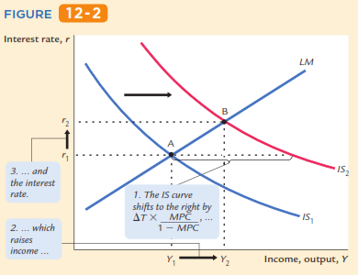
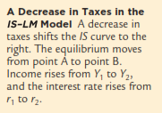
Changes in Taxes
A Decrease in Taxes in the IS–LM Model
C
Titik A → titik C → titik B
T ↓ → ∆Y < - MPC /(1-MPC) . ∆T
Y3

Slide 13
Changes in Taxes
A Decrease in Taxes in the IS–LM Model
IS₁ dan LM: titiik A (r1 dan Y1)
T ↓ ➔ pasar barang: IS kanan dari IS₁ ke IS₂ → pada r1 dan IS₂: titik C (r1 dan Y3): Y ↑ dari Y1 ke Y3 → ∆Y = - MPC/(1-MPC) . ∆T
C
Y ↑ dari Y1 ke Y3 ➔ pasar uang: L ↑ [ L (r, Y) ] ; Ms tetap → r ↑ (dari r1 ke r2) ➔ pasar barang: I ↓ [I(r)] → Y ↓ dari Y3 ke Y2 ➔ IS2 dan LM: titik B (r2 dan Y2)
Y3
T ↓ hasil akhir Y ↑ dari Y1 ke Y2 dg ∆Y < - MPC/(1-MPC) . ∆G
T ↓ → ∆Y < - MPC/(1-MPC) . ∆T

Slide 14
Gb.1 → IS₁ dan LM₁ : titik A (r1 dan Y1)
Gb.1: T ↓ → PE ↑ = C(Y-T ↓) ↑ + I + G → Y ↑ ➔ pasar barang: IS kanan dari IS₁ ke IS₂ → pada r1 dan IS₂ : titik C (r1 dan Y3): Y ↑ dari Y1 ke Y3 → ∆Y = - MPC/(1-MPC) . ∆G ➔ Gb.2: pasar uang: L ↑ dari L (r, Y1) ke L (r, Y3) ] ; Ms tetap → r ↑ (dari r1 ke r2) ➔ Gb. 3: I ↓ [I(r)] dari I1 ke I2 → Gb.1: pasar barang Y ↓ dari Y3 ke Y2 ➔ IS2 dan LM₁: titik B (r2 dan Y2) ➔ T ↓ : hasil akhir Y ↑ dari Y1 ke Y2 dg ∆Y < - MPC/(1-MPC) . ∆T
yst
r
M1/P
r
r
LM1
r2
r2
r2
B
r1
r1
C
r1
L(r,Y3)
A
IS2
I(r)
L(r,Y1)
I
IS1
I2
I1
Y1
M1
M
Y2
Y3
Y
Gb.3
Gb.2
Gb.1
I (r)
Ms = L (r, Y)
IS = LM

Slide 15
Gb.1 → IS₁ dan LM₁ : titik A (r1 dan Y1)
Gb.1: T ↓ → PE ↑ = C(Y-T ↓) ↑ + I + G → Y ↑ ➔ pasar barang: IS kanan dari IS₁ ke IS₂ → pada r1 dan IS₂ : titik C (r1 dan Y3): Y ↑ dari Y1 ke Y3 → ∆Y = - MPC/(1-MPC) . ∆G ➔ Gb.2: pasar uang: L ↑ dari L (r, Y1) ke L (r, Y3) ] ; Ms tetap → r ↑ (dari r1 ke r2) ➔ Gb. 3: I ↓ [I(r)] dari I1 ke I2 → Gb.1: pasar barang Y ↓ dari Y3 ke Y2 ➔ IS2 dan LM₁: titik B (r2 dan Y2) ➔ T ↓ : hasil akhir Y ↑ dari Y1 ke Y2 dg ∆Y < - MPC/(1-MPC) . ∆T
1
3
1
2
4
T ↓ → PE ↑ = C(Y-T ↓) ↑ + I + G → Y ↑ (Y = PE) dan
∆Y = -MPC/(1-MPC).∆T → L ↑ [L(r, Y)] ; Ms tetap → r ↑ (Ms = L(r,Y)
→ I ↓ [I(r)] → PE ↓ = C(Y-T) + I ↓ + G → Y ↓ (Y = PE) →
T ↓: hasil akhir Y ↑ dan ∆Y < - MPC/(1-MPC) . ∆T
5
6
7
8
7
9

Slide 16
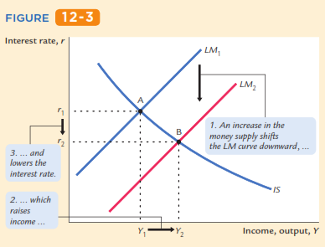
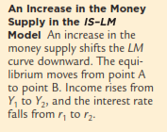
Changes in The Money Supply
An Increase in the Money Supply in
The IS–LM Model
C
Titik A → titik C → titik B
r3
M ↑ → Y ↑

Slide 17
Changes in The Money Supply
An Increase in the Money Supply in
The IS–LM Model
IS₁ dan LM₁: titik A (r1 dan Y1)
M ↑ → pasar uang: M ↑ ; L (r, Y1) tetap → r ↓ (dari r1 ke r3) → LM geser kanan dari LM₁ ke LM₂ → pada r3 dan IS: titik C (r3 dan Y1) ➔ I ↑ [I(r)] → Y ↑ dari Y1 ke Y3 ➔ pasar uang: L ↑ [ L (r, Y2) ] ; Ms tetap → r ↑ (dari r3 ke r2) ➔ I ↓ [I(r)] → Y ↓ dari Y3 ke Y2 ➔ IS dan LM₂: titik B (r2 dan Y2)
C
C’
r3
Y3
M ↑: hasil akhir → Y ↑ dari Y1 ke Y2

Slide 18
Gb.1 → IS₁ dan LM₁: titik A (r1 dan Y1)
Gb.2: M ↑ → pasar uang: M ↑ dari M1/P1 ke M2/P1; L (r, Y1) tetap → r ↓ (dari r1 ke r3) ➔ Gb.1: LM geser kanan dari LM₁ ke LM₂ ➔ pada r3 dan IS₁: titik C (r3 dan Y3) ➔ Gb.3: I ↑ [I(r)] dari I1 ke I3 ➔ Gb.1: Y ↑ dari Y1 ke Y3 ➔ Gb.2: pasar uang : L ↑ dari L (r, Y1) ke L (r, Y2) ] ; Ms tetap → r ↑ (dari r3 ke r2) ➔ Gb.3: I ↓ [I(r)] dari I3 ke I2 → Gb.1: pasar barang Y ↓ dari Y3 ke Y2 ➔ IS1 dan LM₂: titik B (r2 dan Y2) ➔ M ↑: hasil akhir → Y ↑ dari Y1 ke Y2
r
r
r
M1/P1
M2/P1
LM₁
LM₂
A
r1
r1
r1
r2
r2
r3
r2
B
r3
L(r,Y2)
I(r)
r3
C’
L(r,Y1)
C
IS₁
M1
M2
M
I1
I2
I3
L
Y1
Y2
Y3
Y
Gb.2
Gb.3
Gb.1

Slide 19
Gb.1 → IS₁ dan LM₁: titik A (r1 dan Y1)
Gb.2: M ↑ → pasar uang: M ↑ dari M1/P1 ke M2/P1; L (r, Y1) tetap → r ↓ (dari r1 ke r3) ➔ Gb.1: LM geser kanan dari LM₁ ke LM₂ ➔ pada r3 dan IS₁: titik C (r3 dan Y3) ➔ Gb.3: I ↑ [I(r)] dari I1 ke I3 ➔ Gb.1: Y ↑ dari Y1 ke Y3 ➔ Gb.2: pasar uang : L ↑ dari L (r, Y1) ke L (r, Y2) ] ; Ms tetap → r ↑ (dari r3 ke r2) ➔ Gb.3: I ↓ [I(r)] dari I3 ke I2 → Gb.1: pasar barang Y ↓ dari Y3 ke Y2 ➔ IS1 dan LM₂: titik B (r2 dan Y2) ➔ M ↑: hasil akhir → Y ↑ dari Y1 ke Y2
1
1
2
3
4
3
M ↑ → L tetap [L(r, Y)] ; Ms ↑ → r ↓ → I ↑ [I(r)] →PE ↑ = C(Y-T) + I↑ + G →
Y ↑ (Y = PE) → L ↑ [L(r, Y)] ; Ms tetap → r ↑ [Ms = L (r,Y)] → I ↓ [I(r)] →
PE ↓ = C(Y-T) + I ↓ + G → Y ↓ (Y = PE) ➔
M ↑: hasil akhir Y ↑
5
6
7
8
9
8
10

Slide 20
Thus, the IS–LM model shows that monetary policy inﬂuences income by changing the interest rate. In that chapter we showed that in the short run, when prices are sticky, an expansion in the money supply raises income.
The IS–LM model shows that an increase in the money supply lowers the interest rate, which stimulates investment and thereby expands the demand for goods and services.
Pengaruh kebijakan moneter dalam model IS-LM mempengaruhi pendapatan (Y) melalui perubahan suku bunga (r ):
M ↑ → r ↓ → I ↑ → Y ↑

Slide 21
How a monetary expansion induces greater spending on goods and services—a process called the monetary transmission mechanism → mekanisme transmisi moneter: kebijakan moneter ekspansif (M ↑) mengakibatkan permintaan agregat nai (PE ↑ → Y ↑)
Pengaruh kebijakan moneter dalam model IS-LM mempengaruhi pendapatan (Y) melalui perubahan suku bunga (r ):
M ↑ → r ↓ → I ↑ → Y ↑

Slide 22
Model: monetary & fiscal policy variables (M, G and T ) are exogenous → M, G, T : variabel eksogen → variabel kebijakan
Real world: Monetary policymakers may adjust M in response to changes in fiscal policy, or vice versa. → M dapat disesuaikan untuk meresepon kebijakan fiscal (∆G, ∆T)
Such interaction may alter the impact of the original policy change.

Slide 23
The Fed’s response to ΔG > 0
Suppose Congress increases G. (G ↑ or ∆G > 0)
Possible Fed responses:
1. hold M constant…. M tetap
2. hold r constant…. r tetap
3. hold Y constant…. Y tetap
In each case, the effects of the ΔG are different:
→ dampak dari G ↑ or ∆G > 0 → beda

Slide 24
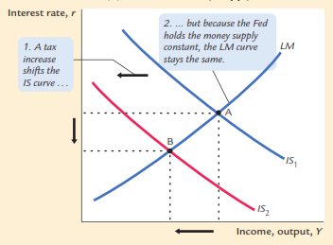
The Response of the Economy to a Tax Increase
IS₁ dan LM: titiik A (r1 dan Y1)
T ↑ ➔ pasar barang: IS kiri dari IS₁ ke IS₂ → pada r1 dan IS2: titik C (r1 dan Y3): Y ↓ dari Y1 ke Y3 → ∆Y = - MPC/(1-MPC) . ∆T
C
r1
Y ↓ dari Y1 ke Y3 ➔ pasar uang: L ↓ [ L (r, Y) ] ; Ms tetap → r ↓ (dari r1 ke r2) ➔ pasar barang: I ↑ [I(r)] → Y ↑ dari Y3 ke Y2 ➔ IS2 dan LM: titik B (r2 dan Y2)
r2
Y3
Y2
Y1
T ↑ hasil akhir Y ↓ dari Y1 ke Y2 dg ∆Y < - MPC/(1-MPC) . ∆T dan r ↓ dari r1 ke r2

Slide 25
Response 1: hold M constant
If Congress raises G, the IS curve shifts right
r
LM₁
If Fed holds M constant, then LM curve doesn’t shift.
Results:
r₂
r₁
IS₂
IS₁
Y
Y₁
Y₂

Slide 26
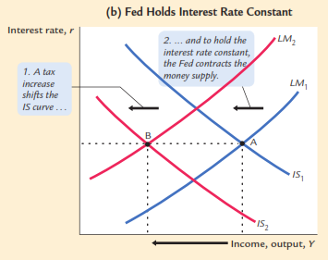
The Response of the Economy to a Tax Increase
IS₁ dan LM: titiik A (r1 dan Y1)
T ↑ ➔ pasar barang: IS kiri dari IS₁ ke IS₂ → pada r1 dan IS2: titik B (r1 dan Y2): Y ↓ dari Y1 ke Y2 → ∆Y = - MPC/(1-MPC) . ∆T
r1
Y ↓ dari Y1 ke Y2 ➔ pasar uang: L ↓ [ L (r, Y) ] ; Ms tetap → r ↓; supaya r tetap maka Ms di ↓ kan → r tetap di r1 → LM geser kiri dari LM₁ ke LM₂ →Y ↓ dari Y1 ke Y2 ➔ IS2 dan LM₂ : titik B (r2 dan Y2)
Y2
Y1
T ↑ hasil akhir Y ↓ dari Y1 ke Y2 dg ∆Y = - MPC/(1-MPC) . ∆T dan r tetap

Slide 27
Response 2: hold r constant
If Congress raises G, the IS curve shifts right
r
LM₁
LM₂
To keep r constant, Fed increases M to shift LM curve right.
r₂
r₁
IS₂
Results:
IS₁
Y
Y₁
Y₂
Y₃

Slide 28
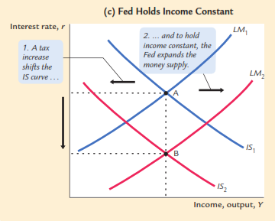
The Response of the Economy to a Tax Increase
IS₁ dan LM: titiik A (r1 dan Y1)
T ↑ ➔ pasar barang: IS kiri dari IS₁ ke IS₂ → pada r1 dan IS2: titik C (r1 dan Y2): Y ↓ dari Y1 ke Y2 → ∆Y = - MPC/(1-MPC) . ∆T ; supaya Y tetap di Y1→ Ms di ↑ kan → L tetap [L(r, Y)] ; Ms ↑ → r ↓ dari r1 ke r2 → I ↑ [I(r)] →PE ↑ = C(Y-T) + I↑ + G → Y ↑ (Y = PE) dari Y2 ke Y1
r1
c
r2
Y2
Y1
T ↑ hasil akhir Y tetap ; r ↓

Slide 29
Response 3: hold Y constant
If Congress raises G, the IS curve shifts right
r
LM₂
LM₁
r₃
To keep Y constant, Fed reduces M to shift LM curve left.
r₂
r₁
IS₂
Results:
IS₁
Y
Y₁
Y₂

Slide 30
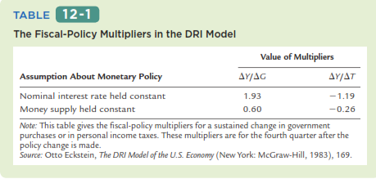

Slide 31
IS shocks: exogenous changes in the demand for goods & services.
Examples:
stock market boom or crash ⇒ change in households’ wealth ⇒ ΔC
change in business or consumer confidence or expectations ⇒ ΔI and/or ΔC

Slide 32
LM shocks: exogenous changes in the demand for money (∆L).
Examples:
a wave of credit card fraud (gelombang kecurangan kartu kredit) increases demand for money
more ATMs or the Internet reduce money demand

Slide 34
EXERCISE: Analyze shocks with the IS-LM model
Use the IS-LM model to analyze the effects of
A boom in the stock market makes consumers wealthier.
After a wave of credit card fraud (kecurangan kartu kredit), consumers use cash more frequently in transactions.
For each shock,
use the IS-LM diagram to show the effects of the shock on Y and r .
determine what happens to C, I, and the unemployment rate.
Notes:
Earlier slides showed how to use the IS-LM model to analyze fiscal and monetary policy. Now is a good time for students to get some hands-on practice with the model. Also, note that part (b) helps students learn that shocks and policies can potentially affect all of the model’s endogenous variables, not just the ones that are measured on the axes.
After working this exercise, your students will better understand the following case study on the 2001 U.S. economic slowdown that immediately follows.
Suggestion: Instead of having students work on these exercises individually, get them into pairs. One student of each pair works on the first shock, the other student works on the second shock. Give them 5 minutes to work individually on the analysis of the shock. Then, allow 10 minutes (5 for each student) for students to present their results to their partners. This activity gives students immediate application and reinforcement of the concepts, so students learn them better and will then better understand and appreciate the remainder of your lecture on Chapter 11.
Answers:
1a. The IS curve shifts to the right, because consumers feel they can afford to spend more given this exogenous increase in their wealth. This causes Y and r to rise.
1b. C rises for two reasons: the stock market boom, and the increase in income. I falls, because r is higher. u falls, because firms hire more workers to produce the extra output that is demanded.
2a. (This is a continuation of the in-class exercise at the end of the PowerPoint presentation of Chapter 10.) The increase in money demand shifts the LM curve to the left: We are assuming that all other exogenous variables, including M and P, remain unchanged, so an increase in money demand causes an increase in the value of r associated with each value of Y (this can be seen easily using the Liquidity Preference diagram). This translates to an upward (i.e. leftward) shift in the LM curve. This shift causes Y to fall and r to rise.
2b. The fall in income causes a fall in C. The increase in r causes a fall in I. The fall in Y causes an increase in u.

Slide 35
So far, we’ve been using the IS-LM model to analyze the short run, when the price level is assumed fixed.
However, a change in P would shift the LM curve and therefore affect Y : ∆P → ∆LM →∆Y
The aggregate demand curve : captures this relationship between P and Y

Slide 36
Deriving the AD curve
r
LM(P₂)
Intuition for slope of AD curve:
↑P ⇒ ↓(M/P )
⇒ LM shifts left
⇒ ↑r
⇒ ↓I
⇒ ↓Y
LM(P₁)
r₂
r₁
IS
Y₂
Y₁
Y
P
P₂
P₁
AD
Y₂
Y₁
Y
Notes:
It might be useful to explain to students the reason why we draw P₁ before drawing the LM curve:
The position of the LM curve depends on the value of M/P. M is an exogenous policy variable. So, if P is low (like P₁ in the lower panel of the diagram), then M/P is relatively high, so the LM curve is over toward the right in the upper diagram. If P is high, like P₂, then M/P is relatively low, so the LM curve is more toward the left.
Because the value of P affects the position of the LM curve, we label the LM curves in the upper panel as LM(P₁) and LM(P₂).

Slide 37
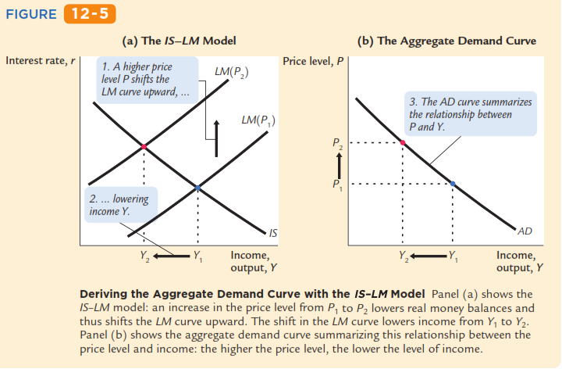
Deriving the AD curve
B
r2
B
A
r1
A

Slide 38
Deriving the AD curve
B
r2
B
A
r1
A
Gb(a)
Gb(b)
Gb(a): IS dan LM(P1) → titik A: r1 dan Y1 → gb(b) → titik A: P1 dan Y1
P ↑ dari P1 ke P2 → LM geser kiri (M ↓) dari LM(P1) ke LM(P2)
Gb(a): IS dan LM(P2) → titik B: r2 dan Y2 → gb(b) → titik B: P2 dan Y2
Gb (b): titik A dan titik B → AD

Slide 39
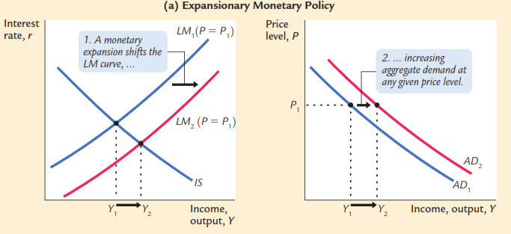
Monetary policy and the AD curve
B
A
A
r1
r2
B
Gb(a)
Gb(b)
Gb(a): IS dan LM(P1) → titik A: r1 dan Y1 → gb(b) → titik A: P1 dan Y1 → AD1
M ↑ → Gb(a): LM geser kanan dari LM1(P=P1) ke LM2(P=P1)
Gb(a): IS dan LM2(P=P1)→ titik B: r2 dan Y2 → gb(b) → titik B: P1 dan Y2 → AD2
M ↑ →AD ↑ geser kanan dari AD1 ke AD2

Slide 40
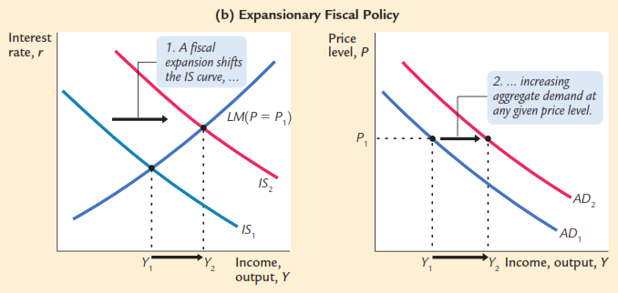
Fiscal policy and the AD curve
r2
B
B
A
r1
A
Gb(a)
Gb(b)
Gb(a): IS dan LM(P1) → titik A: r1 dan Y1 → gb(b) → titik A: P1 dan Y1 → AD1
G ↑ → IS geser kanan dari IS1 ke IS2
Gb(a): IS dan LM2(P=P1)→ titik B: r2 dan Y2 → gb(b) → titik B: P1 dan Y2 → AD2
G ↑ →AD ↑ geser kanan dari AD1 ke AD2

Slide 41
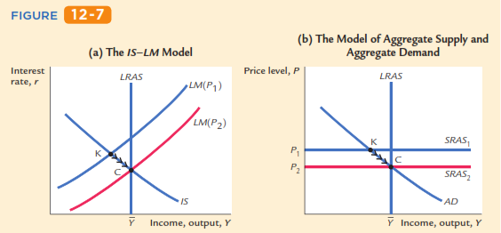

Slide 42
K’
r1
r2
Gb(a)
Y1
Y1
Gb(b)
Gb(a): IS dan LM(P1) dan LRAS → titik K: r1 dan Y1 (Y1<Ybar) → gb(b) → pada P1: SRAS1 dan AD → titik K: P1 dan Y1 (Y1<Ybar)
Gb(b): pada titik K → AD dan LRAS → AD di titik K (Y1); LRAS di titik K’ (Ybar) → kelebihan AS → P ↓ → dari P1 sampai ke P2 → proses dari titik K ke titik C ➔ Gb(a): LM ↑ (karena P ↓) geser kanan dari LM (P1) ke LM (P2) → IS dan LM (P2)→ titik C: r2 dan Ybar

Slide 43
The SR and LR effects of an IS shock
Gb(a): LRAS-IS1-LM(P1) →Titik A: Ybar
Gb(b): LRAS-AD1-SRAS1 →Titik A: Ybar
r
LRAS
LM(P₁)
Shock IS negatif ( …? atau …?)
Gb(a): IS geser kiri dari IS1 ke IS2 → IS2 dan LM(P1) →titik B: Y1 (Y1<Ybar)
Gb(b): AD geser kiri dari AD1 ke AD2 → AD2 dan SRAS1 →titik B: Y1 (Y1<Ybar)
A
B
IS₁
IS₂
Gb(a)
Y1
Y
P
LRAS
P₁
B
A
SRAS₁
A negative IS shock shifts IS and AD left, causing Y to fall.
AD₁
AD₂
In the new short-run equilibrium,
Y1
Y
Gb(b)
Notes:
Abbreviation:
SR = short run, LR = long run

Slide 44
The SR and LR effects of an IS shock
In the new short-run equilibrium,
r
LRAS
LM(P₁)
A
B
Over time, P gradually falls, which causes
SRAS to move down
M/P to increase, which causes LM to move down
IS₁
IS₂
Y1
Y
P
LRAS
P₁
B
A
SRAS₁
AD₁
AD₂
Y1
Y

Slide 45
The SR and LR effects of an IS shock
Shock IS negatif ( …? atau …?)
Gb(a): IS geser kiri dari IS1 ke IS2 → IS2 dan LM(P1) →titik B: Y1 (Y1<Ybar)
Gb(b): AD geser kiri dari AD1 ke AD2 → AD2 dan SRAS1 →titik B: Y1 (Y1<Ybar)
Pada titik B: AD2 dan LRAS → kelebihan AS → P ↓ terus → Gb(a): M ↑ terus → LM(P1) geser kanan sampai ada LM(P2) dan IS2 → Y ↑ ke Y3 ke Ybar → titik C
Gb(b): P ↓ sampai pada P2 dan Y ↑ ke Y3 ke Ybar → SRAS1 geser ke bawah sampai pada SRAS2 ➔ titik C
r
LRAS
LM(P₁)
A
LM(P₂)
B
IS₁
C
IS₂
Gb(a)
Y1
Y3
Y
P
LRAS
P₁
B
A
SRAS₁
P₂
SRAS₂
C
AD₁
AD₂
Y1
Y3
Y
Gb(b)

Slide 46
Dari chapter 10: Intro to fluctuation ec
Over time, prices gradually become “unstuck.” When they do, will they rise or fall?
In the short-run equilibrium, if
then over time, the price level will
rise
fall
remain constant
This adjustment of prices is what moves the economy to its long-run equilibrium.
Notes:
You might want to discuss the intuition for the price adjustment in each case.
First, suppose aggregate demand is higher than the full-employment level of output in the economy’s initial short-run equilibrium. Then, there is upward pressure on prices: In order for firms to produce this above-average level of output, they must pay their workers overtime and make their capital work at a high intensity, which causes more maintenance, repairs, and depreciation. For all these reasons, firms would like to raise their prices. In the short run, they cannot. But over time, prices gradually become “unstuck,” and firms can increase prices in response to these cost pressures.
Instead, suppose that output is below its natural rate. Then, there is downward pressure on prices: Firms can’t sell as much output as they’d like at their current prices, so they would like to reduce prices. With lower than normal output, firms won’t need as many workers as normal, so they cut back on labor, and the unemployment rate rises above the “natural rate of unemployment.” The high unemployment rate puts downward pressure on wages. Wages and prices are “stuck” in the short run, but over time, they fall in response to these pressures.
Finally: if output equals its normal (or “natural”) level, then there is no pressure for prices to rise or fall. Over time, as prices become “unstuck,” they will simply remain constant.

Slide 47
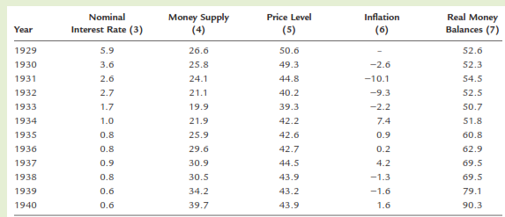
Now that we have developed the model of aggregate demand, let’s use it to address the question that originally motivated Keynes: what caused the Great Depression?
What do you think happened?
An IS shift? An LM shift? Or something else?

Slide 48
asserts (menegaskan) that the Depression was largely due to an exogenous fall in the demand for goods & services -- a leftward shift of the IS curve (depresi karena D barang dan jasa ↓ → IS kekiri)
evidence: output and interest rates both fell, which is what a leftward IS shift would cause → Y dan r turun IS kekiri disebabkan:

Slide 49
Stock market crash ⇒ exogenous ↓C
Oct-Dec 1929: S&P 500 fell 17%
Oct 1929-Dec 1933: S&P 500 fell 71%
Drop in investment (I ↓)
“correction” after overbuilding in the 1920s
widespread bank failures made it harder to obtain financing for investment
Contractionary fiscal policy (G ↓ dan atau T ↑)
in the face of falling tax revenues and increasing deficits, politicians raised tax rates and cut spending

Slide 50
asserts that the Depression was largely due to huge fall in the money supply → M ↓ banyak
evidence: M1 fell 25% during 1929-33.
But, two problems with this hypothesis:
P fell even more, so M/P actually rose slightly during 1929-31. → P ↓ → (M/P) ↑ 1929-1931
nominal interest rates fell, which is the opposite of what would result from a leftward LM shift. → r ↓ dan ini berlawanan dengan hasil dari LM yang bergeser kiri

Slide 51
asserts that the severity (keparahan) of the Depression was due to a huge deflation (P↓ banyak):
P fell 25% during 1929-33.
This deflation was probably caused by the fall in M, so perhaps money played an important role after all. → P↓ banyak karena M yang ↓ → uang berperan penting
In what ways does a deflation affect the economy? → bagaimana dampak dflasi terhadap perkenomian?

Slide 52
The stabilizing effects of deflation:
↓P ⇒ ↑(M/P ) ⇒ LM shifts right ⇒ ↑Y
Pigou effect:
↓P ⇒ ↑(M/P )
⇒ consumers’ wealth ↑
⇒ ↑C
⇒ IS shifts right
⇒ ↑Y

Slide 53
The destabilizing effects of unexpected deflation: debt-deflation theory
↓P (if unexpected)
⇒ transfers purchasing power from borrowers to lenders
⇒ borrowers spend less, lenders spend more
⇒ if borrowers’ propensity to spend is larger than lenders, then aggregate spending falls, the IS curve shifts left, and Y falls

Slide 54
The destabilizing effects of expected deflation:
↓π^{e}
⇒ r ↑ for each value of i
⇒ I ↓ because I = I (r )
⇒ planned expenditure & agg. demand ↓
⇒ income & output ↓

Slide 55
Why another Depression is unlikely
Policymakers (or their advisors) now know much more about macroeconomics:
The Fed knows better than to let M fall so much, especially during a contraction.
Fiscal policymakers know better than to raise taxes or cut spending during a contraction.
Federal deposit insurance makes widespread bank failures very unlikely.
Automatic stabilizers make fiscal policy expansionary during an economic downturn.
Notes:
Examples of automatic stabilizers:
the income tax: people pay less taxes automatically if their income falls
unemployment insurance: prevents income - and hence spending - from falling as much during a downturn
This is discussed in Chapter 14.

Slide 56
Ekonom mempelajari Depresi baik karena kepentingan intrinsiknya sebagai peristiwa ekonomi utama maupun untuk memberikan panduan kepada pembuat kebijakan, sehingga tidak akan terjadi lagi.

Slide 57
Chapter summary
IS-LM model
a theory of aggregate demand
exogenous: M, G, T, P exogenous in short run, Y in long run
endogenous: r, Y endogenous in short run, P in long run
IS curve: goods market equilibrium
LM curve: money market equilibrium

Slide 58
Chapter summary
AD curve
shows relation between P and the IS-LM model’s equilibrium Y.
negative slope because ↑P ⇒ ↓(M/P ) ⇒ ↑r ⇒ ↓I ⇒ ↓Y
expansionary fiscal policy shifts IS curve right, raises income, and shifts AD curve right
expansionary monetary policy shifts LM curve right, raises income, and shifts AD curve right
IS or LM shocks shift the AD curve

Slide 59
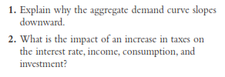
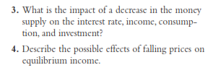

Slide 60
The central bank increases the money supply.
The government increases government purchases.
The government increases taxes.
The government increases government purchases and taxes by equal amounts.

Slide 61
Use the IS–LM model to predict the short-run effects of each of the following shocks on income, the interest rate, consumption, and investment. In each case, explain what the Fed should do to keep income at its initial level.
After the invention of a new high-speed computer chip, many ﬁrms decide to upgrade their computer systems.
A wave of credit card fraud increases the frequency with which people make transactions in cash.
A best-seller titled Retire Rich convinces the public to increase the percentage of their income devoted to saving.
The appointment of a new “dovish” Federal Reserve chairman increases expected inﬂation.

Slide 62
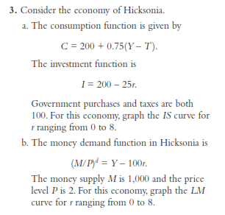

Slide 63
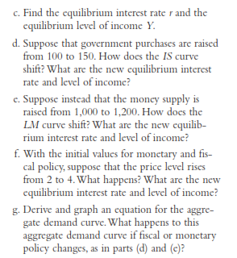
Government purchases and taxes are both
100.
The money supply M is 1,000 and the price level P is 2

Slide 64
Monetary policy and ﬁscal policy often change at the same time.
Suppose that the government wants to raise investment but keep output constant. In the IS–LM model, what mix of monetary and ﬁscal policy will achieve this goal?
In the early 1980s, the U.S. government cut taxes and ran a budget deﬁcit while the Fed pursued a tight monetary policy. What effect should this policy mix have?

Slide 65
Use the IS–LM diagram to describe both the short-run effects and the long-run effects of the following changes on national income, the interest rate, the price level, consumption, investment, and real money balances.
An increase in the money supply
An increase in government purchases
An increase in taxes

Slide 66
The Fed is considering two alternative monetary policies:
holding the money supply constant and letting the interest rate adjust, or
adjusting the money supply to hold the interest rate constant.
In the IS–LM model, which policy will better stabilize output under the following conditions? Explain your answer.
All shocks to the economy arise from exogenous changes in the demand for goods and services.
All shocks to the economy arise from exogenous changes in the demand for money.

Slide 67
Suppose that the demand for real money balances depends on disposable income. That is, the money demand function is:
Using the IS–LM model, discuss whether this change in the money demand function alters the following.
The analysis of changes in government purchases
The analysis of changes in taxes

Slide 68
Use the IS–LM diagram to describe both the short-run effects and the long-run effects of the following changes on national income, the interest rate, the price level, consumption, investment, and real money balances
Gb(a): LRAS-IS1-LM(P1) →Titik A: Ybar
Gb(b): LRAS-AD1-SRAS1 →Titik A: Ybar
r
LRAS
LM(P₁)
A
An increase in the money supply
IS₁
Gb(a)
Y
P
LRAS
P₁
A
SRAS₁
AD₁
Y
Gb(b)
Notes:
Abbreviation:
SR = short run, LR = long run

Slide 69
Use the IS–LM diagram to describe both the short-run effects and the long-run effects of the following changes on national income, the interest rate, the price level, consumption, investment, and real money balances
Gb(a): LRAS-IS1-LM(P1) →Titik A: Ybar
Gb(b): LRAS-AD1-SRAS1 →Titik A: Ybar
r
LRAS
LM(P₁)
A
An increase in government purchases
IS₁
Gb(a)
Y
P
LRAS
P₁
A
SRAS₁
AD₁
Y
Gb(b)
Notes:
Abbreviation:
SR = short run, LR = long run

Slide 70
Use the IS–LM diagram to describe both the short-run effects and the long-run effects of the following changes on national income, the interest rate, the price level, consumption, investment, and real money balances
Gb(a): LRAS-IS1-LM(P1) →Titik A: Ybar
Gb(b): LRAS-AD1-SRAS1 →Titik A: Ybar
r
LRAS
LM(P₁)
A
An increase in taxes
IS₁
Jawabannya lihat slide 45
Gb(a)
Y
P
LRAS
P₁
A
SRAS₁
AD₁
Y
Gb(b)
Notes:
Abbreviation:
SR = short run, LR = long run

